Slide 2
Goal

Slide 3
Conversational Systems
To be able to create a solution leveraging Watson Conversation Service in conjunction with client data or services to solve a self service customer challenge.

Slide 4
Experiment

Slide 5
Watson Conversation Service

Slide 6
Enhanced Understanding

Slide 7
Core Service Components

Slide 8
Critical Thinking

Slide 9
Solution Dependencies

Slide 10
Architectural Decisions

Slide 11
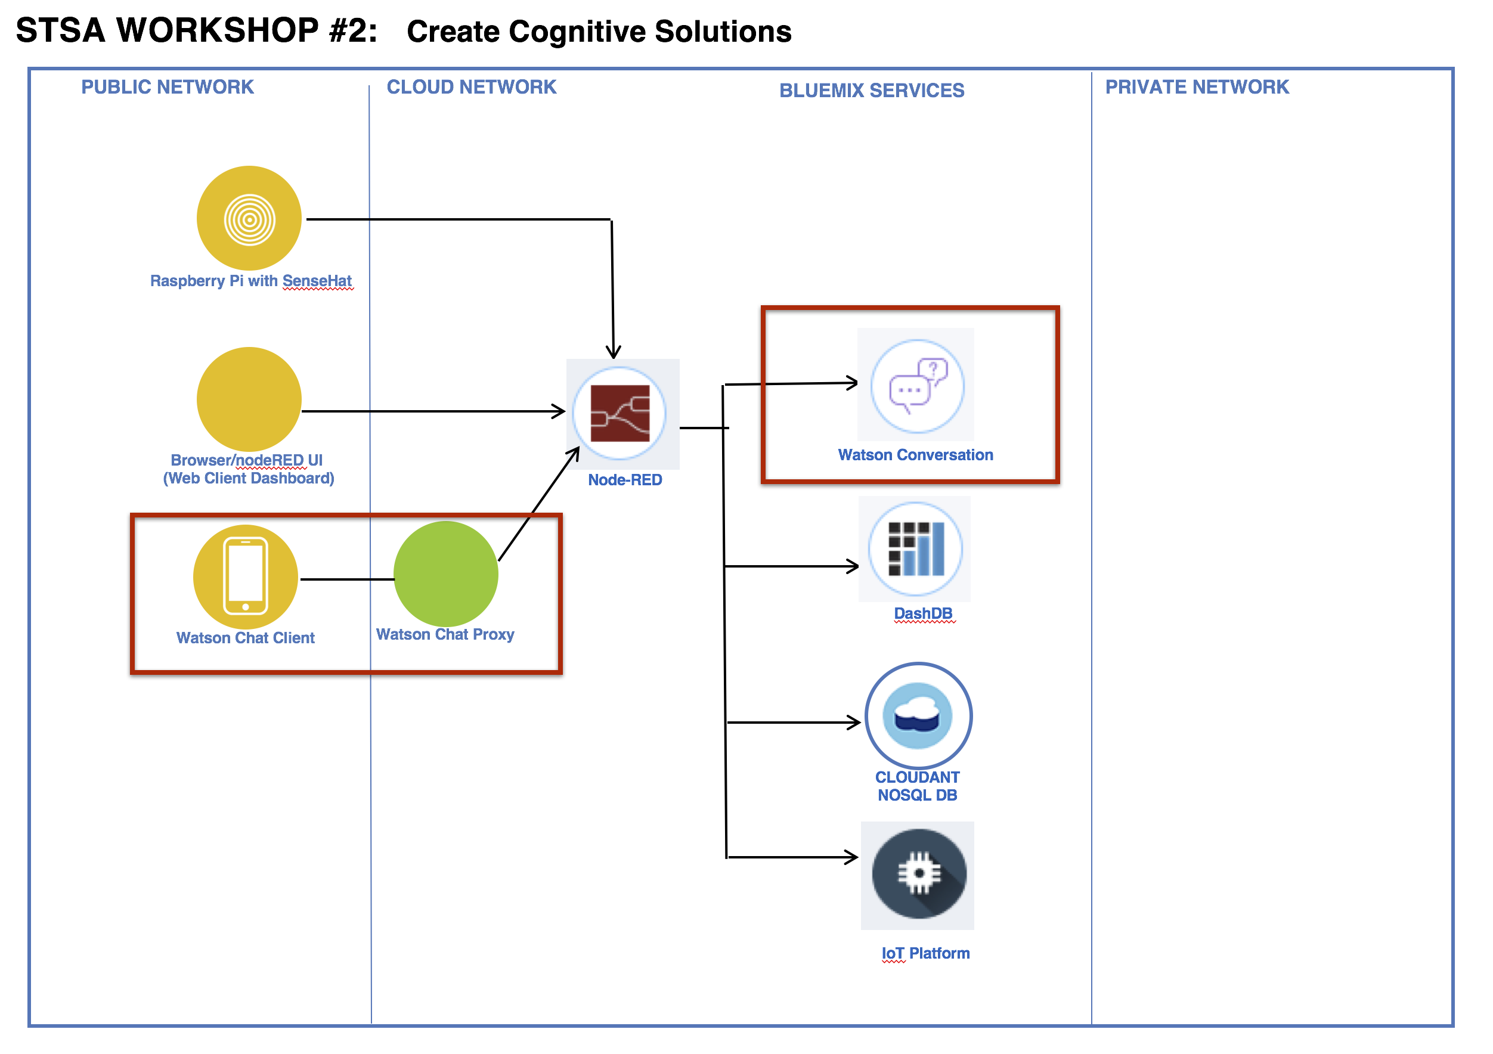
Watson Conversation in the Cloud Reference Architecture

Slide 12


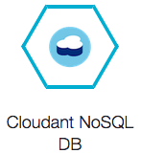


Public Network
Cloud Network
Bluemix Services
Private Network
Watson Conversation
Browser/nodeRED UI
(Web client Dashboard)
Watson Chat Proxy
Watson Chat Client
Weather Company Data

Slide 14





Uses for Conversational Agents
Customer Service Add a chatbot to your website that automatically responds to your customers’ most frequently asked question | Mobile Apps Allow your customers to control your mobile app using natural language virtual agents | Messaging Channels Build Twitter, Slack, Facebook Messenger, and other messaging platform chatbots that interact instantly with channel users | Internet-of-Things Power connected devices to understand language and respond to your users’ commands | Robots Power your robots with natural language understanding and conversational capabilities

Slide 15
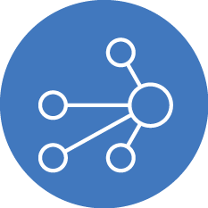



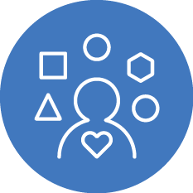
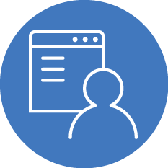
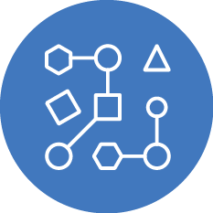
Watson as the Center of Customer Engagement
Flexible, cost-effective solutions for building chat bots and virtual agents
Build from the ground up or buy pre-built capabilities
Build once, deploy across multiple platforms
Create natural language interactions with your end-users, including Q&A and onboarding
Detect emotional states* and responds in appropriate ways
Create an omni-channel experience for better user engagement
Walk customers through business processes like application forms or resetting a password
Advanced Machine Learning capabilities
*Leveraging Watson Tone Analyzer

