Slide 1
Standard Model for Control
Introduction
Motor Model
Basics
Control Laws
Settings & Perfs
Perspectives
Electrical Part of Motor
Electromagnetic Torque
Mechanical Part of Motor
Stator Voltages
Mechanical Rotor Speed
Stator Currents
Mechanical Rotor Speed
Electrical Rotor Speed
Mechanical Rotor Position
Load Torque
Electrical Rotor Position

Slide 2


















Notations
Introduction
Motor Model
Basics
Control Laws
Settings & Perfs
Perspectives

Slide 3

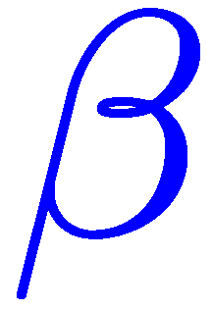
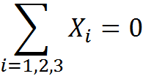
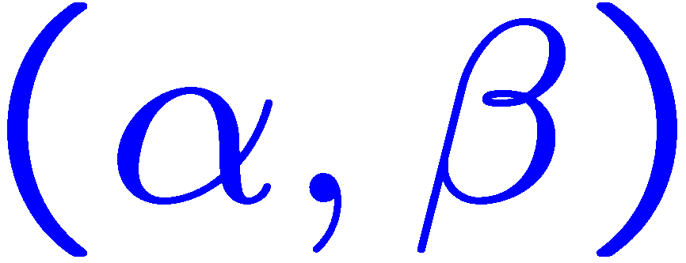
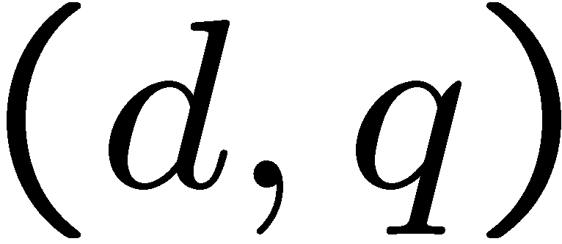


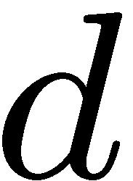
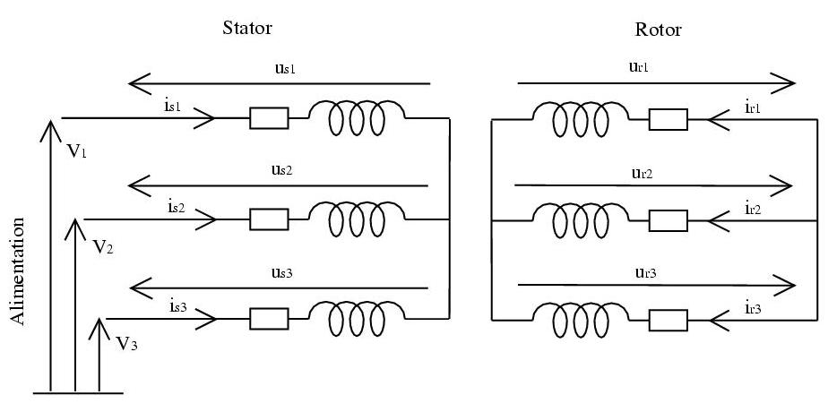

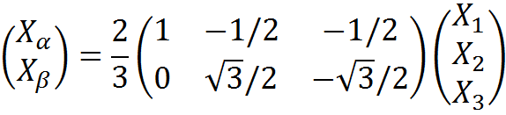

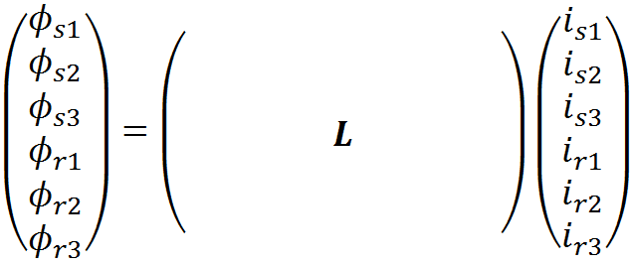



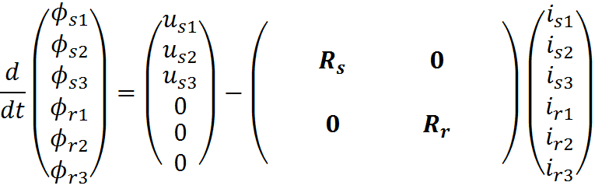


Standard Electrical Model for Control
Introduction
Motor Model
Basics
Control Laws
Settings & Perfs
Perspectives
Fixed frame
Fixed frame
Rotating frame
Clarke
+
Rotation
+ Torque equation:

