Slide 1
MUSIC TRANSFORMER
EE641 : Project Presentation
Team Members:
Divya Nandlal Sahetya (1648584262)
Vaishnavi Channakeshava (96737188359)
Krishna Dheeraj Krovi (6220673324)

Slide 2
OUTLINE OF PROJECT
Input
MIDI File
Preprocessing
Transformer
Output

Slide 3
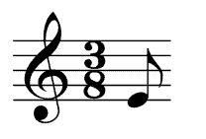
MOTIF
Motif ~ Motive
Smallest unit of a piece of music that has a structural identity.
Motif = Series of Notes
Note
A notation representing the pitch and duration of a musical sound.
Notes:
In music, a motif (also sometimes written as motive) is the smallest unit of a piece of music that contains some kind of thematic or structural identity.

Slide 4
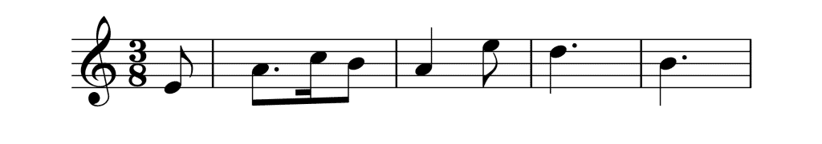
MOTIF
Usually called Leitmotifs :
Makes a story “engaging” and “immersive” way.
Motif = Sequence of Notes
Notes:
Just like how a single letter cannot give any information, a single note is not interesting.

Slide 5
INTRODUCTION
Repetition and long-term structure are also important factors that make a musical piece coherent and understandable.
Building machines that can compose music like human beings is one of the most exciting tasks in multimedia and artificial intelligence.
Sequence models such as the Transformer can then be applied to model the probability distribution of the event sequences, and to sample from the distribution to generate new music compositions.

Slide 6
INTRODUCTION
A model that generates music based on a initial motif.
The basic principle is to build a sequence model for music.
Using transformers to generate notes in an autoregressive manner using relative self attention mechanism.

Slide 7
DATASET
Created custom dataset.
Maestro V.2.0 dataset consisted of 1283 files + 1079 files.
File format :MIDI (Musical Instrument Digital Interface)
The union of the following datasets used : The Maestro Dataset, Stanford University Piano Roll Archive and Classical Piano Midi Dataset.
This dataset is approximately 160MB and consists 2362 midi files.
The dataset is split into train, test and val as a part of the preprocessing step.
Notes:
Unlike digital audio (.wav) files, compact discs, or cassettes, MIDI does not capture and store actual sounds. Instead, it is a set of data which describes the specific steps that a soundcard or other playback device must take to generate the same sounds via electronic synthesis.
MIDI files are very much smaller than other audio files. The compact size of MIDI files makes them especially well suited for delivery over the Internet. A one-minute MIDI file might require about 10 KB of disk space. Compare this to a .wav file of the same duration, which might require from 5 MB to 10 MB of disk space, depending on the audio qualities of the file.

Slide 8
DATA PREPROCESSING
pretty_midi python library is used for extracting information from MIDI files.
Encoding : The time information for each event of the MIDI stream is extracted to convert into discrete ordered message types for training and evaluating.
The encoded information of each MIDI file is saved as a .pickle file
Split dataset to train, test and val parts.
Notes:
Unlike digital audio (.wav) files, compact discs, or cassettes, MIDI does not capture and store actual sounds. Instead, it is a set of data which describes the specific steps that a soundcard or other playback device must take to generate the same sounds via electronic synthesis.
MIDI files are very much smaller than other audio files. The compact size of MIDI files makes them especially well suited for delivery over the Internet. A one-minute MIDI file might require about 10 KB of disk space. Compare this to a .wav file of the same duration, which might require from 5 MB to 10 MB of disk space, depending on the audio qualities of the file.
pretty_midi, a Python library for creating, manipulating, and extracting information from MIDI files. For more information, check the docs.
The PrettyMIDI class is the main container in pretty_midi. It stores not only all of the events that constitute the piece, but also all of the timing information, meta-events (like key signature changes), and utility functions for manipulating, writing out, and inferring information about the MIDI data it contains.

Slide 9
MOTIVATION TO USE TRANSFORMERS
Transformer avoids recursion by processing sentences as whole unlike RNN that process data sequentially and is not very efficient in handling long sequences.
Transformers train faster and have much better long term memory.
Vanilla transformers capture self-reference through attention - hard time keeping track of regularity that is based on relative distances, event orderings, and periodicity.
Relative attention, modulates attention based on how far apart two tokens are, the model is able to focus more on relational features.
Relative self-attention also allows the model to generalize beyond the length of the training examples, which is not possible with the original Transformer model.
Notes:
Transformer avoids recursion by processing sentences as whole using attention mechanisms and positional embeddings. RNN process data sequentially and is not very efficient in handling long sequences.
Vanilla transformers capture self-reference through attention, it relies on absolute timing signals - hard time keeping track of regularity that is based on relative distances, event orderings, and periodicity.
Long Short-Term Memory (LSTM) or RNN models are sequential and need to be processed in order, unlike transformer models. Due to the parallelization ability of the transformer mechanism, much more data can be processed in the same amount of time with transformer models.
Transformer avoids recursion by processing sentences as whole using attention mechanisms and positional embeddings. RNN process data sequentially and is not very efficient in handling long sequences. (sorter memory window)
While the original Transformer allows us to capture self-reference through attention, it relies on absolute timing signals and thus has a hard time keeping track of regularity that is based on relative distances, event orderings, and periodicity.
We found that by using relative attention, which explicitly modulates attention based on how far apart two tokens are, the model is able to focus more on relational features. Relative self-attention also allows the model to generalize beyond the length of the training examples, which is not possible with the original Transformer model.

Slide 10
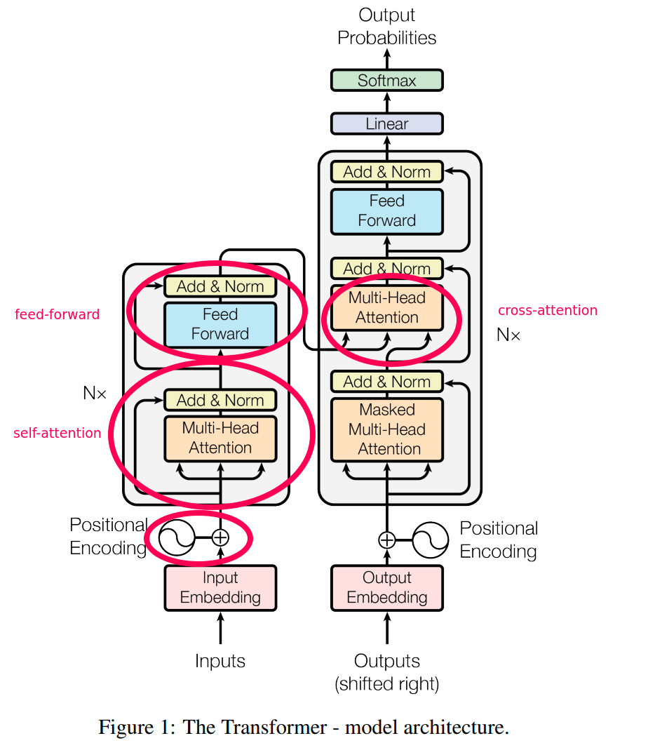
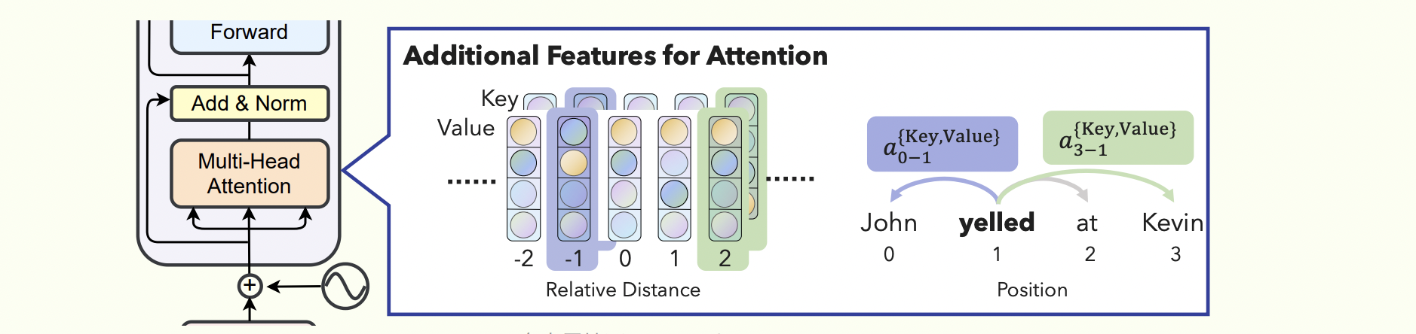
TRANSFORMER
• Based on Cheng-Zhi et al. and Huang et al. paper, the transformer is implemented using Relative Positional Representations in PyTorch.
Notes:
We used the Transformer class provided since Pytorch.
The provided Transformer assumes an encoder-decoder architecture.
To make it decoder-only like the Music Transformer, you use stacked encoders with a custom dummy decoder.
To account for the lack of RPR support, we modified Pytorch 1.2.0 Transformer code to support it. This is based on the Skew method proposed by Huang et al. which is more memory efficient.

Slide 11
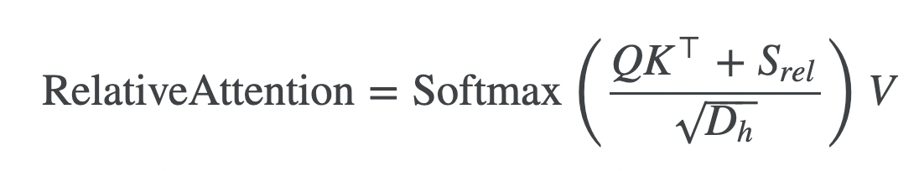
Self-Attention with Relative Position Representations
Using absolute positional information limits the number of tokens a model can process.
Relative positional encodings can generalize to sequences of unseen lengths, since theoretically the only information it encodes is the relative pairwise distance between two tokens.
Another important point to note is that the maximum number of words considered is clipped to some absolute value of k.
Notes:
There are a number of reasons why we might want to use relative positional encodings instead of absolute ones. First, using absolute positional information necessarily means that there is a limit to the number of tokens a model can process. Say a language model can only encode up to 1024 positions. This necessarily means that any sequence longer than 1024 tokens cannot be processed by the model.
Using relative pairwise distances can more gracefully solve this problem, though not without limitations. Relative positional encodings can generalize to sequences of unseen lengths, since theoretically the only information it encodes is the relative pairwise distance between two tokens.

Slide 12
DEMO
Notes:
Unlike digital audio (.wav) files, compact discs, or cassettes, MIDI does not capture and store actual sounds. Instead, it is a set of data which describes the specific steps that a soundcard or other playback device must take to generate the same sounds via electronic synthesis.
MIDI files are very much smaller than other audio files. The compact size of MIDI files makes them especially well suited for delivery over the Internet. A one-minute MIDI file might require about 10 KB of disk space. Compare this to a .wav file of the same duration, which might require from 5 MB to 10 MB of disk space, depending on the audio qualities of the file.

Slide 13
FUTURE WORK
Notes:
Unlike digital audio (.wav) files, compact discs, or cassettes, MIDI does not capture and store actual sounds. Instead, it is a set of data which describes the specific steps that a soundcard or other playback device must take to generate the same sounds via electronic synthesis.
MIDI files are very much smaller than other audio files. The compact size of MIDI files makes them especially well suited for delivery over the Internet. A one-minute MIDI file might require about 10 KB of disk space. Compare this to a .wav file of the same duration, which might require from 5 MB to 10 MB of disk space, depending on the audio qualities of the file.

