Slide 1
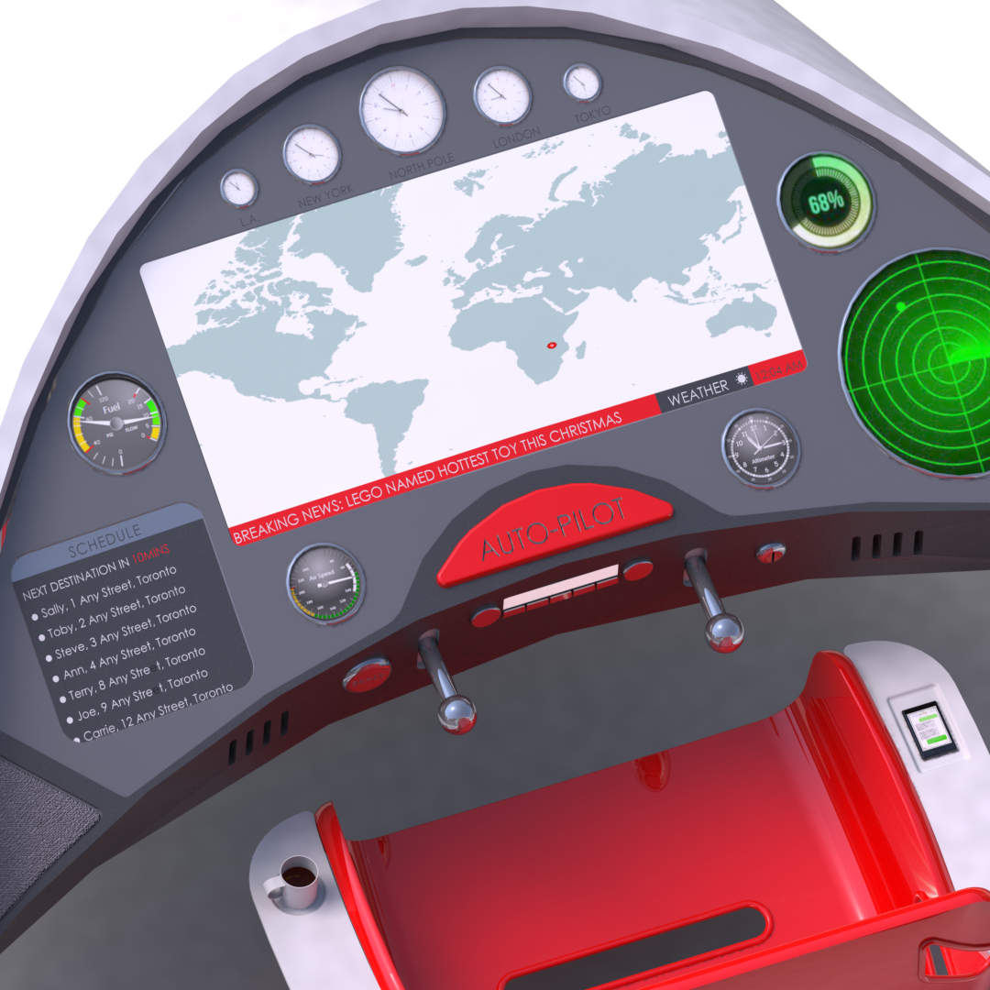
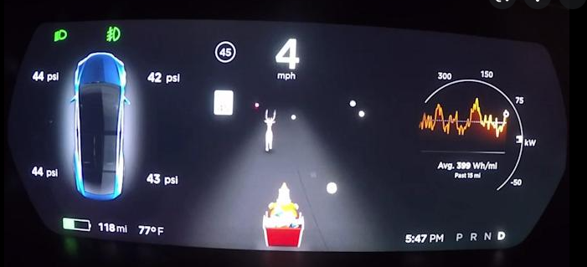

Slide 2
Calorie Target
Milk/Cookies
Homes REMAINING
Delivery Speed
Calories Tonight
Carrot/Tea
Homes Visited
TOTAL TIME
START
HYPER
DRIVE
STOP

