Slide 1
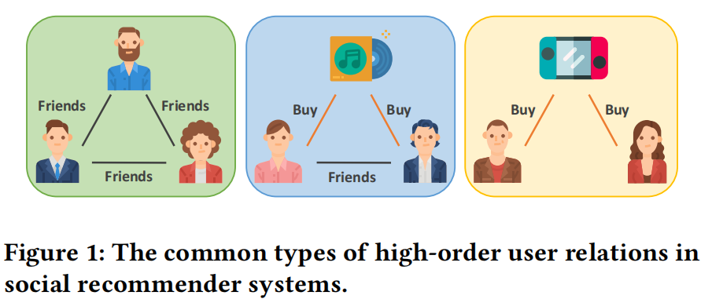
01
Problem, Claim, and Research Question
WWW 2021 | Junliang Yu et al. | Social recommendation under sparsity and cold-start
Why this paper
Target task: improve social recommendation when user-item interactions are sparse.
Core claim: pairwise social edges miss high-order patterns such as friends plus shared purchase behavior.
Main question: how to encode these high-order relations and turn them into better top-K ranking performance?
One-sentence takeaway
Move from pairwise social graph modeling to high-order relation construction, then regularize the learned structure with self-supervision.
What to remember
This is not just another recommender with a better backbone. The key move is to explicitly model high-order social structure.
Figure 1: intuitive examples of high-order user relations.
Evidence: Abstract; Section 1; Figure 1
PaperReadand Report | S^2-MHCN
Notes:
Open by explaining the paper's limitation claim before mentioning equations. The practical pain point is data sparsity, especially cold-start users. Evidence: Abstract; Section 1 Introduction; Figure 1.

Slide 2
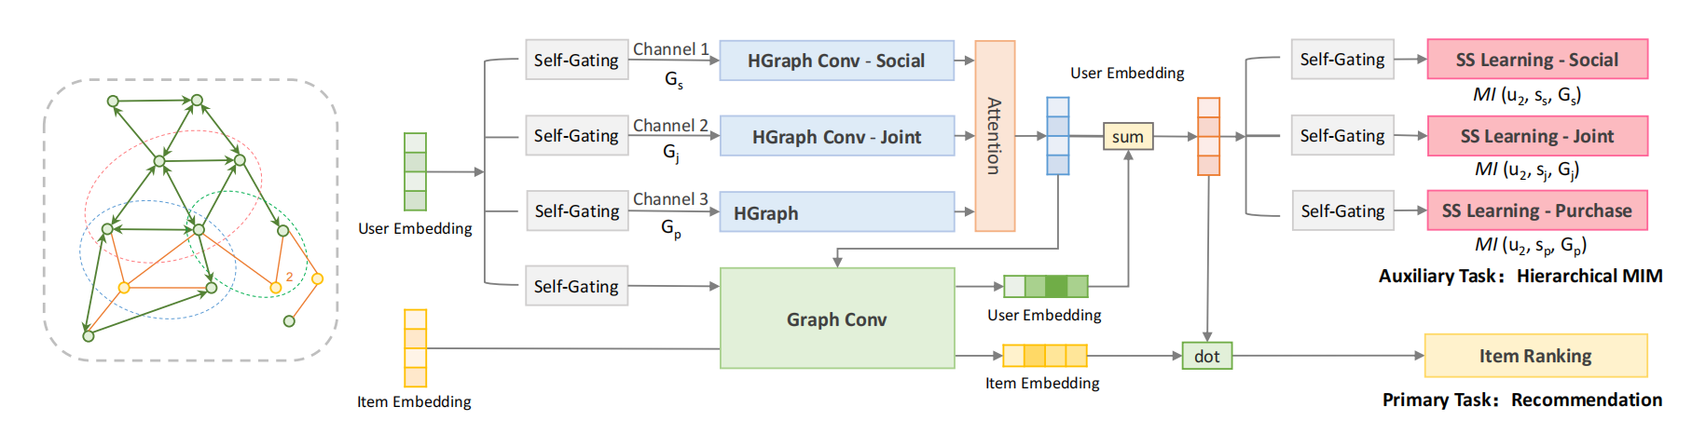
02
Method Roadmap
From motif extraction to ranking and structural regularization
Four steps
1. Detect motifs
Use interaction matrix R and social matrix S to find 10 local triangular motif instances.
2. Build channels
Group motif instances into social, joint, and purchase channels, each inducing one user relation structure.
3. Learn embeddings
Run channel-specific hypergraph propagation plus one user-item graph branch for collaborative item signal.
4. Train jointly
Fuse channels with attention and optimize BPR together with hierarchical mutual information regularization.
Figure 3: the method combines three hypergraph channels, one graph branch, and an auxiliary self-supervised task.
Evidence: Section 3; Figure 3
PaperReadand Report | S^2-MHCN
Notes:
Use this slide as the map for the rest of the talk. The clean mental model is motif extraction -> three channels -> fusion -> ranking -> self-supervised regularization. Evidence: Section 3; Figure 3.

Slide 3
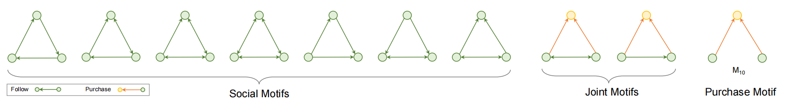
03
Motif Construction and Channel Semantics
Figure 2 explains what the three channels actually encode
Figure 2: 10 motif types grouped into social, joint, and purchase channels.
Social channel
Joint channel
Purchase channel
Motifs M1-M7 capture follow / social connectivity patterns among users.
Motifs M8-M9 mix social and purchase evidence to encode shared but hybrid high-order relations.
Motif M10 focuses on purchase-driven high-order proximity and later becomes the strongest branch in ablation.
Important reading note
A motif is a local triangle instance, not a partition of the whole graph. Each channel then induces one user hypergraph or one equivalent motif-induced adjacency A_c.
Evidence: Section 3.2.1; Figure 2
PaperReadand Report | S^2-MHCN
Notes:
Be precise here: the paper identifies local motif instances and groups them by semantics. This step is what turns vague high-order intuition into three usable channels. Evidence: Section 3.2.1; Figure 2.

Slide 4

04
Representation Learning in Vanilla MHCN
SGU -> channel propagation -> attention fusion -> graph branch -> ranking
Pipeline inside MHCN
Core equations
SGU
Hypergraph conv
Attention
Channel input gating
Gate the shared user embedding into channel-specific inputs.
Run Eq. (2) / Eq. (4) inside each semantic channel.
Fuse P_s*, P_j*, and P_p* with user-specific weights.
Efficient hypergraph propagation
Graph branch
Final embeddings
A LightGCN-style user-item graph branch injects item-side collaborative signal.
Combine channel fusion with the graph branch to get user and item embeddings P and Q.
Recommendation score
Prediction
Score with p_u^T q_i and train with BPR ranking loss.
Key nuance
The propagation operator itself is mostly weight-light; the main learnable pieces are the SGU parameters, embeddings, and attention.
Evidence: Section 3.2.2; Eq. (1); Eq. (4); Eq. (6); Eq. (7); Eq. (8)
PaperReadand Report | S^2-MHCN
Notes:
This slide is the main technical backbone of the talk. Walk through it as SGU, per-channel propagation, layer average plus attention, graph branch, then BPR-based ranking. Evidence: Section 3.2.2; Eq. (1), Eq. (4), Eq. (6), Eq. (7), Eq. (8).

Slide 5
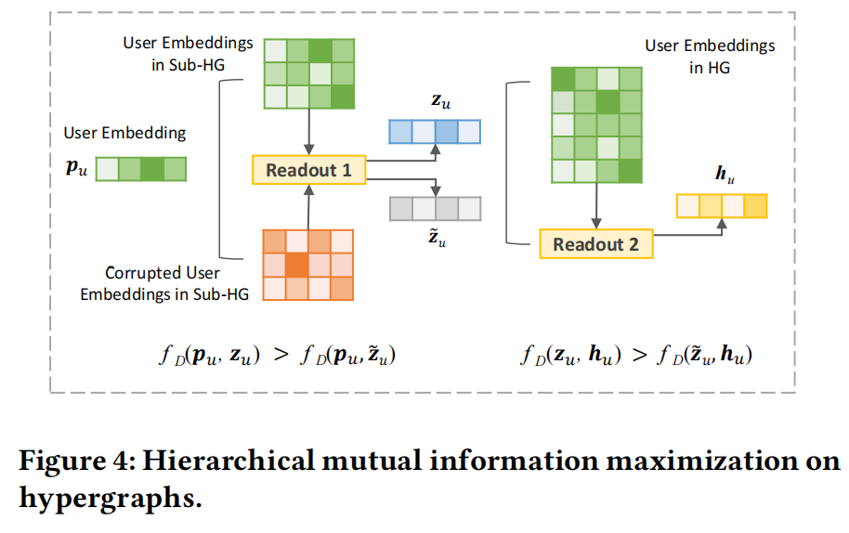
05
Why Self-Supervised Learning Is Added
Hierarchical mutual information acts as structural regularization
Design logic
After multi-channel aggregation, some high-order structure can be diluted. The paper calls this aggregating loss.
The auxiliary task builds the hierarchy user <- sub-hypergraph <- hypergraph and maximizes mutual information across that hierarchy.
Positive pairs come from the real structure; negative pairs come from shuffled sub-hypergraph representations.
Discriminator view
Joint training
Figure 4: hierarchical mutual information over user, sub-hypergraph, and hypergraph representations.
Evidence: Section 3.3; Figure 4; Eq. (9); Eq. (11); Eq. (12)
PaperReadand Report | S^2-MHCN
Notes:
Explain this as a regularizer, not as a second recommendation label. The big idea is to preserve structural information that may be washed out by aggregation. Evidence: Section 3.3; Figure 4; Eq. (9), Eq. (11), Eq. (12).

Slide 6
06
Experimental Setup and Main Results
MHCN is already strong, and S^2-MHCN improves it further
Setup
Table 3: complete test set
Datasets: LastFM, Douban, and Yelp. Douban is converted from explicit ratings to implicit positive feedback for top-K recommendation.
Evaluation uses 5-fold cross-validation and full-candidate ranking, not sampled candidate sets.
The paper reports both complete test results and cold-start results.
Baselines include BPR, SBPR, GraphRec, DiffNet++, LightGCN, and DHCF.
LastFM
NDCG@10
LightGCN: 0.23392
MHCN: 0.23834
S^2: 0.24395
best
Douban
Recall@10
LightGCN: 6.247%
MHCN: 6.556%
S^2: 6.681%
best
Yelp
NDCG@10
LightGCN: 0.04998
MHCN: 0.05356
S^2: 0.06061
best
Table 4: cold-start users
LastFM
NDCG@10
DiffNet++: 0.16031
MHCN: 0.17218
S^2: 0.19138
best
Reading rule
Separate two claims: MHCN > baseline means the structure works; S^2-MHCN > MHCN means the SSL module is not decorative.
Douban
Recall@10
MHCN: 9.646%
MHCN: 9.646%
S^2: 10.632%
best
Yelp
NDCG@10
MHCN: 0.04354
MHCN: 0.04354
S^2: 0.05143
best
Evidence: Section 4.1; Section 4.2; Table 3; Table 4
PaperReadand Report | S^2-MHCN
Notes:
Do not oversell this as only a first-place table. The stronger reading is that the architecture already beats strong baselines, then SSL brings another boost, especially for cold-start users. Evidence: Section 4.1; Section 4.2; Table 3; Table 4.

Slide 7
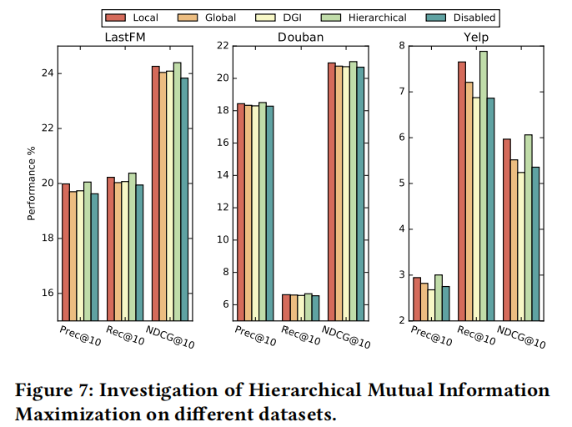
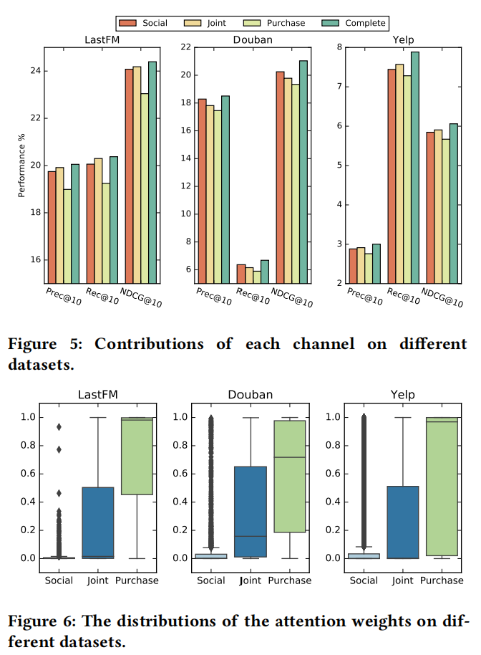
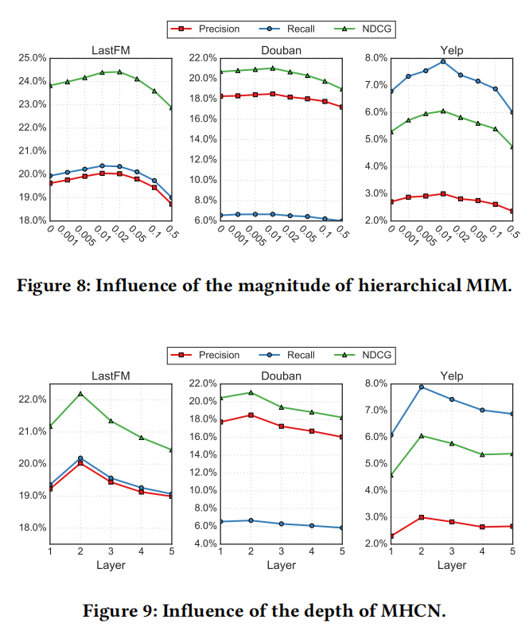
07
Ablation, Sensitivity, and Mechanism Validation
Figure 5 to Figure 9 explain why the method works and where its boundary lies
What the experiments say
Figure 5 and Figure 6: all channels help, but purchase channel contributes the most.
Figure 7: hierarchical MIM beats local-only, global-only, and DGI-style alternatives.
Figure 8: the SSL weight beta should stay small; performance peaks around 0.01.
Figure 9: shallow depth works best; deeper models suffer from over-smoothing.
Figure 7: hierarchical MIM is the strongest self-supervised design.
Best one-line summary
The paper proves not only that the method wins, but also which component matters most and what tuning range keeps it stable.
Figure 5-6: purchase channel dominates both ablation and attention.
Figure 8-9: small beta and depth 2 work best.
Evidence: Section 4.3; Section 4.4; Figure 5; Figure 6; Figure 7; Figure 8; Figure 9
PaperReadand Report | S^2-MHCN
Notes:
This is the slide that validates the design story from earlier sections. Figure 7 is especially important because it checks whether the hierarchical self-supervised design is actually justified. Evidence: Section 4.3; Section 4.4; Figure 5 to Figure 9.

Slide 8
08
Contribution, Limitation, and Takeaway
How to explain the paper clearly to the group
Main contributions
Main limitations
1. High-order relation construction
Purchase signal dominates
Reframe social recommendation from pairwise social graph modeling to multi-channel motif-induced hypergraph modeling.
The strongest evidence comes from purchase-related structure, so the method is not winning through explicit social edges alone.
2. Practical representation pipeline
Combine SGU, efficient hypergraph propagation, channel attention, and one user-item graph branch in a clean ranking architecture.
Tuning and depth matter
The method prefers small beta and shallow depth. Larger auxiliary weight or deeper propagation can hurt performance through interference or over-smoothing.
3. Structural self-supervision
Use hierarchical mutual information that matches the user <- sub-hypergraph <- hypergraph hierarchy instead of generic DGI-style SSL.
Best final mental model
Tell the story as high-order relation construction plus controlled structural regularization. That is the cleanest way to explain why this paper is different from a plain social GNN recommender.
Evidence: Section 5 Conclusion; Table 4; Figure 5; Figure 7; Figure 8; Figure 9
PaperReadand Report | S^2-MHCN
Notes:
End with a balanced judgment: the paper has a coherent design story and evidence, but it also shows clear boundaries. That balance makes it a good group-meeting paper. Evidence: Section 5 Conclusion; Table 4; Figure 5; Figure 7; Figure 8; Figure 9.

