Slide 1
Driveway Junction Accidents
And how to reduce it

Slide 2
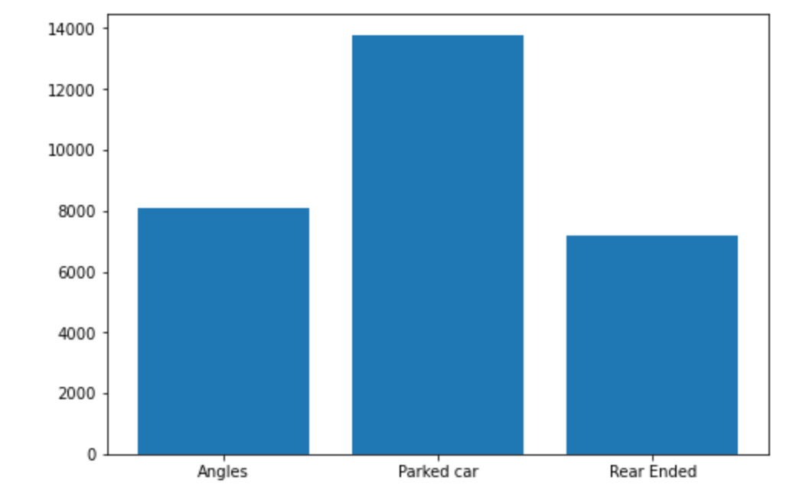
What is the most common collision type?

Slide 3
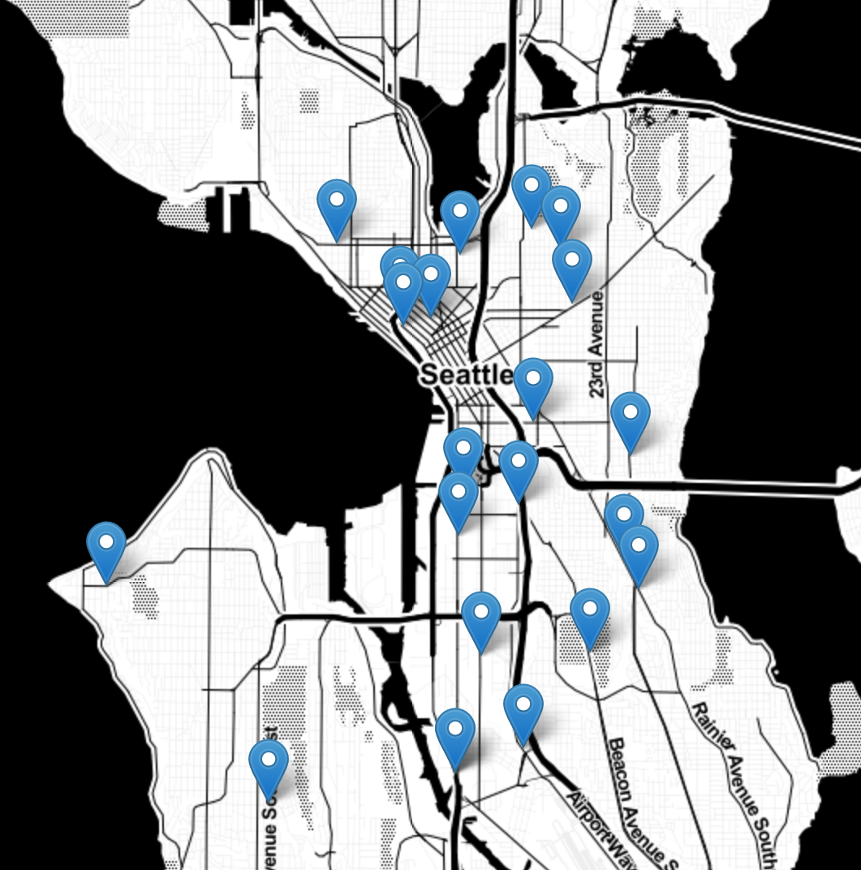
Where should we place convex mirrors?
Evidently in 2019, there are more incidences of angle-type collision nearer Seattle.
We need to use our resources to reduce the number of accidents on driveway junctions at nights near the city.
This could reduce the number of traffic congestions.

