Slide 1
CWE AI Working Group
Co-chairs:
Deana O’Meara (NVIDIA), Kate Farris (Robust Intelligence)

Slide 2
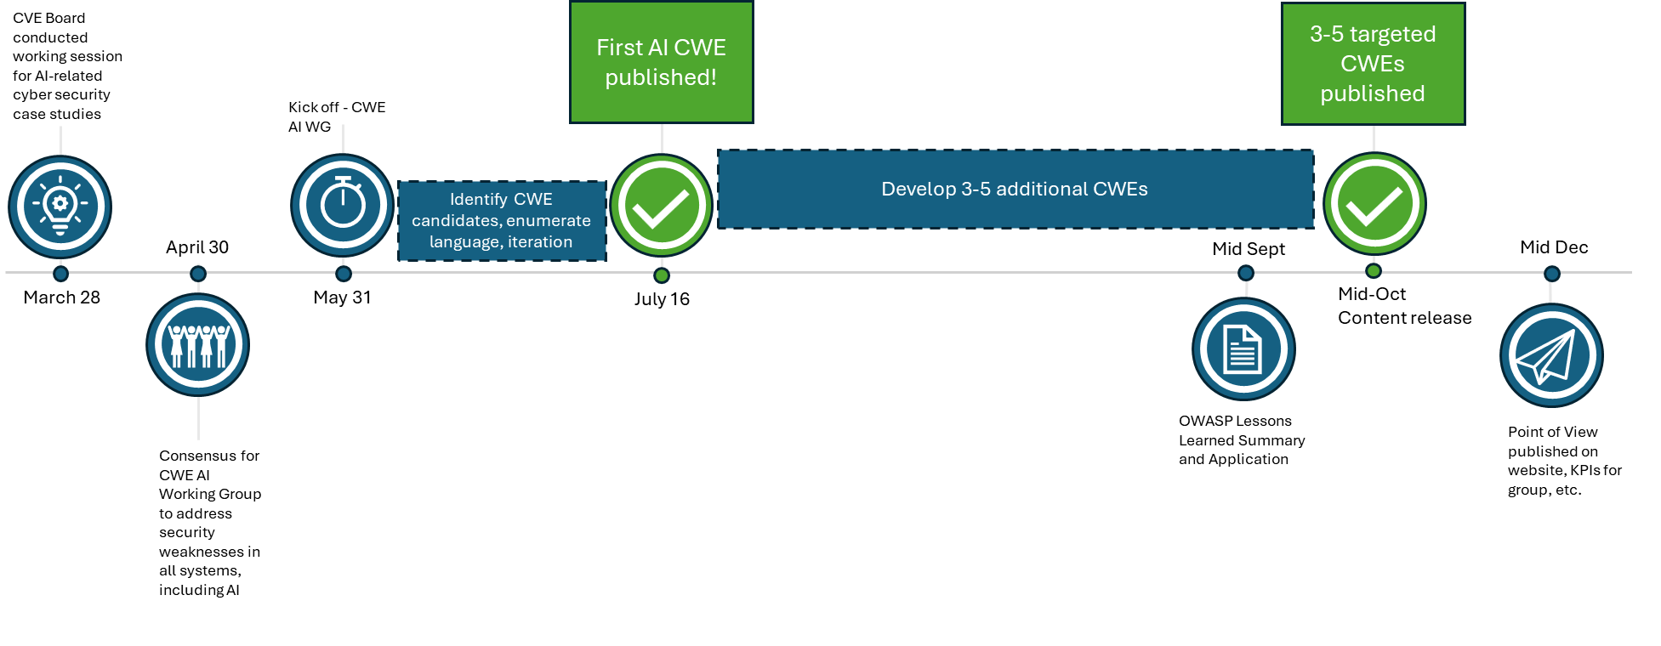
Milestones and Targeted Future Outcomes
Mission: Develop and publish accurate CWEs for the AI space by driving consensus among several SMEs
Notes:
Discuss "Rhythm of Business"
CWE AI Working Group Kickoff on May 17, 2024
Bi-Weekly Meeting Series
KPIs and quarterly report out dates
CWE AI submissions aligned with regular releases
20+ Attendees

Slide 3
Cross-Industry Consensus Building
Diverse representation across sectors drives resolution on complex CWE AI submissions.
E.g. Recent Prompt Injection related CWE submission
Over 9 participating organizations, including 2 industry standards groups and growing.
NVIDIA
Robust Intelligence
MITRE
OWASP
RedHat
Microsoft
Convera
Praetorian
BitSight

Slide 4
New CWE AI Published Content
Weakness | Related to | Child of | Description | Release
CWE-1426: Improper Validation of Generative AI Output | Prompt Injection | CWE-707 | The product invokes a generative AI/ML component whose behaviors and outputs cannot be directly controlled, but the product does not validate or insufficiently validates the outputs to ensure that they align with the intended security, content, or privacy policy. | CWE v4.15 07-16-2024
“prompt injection”-related demox
CWE-77: Improper Neutralization of Special Elements used in a Command ('Command Injection’)
New observed examples were added to multiple CWEs related to AI/ML and generative AI prompts

Slide 5
Learnings
Gaining cross-industry consensus is important to move forward.
Learning from retrospective of other groups is crucial.
E.g. OWASP LLM and ML standards volunteered to list learnings to help CWE.
Tune operational aspects of the working group.
Strike balance when it comes to speed of getting new CWEs approved versus thoughtful consensus.
Targeting 3-5 new CWEs for next content release

Slide 6
Questions?

