Slide 1
CWE AI WG Kickoff Meeting
May 17, 2024

Slide 2
Notice: This Meeting Will Be Recorded

Slide 3
Agenda
Introductions
WG Mission and Goals
Co-Chairs
CWE and Prompt Injection

Slide 4
Participant Introductions
MITRE staff
Alec Summers
Steve Christey Coley
Bob Heinemann
Other WG Group Members

Slide 5
AI WG Mission and Goals
Draft proposal:
Identify and address gaps in the CWE corpus where AI-related weaknesses are not adequately covered, and work collaboratively to fix them
Thoughts about where do the things go that don't fit in CWE/CWE? PSIRT teams are struggling with this. Incorporate scope of programs into above mission language
Not all AI-related security issues may be within CVE & CWE scope

Slide 6
WG Leadership Structure
CVE and CWE working groups are governed by the CVE and CWE Boards, respectively
This group was launched after approval from the CWE Board
Periodic reporting of status and activities
Working Groups are most effective when led by a set of chairs/co-chairs that represent the diverse CVE/CWE stakeholder communities
If you are interested in being a chair / co-chair, please email cwe@mitre.org or let us know in the chat

Slide 7
CWE: Prompt Injection Weaknesses

Slide 8

Prompt Injection – How Did We Get Here?
Use of new CDR (Content Development Repository)
2 older submissions were not weakness-focused and had many problems
CWE Team members consulted with MITRE AI SMEs to propose a new submission to replace the previous two submissions
We are seeking input from both the AI WG and the broader CDR community
Pending community consensus, we hope to get “prompt injection” into CWE 4.15 in July

Slide 9
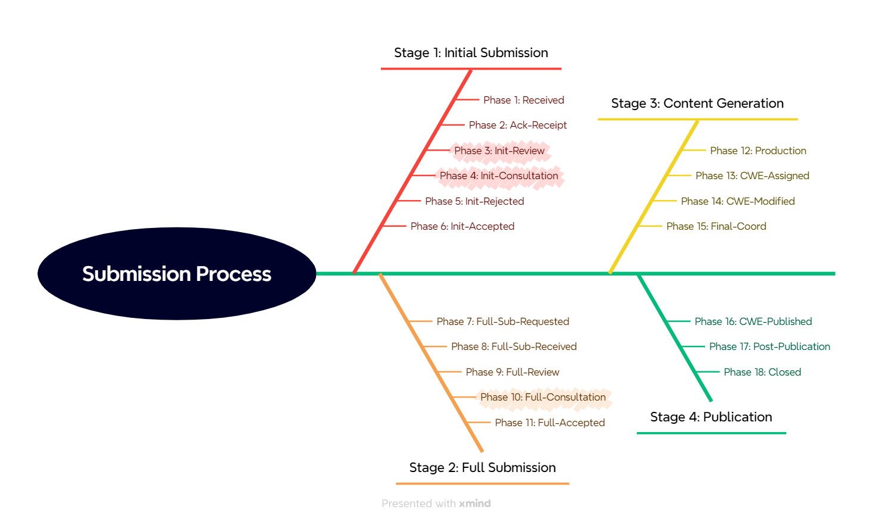
CDR Stages and Phases
Stage 1: clarify the bare essentials
We are in Phase 4, the biggest hurdle
The CWE Team identified multiple problems in Phase 3
Stage 2: requires lots of effort and expertise, but generally isn’t technically difficult
Stages 3 and 4 require minimal effort

Slide 10
New Submission ES2405-84711fc4 - Insufficient Input Validation in Generative AI Applications
Element | Value
Short Desc | The product accepts user inputs for a generative artificial intelligence application, which can modify or bypass the original instructions resulting in an unintended response.
Extended Desc | Without sufficient validation to application user inputs, the generative artificial intelligence model can change its original behavior or provide unintended responses. This can be used to reveal model secrets, output biased responses, and possibly execute system commands, depending on application capabilities. This flaw depends on the fact that generative artificial intelligence models make no real distinction between the control and data planes.
Alternate Term(s) | prompt injection. Note to user: prompt injection is an attack and applies to multiple weaknesses, not just this one.
Relationships | ChildOf CWE-20: Improper Input Validation
https://github.com/CWE-CAPEC/CWE-Content-Development-Repository/issues/109
* Email cwe-submissions@mitre.org if you need access to CDR

Slide 11
Boilerplate Problem Descriptions for This New Submission
Submission Label | Description
SUB.UNCLEAR - "Unclear weakness" | The submission's name and/or description does not clearly identify a weakness, or it is written in a way that is vague and could cause the submission to be incorrectly mapped to.
SUB.MITIGATION - "Too mitigation-focused" | The submission's name and/or description emphasizes missing or incorrect mitigation without clarifying the weakness.
SUB.OVERLAP - "Duplicate/Overlap" | The submission identifies a weakness, but it is a duplicate of (or partially overlaps) existing weaknesses, indicating problems with the submission or associated CWE entries.
SUB.COORD - "Requires extensive coordination" | The submission will require or is currently undergoing close coordination, discussion, and debate between multiple parties with different perspectives and opinions…
SUB.NEWTECH - "New/Emerging Technology" | The submission is related to a new or emerging technology that is not well-understood from a weakness perspective, which can cause real or perceived gaps in CWE that require extra effort and time to analyze. Typically, for new/emerging technologies, early vulnerability discovery and research does not focus on root cause analysis (i.e., weakness identification). Instead, the focus is on other areas such as attacks and exploitation methods, technical impacts, threats, mitigations, or other concerns.

Slide 12
Problems Not Needing Further Discussion
SUB.OVERLAP - "Duplicate/Overlap"
The CDR Team needs to close out the original, older submissions
SUB.COORD - "Requires extensive coordination"
We are here; the submission might take extra time
SUB.NEWTECH - "New/Emerging Technology
We are here; the submission might take extra time

Slide 13
Discussion: SUB.UNCLEAR - "Unclear weakness"
(1) Unlike most software related weaknesses, there does not seem to be a clear understanding of what is actually happening "under the hood," i.e., generative AI is like a "black box" in which the specific insecure behaviors are not clearly understood
Weaknesses in CWE are characterized by their behaviors.
The emphasis on mitigations such as "input validation" and "adversarial" techniques, or on attack methods, further suggests this lack of a clear understanding.
(2) What is meant by "generative artificial intelligence application"? Is it the model itself or an application that makes use of a model? Or is it both?
This ambiguity could cause people to interpret this weakness in different ways depending on if they are an app developer or a model developer.
(3) “accepts user inputs” is a normal behavior; “… which can modify or bypass the original instructions” seems more like a focus on technical impacts, or an emphasis on characteristics of the inputs, instead of the insecure behavior

Slide 14
Discussion: SUB.MITIGATION - "Too mitigation-focused"
CWE entries typically try to stay away from emphasizing the protection mechanism (in this case, input validation)
A weakness can typically be addressed by multiple protection mechanisms
Also, input validation is notoriously subject to many variations as adversaries develop new techniques to bypass validation steps
see CWE-184: Incomplete List of Disallowed Inputs
Since there is such a significant emphasis on input validation by the wider community, the best option might be to create a new CWE entry that is focused on improper input validation for generative AI applications.

Slide 15
Prompt Injection: Next Steps
Discuss on CDR and in the next AI WG meeting
Can we more clearly elucidate the weakness?
Decide if we have to “live with” an emphasis on input validation
"Injection is an attack"? What allowed that to occur...
<Alternate Terms>

Slide 16
Backup Slides

Slide 17
General CDR Process
Stage 1 (Initial): ensure the weakness/weaknesses is clearly described
Limited number of elements (description, relationships, references)
Stage 2 (Full): gather additional details
All required elements – potential mitigations, observed/demonstrative examples,
Finalize (copy-edit) and review all elements
Stage 3 (Content Production): enter the data into internal repository
Assign new CWE ID, convert text to CWE’s XML format, etc.
Stage 4 (Publication): publish in a new CWE version
Every 4 months
Next version: CWE 4.15 – July 16, 2024

