Slide 1
Education and CWE/CAPEC/CVE
8 June 2022

Slide 2
Agenda
Introductions
Goals
Sharing what has been done
What do we want to focus on?
Funding

Slide 3
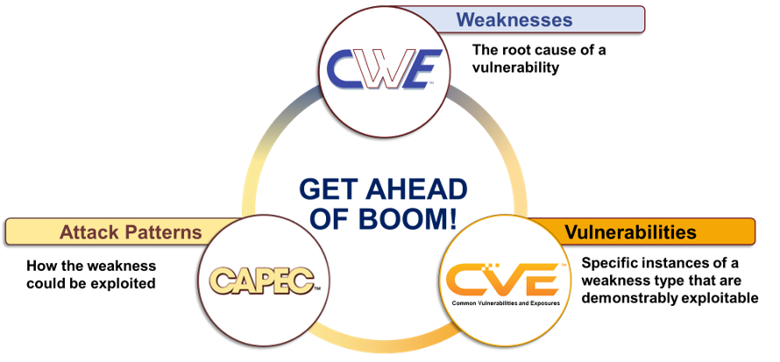
Goals
CWE/CAPEC/CVE should be easy to understand and use
New Cyber Security professionals should be fluent in these corpuses
Training for those new to CWE/CAPEC/CVE
Shared University Curriculum
Teaching students the importance of “getting ahead of boom”

Slide 4
What Currently Exists
Sharing current status, if you are using CWE/CAPEC/CVE in your classes
MITRE Institute

Slide 5
What to Focus On?
CWE/CAPEC/CVE is primarily about helping designers and developers:
Avoid common mistakes
Showing how those mistakes can be used by attackers
Giving examples of those mistakes used in real-life situations
CWE/CAPEC/CVE is also about use cases
Secure Coding
Pen Testing
Threat Modeling
Security Control Selection
Vulnerability Management

Slide 6
Funding
MITRE is interested in working with academia
Our sponsor is concerned about a conflict of interest
Their funding cannot be perceived to be supporting an unfair advantage for those going after competitive funding
It might be possible to draft a document about the general use of CWE/CAPEC/CVE in the education setting
Independent of your funding, we want to work closely with you on this effort

