Slide 1
CWE User Experience Working Group Meeting
March 26, 2025

Slide 2
Agenda
This meeting is being recorded :-)
Primary topics
Macro-Usability Changes for CWE 4.17
CVE Views Questions & Guidance
Open Discussion
Reminders and Adjourn

Slide 3
Topic 1
Macro-Usability Changes for CWE 4.17
Steve Christey Coley

Slide 4
Macro-Usability – Potential Changes for CWE 4.17
Previous work has been focused on front page and related menus
Additional changes are possible
only small technical changes can be made due to limited time
Features like “dynamic hierarchy navigator,” ability to change order of fields in an entry, ATT&CK-style matrix, etc. are not feasible for CWE 4.17 release
Goal: improve UX for first-time visitors to individual CWE entry pages
Many visitors click on a CWE link from another web site and are driven to the individual web page for that CWE
Goal: make useful features more readily apparent
The CWE site has lots of useful information that users probably don’t even notice
Hidden in menus, obscured in a link in the corner, etc.

Slide 5
Improving UX for Individual Web Pages
Improve UX for people who first visit individual CWE entry pages
Current default is “Comprehensive” – all fields (wall of text)
Change default to include only some elements
Maybe similar to “Conceptual” presentation
Change color/presentation for some kinds of entries (deprecated, obsolete, categories, views)
Categories have pale yellow background but still look-and-feel the same as weaknesses
Deprecated/Obsolete look like regular active entries – could gray them out?
Change layout of complex fields (reduce wall-of-text)
Currently it’s “all-or-nothing”
Default “Minimize” some complex/extensive fields
Remove/minimize IDs in category/views
Presentation filters to select fields to show
Big buttons that “blend in” to the page AND take up lots of space

Slide 6
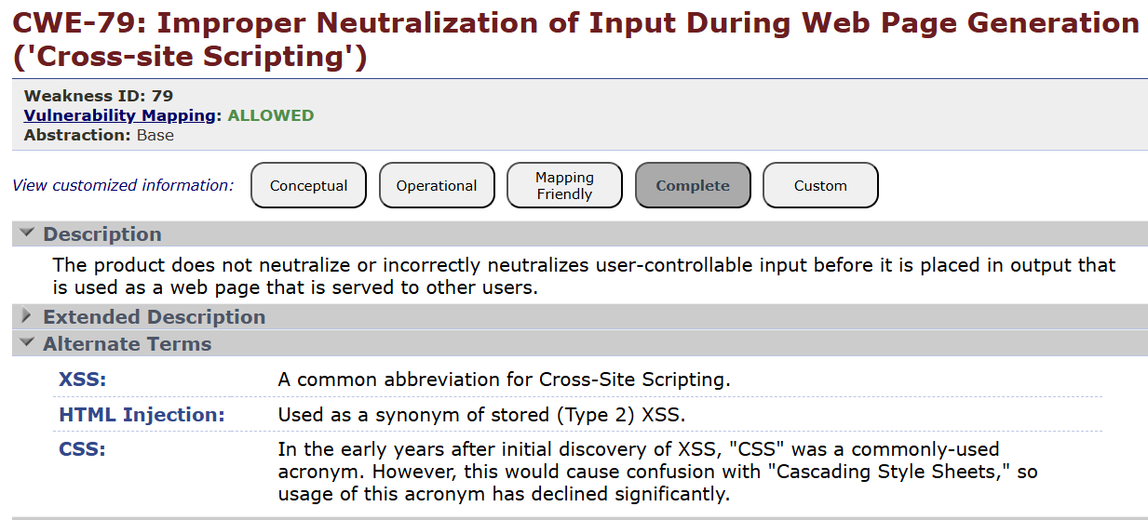
Example – CWE-79, Part 1
Lots of vertical space taken
5 big buttons that take up lots of space
“Complete” default
(Missing diagram – a content issue)
Extended description could be hidden by default

Slide 7
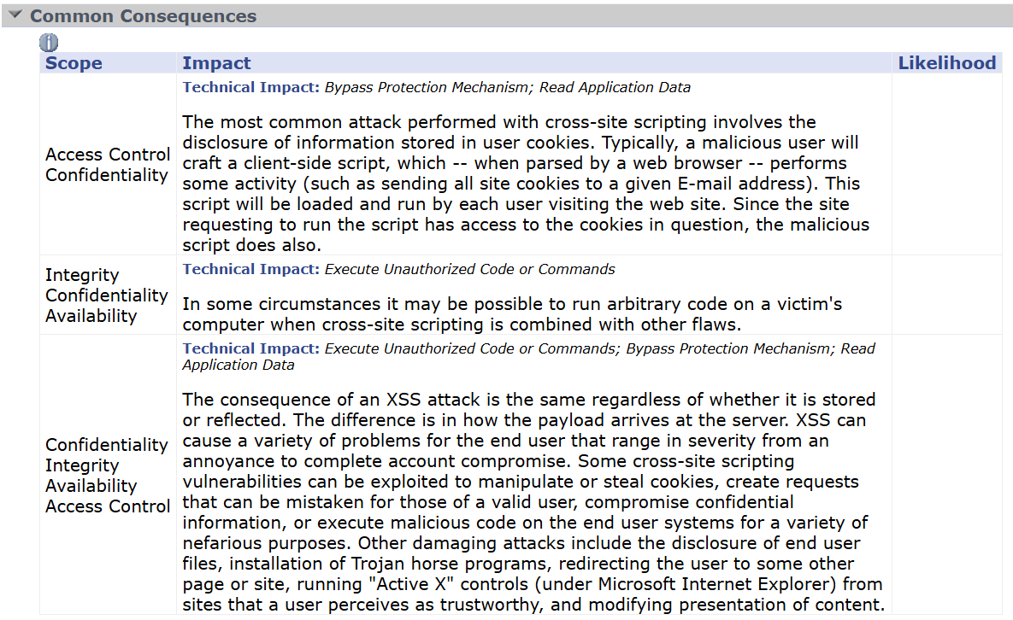
CWE-79, Part 2
“Likelihood” is rarely filled (and extremely context-dependent). Reduces horizontal space (and makes the field vertically longer)
WALL.
OF.
No clear lines between rows / cells – maybe do alternate shading?
TEXT.
… but still laid out cleanly if somebody really needs to understand how bad it can be
Consider moving Scope to the right

Slide 8
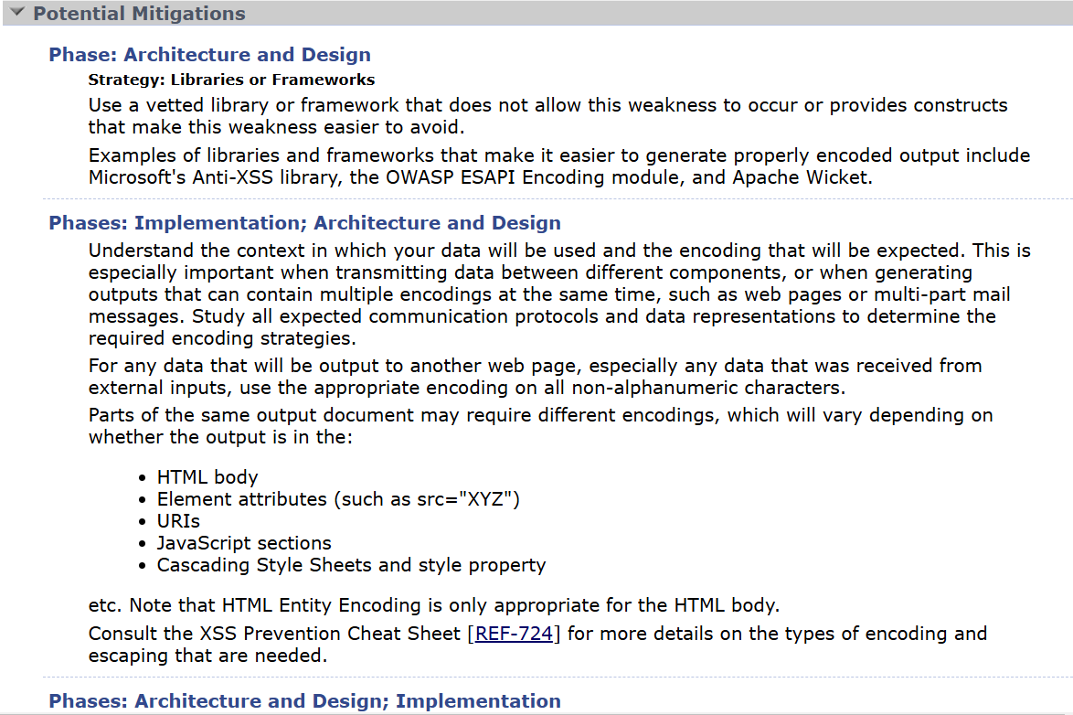
CWE-79, Part 3
WALL.
OF.
… but a nicely organized table if you’re tasked with fixing the thing
TEXT.
Layout is inconsistent with Common Consequences (which is more table-oriented)

Slide 9
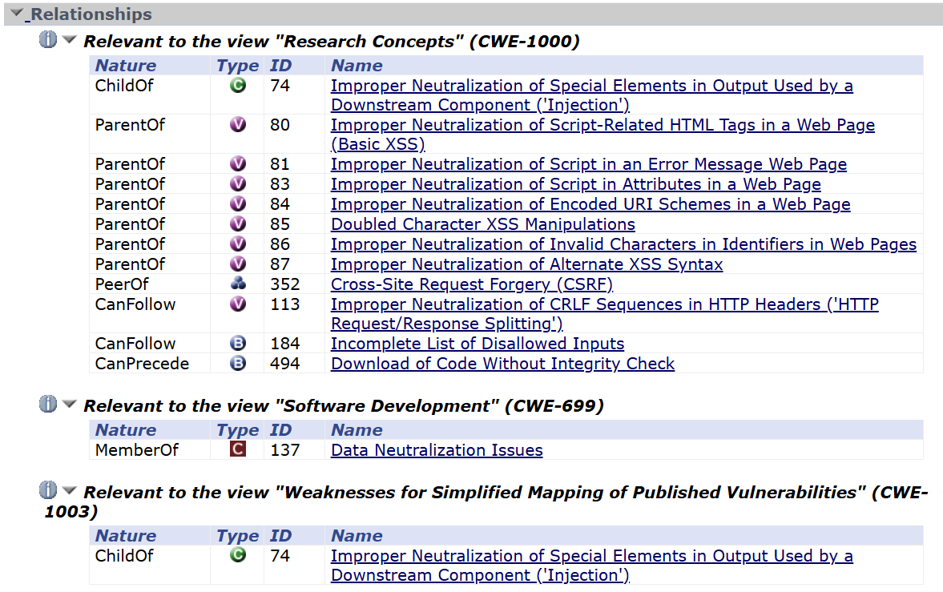
CWE-79, Part 4
So many links with purple text
Repetitive “ParentOf”
(But the icons are helpful to power users)
Change abstraction icons?
Maybe not all views need to be expanded by default?
Views have CWE IDs listed

Slide 10
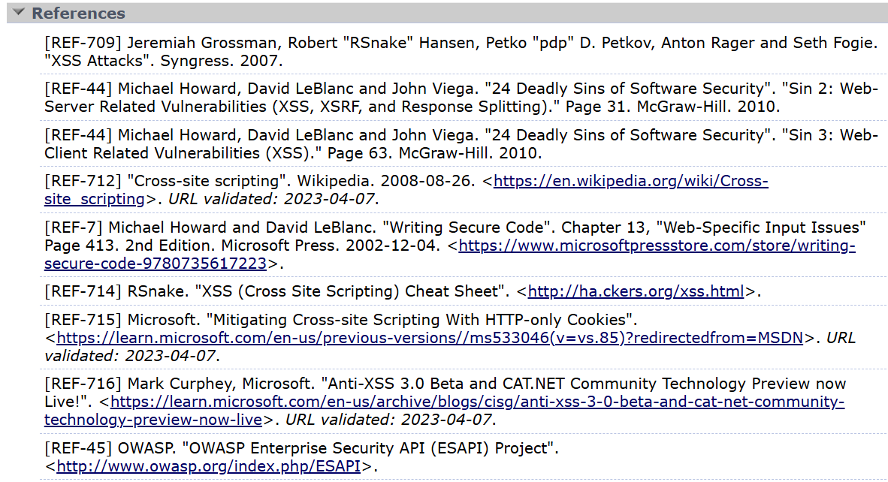
CWE-79, Part 5
WALL.
OF.
TEXT.

Slide 11
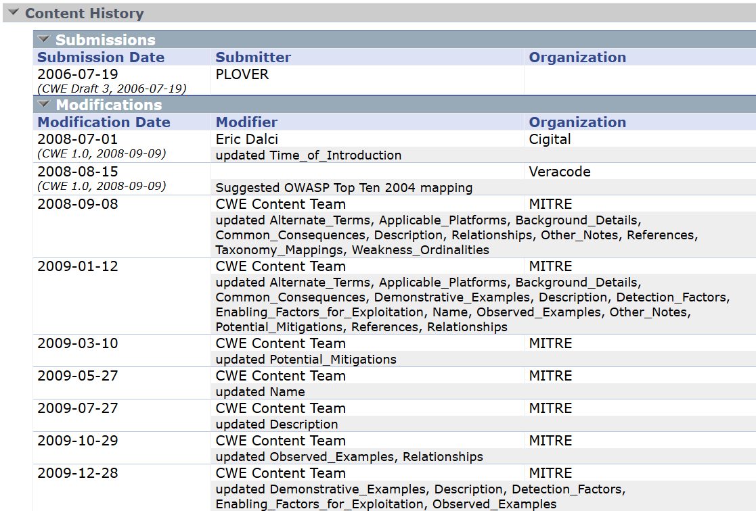
CWE-79, Part 6
Modifications – most recent should probably be on top
Not sure who uses or wants these details (besides me about once a month)

Slide 12
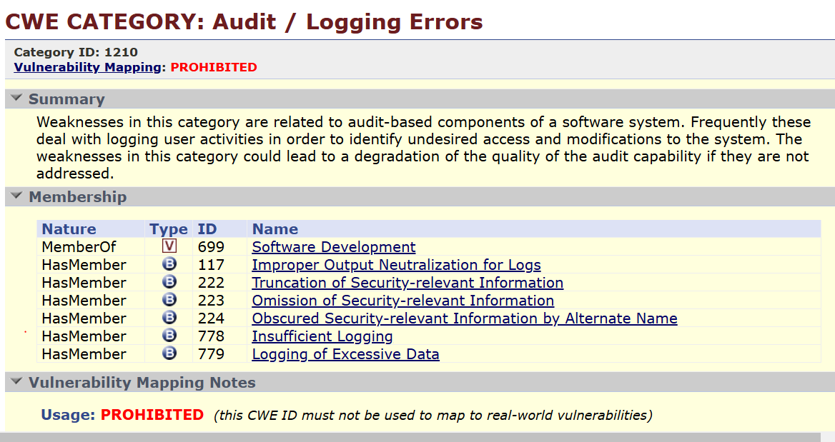
Category Example
Numeric ID displayed
Repetitive “HasMember”
So many links with purple text
Yellow background is different, but structure / layout is the same

Slide 13
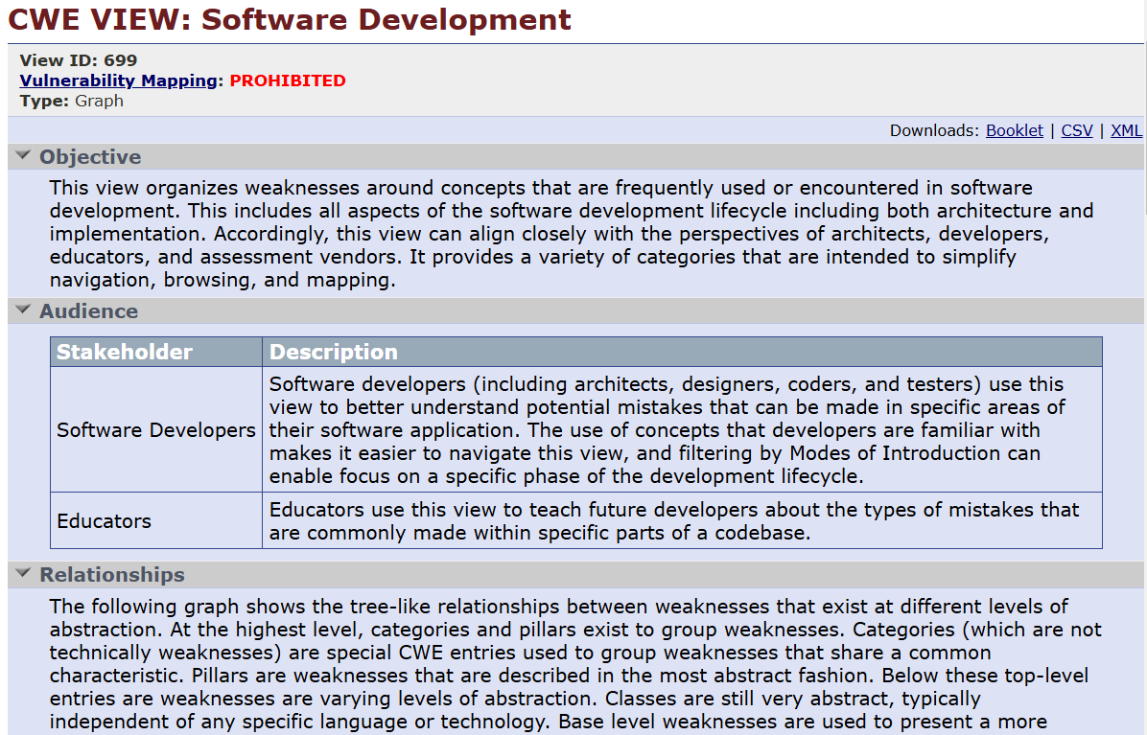
View-699 Example – Part 1
Numeric ID displayed
Data downloads not clear
Long explanatory text

Slide 14
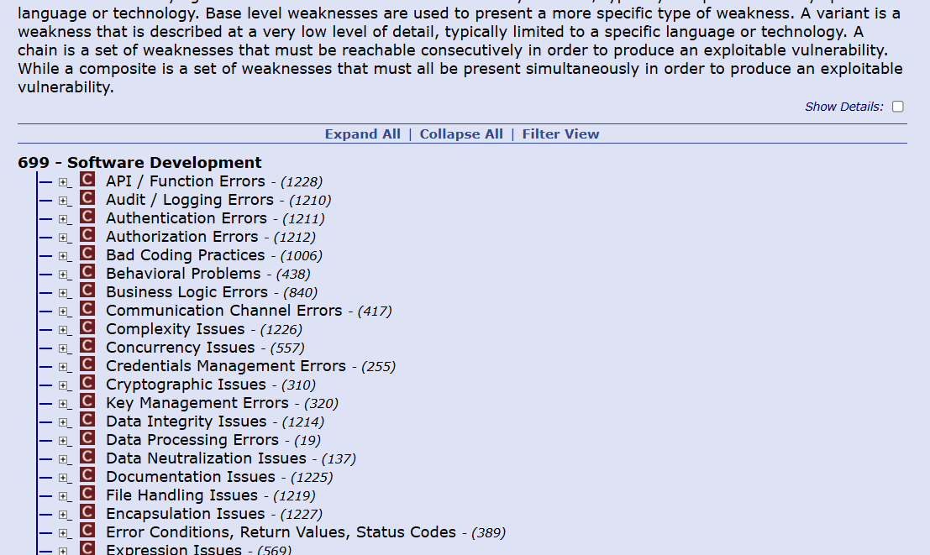
View-699 Example – Part 2
“Show Details” not clear
“Expand All” / other options kind of obscured

Slide 15
Make Useful Features More Readily Apparent
There’s lots of potentially helpful data that casual users won’t be exposed to
ID lookup (always in the top corner)
Downloads of entire repository
Diff files, older versions
Individual views
Download data (CSV, XML, PDF, etc.) – small links in upper right
Expose REST API option
Hierarchy visualizations (PDFs) for various views
View filter
Option is in a clickable link in the middle of the page
Google keyword search
We don’t (yet) have logs on what people search for
Could consider preventing indexing of some CWEs, or restricting results to only weaknesses

Slide 16
Topic 2
CVE Views Questions & Guidance
Chris Coffin

Slide 17
CWE Views Questions
Recently received some questions from a software engineer who stated the following:
“I am working on integrating CWE data into our internal systems and have several questions regarding the role of views and their relationship with CWE hierarchies. These questions are essential for ensuring we provide accurate and contextually appropriate information to our customers. I would appreciate your clarification on the following points:”
Providing CWE Relationships Without View Context:
If I want to provide my customers with the CWE linked to their vulnerability (according to NVD) and also include the parent and all ancestors of the CWE, is it wrong to present this information without including the view context?
If one CWE has a parent in one view and another parent in a different view, does that imply that both CWEs are valid parents, or is the relationship only valid within the context of a specific view?

Slide 18
CWE Views Questions (continued)
Structure of CWEs and Views:
Are all CWEs stored as a single tree or graph structure, where views represent different slices or perspectives of this overall hierarchy?
CWE and Category Relationships:
Is it incorrect to state that a CWE is related to a category if the relationship only exists within a specific view? Should such relationships always be tied explicitly to the view context?
Depth of Relationships:
Is there a limit to how deep the relationships go in the CWE hierarchy? For example, is there a maximum number of generations for ancestors and descendants?

Slide 19
CVE Views Guidance
Do others on the call have similar questions?
Is more guidance and education needed on CWE Views?
Any other questions we need to answer outside of those provided here?
Should we point to the Research Concepts View as the complete CWE View? (See ‘Structure of CWEs and Views’ question on previous slide)
CWE home page points to this View with the title All Weaknesses
Research Concepts View does NOT include Categories or other Views

Slide 20
Topic 3
Open Discussion
Chris Coffin

Slide 21
Next Meeting – April 30 @ 12pm
PLEASE CONTACT WITH ANY QUESTIONS OR THOUGHTS
CWE@MITRE.ORG

Slide 22
Backups

Slide 23
Reminder
VulnCon 2025 is April 7-10, 2025
https://www.first.org/conference/vulncon2025/
Call for papers was extended to January 31st

Slide 24
Home Page Redesign
The Problem: Lack of direction “where do I go now?” - especially for new users
Proposed solution: Focus on grouping sections by common user actions
Learn About CWE
Access Content
Contribute
Contribute content
Participate in working groups

Slide 25
Reorganize New User Content
The Problem: New user content is in multiple places (under About and under Root Cause Mapping)
Proposed Solution: Reorganize new user content
Remove duplication (e.g., New to CWE and Root Cause Mapping Guidance)
Tie together pieces from different places
Specific information focused on different types of users

Slide 26
New User Guidance on CWE Entry Pages
The Problem: many new users enter the CWE website through a link to a specific CWE weakness page. No clear guidance without taking the time to read through all the new user info (which many won’t have the time to do)
Proposed Solution: Add some content and structure to the CWE pages
Make it easier for the novice to find what they need quickly
Could add some additional categorization to the CWE weakness entries as proposed on the following two slides

Slide 27
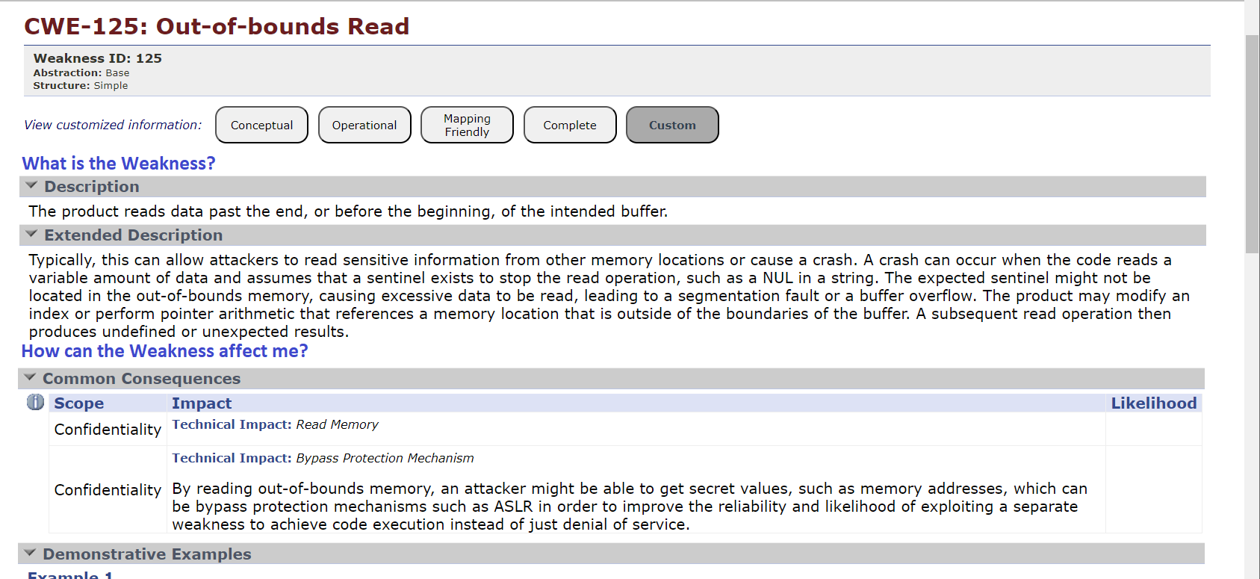
CWE Element/Information Presentation – Mockup for New CWE Users

Slide 28
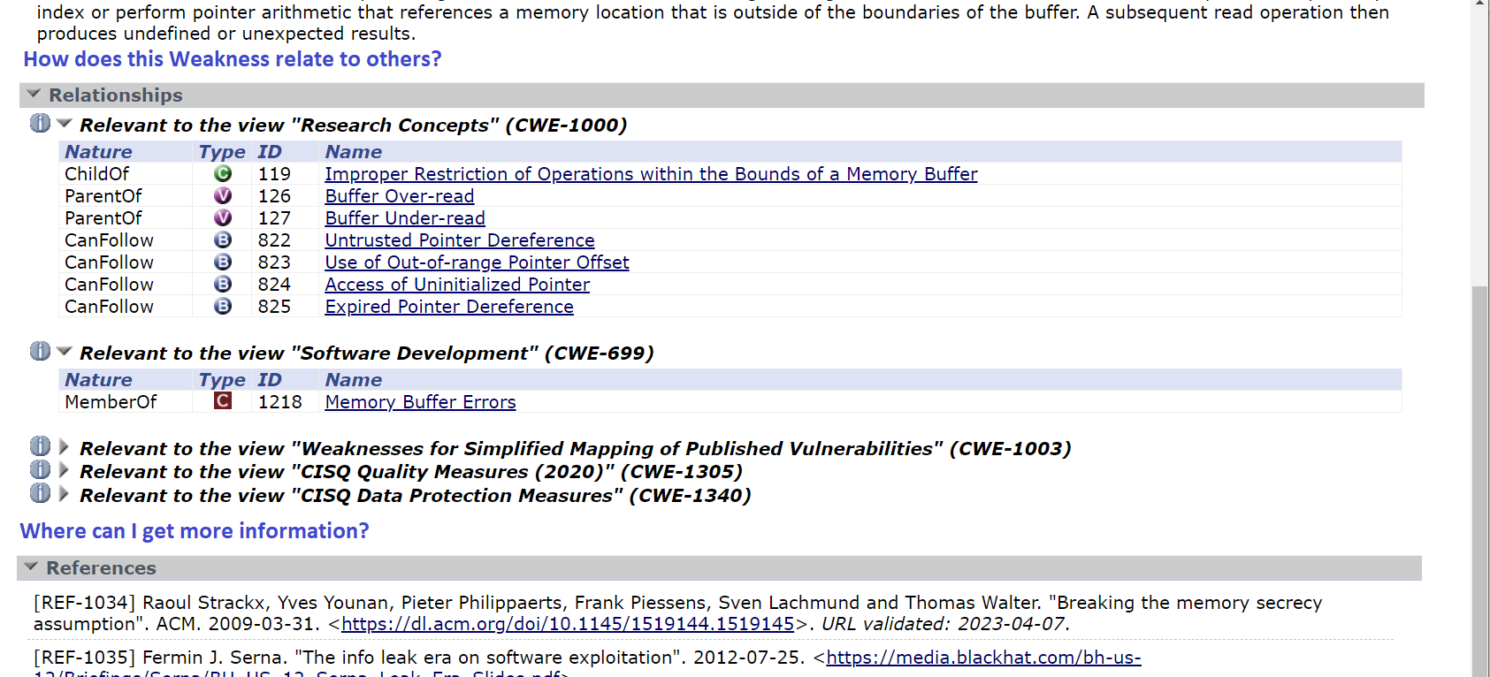
CWE Element/Information Presentation – Mockup for New CWE Users

Slide 29
Improve Search
The Problem: Search is a generic option that searches the whole website, without the ability to focus in on key items of interest
Proposed Solution: Build a more robust search capability
Advanced search, filter results
Select fields to search in
Search alternate terms
Show only mappable CWEs

Slide 30
What’s new in CWE Release 4.15?
First installment of major usability improvements that are underway to enhance the understandability, navigability, and usability of CWE content
15 CWE Entry pages now include a concise summary of the weakness along with a visual aid at the top of each entry page
These 15 CWEs were selected based on their inclusion in the CWE top 25 list
Full list can be found at: https://cwe.mitre.org/news/archives/news2024.html#july16_CWE_Version_4.15_Now_Available
The Alternate Terms, Common Consequences, and Mitigations sections were reordered so that they appear directly below the new summary section

Slide 31
Open Discussion Topics?
Increase motivations to fix weaknesses versus vulnerabilities
Could we find a way to incorporate cost and expense associated with a weakness into CWE?
What CWE personas most benefit from weakness visualizations​?
Technical writers and security architects whose audience is less technical could benefit from reusing visualizations
New or junior level Software or Hardware developers could better understand security issues in visual form
CWE persona for technical manager?

Slide 32
Usability: Macro- and Micro-Level Review
Macro –
How to organize weaknesses at structural, site-wide level?
Organizing Views
Site-wide navigation
Micro –
How to define a weakness understandably/accurately
Remove redundant and unnecessary information
Moving information to a better place
Better leverage the schema

Slide 33
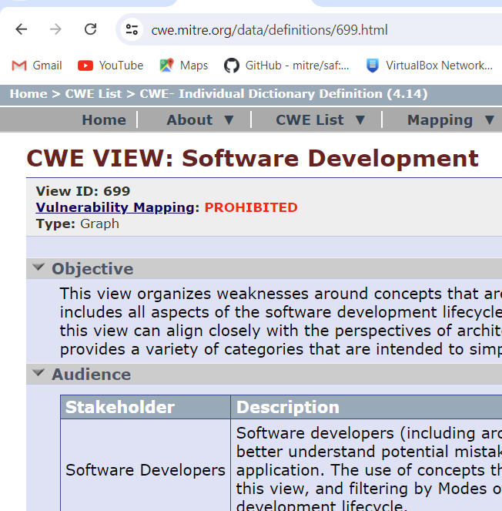
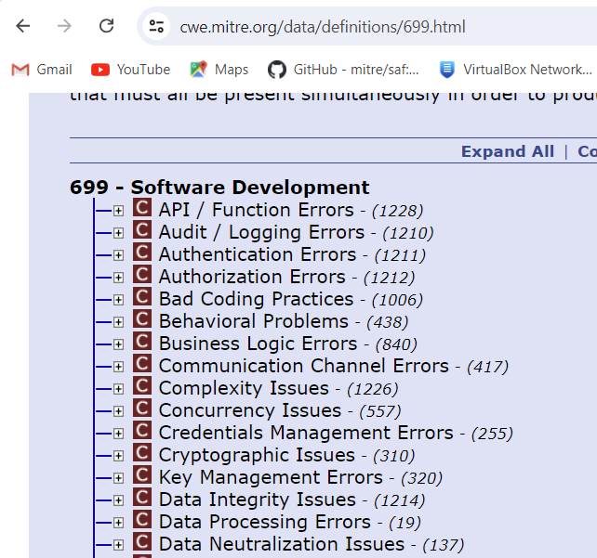
View and Category IDs
Discussions around removing View and/or Category CWE IDs from page (under title) to prevent mappings
Already removed IDs from titles
IDs will still be used in URL

Slide 34
Other Macro Changes?
Any other thoughts or ideas on Macro usability changes?

Slide 35
UEWG: Purpose
Mission: Identifying areas where CWE content, rules, guidelines, and best practices must improve to better support stakeholder community, and work collaboratively to fix them
Periodic reporting of activities to CWE Board
Next quarterly Board meeting TBD Q2-2024
Please solicit participation from your contacts
Contact: cwe@mitre.org

Slide 36
Housekeeping
CWE UEWG May Meeting
The next regularly scheduled meeting is Wed 7/31
The CWE Program is continuously seeking feedback on UEWG activities and priorities during these sessions or via email: cwe@mitre.org

Slide 37
Usability Task Micro Updates Initial Goals
Above the fold (before the webpage scroll point):
Important and concise text is above the fold so the reader can easily scan and digest
Points to Make Above the Fold:
Describe just the weakness and provide a visual aid
Concise summary of weakness (only in description, no extended description)
Describe the condition and some context about the condition
Concise is 3 – 4 sentences. Images will provide additional context.
Reorder Elements:
Alternate Terms
Consequences Element (bad outcomes)
Mitigations Element (what to do about the weakness)
Remaining Elements follow
Notes:
"Inverted Pyramid“: A style of writing. It is a method of communication that involves presenting the most important information first, followed by details and background information. This approach is designed to attract readers' attention and encourage them to continue reading.
“Above the fold” It refers to the portion of a webpage that is visible without scrolling. The content placed in this area is often considered the most valuable as it is the first thing visitors see.

Slide 38
Prioritizing User Experience Improvements
User Experience Working Group was established in response to negative feedback related to CWE’s usability
This group has accomplished much in response (e.g., submission guidelines, mapping guidance, “New to CWE?” launch, weakness filtering)
We must now begin to address usability and understandability in further ways throughout the corpus structure and down to individual weakness language
CWE entry clean-up (across the entire corpus)
Understandability: revising all entries for simpler language; remove redundancy
Simplifying descriptions/extended descriptions to leverage other elements appropriately
E.g., removing example instance, impacts, etc. language from descriptions
Only having one description written in concise, accurate language focusing on the weakness
Completeness: ensuring all entries have basic required elements populated
Visualizations: adding to entries to explain topics visually (leverage Abhi’s top25 examples, build from there)

Slide 39
Usability: Macro- and Micro-Level
Macro –
How to organize weaknesses at structural, site-wide level?
Organizing Views
Site-wide navigation
Micro –
How to define a weakness understandably/accurately
Remove redundant and unnecessary information
Better leverage the schema

Slide 40
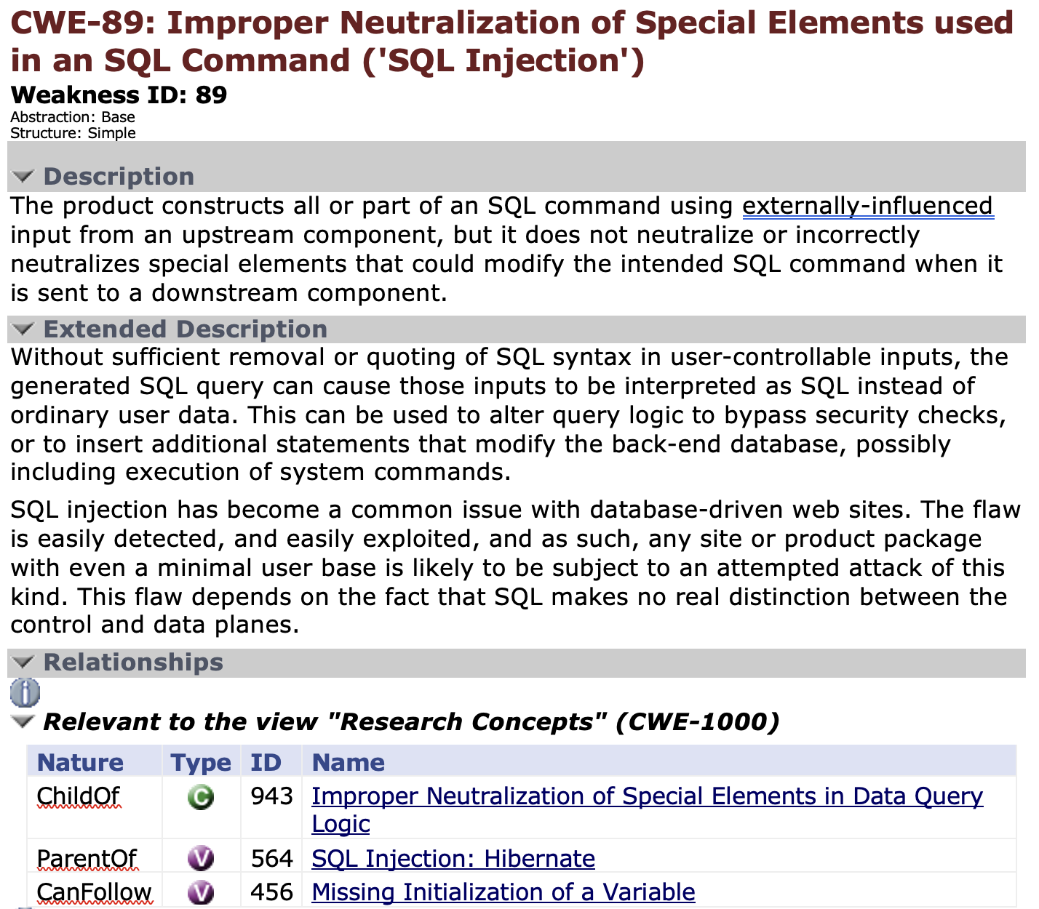
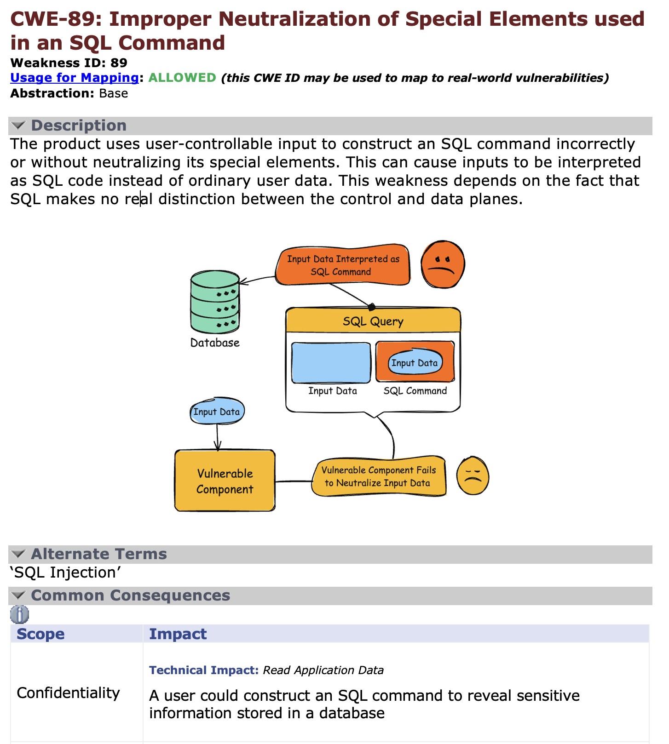
Example

Slide 41
Overall Prioritization
At what level should we begin our focus?
Macro (CWE organization and navigation) vs Micro level (weakness understandability)
Micro could include CWE record:
Understandability
Completeness
Visualizations

Slide 42
A possible path forward
Discuss a single CWE and how we could improve usability by
Merging the description and extended descriptions
Removing redundant information
Moving information that belongs in other parts of the schema
Removing vulnerability specific information
We could walk though one example in the meeting
Would anyone be interested in trying this exercise with another CWE on their own
Could present their results in the next meeting

Slide 43
Topic 2
New to CWE Updates
Chris Coffin

Slide 44
Prioritizing User Experience Improvements
To come: New Strategy and Implementation Plan for usability improvements across CWE corpus aligned to required elements and their requirements as outlined in CWE content suggestion guidelines
Community partners in UEWG are invited to help us tackle this important work
More intentional focus in UEWG
CWE Content Web Submission Form for suggested mods on any weakness
Content Development Repository (CDR), GitHub repo for community collaboration is coming soon and will provide transparent, collaborative platform on which to work

Slide 45
Recent Discussions on SW Licensing Issues
Since November, a resurrection of debate around SW licensing issues being in/out of CWE scope on the CWE-Research email listserv
In 2018, it was determined that “improper licensing” was outside of CWE's scope
Rationale: Impact to software and its usage not through the technical exploitation of a software security weakness in architecture, design, or code. Rather, it is through policy/programmatic exploitation.
Availability concern comparable with supply chain issues where one disrupts a supplier to stop/limit a product from being delivered, and hence make it not available
Recent arguments are varied:
Pro: Misusing SW licenses can negatively affect maintainability, availability
Against: Invalid/Improper licenses cannot lead to a vulnerability
Pro: CWE absorbed CQE content ~2018; improper licensing is a code quality issue
Against: Licensing issues are not a property of SW, but of the society and economy around the SW

Slide 46
CWE Scope
CWE’s definition of “Weakness”:
A condition in a software, firmware, hardware, or service component that, under certain circumstances, could contribute to the introduction of vulnerabilities
Community members sometimes suggest new entries to CWE that do not satisfy this “weakness” definition, but they want CWE to treat them as “weaknesses”
Other times, people effectively suggest the expansion of CWE’s scope beyond “traditional” software/hardware
“Scope exclusions” attempt to formalize decisions about what can or cannot be included in CWE as an official “weakness” entry
Have already been used in external submissions

Slide 47
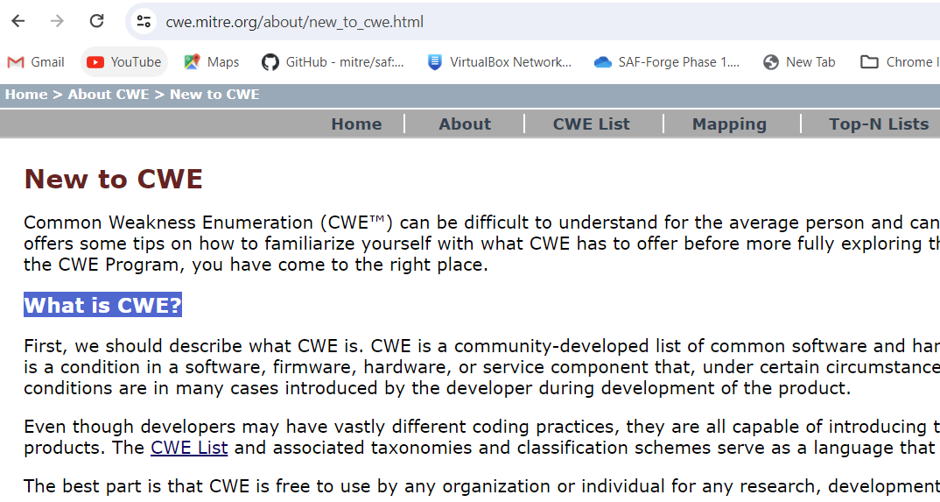
New to CWE – Additional Examples
The current New to CWE page has one example “CWE-798: Use of Hard-coded Credentials”
More examples are needed
Should be simple to understand to closely match the intended audience of the New to CWE page
Examples for consideration?
Might focus on 2023 Top 25 CWEs?
CWE-434: Unrestricted Upload of File with Dangerous Type
CWE-287: Improper Authentication
Others?

Slide 48
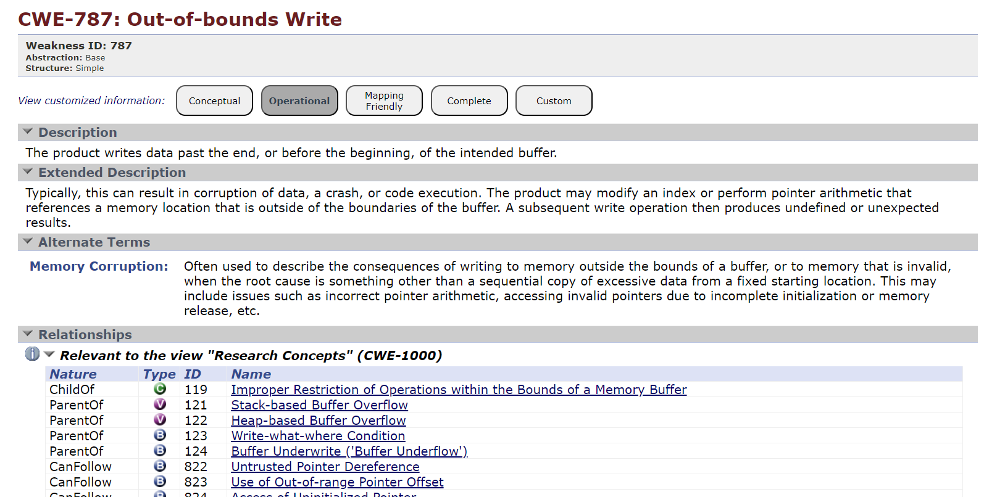
New to CWE – Additional Examples – Selection Criteria (Continued)
What CWE characteristics are important when determining the best examples for new CWE users?
Is the description easy to understand for a non-developer or industry expert?
Does it include good examples (demonstrative and observed)?
Is it a well-known/well-understood weakness?
Does it exist in the Top 25 list (now or previous years)?
Others?

Slide 49
New to CWE Series – Future Topics
The CWE team is considering developing additional documents as part of a “New to CWE” series
Keep them short so that new and casual users can read quickly
Each document would link to others in the series where appropriate
Topics for consideration?
Categorization - Views and Categories
How do I navigate the CWE corpus?
CWE Hierarchy - Pillars, Classes, Bases, and Variants
Others?

Slide 50
New to CWE Series – How to Navigate CWE
The CVE -> CWE Mapping Guidance exists on the website today
The Mapping Methodologies section of the guidance could be reused with some modification
Keyword search
Views
PDF Visualization
The goal is to create a “New to CWE: How to Navigate CWE” document that could be referenced by the current “New to CWE” page that exists today

Slide 51
CWE Element/Information Presentation – Mockup for New CWE Users

Slide 52
CWE Element/Information Presentation – Mockup for New CWE Users

Slide 53
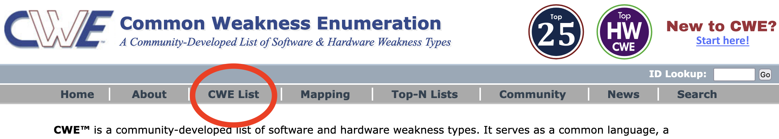
Grouping CWEs
CWE entries are currently “grouped” in different ways to provide useful subsets of the CWE corpus for different purposes:
Views: a subset of CWE entries that provides a way of examining CWE content. The two main view structures are Slices (flat lists) and Graphs (containing relationships between entries), examples include:
CWE-1194: Hardware Design
CWE-699: Software Development
CWE-1400: Comprehensive Categorization for Software Assurance Trends
CWE-1003: Weaknesses for Simplified Mapping of Published Vulnerabilities (NVD)
Categories: a CWE entry that contains a set of other entries that share a common characteristic. A category is not a weakness, but rather a structural item that helps users find weaknesses that share the stated common characteristic.
CWE-1199: General Circuit and Logic Design Concerns
~ Overall Hierarchy
CWE-1000: Research Concepts contains all CWE entries in one hierarchical structure

Slide 54
Grouping CWEs, cont.
What groupings are most useful to new or casual CWE users? Experienced users?
How can groupings be better presented/discovered/identified to the user?
Should new users be guided to groupings of CWEs for learning about CWE? (e.g., links in user stories)
Are there additional groupings that we are missing? Too many?

Slide 55
CSV Single Colon Separators Within Column Data
A double colon is used to separate csv fields/columns data, while a single colon is used to separate multi-value data within fields/columns
The Observed Examples field contains Reference and link data that includes a url in some cases (colon within “http://...”)
Should a note be added to the download data that warns the user of this, or should we look into an alternative separator?
Example taken from CWE - CWE-41: Improper Resolution of Path Equivalence (4.12) (mitre.org)
::REFERENCE:CVE-2000-1114:DESCRIPTION:Source code disclosure using trailing dot:LINK:https://www.cve.org/CVERecord?id=CVE-2000-1114::REFERENCE:CVE-2002-1986:DESCRIPTION:Source code disclosure using trailing

Slide 56
CWE User Pain Points
Pain point topics that the group is aware of or would like to discuss
For those on the call, what were your biggest questions or concerns when beginning to use CWE?
Are there common questions that CWE users have that are not covered in the current FAQ?
Other potential opportunities:
Features we could expand or improve to make CWE consumption easier?
Maybe engage the community in one or more ways to solicit this kind of feedback (see topic #3)
Other thoughts?

Slide 57
Community Engagement Strategy
Develop a strategy for engaging the CWE user community for feedback
What are the best methods to query the community on topics such as the pain points covered in topic #2
What communication methods should be employed?
E.g., polls, emails, web, social media
Should we target specific user types?
Other thoughts?

Slide 58
CWE Video Tips Series
Current video ideas:
How to search CWE for a weakness
How to display only the information that you need with presentation filters
What is a weakness (vs a vulnerability)
How are weaknesses organized
What is a category (how is it different than a pillar)
What are views
How and why to use the research view
Use cases for CWE (could user stories be used?)
How do I submit an idea for a new weakness
How can I improve the quality of existing weaknesses

Slide 59
New to CWE – Future Content
The New to CWE content audience is different from what has been catered to previously
The audience is the casual or new user to CWE or even the manager who makes security funding decisions
The team has previously drafted material for the New to CWE audience that covers the CWE hierarchy
Not yet released material
Do members agree that this topic should be covered for New to CWE?
Are there other topics that UEWG members feel strongly about or believe should be covered given the intended audience?
Should there be a close coupling of the topics covered here with the CWE Video Tips series?

Slide 60
CWE Naming and Vulnerability Mapping
Being thinking about solutions for common and well-known issues surrounding use of CWE names and how to more easily map vulnerabilities to CWEs
Current CWE structure is difficult to understand and use
Community needs better root cause information for vulnerabilities
Does CWE naming need a change or update to support easier mapping?
Remove CWE names for Views and/or Categories?
New naming that embeds a structure (e.g., CWE-1234-1)

