Slide 1
CWE/CAPEC User Experience Working Group
June 1, 2022

Slide 2
Agenda
Housekeeping
Primary topics
Definitions!
Harmonizing common terms across CWE/CAPEC (CVE?)
Review proposed definitions and consider initial feedback
Continue/Finalize persona definitions for publication
CWE v4.8 June 28
Reminders
Adjourn

Slide 3
UEWG: Reminders
Mission: Identifying areas where CWE/CAPEC content, rules, guidelines, and best practices must improve to better support stakeholder community, and work collaboratively to fix them
Periodic reporting of activities to CWE/CAPEC Board
(next quarterly Board meeting June 3)
Please solicit participations from your contacts
Contact: cwe@mitre.org & capec@mitre.org

Slide 4
Housekeeping
Welcome new CWE/CAPEC UEWG Co-Chair
Shadya Maldonado Rosado, Sandia National Labs
Community member co-chair
Take a more active role in such things as:
Plan meeting agendas, identify opportunities for discussion/action, drive working group activities, etc.
Help brief the CWE/CAPEC Board on UEWG activities

Slide 5
Topic
Definitions!
Harmonizing common terms across CWE/CAPEC (CVE?)
Alec Summers

Slide 6
CWE / CAPEC Terminology
Authoritative sources for cybersecurity terminology define terms differently – including CWE/CAPEC!
Vulnerability is defined three different ways between CVE, CWE, and CAPEC ☹
Vulnerability, Weakness, and Attack Patterns have multiple definitions across CISA, NIST, ISO Standards, etc.

Slide 7
Vulnerability

Slide 8
Weakness

Slide 9
Attack Pattern

Slide 10
Proposed Definitions
Term | Definition | Authority | Authorities Doc
Vulnerability | A flaw in a software, firmware, hardware, or service component resulting from a weakness that can be exploited, causing a negative impact to the confidentiality, integrity, or availability of an impacted component or components | CVE | website
Weakness | A type of mistake made during the implementation, design, or other phases of a product lifecycle that, under the right conditions, could contribute to the introduction of vulnerabilities in a range of products made by different vendors. | n/a | edited from def on CWE website
Attack Pattern | The common approach and attributes related to the exploitation of a known weakness type, usually in cyber-enabled capabilities | n/a | edited from def on CAPEC website

Slide 11
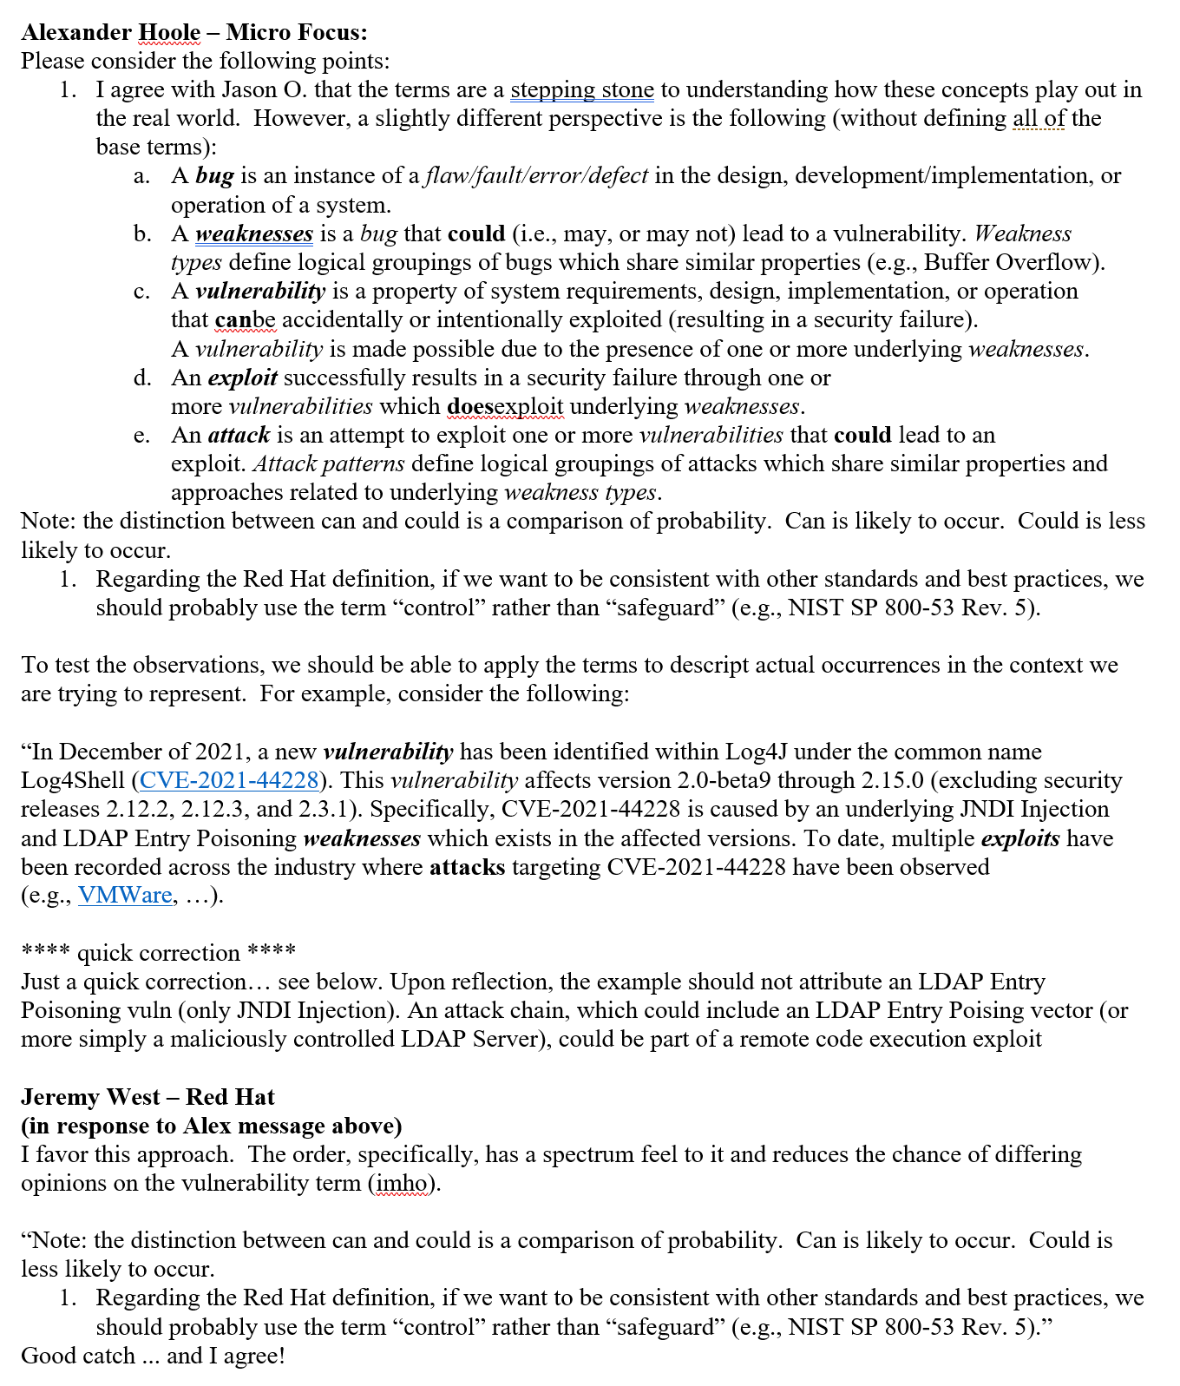
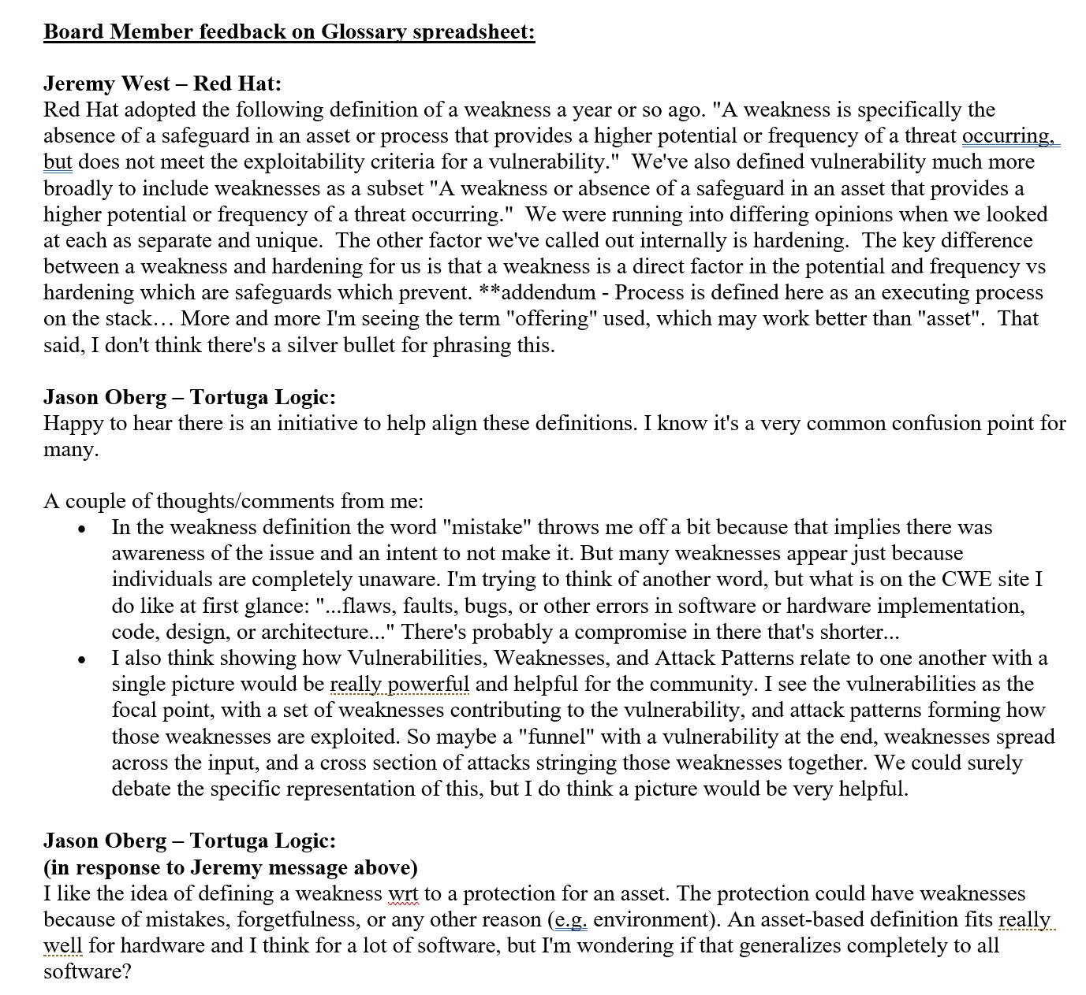
Board Member Feedback

Slide 12
Topic
Continuing the Discussion: User Personas and CWE/CAPEC User Experience
Alec Summers
CWE/CAPEC Deputy Project Lead

Slide 13
Personas: Next Steps
Formally define each user persona
Share with CWE/CAPEC Board
Once finalized, make public on our sites
Use that as a catalyst for modernizing presentation according to persona needs
“Development lifecycle”
Those who build systems: [DEFINE]
Those who use systems: [DEFINE]
Those who protect infrastructure around those systems: [DEFINE]
Educators: Teachers, professors, or certification programs that educate developers and system designers how to develop more secure code, design more secure products, and/or how to find vulnerabilities.
Technical Writers: Those who communicate advanced technical concepts as clearly, accurately, and comprehensively as possible to their intended audience (e.g., code analysis tool users or system designers)
Tool Developers: Developers of code scanning products, services, and other types of automated techniques for finding weaknesses and attacking systems, and reporting/educating on findings to users
Security Researchers/Analysts: Those who look for ways to attack a product by finding weaknesses using manual and/or automated techniques, then reporting the findings to the vendor and/or the general public (to include threat modeling, C-SCRM)
Incident Response Teams: Those responsible for preparation and reaction to any security event

Slide 14
“Two-Types” Model of CWE Presentation
Definitions are useful but may not introduce more unnecessary complexity
“Two-Types” Proposal by Premyslaw Roguski (Red Hat)
Theoretical: users who are more focused on the theoretical aspects of the weaknesses
Educators (teachers, professors, solution architects who design the systems' requirements)
Technical Writers (people responsible for security content, security blogs and articles)
Project and Program Managers who need some level of understanding about security and weaknesses
Technical: users who are managing the security issues and need more details about the nature of the weakness and how to prevent this from happening
Tool Developers, Security Researchers, Pen-testers, Incident Response Analysts

Slide 15
Proposed Data Elements for Each Group
Theoretical:
Description, Extended Description, Alternate Terms, Common Consequences
Technical:
Description, Extended Description, Alternate Terms, Modes of Introduction, Demonstrative Examples, Observed Examples, Potential Mitigations, Relationships
Risk Element
Complete filter presentation to remain as well
Thoughts?

Slide 16
Next Meeting – June 29 @ 12pm
PLEASE CONTACT WITH ANY QUESTIONS OR THOUGHTS
CWE@MITRE.ORG
CAPEC@MITRE.ORG

Slide 17
BACKUPS

Slide 18
Use Case Scenarios → Content Presentation
CAPEC Existing functionality to filter content detail
Basic, High-level, Mapping-friendly, Complete
CWE Content Filter
BASIC | HIGH-LEVEL | MAPPING | COMPLETE
Description | Description | Description | Description
Applicable_Platforms | View_Audience | View_Audience | View_Audience
Common_Consequences | Alternate_Terms | Alternate_Terms | Alternate_Terms
Likelihood_of_Exploit | Time_of_Introduction | Terminology_Notes | Terminology_Notes
Demonstrative_Examples | Common_Consequences | Relationships | Applicable_Platforms
Potential_Mitigations | Relationships | Relationship_Notes | Modes_of_Introduction
Relationships | Content_History | Theoretical_Notes | Common_Consequences
Content_History |  | Related_Attack_Patterns | Likelihood_of_Exploit
 |  | Content_History | Enabling_Factors_for_Exploitation
 |  |  | Detection_Methods
and more…

Slide 19
Use Case Scenarios → Content Presentation
CAPEC Existing functionality to filter content detail
Basic, Complete
CAPEC CONTENT
BASIC | COMPLETE
Description | Description
Relationships | Relationships
Memberships | Memberships
Execution_Flow | Execution_Flow
Prerequisites | Prerequisites
Mitigations | Mitigations
Related_Weaknesses | Likelihood_Of_Attack
 | Alternate_Terms
 | Typical_Severity
 | Skills_Required
 | Resources_Required
 | Indicators
 | Consequences
 | Example_Instances
 | Related_Weaknesses
 | Taxonomy_Mappings
 | References
 | Notes
 | Content_History

