Slide 1
CWE/CAPEC User Experience Working Group
April 6, 2022

Slide 2
Agenda
Housekeeping
Primary topics
Begin drafting formal definitions for CWE/CAPEC User Personas
CWE/CAPEC Content Fields
Responsive Actions after the CAPEC Community Summit
Reminders
Adjourn

Slide 3
UEWG: Reminders
Mission: Identifying areas where CWE/CAPEC content, rules, guidelines, and best practices must improve to better support stakeholder community, and work collaboratively to fix them
Periodic reporting of activities to CWE/CAPEC Board
Please solicit participations from your contacts
Contact: cwe@mitre.org & capec@mitre.org

Slide 4
Housekeeping
Monthly discussion has been informative
We would like more community ownership by UEWG members
Take a more active role
Help complete related tasks
Community member co-chair?
Be aware: new meeting series invite is coming
Forthcoming email to explain actions to take

Slide 5
Topic
User Personas: Drafting formal definitions
Alec Summers
CWE/CAPEC Deputy Project Lead

Slide 6
CWE/CAPEC Personas
User Persona List (UEWG)
System Security Engineer
OEM Software Developers
Risk Assessors
Audit / IV&V
Penetration Testers
Application/Product Security Engineer
Data Scientist
Technical Writer
Educator
Weakness Advocate
Tool Vendors
Assessment Customers
Software customers
Threat/Information Sharing Groups
- Those who:
Build systems
Use systems
Protect infrastructure around those systems
Educators
Technical Writers
Tool Developers
Security Researchers
Incident Response Teams

Slide 7
Personas: Next Steps
Formally define each user persona
Share with CWE/CAPEC Board
Once finalized, make public on our sites
Use that as a catalyst for modernizing presentation according to persona needs
“Development lifecycle”
Those who build systems: [DEFINE]
Those who use systems: [DEFINE]
Those who protect infrastructure around those systems: [DEFINE]
Educators: Teachers, professors, or certification programs that educate developers and system designers how to develop more secure code, design more secure products, and/or how to find vulnerabilities.
Technical Writers: Those who communicate advanced technical concepts as clearly, accurately, and comprehensively as possible to their intended audience (e.g., code analysis tool users or system designers)
Tool Developers: Developers of code scanning products, services, and other types of automated techniques for finding weaknesses and attacking systems
Security Researchers: Those who look for ways to attack a product by finding weaknesses using manual and/or automated techniques, then reporting the findings to the vendor and/or the general public
Incident Response Teams: Those responsible for the preparation and reaction to any security event

Slide 8
Topic
CAPEC Summit: Responsive Actions
Rich Piazza
CAPEC Task Lead

Slide 9
CAPEC Summit Informs Future Direction
Opportunities We Heard:
“Frameworks like CWE and CAPEC are significantly important for beginners in the cyber workforce.”
“CWE/CAPEC content ‘fields’ vary in importance by user persona”
“A CWE/CAPEC REST API would be a valuable resource for the community”
Responsive Action:
Develop a curriculum for using CAPEC/CWE in the classroom or training setting
Start with Pen Testing & Static Analysis
Support external PIs
Formally define personas & requirements
REST API
New working group launching!

Slide 10
CWE/CAPEC REST API Working Group
Launching imminently – first meeting being scheduled for early next week!
Activities:
1) Craft the RESTful API syntax and semantics which users will send to the CWE and CAPEC database web services;
2) Determine which content and syntax the databases will use to deliver content back to the users;
3) Determine if there are structures or content missing from these databases which would complete a link between this content and that required for tools and standards (such as the Accellera SA-EDI standard); and
4) List any structure or content missing from these databases that would help with further automation (such as versioning, etc.).
Attendance at virtual meetings, once a week, likely through the end of 2022.
At the end of this process, the Working Group will provide development and design support, and deliver a document and any other collateral that can be used by MITRE to craft the required infrastructure to support the RESTful API.
Please reply to cwe@mitre.org, capec@mitre.org if you are interested in actively participating in this effort.

Slide 11
Topic
Continued Discussion:
CWE/CAPEC ‘field’ importance findings
Rich Piazza
CAPEC Task Lead

Slide 12
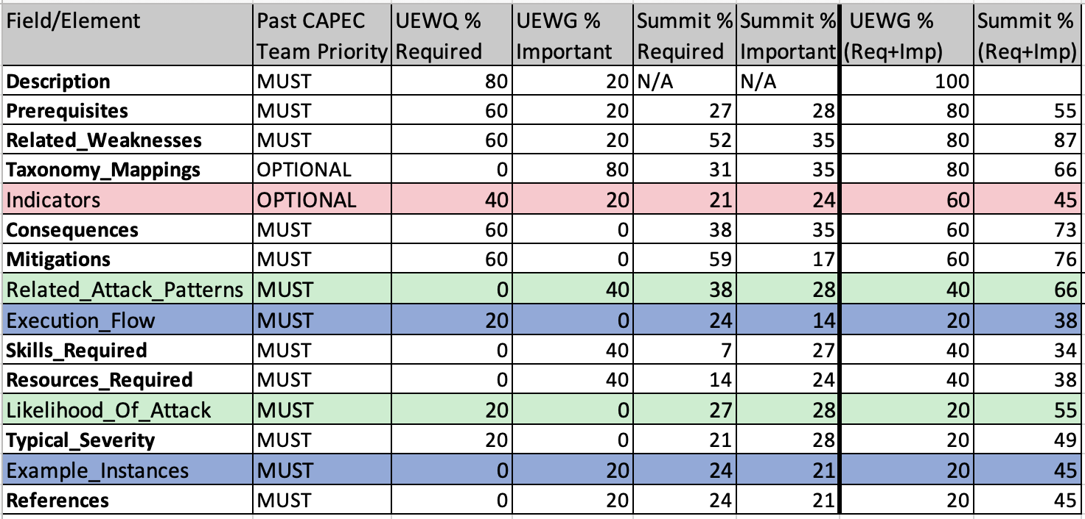
Field Importance Findings
Results relatively consistent
UEWG (over 50%) –
Prerequisites, Related_Weaknesses, Taxonomy_Mappings, Indicators, Consequences, Mitigations
Summit (over 50%)
Related_Weaknesses, Mitigations, Consequences, Taxonomy_Mappings, Related_Attack_Patterns, Prerequisites, Likelihood_Of_Attack
Execution Flows and Example Instances rated near the bottom
Execution Flows only important for pen testing use case
Why aren’t examples instances viewed as important?

Slide 13
Announcements and Reminders
CWE 4.7 Release – end of April
Status attribute will no longer be displayed in CWE or CAPEC web pages
Still included in XML data
Strictly for internal tracking
No schema or data changes planned until field completeness is finalized

Slide 14
Next Meeting – check your inbox soon ;-)
New meeting series invite coming!
PLEASE CONTACT WITH ANY QUESTIONS OR THOUGHTS
CWE@MITRE.ORG
CAPEC@MITRE.ORG

