Slide 1
CWE/CAPEC User Experience Working Group (UEWG)
Overview
Alec Summers, MITRE

Slide 2
Agenda
Welcome!
CWE/CAPEC User Experience Working Group
Goals, Intent, and Overview
Program Overview

Slide 3
Welcome!
Why are we here?
Action as a response to community feedback (e.g., “wall of text”, complicated and inconsistent taxonomies, inconsistent definitions, poor “look and feel”, difficult to apply
Idea:
Start a UEWG comprised of volunteer community stakeholders
Goal:
Identifying areas where CWE/CAPEC content, rules, guidelines, and best practices must improve to better support stakeholder persona use cases, and work collaboratively to fix them

Slide 4
UEWG: What to Expect (1 of 2)
Active discussion and collaborative engagement
Minimal time commitment outside of meetings
Ongoing membership expansion and activity
Potential for establishment of sub-groups for specific discussion and activity
Moderate Secretariat Services:
capturing general discussion and tracking of action items

Slide 5
UEWG: What to Expect
Schedule:
Bi-Weekly / Monthly Meetings
12:00 – 1:00 PM EST
Microsoft Teams
Periodic reporting of activities to CWE/CAPEC Board
Contact: cwe@mitre.org & capec@mitre.org
Questions?

Slide 6
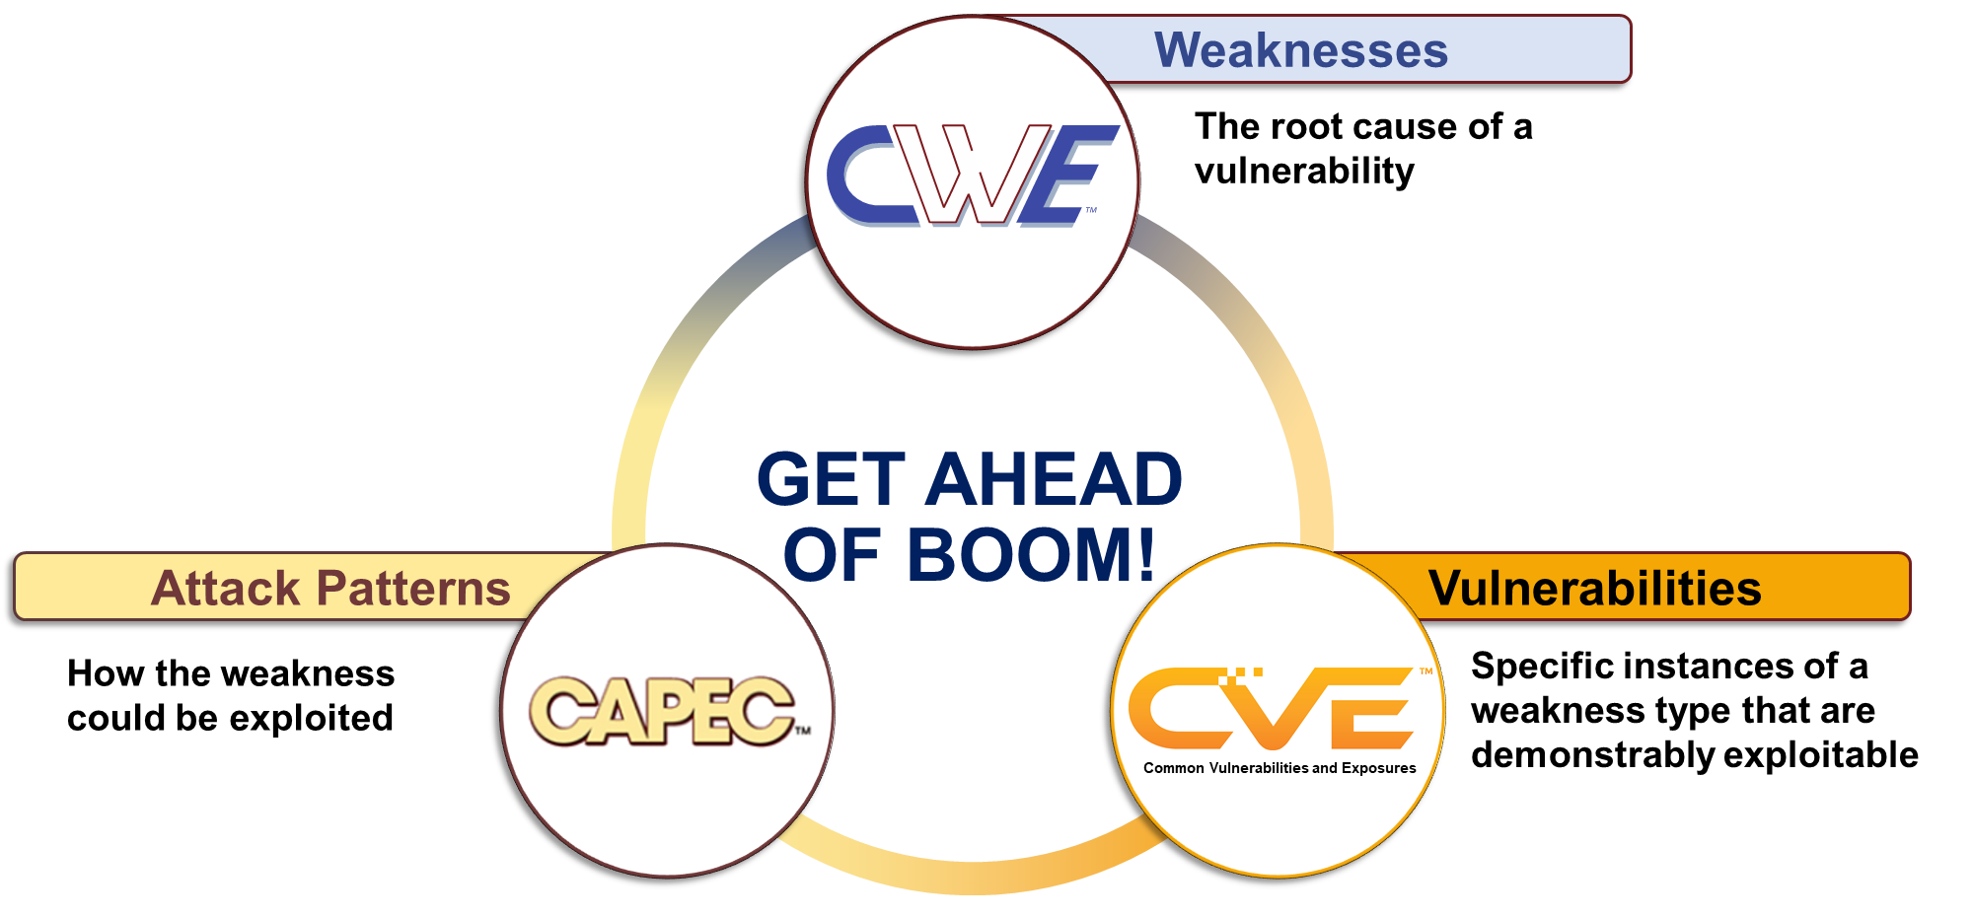
CVE/CWE/CAPEC Program(s) Overview

Slide 7
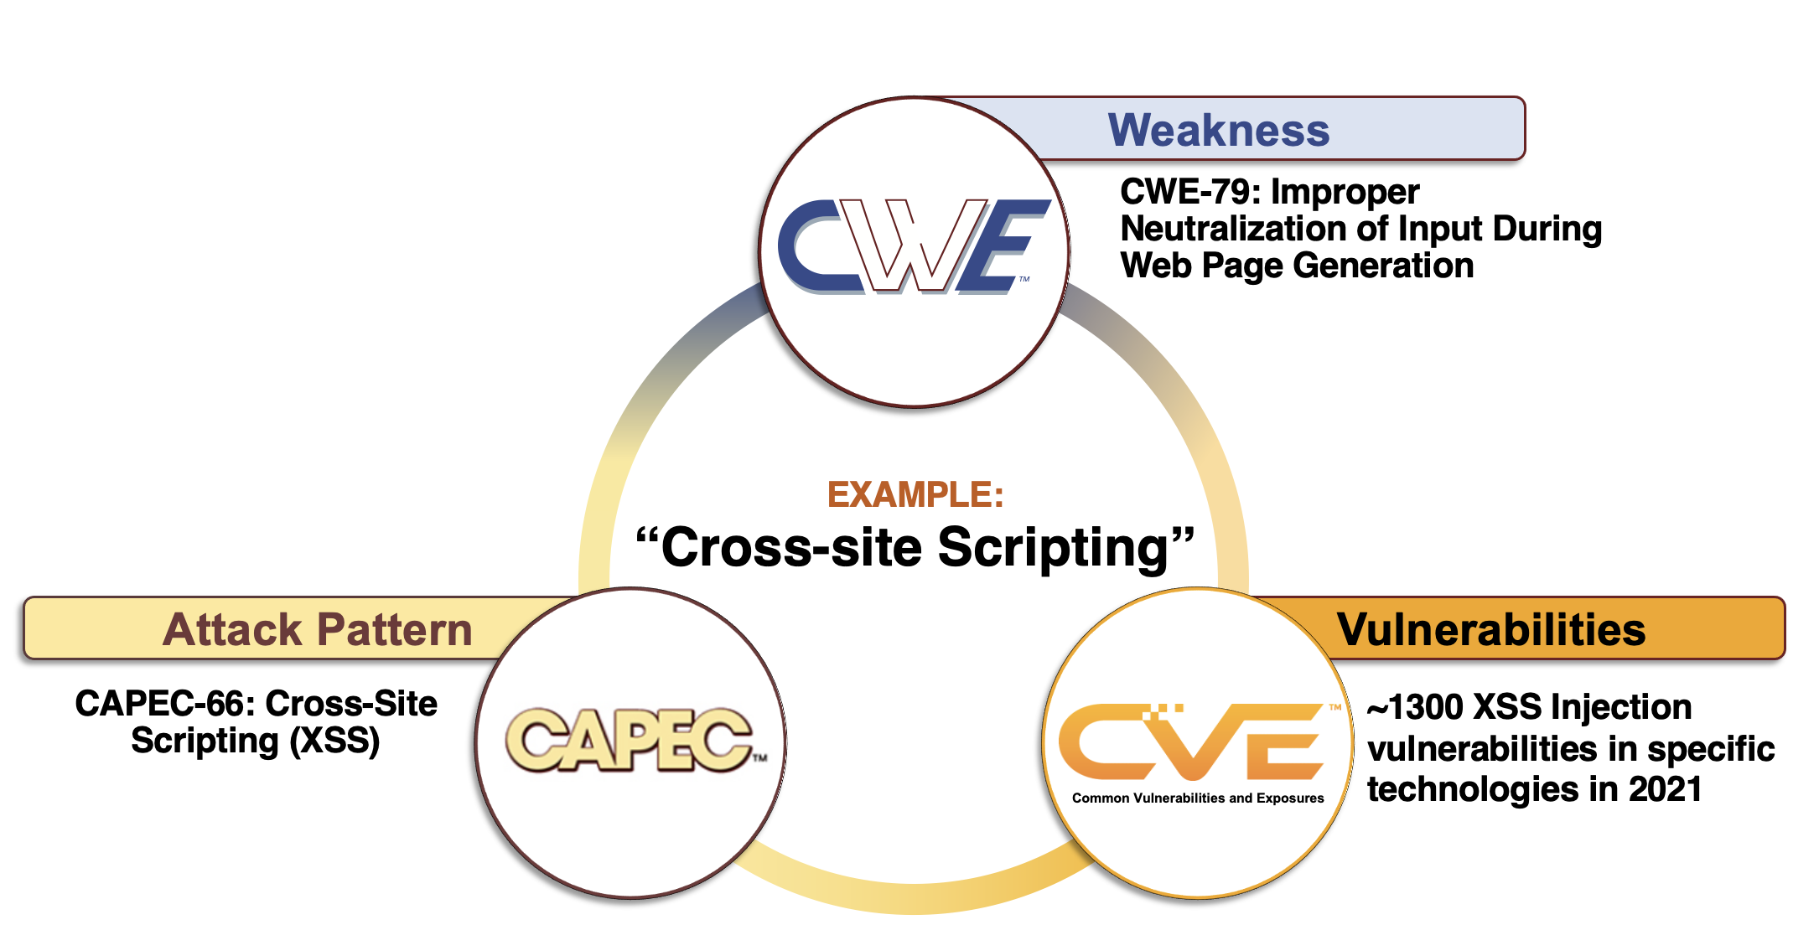
‘Get Ahead of Boom’ Landscape

Slide 8
Differentiating CAPEC and MITRE ATT&CK
MITRE manages both CAPEC and ATT&CK, although both are community-based programs
Both curate cyber-attack knowledge, but from different points of view
CAPEC details how an adversary can exploit a weakness, (e.g., a CWE)
ATT&CK is more oriented towards understanding known attack techniques “from the wild” to detect/prevent adversary actions
CAPEC aimed at “getting ahead of boom” – avoiding the weaknesses in the first place before they can be exploited
MITRE provides a partial mapping between the entries in each corpus
The mapping is partial because many ATT&CK techniques are not related to a weakness, just malicious use of a common application or utility.

Slide 9
Contact
PLEASE CONTACT WITH ANY QUESTIONS OR THOUGHTS
CWE@MITRE.ORG
CAPEC@MITRE.ORG

