Slide 1
CWE User Experience Working Group Meeting
October 25, 2023

Slide 2
Agenda
This meeting is being recorded :-)
Purpose
Housekeeping
Primary topics
Red Hat CWE Blog (Co-chair presentation)
Technical Weaknesses (Member presentation)
Open Discussion
Reminders and Adjourn

Slide 3
UEWG: Purpose
Mission: Identifying areas where CWE content, rules, guidelines, and best practices must improve to better support stakeholder community, and work collaboratively to fix them
Periodic reporting of activities to CWE Board
(next quarterly Board meeting TBD Q4-2023)
Please solicit participations from your contacts
Contact: cwe@mitre.org & capec@mitre.org

Slide 4
Housekeeping
CWE UEWG Meeting frequency
Meetings have been changed and are now set to occur on the last Wednesday of the month
The CWE Program is continuously seeking feedback on UEWG activities and priorities during these sessions or via email: cwe@mitre.org

Slide 5
Topic 1
Red Hat CWE Blog
Co-chair - Przemyslaw Roguski

Slide 6
Red Hat’s CWE journey
CWE/CAPEC User Experience Working Group
Przemysław Roguski

Slide 7
Red Hat’s CWE journey
What prompted Red Hat to publish the “Red Hat’s CWE journey” and “Weakness risk-patterns: A Red Hat way to identify poor software practices in the secure development lifecycle” blog posts?
Limited knowledge of how the CWE program can be used in a daily security work
Lack of the weakness understanding
Weakness vs Vulnerability frequent misunderstanding

Slide 8
Red Hat’s CWE journey
Red Hat’s CWE beginning and recent changes in the Red Hat CWE approach:
Red Hat attained CWE compatibility at the end of 2012
Custom grouping was used until 2022
From the beginning of 2022, Red Hat's default CWE coverage has been based on the CWE-699 Software Development view

Slide 9
Reactive and proactive CWE usage
Reactive and proactive CWE usage:
More efficiently described the nature of vulnerabilities affecting Red Hat products
Better, more accurate weakness monitoring
More useful weakness analysis and statistics
CWE classifications used in Secure Development Lifecycle (SDL)
Threat Models
Static Application Security Testing (SAST)
Penetration Testing

Slide 10
CWE usage challenges
Always something can be done better:
CWE assignment to CVE improvements
RCM working group
Repeated weaknesses in software

Slide 11
Resources:
https://www.redhat.com/en/blog/red-hat-cwe-journey
https://www.redhat.com/en/blog/weakness-risk-patterns

Slide 12
Topic 2
Technical Weaknesses
UEWG Member - John Keane

Slide 13
Why Software Security Is Not Different from Software Quality
John J Keane Jr
jkeanejr@aol.com

Slide 14
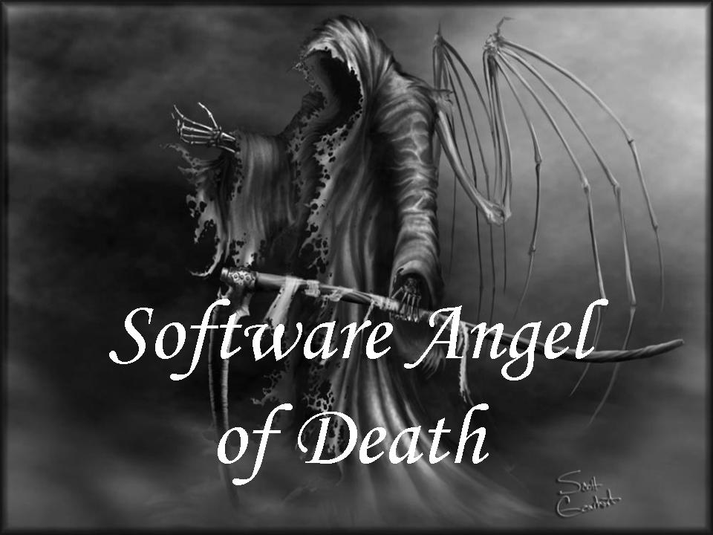
A Presentation by
The

Slide 15
OWASP Application Security Verification Standard 4.0.3
Financial regulators do not tolerate external financial audits with no access to the books, sample
transactions, or the people performing the controls. Industry and governments must demand the same
standard of transparency in the software engineering field.
We strongly encourage the use of security tools within the development process itself. DAST and SAST tools
can be used continuously by the build pipeline to find easy to find security issues THAT SHOULD NEVER BE
PRESENT.

Slide 16
OWASP Mobile Application Security Verification Standard 2.0.0
MASVS-CODE: Code Quality
Mobile apps have many data entry points, including the UI, IPC, network, and file system, which might receive data that has been inadvertently modified by untrusted actors.
By treating this data as untrusted input and properly verifying and sanitizing it before use, developers can prevent classical injection attacks, such as SQL injection, XSS, or insecure deserialization. However, other common coding vulnerabilities, such as memory corruption flaws, are hard to detect in penetration testing but easy to prevent with secure architecture and coding practices.
Developers should follow best practices such as the OWASP Software Assurance Maturity Model (SAMM) and NIST.SP.800-218 Secure Software Development Framework (SSDF) to avoid introducing these flaws in the first place.
This category covers coding vulnerabilities that arise from external sources such as app data entry points, the OS, and third-party software components. Developers should verify and sanitize all incoming data toprevent injection attacks and bypass of security checks. They should also enforce app updates and ensure that the app runs up-to-date platforms to protect users from known vulnerabilities.

Slide 17
But First A Trip To The Dark Ages of Computing
Buffer Overflows were understood and partially publicly documented as early as 1972
Computer Security Technology Planning Study laid out the technique:
The code performing this function does not check the source and destination addresses properly, permitting portions of the monitor (Kernel) to be overlaid by the user. This can be used to inject code into the monitor (kernel) that will permit the user to seize control of the machine.
Actively discussed during Graduate Studies
Focus on Performance Only
Not recognized as potential SECURITY issue at that time
The earliest documented hostile exploitation of a buffer overflow was in 1988.
It was one of several exploits used by the Morris worm to propagate itself over the Internet.

Slide 18
2016
MITRE Translates Software Quality Issues into a Common Language | The MITRE Corporation
https://www.electronicdesign.com/industrial-automation/article/21805867/whats-the-difference-between-cwe-and-cqe.
MITRE's John Marien notes, “The Common Weakness Enumeration (CWE) lists quality issues that can be exploited. One or more weaknesses can create a vulnerability. Yet beyond these security-relevant weaknesses, there's a large set of quality issues not covered by CWE.”

Slide 19
Private Conversation With John Marien
In 2016, 60% of Security Weaknesses were directly attributable to Quality Weaknesses
In 2022, it appears that is now 85%

Slide 20
What Else Happened In 2016?
Publication of “Software Quality Assurance”
Reliability is an important prerequisite to software security. It is hard to conceive of a secure system that is unreliable, but easy to think of a reliable system that may be unsecure….
Security must be a quality concern for software engineers building any software system that manages stakeholder resources, including intellectual property and identity information.
Software Security - an overview | ScienceDirect Topics

Slide 21
Using FORTIFY Taxonomy-2019
https://vulncat.fortify.com/en
Searched On
Availability – 74 Weaknesses
Reliability – 77 Weaknesses
Safety – 62 Weaknesses
Maintainability – 31 Weaknesses
Performance – 175 Weaknesses
Bad Practices – 138 Weaknesses
Supportability – 46 Weaknesses
Dependability – 91 Weaknesses
Created Separate Worksheet for Each Technical Weakness
442 Unique Weaknesses
Mapped to Related Security Weakness
694 Total Weaknesses
276 Security Weaknesses Mapped to 1 Technical Weakness
XSLT Injection Mapped To Performance
166 Security Weaknesses Mapped From 2 to 5 Weaknesses
Unsafe Reflection Maps to Safety, Reliability, Performance, Bad Practice and Dependability

Slide 22
SAFETY
Buffer Overflow |  | Integer Overflow |  | Race Condition: App Download
Buffer Overflow: Format String |  | JSON Path Manipulation |  | Race Condition: File System Access
Buffer Overflow: Format String (%f/%F) |  | LDAP Injection |  | Race Condition: Signal Handling
Buffer Overflow: Off-by-One |  | LDAP Manipulation |  | Resource Injection
Buffer Overflow: Signed Comparison |  | Log Forging |  | Setting Manipulation
Code Correctness: Arithmetic Operation on Boolean |  | Log Forging (debug) |  | SQL Injection
Code Correctness: Erroneous Synchronization |  | Memory Leak |  | SQL Injection: Poor Validation
Code Correctness: Memory Free on Stack Variable |  | Memory Leak: Reallocation |  | String Termination Error
Code Correctness: Premature Thread Termination |  | NoSQL Injection: DynamoDB |  | Type Mismatch: Integer to Character
Command Injection |  | NoSQL Injection: MongoDB |  | Type Mismatch: Negative to Unsigned
Dangerous Function |  | Null Dereference |  | Type Mismatch: Signed to Unsigned
Dangerous Function: strcpy() |  | Often Misused: Exception Handling |  | Unchecked Return Value
Dead Code |  | Often Misused: Strings |  | Undefined Behavior
Dead Code: Expression is Always false |  | Out-of-Bounds Read |  | Uninitialized Variable
Dead Code: Expression is Always true |  | Out-of-Bounds Read: Off-by-One |  | Unreleased Resource
Denial of Service |  | Out-of-Bounds Read: Signed Comparison |  | Unreleased Resource: Synchronization
Double Free |  | Path Manipulation |  | Unsafe Reflection
Format String |  | Path Manipulation: Base Path Overwriting |  | Use After Free
Format String: Argument Number Mismatch |  | Poor Style: Variable Never Used |  | XML External Entity Injection
Format String: Argument Type Mismatch |  | Process Control |  | XML Injection
Illegal Pointer Value |  |  |  | XPath Injection

Slide 23
AVAILABILITY
Access Control: Database |  | Insecure Storage: Insufficient Keychain Protection |  | Privacy Violation: iOS Property List
ASP.NET Misconfiguration: Persistent Authentication |  | Insecure Storage: Lacking Data Protection |  | Privacy Violation: Keyboard Caching
Axis Misconfiguration: Service Enumeration |  | Insecure Storage: Lacking Keychain Protection |  | Privacy Violation: Screen Caching
Biometric Authentication: Insufficient Touch ID Protection |  | Insecure Storage: Passcode Policy Unenforced |  | Process Control
Cache Management: Headers |  | Insecure Storage: Unspecified Keychain Access Policy |  | Process Control: Invoker Servlet
Cache Management: Insecure Policy |  | Insecure Transport: Secure Section Access Not SSL-Enabled |  | Race Condition: Roaming Data Access
Cache Management: Language |  | J2EE Bad Practices: Sockets |  | Server-Side Script Injection
Cache Management: User-Agent |  | J2EE Misconfiguration: Insufficient Session ID Length |  | Server-Side Template Injection
Credential Management: Hardcoded Username |  | Key Management: Empty Encryption Key |  | SQL Injection
Cross-Session Contamination |  | Key Management: Empty PBE Password |  | System Field Overwrite
Cross-Site Scripting: Inter-Component Communication |  | Key Management: Hardcoded Encryption Key |  | System Information Leak: Struts 2
Cross-Site Scripting: Inter-Component Communication (Cloud) |  | Key Management: Hardcoded PBE Password |  | Unchecked Return Value
Cross-Site Scripting: Persistent |  | Key Management: Null Encryption Key |  | Unreleased Resource
Cross-Site Scripting: Poor Validation |  | Key Management: Null PBE Password |  | Unreleased Resource: Android SQLite Database
Cross-Site Scripting: Reflected |  | Object Injection |  | Unreleased Resource: Database
Database Bad Practices: Use of Restricted Accounts |  | Obsolete |  | Unreleased Resource: Files
Dead Code: Unused Parameter |  | Obsolete: Deprecated by ESAPI |  | Unreleased Resource: Streams
Dynamic Code Evaluation: Unsafe Deserialization |  | Password Management |  | Unreleased Resource: Unmanaged Object
Expression Language Injection |  | Password Management: Empty Password |  | Unsafe JNI
HTML5: CORS Functionality Abuse |  | Password Management: Hardcoded Password |  | Unsafe Native Invoke
HTML5: CORS Prolonged Caching of Preflight Response |  | Password Management: Password in Comment |  | User or System Dependent Program Flow
HTML5: CORS Unsafe Methods Allowed |  | PCI Privacy Violation |  | Weak Cryptographic Hash
Insecure Deployment: Unpatched Application |  | Privacy Violation |  | Weak Encryption
Insecure Storage: Externally Available Keychain |  | Privacy Violation: Android Internal Storage |  | Web Server Misconfiguration: Weak Authentication

Slide 24
One BIG Surprise From FORTIFY Taxonomy
The Spreadsheet Showed Significant Overlap Between Safety (MISRA) and Availability
More Availability Than Safety
Safety and Availability Worksheets Color-coded
Data Transferred to New Worksheet and Stacked with Availability on Top
Data Sorted Alphabetically and then with Duplicates Removed.
NO Safety Findings Remained
Safety is a subset of Availability
No Debate as to whether MISRA is a “Security” standard
Answered Concern Expressed By Senior Executive

Slide 25
BIGGER SURPRISES
Automated tools and online scans are unable to complete more than half of the ASVS without human
assistance. If comprehensive test automation for each build is required, then a combination of custom
unit and integration tests, along with build initiated online scans are used. Business logic flaws and
access control testing is only possible using human assistance. These should be turned into unit and
integration tests. OWASP Application Security Verification Standard 4.0.3
DoD Cybersecurity Test and Evaluation Guidebook Starting on page 16, Section 3.7.1.1
“RMF A&A is necessary but not sufficient to ensure that a system can operate in a cyber-contested
environment…it does not test how well the sescurity capabilities in an integrated aspect work in the
presence during mission execution.”

Slide 26
The Bottom Line
Fixing Technical Weaknesses Provides Direct Benefit To The Security of The Code
There is Enough Publicly Available Information To Support The Premise That Software Security
Is Not Much Different From Software
Quality

Slide 27
BACKUP

Slide 28
Specific Example
Legacy Electronic Health Record (AHLTA)
Poor Response Time Resulting In Bad User Experience
Multiple Transactions Failing to Meet Key Performance Parameters
Security Weaknesses (CAT 1) uncorrected from earlier pilot
Contract to
Meet or Exceed KPPs
Fix All Cat 1s and Introduce No New Ones
CAST and Fortify Baseline Scans Provided From My IV&V Team
Extensive Early Meetings To Decompose CAST Results

Slide 29
STEP 1
Very Early Use of CAST – 2014
Calculate the Percentage of Violations Against The Total Number of Rules Assessed
1392970 Rules Assessed
80638 Violations
5.7%
Calculate The Number of Clean Rules
145 Distinct Rules
10 Rules with 1 Finding
Later Scans Had Several Rules With 0 Findings

Slide 30
STEP 2 Health Factors Example
Criterion | Total KO (Failures)
Architectural Design | 3725
Changeability | 10204
Documentation | 23084
Performance | 285
Programming Practices | 5636
Robustness | 6462
Security | 1381
Technical Quality Index | 32752
Transferability | 27498

Slide 31
Step 2 Continued
Color Code Health Factors in Spreadsheet
Security Always RED
Rack and Stack With Security On The Bottom Of The Stack
SORT Alphabetically And Observe Duplicate Entries
SORT Again To Remove Duplicates
Except for 2 Encryption Findings In One Project, Security (Red) Disappeared In Every Report

Slide 32
SECURITY
Avoid using Inner Classes | 258 |  | Avoid using 'System.printStackTrace()' within a try catch block | 7 |  | Avoid using native Methods (JNI) | 0
Avoid using fields (non Static final) from other Classes | 182 |  | Avoid using 'System.printStackTrace()' outside a try catch block | 6 |  | Use only Hibernate API to access to the database | 0
Avoid declaring and throwing an exception and not throwing it | 130 |  | Avoid missing default in switch statements | 5 |  | Avoid direct Class inheritance from java.lang.Throwable | 0
Avoid declaring Instance Variables without defined access type | 112 |  | Avoid using Hashtable | 4 |  | Avoid using finalize() | 0
Avoid public/protected setter for the generated identifier field | 88 |  | Avoid using Vector | 4 |  | Collection-typed attributes getter must be defined with the correct interface | 0
Avoid catching an exception of type Exception, RuntimeException, or Throwable | 66 |  | Avoid to use this within constructor in multi-thread environment | 3 |  | Never exit a finally block with a return, break, continue, or throw | 0
Declare as Static all methods not using instance fields | 63 |  | Avoid empty finally blocks | 3 |  | Track Classes referencing database objects | 0
Avoid using references to the id in the persistent class's method equals() | 62 |  | Avoid to use Log.debug() without calling Log.isDebugEnabled() | 3 |  | Avoid many-to-many association | 0
Avoid large number of String concatenation | 57 |  | Persistent classes should Implement hashCode() and equals() | 2 |  | Avoid catch blocks with assertion | 0
Avoid non serializable Entities | 54 |  | Avoid cyclical calls and inheritances between packages | 2 |  | Avoid String initialization with String object (created using the 'new' keyword) | 0
Avoid declaring Inner Classes | 53 |  | Avoid directly instantiating a class used as a Spring bean | 2 |  | Avoid using 'java.lang.Runtime.exec()' | 0
Avoid instanceof in methods that override or implement Object.equals(), Comparable.compareTo() | 45 |  | Avoid thread creation for application running on application server | 2 |  | Avoid table and column names that are too long (portability) | 0
Avoid throwing an exception in a catch block without chaining it | 45 |  | Avoid double checked locking | 2 |  | Avoid using 'java.lang.System.getenv()' | 0
All types of a serializable class must be serializable | 42 |  | The exception Exception should never been thrown. Always Subclass Exception and throw the Subclassed Classes. | 2 |  | Avoid using 'System.gc' | 0
Avoid fields in servlet classes that are not final static | 16 |  | Avoid using 'java.lang.Error' | 2 |  | Avoid using DriverManager | 0
Avoid using deprecated objects | 12 |  | Avoid using 'sun.*' Classes | 2 |  | Avoid Classes with a High Public Data Ratio | 0
Avoid declaring Non Final Class Variables with Public or Package access type | 11 |  | Avoid using incorrect XML parsing model | 2 |  | Avoid using 'java.System.exit()' | 0
Persistent class method's equals() and hashCode() must access its fields through getter methods | 10 |  | Avoid non thread safe singleton | 1 |  | Avoid instantiating Boolean | 0
Avoid declaring Final Instance Variables that are not dynamically initialized | 7 |  | Avoid empty catch blocks | 0 |  | Avoid too many packages referencing Mainframe | 0
Avoid static field of type collection | 7 |  | Pages should use error handling page | 0 |  | Avoid using 'System.err' and 'System.out' outside a try catch block | 0
Avoid using 'java.io.File' | 7 |  | Avoid database tables associated to more than one Entity | 0 |  | Avoid using 'System.err' and 'System.out' within a try catch block | 0

Slide 33
PERFORMANCE
Avoid instantiations inside loops | 72 |  | Avoid String concatenation in loops | 1
Declare as Static all methods not using instance fields | 63 |  | Avoid Artifacts with a Complex SELECT Clause | 1
Avoid large number of String concatenation | 57 |  | Use lazy fetching for collection | 0
Avoid indirect String concatenation inside loops | 28 |  | Avoid using SQL queries inside a loop | 0
Avoid the use of InstanceOf inside loops | 20 |  | Avoid Artifacts with Group By | 0
Avoid method invocation in a loop termination expression | 13 |  | Avoid Artifacts with High Depth of Nested Subqueries | 0
Avoid static field of type collection | 7 |  | Avoid select-before-update when the table is not associated to an UPDATE trigger | 0
Avoid using Dynamic instantiation | 4 |  | Never use array to map a collection | 0
Avoid using Hashtable | 4 |  | Avoid SELECT *" queries" | 0
Avoid using Vector | 4 |  | Avoid using finalize() | 0
Avoid direct or indirect remote calls inside a loop | 3 |  | Collection must be the same between getter and setter | 0
Avoid to use Log.debug() without calling Log.isDebugEnabled() | 3 |  | Avoid Artifacts with High RAW SQL Complexity | 0
Avoid using incorrect XML parsing model | 2 |  | Avoid String initialization with String object (created using the 'new' keyword) | 0
Avoid Artifacts with queries on more than 4 Tables | 1 |  | Avoid using 'System.gc' | 0
Avoid Artifacts with SQL statement including subqueries | 1 |  | Avoid using DriverManager | 0
Prefer UNION ALL to UNION | 1 |  | Avoid instantiating Boolean | 0

Slide 34
Accomplishments
CAST Results Used To Prioritize Technical Work
FORTIFY Used To Identify CAT I Issues
At End of 1 Year POP:
All Prior Cat 1 Weaknesses Corrected and No New Ones Introduced
All KPPs met or exceeded in test lab.
Limitations
Could Not Fix The Serious Internal Architecture Flaws
Not Enough Time Nor Money To Fix Everything Else In One Year

Slide 35
Topic 3
Open Discussion
Chris Coffin

Slide 36
Miscellaneous Topics
Other thoughts or topics?

Slide 37
Next Meeting – November 29 @ 12pm
PLEASE CONTACT WITH ANY QUESTIONS OR THOUGHTS
CWE@MITRE.ORG

Slide 38
Backups

Slide 39
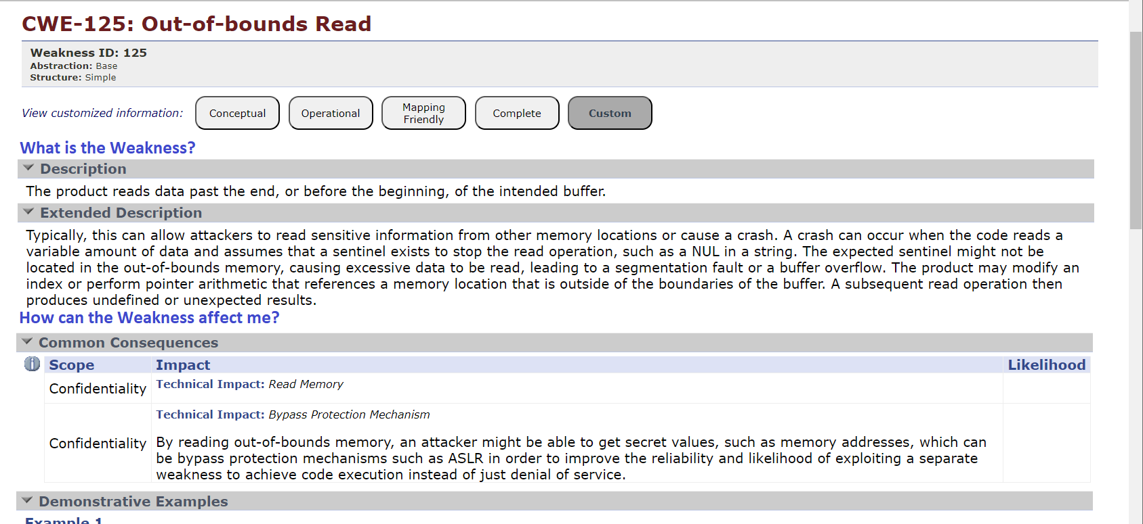
CWE Element/Information Presentation – Mockup for New CWE Users

Slide 40
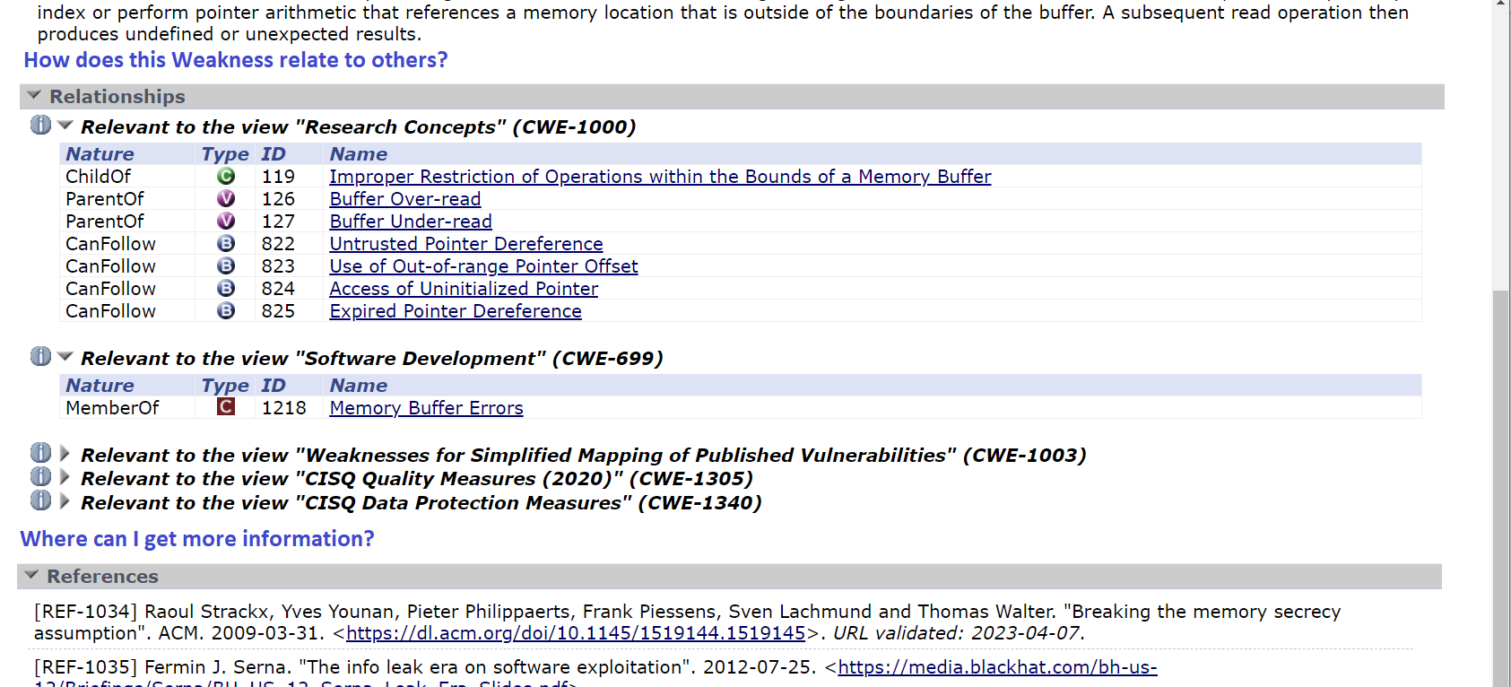
CWE Element/Information Presentation – Mockup for New CWE Users

Slide 41
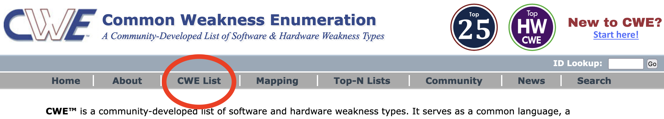
Grouping CWEs
CWE entries are currently “grouped” in different ways to provide useful subsets of the CWE corpus for different purposes:
Views: a subset of CWE entries that provides a way of examining CWE content. The two main view structures are Slices (flat lists) and Graphs (containing relationships between entries), examples include:
CWE-1194: Hardware Design
CWE-699: Software Development
CWE-1400: Comprehensive Categorization for Software Assurance Trends
CWE-1003: Weaknesses for Simplified Mapping of Published Vulnerabilities (NVD)
Categories: a CWE entry that contains a set of other entries that share a common characteristic. A category is not a weakness, but rather a structural item that helps users find weaknesses that share the stated common characteristic.
CWE-1199: General Circuit and Logic Design Concerns
~ Overall Hierarchy
CWE-1000: Research Concepts contains all CWE entries in one hierarchical structure

Slide 42
Grouping CWEs, cont.
What groupings are most useful to new or casual CWE users? Experienced users?
How can groupings be better presented/discovered/identified to the user?
Should new users be guided to groupings of CWEs for learning about CWE? (e.g., links in user stories)
Are there additional groupings that we are missing? Too many?

Slide 43
CSV Single Colon Separators Within Column Data
A double colon is used to separate csv fields/columns data, while a single colon is used to separate multi-value data within fields/columns
The Observed Examples field contains Reference and link data that includes a url in some cases (colon within “http://...”)
Should a note be added to the download data that warns the user of this, or should we look into an alternative separator?
Example taken from CWE - CWE-41: Improper Resolution of Path Equivalence (4.12) (mitre.org)
::REFERENCE:CVE-2000-1114:DESCRIPTION:Source code disclosure using trailing dot:LINK:https://www.cve.org/CVERecord?id=CVE-2000-1114::REFERENCE:CVE-2002-1986:DESCRIPTION:Source code disclosure using trailing

Slide 44
CWE User Pain Points
Pain point topics that the group is aware of or would like to discuss
For those on the call, what were your biggest questions or concerns when beginning to use CWE?
Are there common questions that CWE users have that are not covered in the current FAQ?
Other potential opportunities:
Features we could expand or improve to make CWE consumption easier?
Maybe engage the community in one or more ways to solicit this kind of feedback (see topic #3)
Other thoughts?

Slide 45
Community Engagement Strategy
Develop a strategy for engaging the CWE user community for feedback
What are the best methods to query the community on topics such as the pain points covered in topic #2
What communication methods should be employed?
E.g., polls, emails, web, social media
Should we target specific user types?
Other thoughts?

Slide 46
CWE Video Tips Series
Current video ideas:
How to search CWE for a weakness
How to display only the information that you need with presentation filters
What is a weakness (vs a vulnerability)
How are weaknesses organized
What is a category (how is it different than a pillar)
What are views
How and why to use the research view
Use cases for CWE (could user stories be used?)
How do I submit an idea for a new weakness
How can I improve the quality of existing weaknesses

Slide 47
New to CWE – Future Content
The New to CWE content audience is different from what has been catered to previously
The audience is the casual or new user to CWE or even the manager who makes security funding decisions
The team has previously drafted material for the New to CWE audience that covers the CWE hierarchy
Not yet released material
Do members agree that this topic should be covered for New to CWE?
Are there other topics that UEWG members feel strongly about or believe should be covered given the intended audience?
Should there be a close coupling of the topics covered here with the CWE Video Tips series?

Slide 48
CWE Naming and Vulnerability Mapping
Being thinking about solutions for common and well-known issues surrounding use of CWE names and how to more easily map vulnerabilities to CWEs
Current CWE structure is difficult to understand and use
Community needs better root cause information for vulnerabilities
Does CWE naming need a change or update to support easier mapping?
Remove CWE names for Views and/or Categories?
New naming that embeds a structure (e.g., CWE-1234-1)

