Slide 1
Hardware CWE™ Special Interest Group (SIG)
Gananand Kini, Bob Heinemann, Gage Hackford, Steve Christey Coley, Alec Summers
MITRE
February 9, 2024

Slide 2
Agenda
REMINDER: This meeting is being recorded.
1 | µArchitecture Weaknesses Updates | Bob H | 10
2 | Mitigations and Detection methods in CWE | Bob H | 20
3 | OBEX Working Group Formation | Bob H | 20
4 | Any Other Business (AOB)

Slide 3
Housekeeping
Schedule:
Next Meeting: March 8
12:30 – 1:30 PM EST (16:30 – 17:30 UTC)
Microsoft Teams
Contact: cwe@mitre.org
Mailing List: hw-cwe-special-interest-group-sig-list@mitre.org
Minutes from previous meetings available on our GitHub site:
https://github.com/CWE-CAPEC/hw-cwe-sig

Slide 4
Announcements
CWE Content Development Repository (CDR) pilot now on GitHub! Currently invite only. Potential public release in early 2024.
CWE 4.14 Release Planned for February 29.
DEMOX’s and Microarchitectural Weaknesses have been a priority for this release.
CWE 4.15 release will be around June/July
Expect a new meeting series

Slide 5
Farewells
Transitioning from MITRE.
Hope to participate in the SIG as a member.
Please contact Bob Heinemann, Steve Christey or cwe@mitre.org for any issues related to Hardware CWE.

Slide 6
Microarchitectural Weaknesses Update

Slide 7
Microarchitectural Weaknesses Update
Working group met on Monday, January 22nd.
Group approves to move forward with current submissions (4 total)
On track to be released for 4.14 (Feb 29)
Intel, Cycuity, and MITRE plan to coordinate announcing µArchitectural Weaknesses.
Some work to continue into 4.15 for WG
Path forward on CWE-1342: Information Exposure through Microarchitectural State after Transient Execution
Define what is meant by Architectural and Microarchitecture to clarify readers not familiar
Minor change in some of the language from ARM
Other minor quality updates

Slide 8
Microarchitectural Weaknesses Update
4 new submissions being worked
CWE-1420 (CWE A): Exposure of Sensitive Information during Transient Execution
CWE-1421 (CWE-B): Exposure of Sensitive Information in Shared Microarchitectural Structures during Transient Execution
CWE-1422 (CWE-C): Exposure of Sensitive Information caused by Incorrect Data Forwarding during Transient Execution
CWE-1423 (CWE-D): Exposure of Sensitive Information caused by Shared Microarchitectural Predictor State that Influences Transient Execution

Slide 9
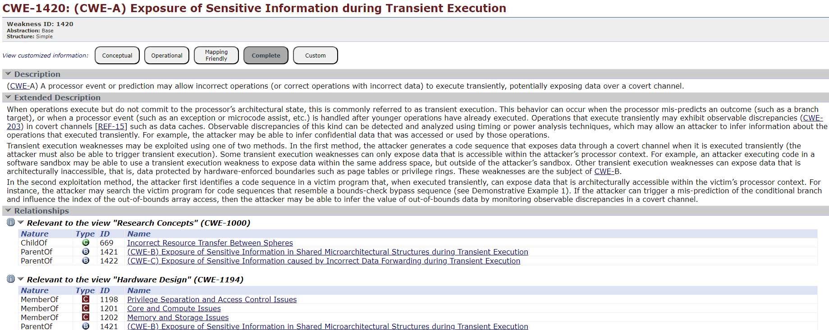
CWE-1420
DRAFT

Slide 10
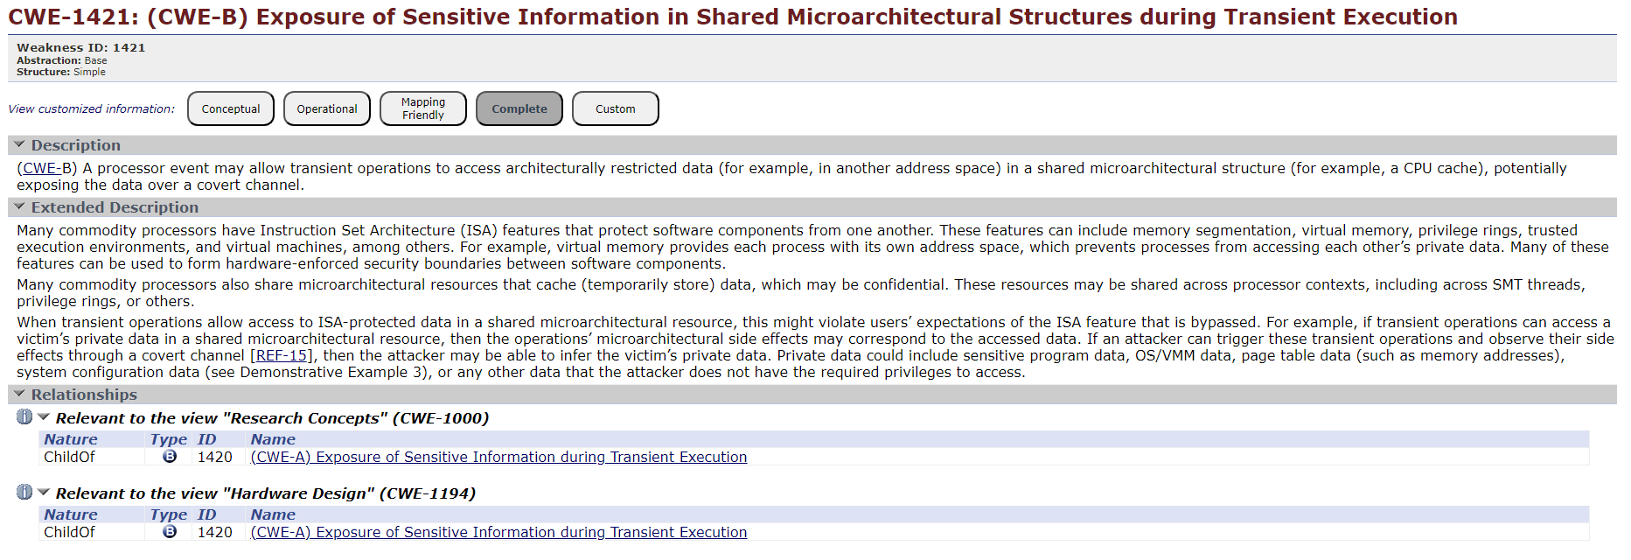
CWE-1421
DRAFT

Slide 11
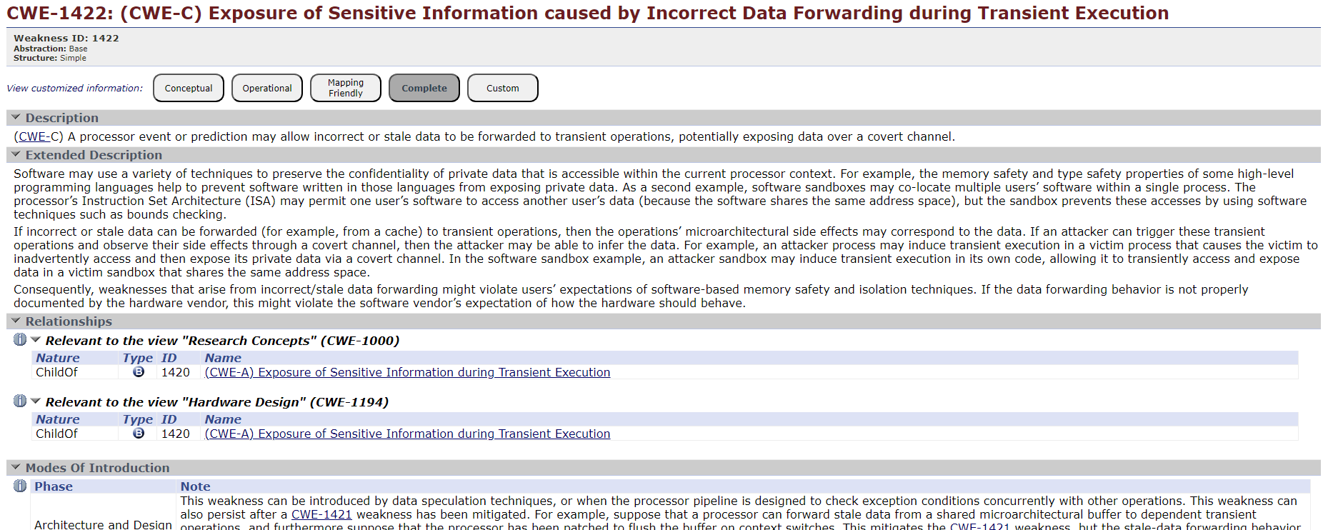
CWE-1422
DRAFT

Slide 12
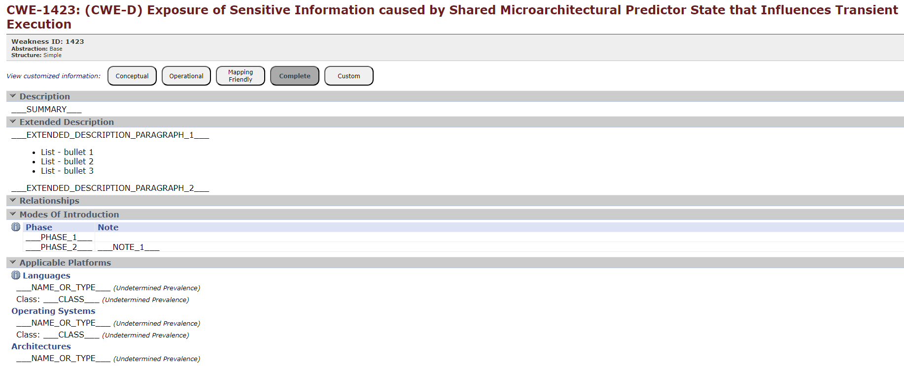
CWE-1423
DRAFT

Slide 13
CWE Nit Bits Potential Mitigations and Detection Methods

Slide 14
Potential Mitigations Element
Contains one or more mitigations that indicate a decision, action, or practice intended to reduce the impact or eliminate a weakness.
Sub-Elements:
Phase: indicates the development life cycle phase during which this mitigation may be applied.
Description: contains a description of this individual mitigation including any strengths and shortcomings of this mitigation for the weakness.
Strategy: describes a general strategy for protecting a system to which this mitigation contributes.
*Effectiveness: summarizes how effective the mitigation may be in preventing the weakness.
Effectiveness Notes: additional discussion of the strengths and shortcomings of this Mitigation.
Note: Italics indicate that the element is optional

Slide 15
Detection Method Element
Contains one or more detection methods that may be employed to detect this weakness.
Sub-Elements:
Detection Method: identifies the detection method for weakness.
Description: how this method can be applied to a specific weakness.
*Effectiveness: says how effective the detection method may be in detecting the associated weakness.
Effectiveness Notes: additional discussion of the strengths and shortcomings of this detection method
Note: Italics indicate that the element is optional

Slide 16
Detection Methods Labels
Labels for the Detection Methods:
Automated Analysis
Automated Dynamic Analysis
Automated Static Analysis
Automated Static Analysis - Source Code
Automated Static Analysis - Binary or Bytecode
Fuzzing
Manual Analysis
Manual Dynamic Analysis
Manual Static Analysis
Manual Static Analysis - Source Code
Manual Static Analysis - Binary or Bytecode
White Box
Black Box
Architecture or Design Review
Dynamic Analysis with Manual Results Interpretation
Dynamic Analysis with Automated Results Interpretation
Formal Verification
Simulation / Emulation
Other

Slide 17
Mitigations vs Detection Methods
 | Potential Mitigations (How to fix) | Detection Methods (How to find)
Conveys | A decision, action, or practice intended to reduce the impact or eliminate a weakness¹. | Information about what types of assessment activities that a weakness can be found by.
Intended for | For designers and developers | For reviewers, testers, and assessors
Notes | Only mitigations that are practical and actionable. Incudes a phase element indicates the development life cycle phase during which this mitigation may be applied. | Assumes the use of best-of-breed tools, analysis, and methods. Includes strengths and limitations. There is limited consideration for financial costs, labor, or time.
Common Mistake:
Testing is often thought of as a mitigation, but in CWE it is generally regarded as a detection method. You can’t mitigate a weakness in testing; the weakness still exists. But testing is one way to detect that a weakness even exists.
Notes:
Borrowed language from NIST’s definition of mitigation
https://cwe.mitre.org/community/swa/detection_methods.html
https://cwe.mitre.org/documents/schema/index.html#PotentialMitigationsType
https://cwe.mitre.org/documents/schema/index.html#DetectionMethodsType

Slide 18
Example
CWE-1328: Security Version Number Mutable to Older Versions
Potential Mitigations
Phase: Architecture and Design When architecting the system, security version data should be designated for storage in registers that are either read-only or have access controls that prevent modification by an untrusted agent. Phase: Implementation During implementation and test, security version data should be demonstrated to be read-only and access controls should be validated.
Detection Methods
Automated Dynamic Analysis Mutability of stored security version numbers and programming with older firmware images should be part of automated testing. Effectiveness: High Architecture or Design Review Anti-roll-back features should be reviewed as part of Architecture or Design review. Effectiveness: High

Slide 19
Addressing Observed Example Gaps for HW CWE

Slide 20
OBEX Gaps Agenda
Current Need
OBEX Challenges
Participation and Organizing Work
How you can help

Slide 21
Observed Examples Working Group
Goal: Ensure every HW CWE has at least one OBEX.
The OBEX element is important in that it links real-world examples to weaknesses.
61 (52%) of HW CWEs lack observed examples.
Your contribution can reduce this gap.
Timeframe and Commitment: Next release cycle, approx., March through June.
We value your time and expertise, so would like to structure the workgroup so that participation can be flexible and asynchronous.
Target generating OBEXs for 10% - 20% of the HW CWEs missing OBEXs for this release.
Recognition: All contributors will be acknowledged for their valuable input.
This is a great opportunity to gain recognition within the community and add a contribution to your professional portfolio.
Notes:
https://github.com/CWE-CAPEC/hw-cwe-sig/issues

Slide 22
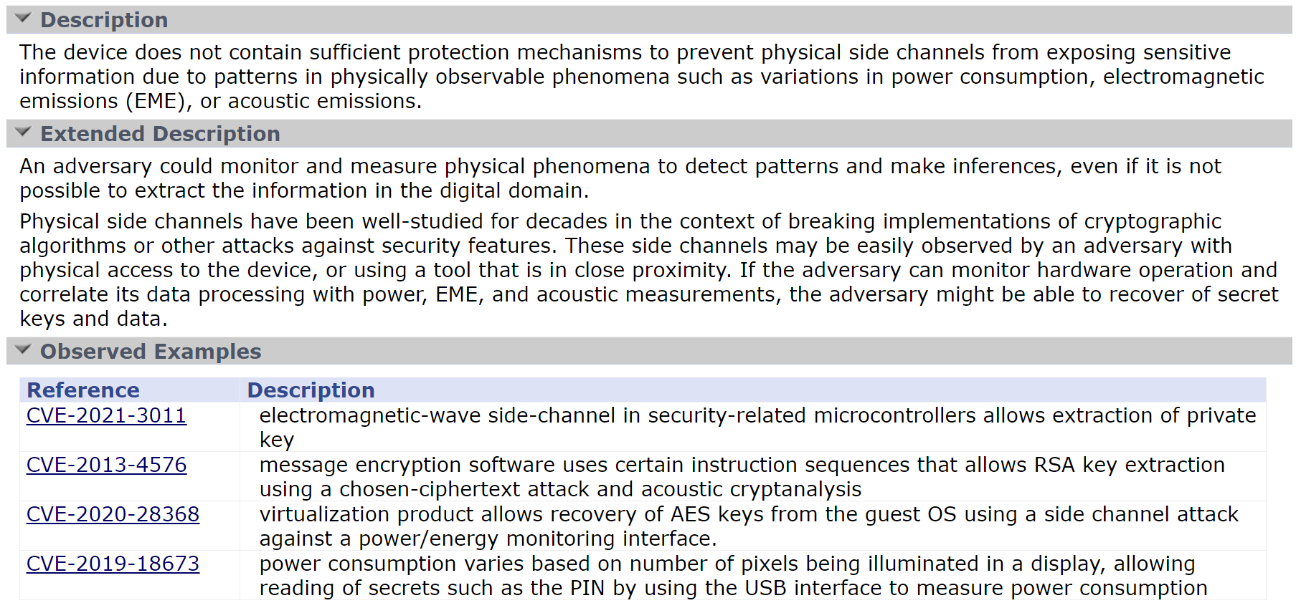
CWE-1300: Improper Protection of Physical Side Channels

Slide 23
OBEX Challenge #1 – Specific to HW CWE
CVE has limited coverage for hardware specific vulnerabilities
Examples:
Did not find a CVE that could be mapped to the above CWEs
CWE-1351: Improper Handling of Hardware Behavior in Exceptionally Cold Environments did not turn up any results
CWE-1338: Improper Protections Against Hardware Overheating
CWE-1334: Unauthorized Error Injection Can Degrade Hardware Redundancy
Found CVE that may map but not enough details to be sure
CWE-1328: Security Version Number Mutable to Older Versions
Found CVE that map
CWE-1326:Missing Immutable Root of Trust in Hardware
CVE-2022-38773, CVE-2022-28383, CVE-2023-22955

Slide 24
How to help: HW Vulnerability Sources
Since CVE has limited coverage for hardware vulnerabilities, we need to consult other sources for observed examples.
We like to tap into the collective knowledge and expertise of this group.
Please provide sources other than CVE that we could use to pull observed examples from for HW CWEs.
Preferably site that aggregate vulnerability reports.
[WORKING ITEM] Sources for Hardware Vulnerability Reports
https://github.com/CWE-CAPEC/hw-cwe-sig/issues/109

Slide 25
Observed Example Element
Contains one or more publicly reported vulnerabilities in real-world products that exhibit the weakness.
Sub-Elements
Reference: This contains the CVE Identifier, e.g., CVE-2005-1951 a vulnerability identifier.
Description: Clear, simple, and concise summary of CVE vulnerability report that focuses on the link between the CVE report and weakness. Exclude product name, attack vectors and other irrelevant details.
Link: URL Link to CVE vulnerability report. Preferably from https://www.cve.org/.

Slide 26
OBEX Challenge #2 – General CWE Challenge
Vulnerability reports are not written from a weakness aspect
The original weakness is not always covered.
From a vulnerability management perspective, the underlying weakness may not actually be important to the organization.
Reports emphasize product impact, product versions affected, and how easy it is for an attacker to exploit.
Routinely we see that many of the vulnerability descriptions do not have enough information to determine what the underlying weakness is.
For OBEXs we cannot infer the weakness, the vulnerability report must specifically describe the weakness.

Slide 27
How to help: Submitting an OBEX
Find HW CWE(s) you would like to contribute an OBEX.
There is a list maintained on our GitHub.
There is an issue per HW CWE that is missing an OBEX.
NVD Data may be a help here
Assign yourself to the GitHub Issue.
In the Issue comments, provide a CVE Number, URL, description, and how you would like to be cited for the contribution.
Preferred Name and organization.
Issues are here:
https://github.com/CWE-CAPEC/hw-cwe-sig/labels/Missing%20OBEX
Note: We are planning to release a OBEX Style guide soon

Slide 28
Summary
Our ask
Commit to supporting the working group.
Send an email to cwe@mitre.org, subject: OBEX WG.
Provide additional HW Vulnerability Sources.
https://github.com/CWE-CAPEC/hw-cwe-sig/issues/109
Generate 1 OBEX or many OBEXs.
https://github.com/CWE-CAPEC/hw-cwe-sig/labels/Missing%20OBEX

Slide 29
Next Meeting (Mar 8)
Mailing List: hw-cwe-special-interest-group-sig-list@mitre.org
NOTE: All mailing list items are archived publicly at:
https://www.mail-archive.com/hw-cwe-special-interest-group-sig-list@mitre.org/
What would members of this body like to see for the next HW SIG agenda?
Questions, Requests to present? Please let us know.
CWE@MITRE.ORG

Slide 30
Backup

Slide 31
Open Community Items

Slide 32
HW CWE’s With Missing: DEMOX’s, OBEX’s and Mitigations
Missing Mitigations
4 HW CWEs are missing mitigations (No change)
Missing Detection Methods
How many do we have? CREATE A TRACKER
Missing demonstrative examples (DEMOX)
15 HW CWEs missing demonstrative examples (down 1)
1 added from Hack@DAC, CWE-440
Note: there are other DEMOXs from Hack@DAC but now adding DEMOXs to entries that have an existing DEMOX
How many DEMOX’s are not code based? CREATE A TRACKER
https://github.com/CWE-CAPEC/hw-cwe-sig/issues

Slide 33
Discussion Items on GitHub
Resonant frequency weakness, proposal (Topic Lead: OPEN)
https://github.com/CWE-CAPEC/hw-cwe-sig/issues/105
Covert Channel Coverage in HW View (Topic Lead: OPEN)
https://github.com/CWE-CAPEC/hw-cwe-sig/issues/108
CWE Coverage of HW Cryptography (Topic Lead: OPEN)
https://github.com/CWE-CAPEC/hw-cwe-sig/issues/7
Lifecycle-stage classification for HW CWEs –Dan DiMase (Topic Lead: OPEN)
https://github.com/CWE-CAPEC/hw-cwe-sig/issues/4

Slide 34
Covert Channel Coverage in CWE

Slide 35
COVID-Bit Research Item^{[1][2]}
In 2022, researchers at Ben Gurion University in Israel developed a new data exfiltration method for air-gapped systems called COVID-bit.
Malware generates electromagnetic radiation in the 0-60 kHz frequency band (assumes Malware got there somehow).
EM emissions are generated by manipulating the workload of the CPU. Claims of indirect control SMPS.
The electromagnetic radiation generated by this intentional process can be received from a distance using appropriate antennas.
https://thehackernews.com/2022/12/covid-bit-new-covert-channel-to.html?m=1
https://arxiv.org/abs/2212.03520
Notes:
Glossary have more updated (but terms list is relevant)

Slide 36
Covert Channels and Side Channels
Initial thought was that COVID-Bit could be a DEMOX for CWE-1300: Improper Protection of Physical Side Channels
As HW SIG Members had correctly pointed out, COVID-Bit is about Covert Channels and NOT Side Channels
Covert Channel (CC) / Side Channel (SC)
Intentional transmission (CC). Accidental transmission (SC) – Ross Anderson ^{[1]}
Adversary controls input and output (CC). Adversary can only read output (SC) – Intel ^{[2]}
Not an intended resource but exists due the application's behaviors. –CWE-514 Notes ^{[3]}
If not CWE-1300 (SC), where would something like this map to in HW view?
Closest we have is CWE-514: Covert Channels
https://www.cl.cam.ac.uk/~rja14/Papers/SEv3-ch19-7sep.pdf
https://www.intel.com/content/www/us/en/developer/articles/technical/software-security-guidance/best-practices/refined-speculative-execution-terminology.html
https://cwe.mitre.org/data/definitions/514.html
Notes:
https://github.com/CWE-CAPEC/hw-cwe-sig/issues/10
Not an intended resource, however it exists due the application's behaviors.

Slide 37
CWE-514: Covert Channel
https://cwe.mitre.org/data/definitions/514.html
Abstraction: Class Description: A covert channel is a path that can be used to transfer information in a way not intended by the system's designers. Extended Description: Typically the system has not given authorization for the transmission and has no knowledge of its occurrence. Relationships: ChildOf CWE-1229:Creation of Emergent Resource ParentOf CWE-385:Covert Timing Channel ParentOf CWE-515: Covert Storage Channel CanFollow CWE-205: Observable Behavioral Discrepancy Vulnerability Mapping Notes: Usage: Allowed-with-Review; Reason: Abstraction Rationale: This CWE entry is a Class and might have Base-level children that would be more appropriate; Comments: Examine children of this entry to see if there is a better fit.
NOTE: Nothing about EM based Covert Channels, nor HW cause, e.g., SMPS

Slide 38
Discussion
Questions:
Should we place CWE-514 in the HW View?
Do we need to modify CWE-514 to be less software centric?
Or create a base of CWE-514 and put that into the HW view?
Previous HW SIG Member Comments:
Covert Channels should have coverage in the hardware view –Jason Oberg
Covert Channels should be in the HW categories Security Flow Issues, General Circuit and Logic Design Concerns, or Debug and Test Problems. –Paul Wortman

Slide 39
Most Important Hardware Weaknesses Refresh Bob H

Slide 40
Most Important Hardware Weaknesses (MIHW)
Is this something worth revisiting?
Part of CWE 4.6 Release, October 28, 2021
Have there been substantial developments since the last release of MIHW?
Would those affect the rankings and inclusions of the list in any meaningful way?
Notes:
https://cwe.mitre.org/scoring/lists/2021_CWE_MIHW.html

Slide 41
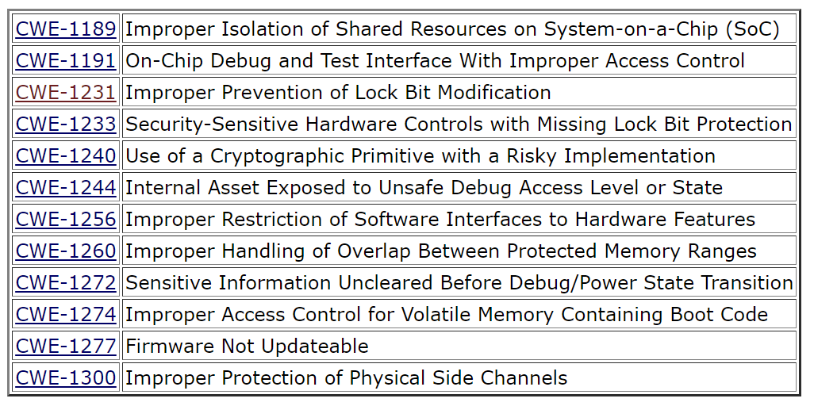
Current MIHW

Slide 42
New HW CWEs Since MIHW
CWE-1342: Information Exposure through Microarchitectural State after Transient Execution
CWE-1357: Reliance on Insufficiently Trustworthy Component
CWE-1384: Improper Handling of Physical or Environmental Conditions
CWE-1388: Physical Access Issues and Concerns

Slide 43
Discussion
Have there been substantial developments since the last release of MIHW?
Would those affect the rankings and inclusions of the list in any meaningful way?
Are there observational trends that would change the current list in any significant and meaningful way?

Slide 44
OBEX WG Formation
Purpose: Populating missing observed examples (OBEXs) in HW CWEs.
Your expertise can make a difference!
Challenge: 61 (52%) of HW CWEs lack observed examples.
Your contribution can significantly reduce this gap.
Goal: Ensure every HW CWE has at least one OBEX
You can help enhance the quality and comprehensiveness CWE.
Motivation: The OBEX element is important for new users
Your input will directly impact the ease of use
Timeframe and Commitment: March through June. Participation is flexible and asynchronous, allowing you to contribute when it suits you best.
We value your time and expertise.
Recognition: All contributors will be acknowledged for their valuable input.
This is a great opportunity to gain recognition within the community and add a significant contribution to your professional portfolio.
Notes:
https://github.com/CWE-CAPEC/hw-cwe-sig/issues

