Slide 1
Hardware CWE™ Special Interest Group (SIG)
Chair: Bob Heinemann (MITRE)
Co-Chair: “Manna” Parbati Kumar Manna (Intel)
MITRE Team: Ganu Kini, Steve Christey Coley, Alec Summers
MITRE
December 13, 2024

Slide 2
Agenda
REMINDER: This meeting is being recorded.
1 | Most Important Hardware Weaknesses Refresh | Ganu Kini | 40 min
2

Slide 3
Housekeeping
Schedule:
Next Meeting: Need to send out 2025 Meeting Series
12:30 – 1:30 PM EST (16:30 – 17:30 UTC)
Microsoft Teams
Contact: cwe@mitre.org
Mailing List: hw-cwe-special-interest-group-sig-list@mitre.org
Minutes from previous meetings available on our GitHub site:
https://github.com/CWE-CAPEC/hw-cwe-sig

Slide 4
Announcements
Welcome back Ganu.
CWE Content Development Repository (CDR) pilot now on GitHub! Open to anyone by request.
CWE 4.16 has been released. Includes the 2024 Top 25.
Next release planned for early 2025.
Hardware Submissions In Progress: (see next slide)

Slide 5
Hardware Submissions in Progress
Initial Consultation (Stage 1, Phase 4 – common bottleneck)
ES2208-26ac7ee6 Improper Protection of Intermediate Cryptographic State/Results (Andres Meza)
ES2208-9fb81a1a Speculative propagation of requests for transaction before data validation in multi-manager bus architectures (Francesco Restuccia)
HW/SW: ES2306-c0b52346 Use of a Quantum-Vulnerable Cryptographic Algorithm (NIST)
Detailed Consultation (Stage 2, Phase 10)
ES2312-c2337436 Lack of Feedback for Unexecuted Operations Across System Interfaces (Amisha Srivastava)
See CDR: https://github.com/CWE-CAPEC/CWE-Content-Development-Repository/issues

Slide 6
Call for Topics

Slide 7
What topics should we cover next time?
Anything to share today or topics for consideration for next meeting?

Slide 8
Most Important Hardware Weaknesses (MIHW) Refresh Gananand Kini

Slide 9
Use Cases for the Most Important Hardware Weaknesses
Please use the hand raise feature and chime in!
How are you using the most important hardware weaknesses list today?
How would you use such a list going forward?
What attributes of the list are important to you? What is the “important” part?

Slide 10
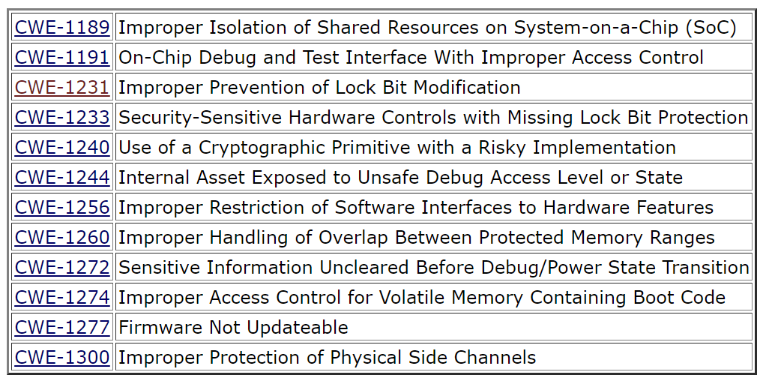
Current MIHW from CWE 4.6 (Unranked)

Slide 11
Previous Methodology for the MIHW
Previously, the Delphi method was used to poll members of this august body:
Which 10 HW weaknesses were important based on nine significance questions:
How frequently is this weakness detected after it has been fielded?
Does the weakness require hardware modifications to mitigate it?
How frequently is this weakness detected during design?
How frequently is this weakness detected during test?
Can the weakness be mitigated once the device has been fielded?
Is physical access required to exploit this weakness?
Can an attack exploiting this weakness be conducted entirely via software?
Is a single exploit against this weakness applicable to a wide range (or family) of devices?
What methodologies do you practice for identifying and preventing both known weaknesses and new weaknesses?

Slide 12
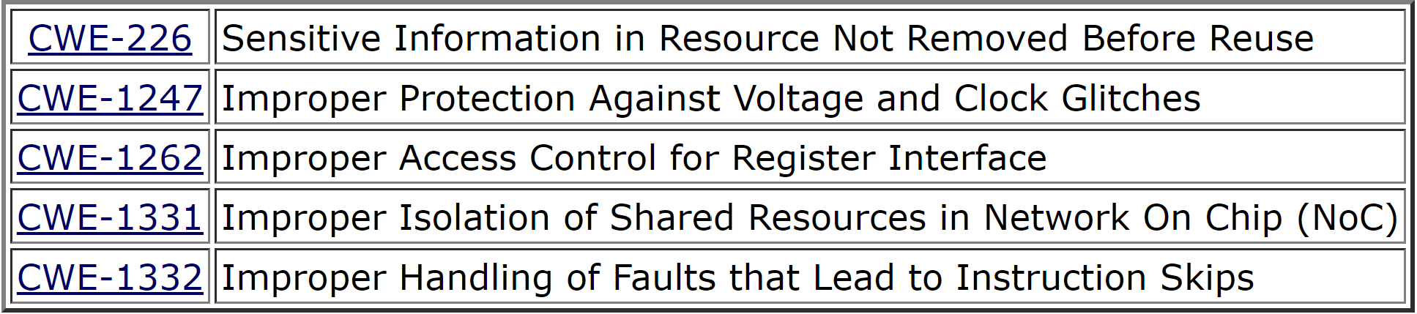
Previous Methodology for MIHW
After combining the above, thirty-one unique weaknesses resulted.
Live poll conducted during SIG meeting asked members to assign the thirty-one into various buckets with weights (strongly support (+2), somewhat support (+1), no opinion (0), somewhat oppose (-1), strongly oppose (-2)).
Multiple groups emerged from the data when ranked by weighted percentage of votes, of which the primary group contained twelve. The secondary group were listed as Hardware Weaknesses on the Cusp (shown below).

Slide 13
Changes to HW CWEs since MIHW (v4.6 to v4.16)
(DEPRECATED) CWE-1324: Sensitive Information Accessible by Physical Probing of JTAG Interface
CWE-1342: Information Exposure through Microarchitectural State after Transient Execution
(Class) CWE-1357: Reliance on Insufficiently Trustworthy Component
CWE-1329: Reliance on Component That is Not Updateable
(Class) CWE-1384: Improper Handling of Physical or Environmental Conditions
(Category) CWE-1388: Physical Access Issues and Concerns
(Parent) CWE-1420: Exposure of Sensitive Information during Transient Execution
CWE-1421: Exposure of Sensitive Information in Shared Microarchitectural Structures during Transient Execution
CWE-1422: Exposure of Sensitive Information caused by Incorrect Data Forwarding during Transient Execution
CWE-1423: Exposure of Sensitive Information caused by Shared Microarchitectural Predictor State that Influences Transient Execution
This list is not complete!

Slide 14
Questions to think about and frame the MIHW activity
Unfortunately, not many HW CWEs assigned to CVE entries in NVD currently.
A lot of the observed examples (CVE) were added mostly for Transient Execution weaknesses. There are many that remain incomplete.
What methodology should be used for the new MIHW list?
What data could be used to generate the new MIHW list?
Any observations or lessons learned that could change or impact the current list in a meaningful way? Any observed trends that could impact the list?
Does it capture the use cases and important attributes discussed earlier for such a list?

Slide 15
Call for volunteers to form a MIHW ad hoc group
Anybody here willing to commit some time to help with this activity?
The group activities will involve the following :
Defining the methodology for updating the list.
Setting timelines.
Collecting and compiling feedback from SIG members.
Scheduling and conducting a poll on the proposed updates.
Preparing the final list for publication.
Coordinating communications when publishing the updated list.

Slide 16
MIHW List Discussion
Please continue discussion on the HW CWE Mailing List (see below).
You can tag email subject lines using “[MIHW]” to get more visibility.
Mailing List: hw-cwe-special-interest-group-sig-list@mitre.org
NOTE: All mailing list items are archived publicly at:
https://www.mail-archive.com/hw-cwe-special-interest-group-sig-list@mitre.org/

Slide 17
Next Meeting (TBD)
Mailing List: hw-cwe-special-interest-group-sig-list@mitre.org
NOTE: All mailing list items are archived publicly at:
https://www.mail-archive.com/hw-cwe-special-interest-group-sig-list@mitre.org/
What would members of this body like to see for the next HW SIG agenda?
Questions, Requests to present? Please let us know.
CWE@MITRE.ORG

Slide 18
Backup

Slide 19
Popular CWEs in NVD excluding Software CWEs
33 unique HW CWEs with at least 1 CVE in NVD.
16 HW CWEs with only 1 CVE
11 HW CWEs with 2 CVEs
13 | CWE-1220: Insufficient Granularity of Access Control
4 | CWE-1320: Improper Protection for Outbound Error Messages and Alert Signals
3 | CWE-1357: Reliance on Insufficiently Trustworthy Component
3 | CWE-1295: Debug Messages Revealing Unnecessary Information
3 | CWE-1258: Exposure of Sensitive System Information Due to Uncleared Debug Information
3 | CWE-1240: Use of a Cryptographic Primitive with a Risky Implementation
2 | CWE-1332: Improper Handling of Faults that Lead to Instruction Skips
2 | CWE-1319: Improper Protection against Electromagnetic Fault Injection (EM-FI)
2 | CWE-1303: Non-Transparent Sharing of Microarchitectural Resources
2 | CWE-1299: Missing Protection Mechanism for Alternate Hardware Interface
2 | CWE-1298: Hardware Logic Contains Race Conditions
2 | CWE-1281: Sequence of Processor Instructions Leads to Unexpected Behavior
2 | CWE-1279: Cryptographic Operations are run Before Supporting Units are Ready
2 | CWE-1269: Product Released in Non-Release Configuration
2 | CWE-1263: Improper Physical Access Control

Slide 20
Formation of Ad-Hoc Committee
Will be putting a call out of the mailing list for members to join an ad-hoc committee to study.
We will be looking for committee members to study the feasibility of a new list and making a decision to proceed.
Also, members will develop an approach to develop the list with the community.

Slide 21
Most Important Hardware Weaknesses (MIHW)
Is this something worth revisiting?
Part of CWE 4.6 Release, October 28, 2021
Have there been substantial developments since the last release of MIHW?
Would those affect the rankings and inclusions of the list in any meaningful way?
Is there any data available that we could utilize to generate the list? Or should we use the delphi method again?
Are there observational trends that would change the current list in any significant and meaningful way?
Notes:
https://cwe.mitre.org/scoring/lists/2021_CWE_MIHW.html

