Slide 1
Hardware CWE™ Special Interest Group (SIG)
Steve Christey Coley, MITRE
August 2021

Slide 2
Agenda
New CWE 4.5 / CAPEC 3.5 Released
Status Update: Top-N List
New Submissions from Paul Wortman
Reverse Engineering and CWE Scope
Update: Counterfeit / Anti-Tamper Coverage

Slide 3
Housekeeping
Schedule:
Next Meeting – Friday, September 3
12:30 – 1:30 PM EST
Microsoft Teams
Contact: cwe@mitre.org
Minutes from previous meetings available on our Github site:
https://github.com/CWE-CAPEC/hw-cwe-sig

Slide 4
New CAPEC 3.5 Release - June
New Supply Chain entries
CAPEC-669: Alteration of a Software Update
CAPEC-670: Software Development Tools Maliciously Altered
CAPEC-671: Requirements for ASIC Functionality Maliciously Altered
CAPEC-672: Malicious Code Implanted During Chip Programming
CAPEC-673: Developer Signing Maliciously Altered Software
CAPEC-674: Design for FPGA Maliciously Altered
CAPEC-675: Retrieve Data from Decommissioned Devices
More supply chain work in the coming months

Slide 5
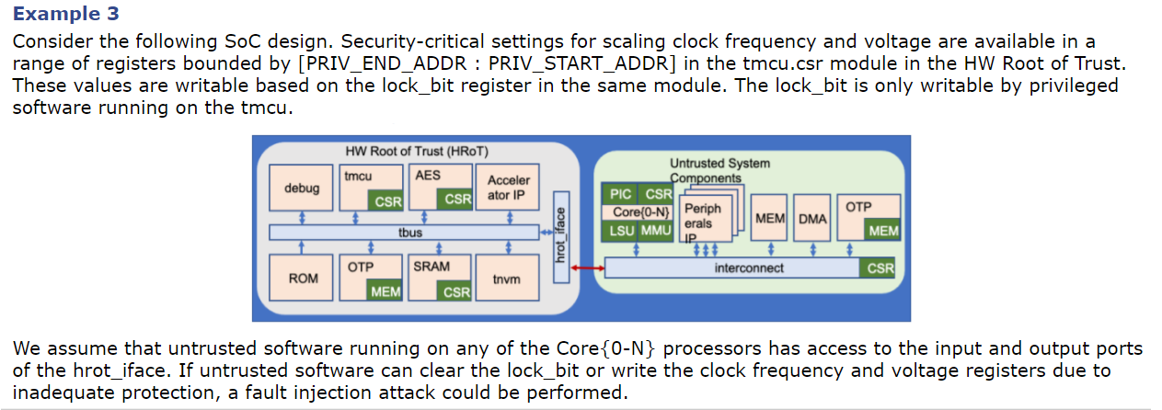
New CWE 4.5 Release - July
CWE-1351: Improper Handling of Hardware Behavior in Exceptionally Cold Environments
Update to CWE-1256: Hardware Features Enable Physical Attacks from Software
Thanks to Tortuga Logic
To do: Figure out the “right” way to support images

Slide 6
Top-N List: Timeline to Publication
Publish 2021 HW CWE Top 10
– October –
Analysis & Development
Preliminary Top-N Survey
– April –
Send Out Final Top-10 Survey
– September –
Analyze initial responses
Refine & Iterate
Engage social & behavioral science support for survey improvement / validation
Coincide with CWE 4.6 minor release

Slide 7
Hardware Top-N List
Goal: conduct survey in September, release in October
Consulted internal MITRE survey experts
Great feedback on limiting to the right audience
Hardware SIG members and other invited people with relevant roles/experience
Operationally not feasible for MITRE to run a survey by September
Several options (decision needed ASAP)
MITRE-led “Card-Sorting” exercise
Performed during the SIG call or in separate meetings
Survey operated by SIG members
Basic question: how “scientific” do we want this to be?

Slide 8
Submissions from Paul Wortman
Many are related to less well-developed parts of CWE
HCWE102: Untrusted Manufacturing of Intellectual Property (IP)
This may become the hardware component of a more general CWE encompassing both hardware and software. It might fall under CWE-684 (Incorrect Provision of Specified Functionality).
CWE-684 is currently software-focused
Might need a new entry and/or modify CWE-684
HCWE103: Verifiable Integration Testing
We believe this should be added to CWE-684 (Incorrect Provision of Specified Functionality) as a mitigation and/or detection method
“Testing” is not a separate element within CWE; basically treated as a detection method
Testing seems more important for hardware

Slide 9
Submissions from Paul Wortman (2)
HCWE105: Hardware Trojans
This may fall under CWE-912 (Hidden Functionality), which is (or will be?) a child of CWE-684
HCWE106: Lack of Hardware Design Verification Against a Golden Standard
“one lacks a golden standard/reference for hardware design and therefore is unable to perform the necessary validation of a final product. Post manufacturing verification is not possible without this reference material.”
We believe this may be related to CWE-1059 (Incomplete Documentation) which in turn leads to CWE-684 or CWE-573 (Improper Following of Specification by Caller)
Consider “Incomplete Specification” (whatever “specification” means)

Slide 10
Proposed for Discussion
CWE-1059: (Incomplete Documentation)
Chain: CanPrecede
CWE-684 (Incorrect Provision of Specified Functionality)
ParentOf
ParentOf
ParentOf
HCWE102: (Untrusted Manufacturing of Intellectual Property (IP))
HCWE106: Golden Standard
We believe this may be related to CWE-1059 (Incomplete Documentation). CWE-1059 leads to CWE-684 or CWE-573 (Improper Following of Specification by Caller)
HCWE103: (Verifiable Integration Testing)

Slide 11
Reverse Engineering and CWE Scope
HCWE104: Missing protective measures for preventing or hindering reverse engineering of IP or other sensitive data
“Protections and measures intended to prevent or hinder reverse engineering of Intellectual Property (IP) are not present in the product design. These include efforts taken to prevent extraction of a product's netlist or obfuscation of hardware to protect SoC design.”
Paul has done some research (not yet public)
MITRE and Hardware SIG will need to make a decision about whether (or how) to include reverse engineering
New CWE entries?
“Stretch” existing entries? e.g., CWE-200
New/existing CAPECs? e.g., CAPEC-188: Reverse Engineering

Slide 12
Pros and Cons: Anti-Reverse Engineering
Some Pros:
Important to manufacturers (e.g., intellectual property / theft)
Hardware devices are deployed into untrusted environments without physical control
Some Cons:
“Security through obscurity” - reverse engineering is a process/action that can make it easier to find weaknesses (CWE-656: Reliance on Security Through Obscurity)
Not necessarily useful to customers
You wouldn’t give a CVE to a leak of source code
We want to discuss this over the next month and come to a decision

Slide 13
Update: Counterfeit / Anti-Tamper
MITRE to review proposal from SAE G32 CPSS (Joe Jarzombek @ Synopsys)
Challenges in supply chain, Enumerating indicators of non-conformant hardware
Proposed additions could expand CWE-1195 (Manufacturing and Life Cycle Management Concerns)
Create list of issues about scope and review with SIG (possibly a Supply Chain subcommittee)
MITRE request submissions for weaknesses that are clearly in scope
(Sub)Community writes/adapts submissions
Relationship to supply chain
Share / collaborate with CAPEC team

Slide 14
Next Meeting (September 3)
Topics of interest?
Questions, Requests to present? Please let us know
CWE@MITRE.ORG

