Slide 1
Hardware CWE™ Special Interest Group (SIG)
Alec Summers & the HW CWE Team
October 2021

Slide 2
Agenda
CWE 4.6 & the 2021 CWE MIHM List
Some of the work behind the scenes
Proposed Action: Expanding HW CWE Proposal SAE G32 CPSS

Slide 3
Housekeeping
Schedule:
Next Meeting – November/December TBD
12:30 – 1:30 PM EST
Microsoft Teams
Contact: cwe@mitre.org
Minutes from previous meetings available on our Github site:
https://github.com/CWE-CAPEC/hw-cwe-sig

Slide 4
Topic #1
2021 CWE Most Important HW Weaknesses
– We did it! –

Slide 5
Top-N List: Timeline to Publication
Publish 2021 HW CWE Top-N
– October 28 –
Analysis & Development
Preliminary Top-N Survey
– April –
Top-N List Voting Session
– Today! –
Initial questions
SIG gut-check/qualitative list
Analyze initial responses
Refine & Iterate
Engage social & behavioral science support for survey improvement / validation
Finalize inaugural list
Determine naming convention
Coincide with CWE 4.6 minor release

Slide 6
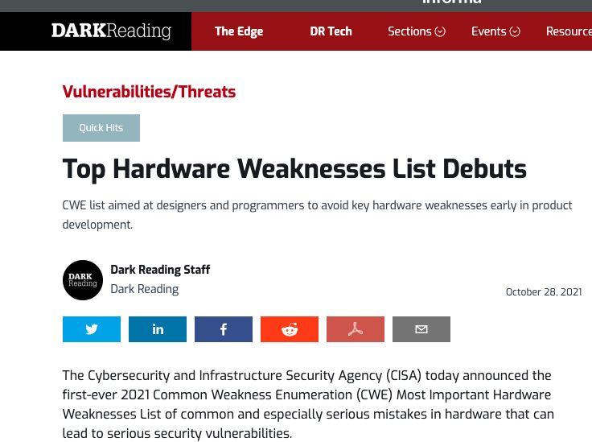
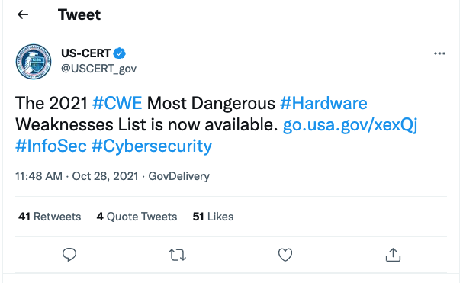

2021 CWE Most Important Hardware Weaknesses List
https://cwe.mitre.org/scoring/lists/2021_CWE_MIHW.html

Slide 7
Topic #2
A Look Behind the Scenes
CWE/CAPEC Technical Lead: Steve Christey

Slide 8
Topic #3
Expanding HW CWE Content
– Proposal from SAE G32 CPSS to Add HW CWEs –
(CWE HW Team Member: Chris Lathrop)

Slide 9
BLUF
The Cyber Physical Systems Security Committee of SAE International (G-32) has proposed the addition of new HW CWEs to address specific supply chain challenges
The proposed additions are sensible in a supply chain context, but challenging to incorporate thematically in the existing corpus; the difficulty hinges on the definition of a CWE weakness
Common Weakness Enumeration (CWE™) is a community-developed list of common software and hardware weakness types that have security ramifications. “Weaknesses” are flaws, faults, bugs, or other errors in software or hardware implementation, code, design, or architecture that if left unaddressed could result in systems, networks, or hardware being vulnerable to attack.
Proposed new HW CWEs would enumerate indicators for HW non-conformance (e.g. counterfeit/tampered products) based on assessable physical attributes
This is inconsistent with/distinct from the definition of a CWE weakness

Slide 10
Reconciliation Approach
Study 2021 CWE Most Important HW Weaknesses (MIHW) and G-32 proposed HW CWE in common context→ flaws, faults, bugs, errors, or intentionally non-conforming attributes
Bin G-32 proposed HW CWEs into “cursory taxonomy” composed of three groups:
Potential HW CWE
Potential CAPEC attack pattern
Not clearly applicable to HW CWE or CAPEC
Consider whether blurring/altering the definition of a HW weakness could address the G-32 proposal
Provided such redefinition doesn’t cause consternation in the CWE community

Slide 11
Next Meeting (November/December TBD)
Topics of interest?
Questions, Requests to present? Please let us know
CWE@MITRE.ORG

