Slide 1

Hardware CWE™ Special Interest Group (SIG)
Alec Summers & the HW CWE Team
December 2021

Slide 2
Agenda
Housekeeping
Update: Content Entry Suggestions from SAE32
Indicators of Non-Conformance for Hardware, Counterfeit Defects and Tampered Components
Technical Discussion
End-to-End Bitstream Tamper Attack Against Flip-Chip FPGAs
Daniel DiMase, Aerocyonics
Schema and Data Population Question for SIG Members
Applicable Platforms
Adjourn

Slide 3
Housekeeping
Schedule:
Next Meeting – January 14
12:30 – 1:30 PM EST
Microsoft Teams
Contact: cwe@mitre.org
Minutes from previous meetings available on our Github site:
https://github.com/CWE-CAPEC/hw-cwe-sig

Slide 4
Topic #1
Update
– Content Entry Suggestions from SAE32 –
Chris Lathrop, HW CWE Team

Slide 5
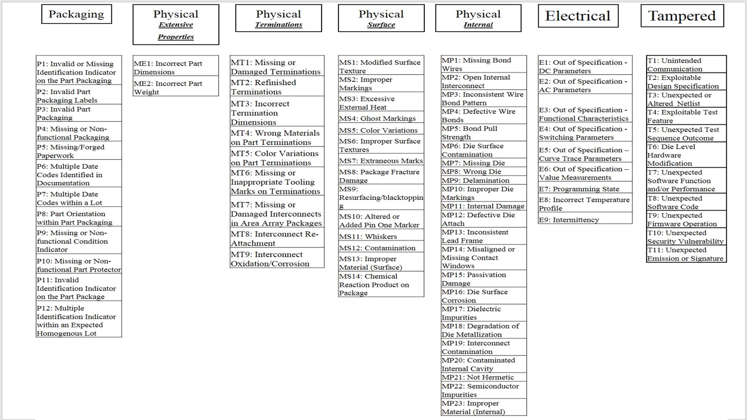
The Proposal
Enumerate indicators of non-conformance for hardware
align H/W CWEs with SAE G19A categories for Counterfeit Defects
use H/W CWEs as indicators for Counterfeit and Tampered Components

Slide 6
SAE32 Content Suggestion Update
Still working on binning the G-32 proposed list of issues into the following:
Potential HW CWE
Potential CAPEC Pattern
Not applicable to either
General Observations thus far:
Most of the entries from the Tampered list seem useful for mapping into CWE/CAPEC.
Other categories are challenging since they are more general and capture physical attributes that could result in any sort of issue including quality, performance or security and the resulting impact is also harder to quantify. Are they more related to introducing vulnerabilities or just bad business practices?
Some of the entries in the G-32 list map to HW CWE categories like CWE-1195: Manufacturing and Lifecycle Management concerns.
Some of the entries map to CAPEC patterns like:
CAPEC-530: Provide Counterfeit Component,
CAPEC-535: Malicious Gray Market Hardware
CAPEC-444: Development Alteration
CAPEC-447: Design Alteration

Slide 7
Topic #2
Technical Discussion
– An End-to-End Bitstream Tamper Attack Against Flip-Chip FPGAs –
Daniel DiMase, Aerocyonics
‘An End-to-End Bitstream Tamper Attack Against Flip-Chip FPGAs’ by Rahman F., Farahmandi F. et al. from University of Florida

Slide 8
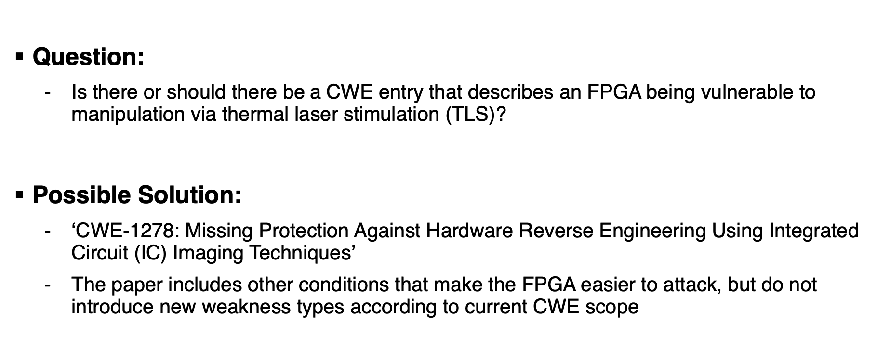
Hardware CWE Technical Discussion
Question:
Is there or should there be a CWE entry that describes an FPGA being vulnerable to manipulation via thermal laser stimulation (TLS)?
Possible Solution:
‘CWE-1278: Missing Protection Against Hardware Reverse Engineering Using Integrated Circuit (IC) Imaging Techniques’
The paper includes other conditions that make the FPGA easier to attack, but do not introduce new weakness types according to current CWE scope

Slide 9
Topic #3
Schema and Data Population Question
– Applicable Platforms –

Slide 10
Applicable Platforms Issue
Currently “Technology Independent” means the weakness applies to a range of technologies that do not have specific types defined within the schema and/or could also apply to dozens of technologies
For many HW CWE Entries, the Applicable Platforms field says “Technology Class: Technology Independent”
Questions:
How are folks from the SIG using this field?
Could SIG members contribute more specific technology types for the existing HW CWE entries (and subsequent content suggestions)?

Slide 11
Next Meeting (January 14)
Topics of interest?
Questions, Requests to present? Please let us know
CWE@MITRE.ORG

