Slide 1
Hardware CWE™ Special Interest Group (SIG)
January 14, 2022

Slide 2
Agenda
Housekeeping
Continuing the Conversation:
“SAE G32 Proposed CWEs”
“Technology Name Enumeration”
HW View Structure and Organization
Categories
CWE Content Discussion
Distinguishing HW/SW/FW content
Announcements and Adjourn

Slide 3
Housekeeping
Schedule:
Next Meeting – February 18
12:30 – 1:30 PM EST
Microsoft Teams
Contact: cwe@mitre.org
Minutes from previous meetings available on our Github site:
https://github.com/CWE-CAPEC/hw-cwe-sig

Slide 4
Continuing the Conversation
– SAE G32 Proposed CWEs –
– “Technology Name” Enumeration –

Slide 5
Update: SAE G32
In December, MITRE looked more closely at the “non-conforming, counterfeit, and tampered indicator categories” provided by Joe Jarzombek and Daniel Dimase
Many defect names and definitions are part of the SAE AS6171 standard, which is SAE intellectual property and requires payment to access
But CWE is a public standard
( … then the holidays happened )
Need to identify and resolve any IP conflicts before moving forward
Upcoming meeting with SAE to discuss (Friday Jan 21)

Slide 6
Technology Name Enumeration
– Gananand Kini, HW CWE Team –

Slide 7
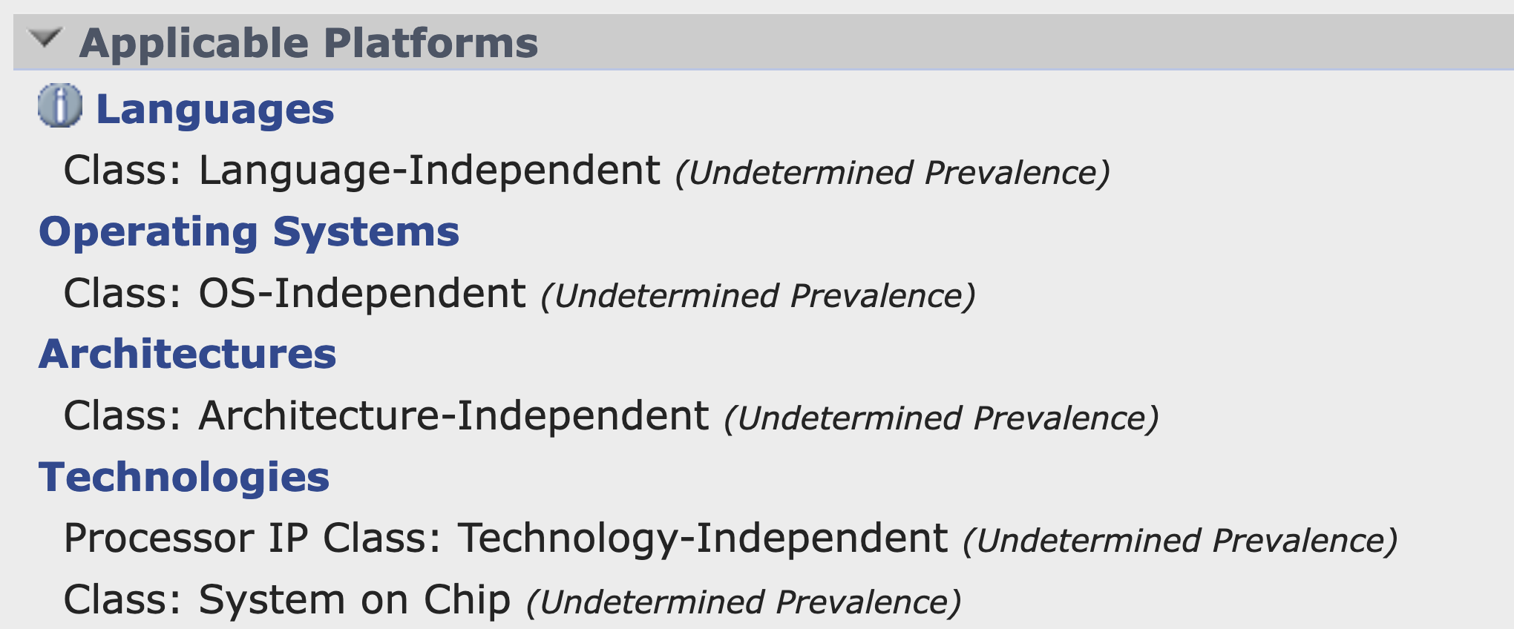
Applicable Platforms: Technologies Class enumeration
20% of the weaknesses in CWE (including non-hardware) have Technologies listed.
Technology Class has:
Client-Server
Cloud Computing
Mainframe
Mobile
N-Tier
SOA
System on Chip
Web Based
Technology-Independent
Hardware entries use Technology-Independent frequently.
Technology-Independent is used to specify if multiple technologies are applicable for the weakness entry.

Slide 8
Applicable Platforms: Technologies Name enumeration
Technology Names has:
Web Server
Database Server
Accelerator IP
Analog and Mixed Signal IP
Audio/Video IP
Bus/Interface IP
Communication IP
Controller IP
Memory IP
Microcontroller IP
Network on Chip IP
Power Management IP
Processor IP
Security IP
Sensor IP
Storage IP
Test/Debug IP
Other
Is this satisfactory?
Are there any other useful Technology classes that are missing?

Slide 9
CWE Hardware Design View
Structure and Organization

Slide 10
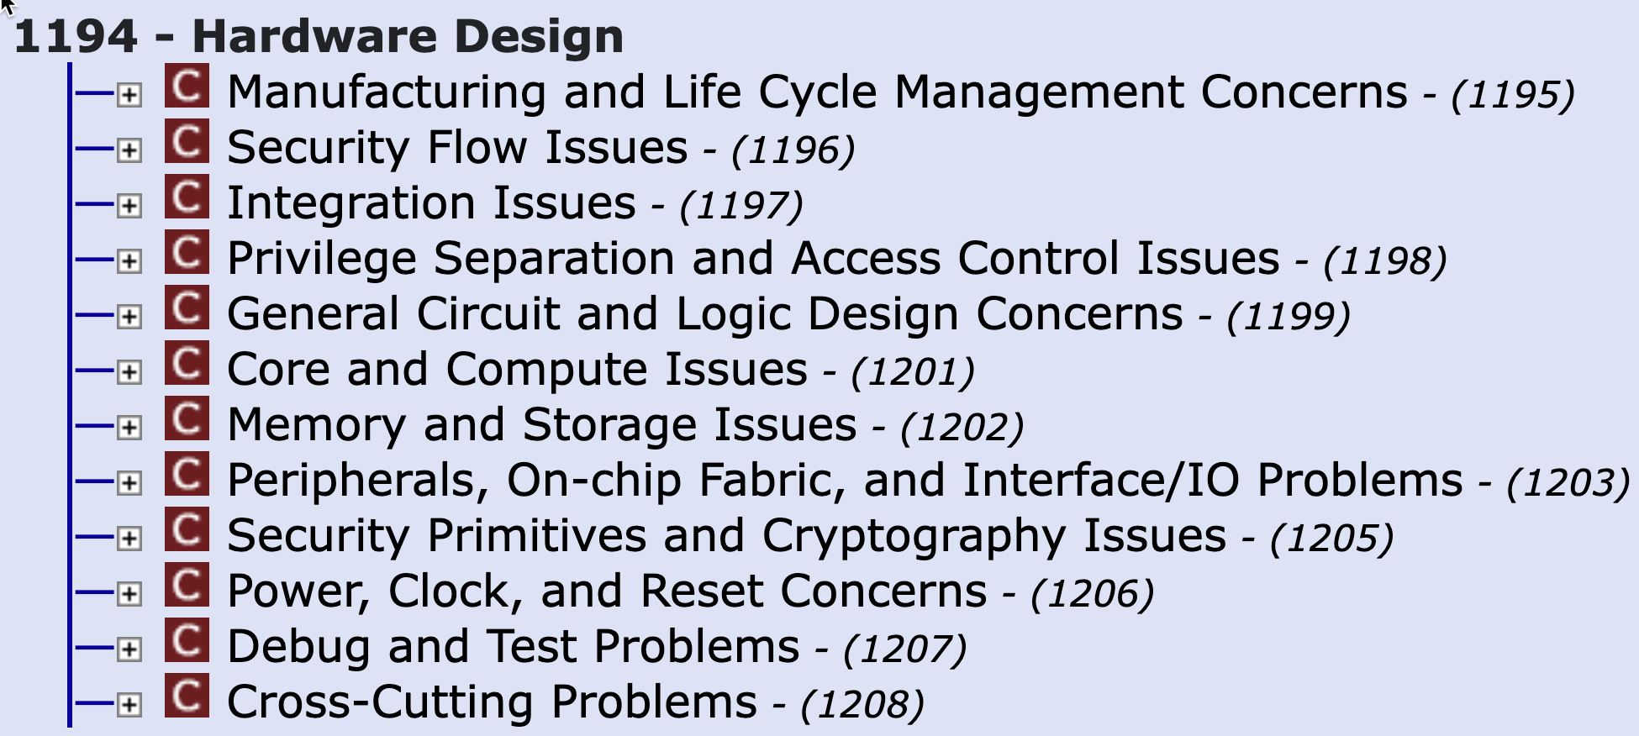
The CWE-1194 Hardware View shows categories
The hardware view has the categories as shown below currently
CWE-1276: Hardware Child Block Incorrectly Connected to Parent System, is the only weakness under Integration Issues category
CWE-1351: Improper Handling of Hardware Behavior in Exceptionally Cold Environments is “forced” into Security Primitives and Cryptography Issues, with no clear alternative
Are there additional Weakness Categories or any improvement suggestions for weaknesses under them?

Slide 11
CWE Content Challenge:
Distinguishing Between HW/SW/FW

Slide 12
Usability Challenge
Some users want a clear way to distinguish between “hardware” and “software” weaknesses
This cannot be done automatically with 100% accuracy
“Membership in the hardware view 1194” includes CWEs that affect both software and hardware
Too many hardware-related technology classes would make for a complicated query, even if data was complete
How to address this?
Add general technology class for Applicable Platforms, or define a new element?
How do we define “hardware,” “software,” and “firmware” in a way that users will agree with?

Slide 13
Announcements and Reminders

Slide 14
Announcements and Reminders (1 of 2)
CAPEC Community Summit
February 23, 2022
Focus: Program improvements, education and awareness, and modernization.
Participate in discussions around:
Assessing CAPEC offerings
User perceptions
Mitigating supply chain attacks with CAPEC
Using CAPEC’s execution flows (steps to perform an attack) as a playbook for pen testing
Vision shaping for the future of the program
Other topics suggested by attendees

Slide 15
Announcements and Reminders (2 of 2)
CWE/CAPEC Feedback Request
Short survey
What do you think about the topics being covered through our blog and podcast, Out-of-Bounds Read? Did you know we had them??
Is there anything else that you want to see or learn more about? We invite you to take a few minutes to share your thoughts today!

Slide 16
Next Meeting (February 18)
Topics of interest?
Questions, Requests to present? Please let us know
CWE@MITRE.ORG

