Slide 1
Hardware CWE™ Special Interest Group (SIG)
Gananand Kini, Luke Malinowski, Chris Lathrop, Bob Heinemann, Steve Christey Coley, Alec Summers
MITRE
May 13, 2022

Slide 2
Agenda
Housekeeping
Announcements
Mailing List Active Discussions Summary
Removal of IP Phrase
Scope Exclusions
Working Items for this meeting:
Removal of IP Phrase Update (Steve)
New Categories Presentation and Discussions
Jason Fung, presenting (15 min)
Paul Wortman, presenting (15 min)
Group discussion (10 min)
CWE 4.7 Release and Update
Scope Exclusions Update (Steve)

Slide 3
Housekeeping
Schedule:
Next Meeting – June 10, 2022
12:30 – 1:30 PM EST
Microsoft Teams
Contact: cwe@mitre.org
Mailing List: hw-cwe-special-interest-group-sig-list@mitre.org
Minutes from previous meetings available on our Github site:
https://github.com/CWE-CAPEC/hw-cwe-sig

Slide 4
Announcements
CWE 4.7 released
ICS/OT related submissions
Documentation entry
Reminder: CWE/CAPEC REST API Working Group is in progress now
ICS/OT Special Interest Group kickoff coming soon …

Slide 5
Removal of “IP” phrasing from Technology Name Steve C.

Slide 6
Removing “IP” from Technology Name Enumeration
This was done in CWE 4.7, but problems remain
Phrases like "Microcontroller", "Processor", "Sensor" and others seemed fine as-is
However, some values can be misunderstood to be applicable to software as well
Security: “my web app uses a third-party module for access control. Let me search CWE for all weaknesses in Security technology.”
Memory: “my program has a buffer overflow or a memory leak. The relevant tech is Memory”
Others: Storage (database), Communication (networking), Test/Debug
Upcoming email discussion: how to change these names to emphasize hardware

Slide 7
HW CWE Categories Work Stream

Slide 8
HW CWE Category Work Stream
Proposal of new categories
“Missing/Improper Protection against Physical Attacks” (Jason F)
“Environmental System Issues”, “Hardware Trojans”, “Untrusted Manufacturing”, and “Reverse Engineering” (Paul W)
Edits to existing categories
Proposed title edit for CWE-1206 (Arun K)
Re-categorization of existing CWEs
Organizing entries by functionality (MITRE)
CWE-1319, CWE-1300, CWE-1278 (Jason F)
CWE-1276 (MITRE)
Cross categorize CWE-1332, CWE-1247, CWE-1255, CWE-1351, CWE-1338, CWE-1263

Slide 9
HW CWE Categories Work Stream Jason Fung

Slide 10
Proposal to Improve Organization of Physical Attack Related HW CWEs for Easier Reference
February 18, 2022
(Updated on May 6, 2022)
[External Presenter]

Slide 11
Motivation
MITRE team posed the following question to the HW CWE SIG on February 17, 2022
If time permits, Texas Instruments has published a note detailing physical security attacks against Silicon devices and potential mitigations. The note highlights attacks and potential mitigations in general. Does this community see any potential weaknesses (existing or new) that allow for such attacks and whether the listed mitigations apply to any existing or new weaknesses?
Per https://www.ti.com/lit/an/swra739/swra739.pdf?ts=1644234570420, the stated scope includes:
Physical attacks include, but are not limited to:
Fault injection attacks, including voltage spike glitches, electromagnetic pulses, clock glitching injection, overclocking, and focused ion beam attacks
Side-channel attacks against silicon, including power analysis and electromagnetic analysis
[External Presenter]

Slide 12
Proposals to Group CWEs Related to Physical Attacks
Create a new sub-category under “Cross-Cutting” called “Missing/Improper Protection against Physical Attacks”
To host entries concerning insufficient mitigations against physical attacks (not remote), including Fault Injection, Side Channels and Reverse Engineering
Open to better naming
“missing” vs. “improper” vs. “insufficient”
“physical attacks” vs. “exploitations of physical properties”
Move vs. Link
Move entry if weakness description does not seem to have a direct linkage to the current category
[External Presenter]

Slide 13
Proposals to Group CWEs Related to Physical Attacks
Move these existing CWEs under the new category (remove from existing categories)
Improper Protection against Electromagnetic Fault Injection (EM-FI) (1319) currently under “Peripherals, On-chip Fabric, and Interface/IO Problems”
Improper Protection of Physical Side Channels (1300) currently under “Cross-Cutting Problems” and “Security Primitives and Cryptography Issues”
Missing Protection Against Hardware Reverse Engineering Using Integrated Circuit (IC) Imaging Techniques (1278) currently under “Cross-Cutting Problems” and “Manufacturing and Life Cycle Management Concerns”
Link these existing CWEs to the new category (keep existing categories)
Improper Handling of Faults that Lead to Instruction Skips (1332) currently under “Power, Clock and Reset Concerns”
Improper Protection Against Voltage and Clock Glitches (1247) currently under “Power, Clock and Reset Concerns”
Comparison Logic is Vulnerable to Power Side-Channel Attacks (1255) currently under “Power, Clock and Reset Concerns”
Improper Handling of Hardware Behavior in Exceptionally Cold Environments (1351) under “Security Primitives and Cryptography Issues”
[External Presenter]

Slide 14
Why These CWEs Not Included?
CWE-1338: Improper Protections Against Hardware Overheating under “Power, Clock and Reset Concerns”
Focus on compromising availability due to overheating being triggered remotely (otherwise hammer attack would be sufficient)
CWE-1263: Improper Physical Access Control under “Cross-Cutting Problems”
Focus on physical access control (preventing attackers access) vs.
Proposed category focuses on resilience against attacks (assuming attackers already have access to pull off their attacks)

Slide 15
Related Considerations
CWE-1319: Improper Protection against Electromagnetic Fault Injection
Currently focuses on EM only
Recommendation: SIG community can help to expand and cover additional Fault Injection vectors like power and laser to make the existing collaterals more complete
CWE-1334: Unauthorized Error Injection Can Degrade Hardware Redundancy
Entry title can potentially lead readers to think it is Physical Attacks related
The issue is actually about unauthorized agents/IPs inside an SoC introducing errors
Recommendation: Consider to update title to make it more clear, such as “Unauthorized Error Injection by Untrusted IP Agent Can Degrade Hardware Redundancy”
[External Presenter]

Slide 16
HW CWE Categories Work Stream Dr. Paul Wortman

Slide 17
MITRE CWE Category Proposals
Wells Fargo: Dr. Paul A. Wortman
May 11, 2022
[External Presenter]

Slide 18
Environmental System Issue
Motivation for the Proposal: As the variety of environments that IC/embedded systems/SoC/devices operate within expand, there is a desire to harden these elements against external influence
Whether intentional or not the external influence could affect operation (malicious or not)
Gaps Observed: Initially in PUF research, lack of consideration for security-based concerns.
PUF proposed as UUID, Challenge/Response, or as a seed for RNG
A keystone of PUF is the unique environment if each PCB/environment being operated in
Similar concerns with electro-magnetic properties of transistors in chips/memory circuits
Can affect assumptions made on operation of electrical devices
How the proposal addresses gaps:
Improves / Provides attention to the scope of initial concerns & considerations that can lead to exploitable weaknesses to electronic & mechanical devices
How change fit within current CWE structures:
Not as widely covering space as “Cross-Cutting Problems” (1208) & uniquely enough to not fit under any of the other Hardware Design View (1194)
[External Presenter]
Notes:
The operational environment of devices needs to be accounted for from each type of potential external influence
This influence can range from being a general nuisance to malicious in nature
How large do we want the scope of the environment to be?
Do we just count external influences?
Do we include the effects caused by this influence?
Do we separate out purely environmental (e.g. hostile environmental conditions) vs human-generated / controlled influences?

Slide 19
Discussion
Should the category be added to HW CWE?
Two separate categories or one?
Category or sub-category?
Name of category?
CWE-1206 (Power, [Thermal], Clock and Reset Concerns)
Should we keep this category?
Notes:
Arun made Thermal suggestion to CWE-1206.

Slide 20
HW CWE 4.7 Release Update

Slide 21
CWE 4.7 Release – Highlights Related to Hardware
(New) CWE-1384: Improper Handling of Extreme Physical Environment Conditions
“The product does not properly detect and handle extreme conditions in the product's physical environment, such as temperature, radiation, humidity, power, or other physical phenomena.”
Parent of CWEs related to single event upsets, not handling extreme cold, voltage/clock glitches, faults causing instruction skips
(Modified) CWE-1059: Insufficient Technical Documentation
“The product does not contain sufficient technical or engineering documentation (whether on paper or in electronic form) that contains descriptions of all the relevant software/hardware elements of the product, such as its usage, structure, architectural components, interfaces, design, implementation, configuration, operation, etc.”
Adds hardware-specific content based on a submission from Paul Wortman
(New) CWE-1357: Reliance on Uncontrolled Component
“The product's design or architecture is built from multiple separate components, but one or more components are not under complete control of the developer, such as a third-party software library or a physical component that is built by an original equipment manufacturer (OEM).”

Slide 22
CWE 4.7 - New view for ICS/OT
New view: CWE-1358: Weaknesses in SEI ETF Categories of Security Vulnerabilities in ICS
https://cwe.mitre.org/data/definitions/1358.html
3-level hierarchy (“super-categories”, categories, weaknesses)
Current mappings derived from original document and MITRE suggestions
Active development to take place in the coming months (in the SIG)
Many “scoping” challenges, e.g., human processes or practices
Signals new expansion / coverage of ICS/OT
Some possible overlap with hardware CWE
Some possible overlap with Top 20 Secure PLC Coding Practices

Slide 23
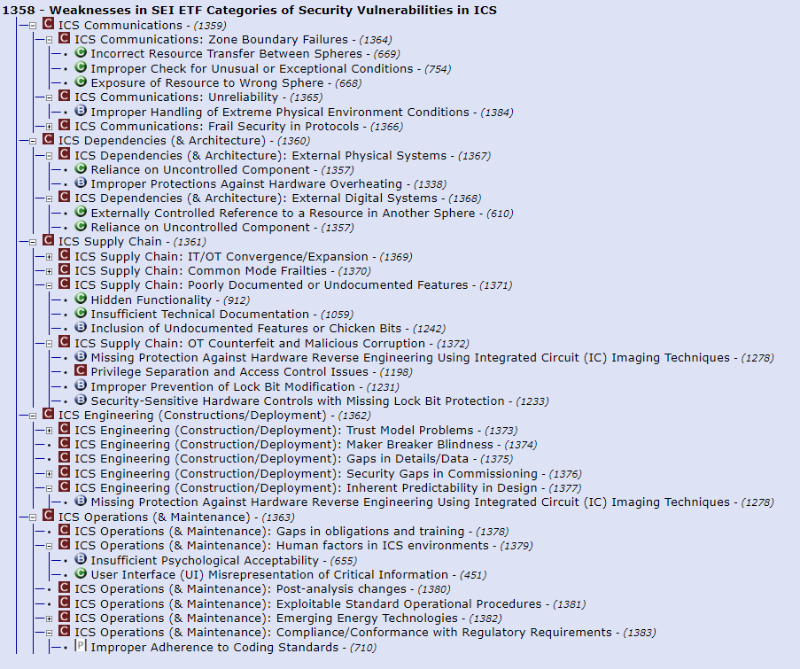
ICS/OT View – Sample Visualization
This screenshot is partially expanded
Red “C” icon = CWE Category
Green “C” C / Blue “B” icons – Class/Base level weaknesses
Categories without member weaknesses have a dot to the left of their icon
Go to individual web page for CWE-1358
Click “Expand All”

Slide 24
Scope Exclusions Discussion Update Steve C.

Slide 25
Revisiting Scope Exclusions
Clarify commonly-seen problems in CWE submissions
Decision is not final yet - focus discussion and debate, increase transparency/tracking
Submissions with these issues can’t receive a CWE ID, but might be captured within fields
 | Description
E1 | Any mistake that has not and cannot happen within real-world software or other electronic logic.
E2 | Any human or organizational process or policy that is not measurable and does not produce clear artifacts that identify weaknesses, such as training or testing. Rationale: weaknesses can emerge as a result of these activities; BSIMM, OpenSAMM, NIST Secure Software Development Framework, etc. already cover this area.
E3 | Any characterization of motivation (e.g., “malicious”) that does not focus on the actual mistake, whether intentionally or accidentally introduced. Rationale: a weakness is based on the behavior of the product.
E4 | Conditions or situations in which weaknesses are more likely to appear. Rationale: these are modes of introduction, which is a separate field in a CWE entry.

Slide 26
Proposed Scope Exclusions (2)
Other exclusions might be added
 | Description
E5 | Any collection of groupings related to the same technology, same language, development lifecycle, etc., without a common behavior. Rationale: weaknesses are based on specific behavior. Such items could be a category.
E6 | There is no actionable mitigation available to the developer to prevent or reduce the weakness.
E7 | The issue is not relevant to the threat model / security concerns of product’s owner/operator (i.e., the customer).
E8 | (NEW) The issue does not directly conflict with other CWE entries, e.g., “X is bad” in one CWE, and “Y is bad so do X instead” in another CWE.

Slide 27
Summary of HW SIG Comments
Responses from 4 SIG members
General feedback
Clarify phrasing
Provide examples
Some exclusions require further discussion and resolution

Slide 28
E6: No Actionable Mitigations
E6: There is no actionable mitigation available to the developer to prevent or reduce the weakness.
SIG comments:
This can be useful for future planning, or for security research
“There’s always a mitigation” such as not having the capability at all
Proposal: “actionable and effective”
Original rationale:
CWE has focused on weaknesses that appear in deployed, real-world products
There may be many different issues with “no mitigation” for which every product could have a CWE reported
Limited usability for people fixing problems now
Affected: CWE-1278 (RE by IC imaging): “does not seem to be a vulnerability as much as a physical reality” (MITRE colleague Kerry Crouse)

Slide 29
E7: Not Relevant to Customer’s Threat Model
E7: The issue is not relevant to the threat model / security concerns of product’s owner/operator (i.e., the customer).
SIG comments
Request for clarification on what this is referring to. What is the goal?
More stakeholders than customers should benefit from CWE
Original Rationale:
CWE focus has been on the risk perspective of the customer themselves
Intellectual property is probably very hairy from a classification perspective
Affected: CWE-1278 (RE by IC imaging): the knowledge of how a product works is not important to a customer.
Also a violation of E8: implying that one must obfuscate how the product works encourages adopting “security through obscurity” (CWE-656).
In general: all open source software shouldn’t be flagged with an anti-RE weakness

Slide 30
Other Comments
Clarification on E4: “Conditions or situations in which weaknesses are more likely to appear” can be broad. How to handle cold boot attacks, rowhammer, gamma ray bitflips?
CWE-1338, CWE-1351
These were not intended to be excluded per se. Will give examples.
New exclusion: incorrect use of a product by its customer
“we also need to exclude the cases where a user is not correctly using the product. (say: user shares the password). In such scenarios, no security can practically work.”

Slide 31
Scope Exclusions – Next Steps
Improvements in phrasing
Some examples
Capture of the debate
Publish as “proposed exclusions” to stakeholders and public CWE web site
Collect feedback
Make final decisions (… but how?)

Slide 32
Next Meeting (June 10)
Mailing List: hw-cwe-special-interest-group-sig-list@mitre.org
What would members of this body like to see for the next HW SIG agenda?
Questions, Requests to present? Please let us know.
CWE@MITRE.ORG

Slide 33
BACKUP

Slide 34
Hardware Trojans
Motivation for the Proposal: Range of insertions from netlist stage to fabrication & a variety of implementation / focuses
Argument is that “Hardware Trojans” is not itself a weakness but rather a common characteristic that describes the result of exploiting or inserting weaknesses into a design
Gaps Observed: Lack of awareness / connection between existing Hardware Trojan resources (e.g. Trust-Hub) & the CWE
Desire to represent the weaknesses that allow for the insertion, use, detection, activation of Hardware Trojans
How the proposal addresses gaps: Presents a clear category of concern that
Outlines the broad space of injection, introduction, & insertion
More weaknesses of protections, mitigations, & documentation
Provide detection & mitigative information
Give the detection & mitigation techniques for searching, locating, & neutralizing Hardware Trojans
How change fit within current CWE structures:
Concepts could fit under “Manufacturing and Life Cycles Management Concerns” (1195) or “General Circuit and Logic Design Concern” (1199); but Hardware Trojans are not specifically the weakness
Notes:
While these Hardware Trojans could be sub-categorized under “Manufacturing and Life Cycles Management Concerns” (1195) or “General Circuit and Logic Design Concern” (1199) categories, it is larger than this
Includes a large space than those entailed by either set
Variety of abstraction level, effect, characteristics, etc. leaves a large potential space of identification, protection, and mitigation of HW Trojans
Note: Not entirely sure how to exactly define the weakness, but the concept is the weakness given to the overall device / system caused by the existing HW Trojan
Effect examples: Loss of C/I/A, leaking of sensitive data (e.g. keys, seeds)
Nota Bene: Could also fit the “Golden Standard” entry / concept
Since Hardware Trojans are not a weakness, it does not make sense to place them under any other category

Slide 35
Untrusted Manufacturing
Motivation for the Proposal: This category covers a potential introduction on unexpected weaknesses due to Security & trust concerns ranging from software to hardware to human resources
Gaps Observed: Covering a similar area of concern as Hardware Trojans, the weaknesses that are not currently present that deal with the manufacturing process, trust assurance of work (e.g. fidelity to original design / function), protections of IP, tracking of provenance / pedigree, & introductions of malicious alterations / circuits
How the proposal addresses gaps: Bring to light the concerns across the supply chain relating to the lost / protection of Intellectual Property (IP) and/or the deployment of protections against malicious alterations / behavior
While the exact weaknesses are not precisely defined, the protection mechanisms & techniques are
How change fit within current CWE structures:
Could fit under other categories, perhaps would work as a class?
Need to determine an appropriate scope

Slide 36
Reverse Engineering
Motivation for the Proposal:
Gaps Observed:
How the proposal addresses gaps:
How change fit within current CWE structures:

