Slide 1
Hardware CWE™ Special Interest Group (SIG)
Gananand Kini, Bob Heinemann, Luke Malinowski, Chris Lathrop, Steve Christey Coley, Alec Summers, Connor Mullaly, Rich Piazza
MITRE
September 9, 2022

Slide 2
Agenda
REMINDER: This meeting is being recorded.
Housekeeping
Announcements
Working Items for this meeting:
Meeting kickoff and administration – 10 Min
CAPEC/CWE HW Mapping Example (Connor Mullaly) – 15 Min
HCWE109 Submission (Scott D Constable) – 30 Min
Existing CWEs that may map to microarchitectural attacks (Ganu Kini) – 5 Min

Slide 3
Housekeeping
Schedule:
Next Meeting – October 14, 2022
12:30 – 1:30 PM EST (16:30 – 17:30 UTC)
Microsoft Teams
Contact: cwe@mitre.org
Mailing List: hw-cwe-special-interest-group-sig-list@mitre.org
Minutes from previous meetings available on our Github site:
https://github.com/CWE-CAPEC/hw-cwe-sig

Slide 4
Mailing List Items
Mailing List: hw-cwe-special-interest-group-sig-list@mitre.org
NOTE: All mailing list items are archived publicly at:
https://www.mail-archive.com/hw-cwe-special-interest-group-sig-list@mitre.org/

Slide 5
Announcements
CAPEC content freeze is September 22, 2022.
CAPEC release is scheduled for September 29, 2022.
CWE content freeze for is October 5, 2022.
CWE 4.9 release is scheduled for October 13, 2022.

Slide 6
CAPEC to HW CWE Mapping Example Connor Mullaly

Slide 7
New Hardware CAPEC
Exploitation of Firmware or ROM Code with Unpatchable Vulnerabilities
Motivated by the following HW CWE entries:
CWE 1277: Firmware not Updateable
CWE 1310: Missing Ability to Patch ROM Code
The CAPEC team is looking for feedback from the SIG
Content improvement
Additional examples
Additional references
Any other areas of improvement

Slide 8
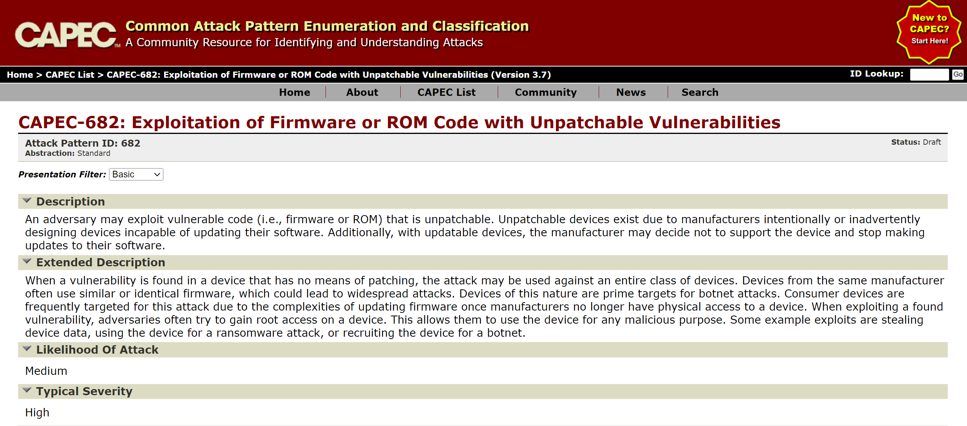
This screenshot is pre-publication

Slide 9
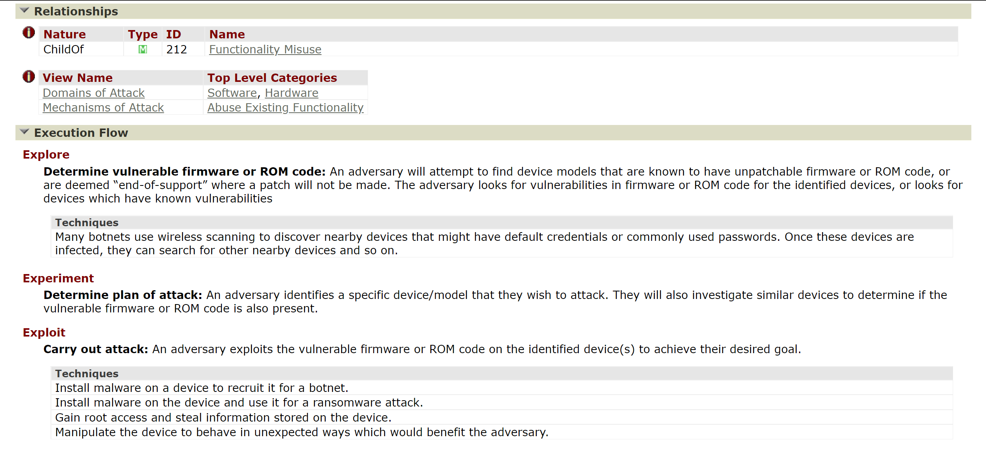
This screenshot is pre-publication

Slide 10
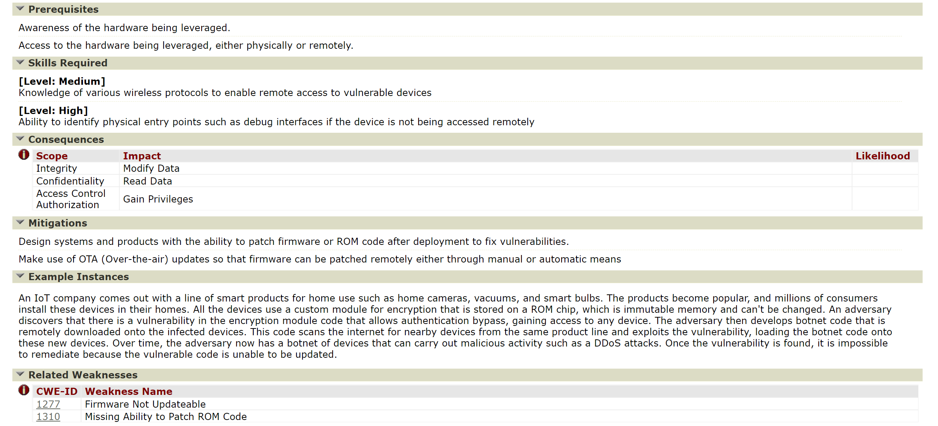
This screenshot is pre-publication

Slide 11
Questions / Feedback?
Please provide feedback directly to the mailing list at hw-cwe-special-interest-group-sig-list@mitre.org

Slide 12
Submission on “Non-transparent behavior of microarchitectural features” Scott Constable

Slide 13
Improving CWE Coverage for Weaknesses that Relate to Transient Execution
Slides from external presenter

Slide 14
CWEs that Relate to Transient Execution
CWE | Title | Description
1037 | Processor Optimization Removal or Modification of Security-critical Code | The developer builds a security-critical protection mechanism into the software, but the processor optimizes the execution of the program such that the mechanism is removed or modified.
1264 | Hardware Logic with Insecure De-Synchronization between Control and Data Channels | The hardware logic for error handling and security checks can incorrectly forward data before the security check is complete.
1303 | Non-Transparent Sharing of Microarchitectural Resources | Hardware structures shared across execution contexts (e.g., caches and branch predictors) can violate the expected architecture isolation between contexts.
Slides from external presenter

Slide 15
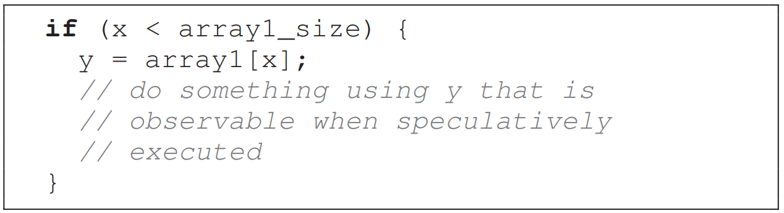
CWEs that Relate to Transient Execution
CWE | Title | Description
1037 | Processor Optimization Removal or Modification of Security-critical Code | The developer builds a security-critical protection mechanism into the software, but the processor optimizes the execution of the program such that the mechanism is removed or modified.
1264 | Hardware Logic with Insecure De-Synchronization between Control and Data Channels | The hardware logic for error handling and security checks can incorrectly forward data before the security check is complete.
1303 | Non-Transparent Sharing of Microarchitectural Resources | Hardware structures shared across execution contexts (e.g., caches and branch predictors) can violate the expected architecture isolation between contexts.
Source: P. Kocher, J. Horn, A. Fogh, D. Genkin, D. Gruss, W. Haas, M. Hamburg, M. Lipp, S. Mangard, T. Prescher, M. Schwarz and Y. Yarom, "Spectre Attacks: Exploiting Speculative Execution," in 40th IEEE Symposium on Security and Privacy, San Francisco, CA, 2019.
Slides from external presenter

Slide 16
HCWE-109
CWE | Title | Description
1037 | Processor Optimization Removal or Modification of Security-critical Code | The developer builds a security-critical protection mechanism into the software, but the processor optimizes the execution of the program such that the mechanism is removed or modified.
1264 | Hardware Logic with Insecure De-Synchronization between Control and Data Channels | The hardware logic for error handling and security checks can incorrectly forward data before the security check is complete.
1303 | Non-Transparent Sharing of Microarchitectural Resources | Hardware structures shared across execution contexts (e.g., caches and branch predictors) can violate the expected architecture isolation between contexts.
XXXX | Non-Transparent Behavior of Microarchitectural Resources | Hardware features (e.g., branch predictors) can violate the expected behavior of a program.
Slides from external presenter

Slide 17
Slides from external presenter
Notes:
CWE-XXXX: Non-Transparent Behavior of Microarchitectural Features
Description
Hardware features (e.g., branch predictors) can violate the expected behavior of a program.
Extended Description
Modern processors use techniques such as out-of-order execution, speculation, prefetching, data forwarding, and caching to increase performance. This is problematic when the hardware implementation of these techniques results in unexpected behavior of instructions that execute but never retire. These instructions may be able to access and use data in a manner that was not expected by the program developer. Some examples of hardware features that may cause this unexpected behavior include branch prediction, memory disambiguation, and store-to-load prediction.
If the behavior of these hardware features in the design microarchitecture is undocumented, it is extremely difficult to ensure system assets are protected against disclosure.
Relationships
Nature
Type
ID
Name
ChildOf
B
203
Observable Discrepancy

Slide 18
Slides from external presenter
Notes:
Modes of Introduction
Phase
Note
Architecture and Design
Such issues could be introduced during hardware architecture and design and identified later during Testing or System Configuration phases.
Implementation
Such issues could be introduced during implementation and identified later during Testing or System Configuration phases.
Applicable Platforms
Languages
Class: Language-Independent
Operating Systems
Class: OS-Independent
Architectures
Class: Architecture-Independent
Technologies
Class: Technology-Independent

Slide 19
Slides from external presenter
Notes:
Common Consequences
Scope
Impact
Likelihood
Confidentiality
Technical Impact: Read Application Data; Read Memory
Microarchitectural side-channels have been used to leak specific information such as cryptographic keys, and Address Space Layout Randomization (ALSR) offsets as well as arbitrary memory.
Demonstrative Examples
Example 1
Secure programs perform bounds checking before accessing an array if the source of the array index is provided by an untrusted source such as user input. In the code below, data from array1 will not be accessed if x is out of bounds. However, if this code executes on a processor that performs speculative execution the outcome of the if statement could be mis-predicted and the access on the next line will occur with a value of x that can point to arbitrary locations in the program’s memory (out-of-bounds).
Even though the processor rolls back the architectural effects of the mis-predicted branch, the memory accesses alter data cache state, which is not rolled back after the branch is resolved. The cache state can reveal array1[x] thereby providing a mechanism to recover any word in this program’s memory space.
if (x < array1_size) y = array2[array1[x] * 4096];
Code snippet is from the Spectre paper: https://spectreattack.com/spectre.pdf.

Slide 20
Slides from external presenter
Notes:
Potential Mitigations
Phase: Architecture and Design
Microarchitectural covert channels can be addressed using a mixture of hardware and software mitigation techniques. These include partitioned caches, new barrier and flush instructions, and disabling high resolution performance counters and timers.
Phase: Requirements
Microarchitectural covert channels can be addressed using a mixture of hardware and software mitigation techniques. These include partitioned caches, new barrier and flush instructions, and disabling high resolution performance counters and timers.
Related Attack Patterns
CAPEC-ID
Attack Pattern Name
CAPEC-663
Exploitation of Transient Instruction Execution

Slide 21
Is This a Partition? Should it be a Partition?
CWE | Title | Description
1037 | Processor Optimization Removal or Modification of Security-critical Code | The developer builds a security-critical protection mechanism into the software, but the processor optimizes the execution of the program such that the mechanism is removed or modified.
1264 | Hardware Logic with Insecure De-Synchronization between Control and Data Channels | The hardware logic for error handling and security checks can incorrectly forward data before the security check is complete.
1303 | Non-Transparent Sharing of Microarchitectural Resources | Hardware structures shared across execution contexts (e.g., caches and branch predictors) can violate the expected architecture isolation between contexts.
XXXX | Non-Transparent Behavior of Microarchitectural Resources | Hardware features (e.g., branch predictors) can violate the expected behavior of a program.
Slides from external presenter

Slide 22
Initial Review of “Non-transparent behavior of microarchitectural features” Steve Christey Coley

Slide 23
Portion of “Initial Review” of Intel’s Submission (using submission problem IDs)
Problem ID | Boilerplate Description
SUB.OVERLAP | "Duplicate/Overlap". Submission identifies a weakness, but it is a duplicate of (or partially overlaps) existing weaknesses, indicating problems with the submission or associated CWE entries. Resolution: the submission cannot progress to later stages until the duplicate/overlap is understood and the CWE Team identifies the process for resolving the duplicate/overlap.
SUB.UNCLEAR | "Unclear weakness". Submission's name and/or description does not clearly identify a weakness, or it is written in a way that is vague and could cause the submission to be incorrectly mapped to. Resolution: an initial submission (or full submission) cannot progress past the consultation phase until SUB.UNCLEAR is addressed.
SCOPE.GROUPING | "Grouping of issues without a common behavior". Submission is a collection of groupings related to the same technology, same language, development lifecycle, etc., without a common behavior between them all.
SUB.NOINIT | "No Initial Review". The submission did not go through the Initial Review / Initial Consultation phases (Proposal stage) and has significant problems that should have been resolved in that phase (e.g., SUB.UNCLEAR). This primarily applies to situations when external requesters provided a Full Submission form (Production stage) in 2021 and 2022, before the CWE Team launched the external submission web server and process. Resolution: the submission must be treated as if in the Initial-Review/Initial-Consultation phase, and the Full submission will not be evaluated until the Proposal stage is complete.

Slide 24
Why are Microarchitectural [and other hardware] Weaknesses Difficult to Manage in CWE?
Some early hardware CWEs (2020) did not clearly identify the weaknesses
"This [feature] can be a problem if programmers make mistakes"
"Somebody could attack this [feature] to do bad things"
Many publications have been focused on the attacks
Unclear why the Augury attack works
No widely-used terms for design/architecture weaknesses
Early taxonomies just say “Design Error”
Example from CWE-Research list: “Compartmentalization” vs. “Isolation”
Design/Architecture level weaknesses in CWE are not well-organized
overflows, injection, etc., are much more established

Slide 25
Existing CWEs that may map to microarchitectural attacks Gananand Kini

Slide 26
Weakness entries that mention “Meltdown”
CWE-1037: Processor Optimization Removal or Modification of Security-critical code
CWE-1303: Non-transparent Sharing of Microarchitectural Resources
CWE-1264: Hardware Logic with Insecure Desynchronization between Control and Data Channels

Slide 27
Weakness entries that mention “Spectre”
CWE-1037: Processor Optimization Removal or Modification of Security-critical code
CWE-1303: Non-transparent Sharing of Microarchitectural Resources
CWE-385: Covert Timing Channel
CWE-1342: Information Exposure through Microarchitectural State after Transient Execution

Slide 28
Spectre and Meltdown are attack focused
The focus in a lot of the papers related to Spectre and Meltdown call out microarchitectural features.
However, the weaknesses are not necessarily specific to any of these features.
Rather, weaknesses relate to transient execution which Scott Constable from Intel defines as "Instructions that depend on speculative values that are invalid and must be squashed, meaning that their results are not committed to the architectural program state." [1]

Slide 29
Transient Execution Weaknesses
A lot of the attacks [2] on out-of-order execution, speculative execution and the transient execution that occur as part of those features appear to go after more fundamental weaknesses:
Improper handling of transient state or effects
Consistency of behavior of transient operations to developers
Transparency of behavior of transient operations to developers
Leakage of transient state into cache
Covert timing channels
Others?

Slide 30
Do some of the earlier mentioned issues exist in CWE?
Improper handling of transient state (improper clean up etc.)
CWE-459: Incomplete Cleanup
CWE-1037: Process Optimization Removal or Modification of Security-critical code
CWE-653: Improper Isolation or Compartmentalization
Consistency of behavior of transient operations to developers
CWE-203: Observable Discrepancy
CWE-1250: Improper Preservation of Consistency Between Independent Representations of Shared State
Transparency of behavior of transient operations to developers
CWE-1303: Non-transparent Sharing of Microarchitectural Resources
Leakage of transient state into cache
CWE-402: Transmission of Private Resources into a New Sphere (‘Resource Leak’)
CWE-1342: Information Exposure through Microarchitectural State after Transient Execution
Covert timing channels in caches
CWE-385: Covert Timing Channel
CWE-208: Observable Timing Discrepancy

Slide 31
Recommendations
Are there gaps in these existing CWEs as applied to the hardware use cases?
Is there a need for finer grained weakness definition when it comes to microarchitectural features?
Analysis of ÆPIC attack (CVE-2022-21233), Augury attack (no CVE) along these lines.
What modifications must be made to existing CWEs to better clarify and organize these weaknesses?

Slide 32
References
Constable, Scott. “Refined Speculative Execution Terminology.” Intel, 25 Apr. 2021, https://www.intel.com/content/www/us/en/developer/articles/technical/software-security-guidance/best-practices/refined-speculative-execution-terminology.html.
Canella, Claudio, et al. "A systematic evaluation of transient execution attacks and defenses." 28th USENIX Security Symposium (USENIX Security 19). 2019.

Slide 33
Questions / Thoughts / Comments

Slide 34
Next Meeting (October 14)
Mailing List: hw-cwe-special-interest-group-sig-list@mitre.org
NOTE: All mailing list items are archived publicly at:
https://www.mail-archive.com/hw-cwe-special-interest-group-sig-list@mitre.org/
What would members of this body like to see for the next HW SIG agenda?
Questions, Requests to present? Please let us know.
CWE@MITRE.ORG

Slide 35
BACKUP

Slide 36
New Category Proposal Paul Wortman - BACKUP

Slide 37
MITRE CWE Category Proposals
Dr. Paul A. Wortman
July 15, 2022
Slides provided by external presenter

Slide 38
Reverse Engineering
Motivation for the Proposal: This category covers the set of concerns related to the protection of Intellectual Property (IP) (e.g. design, components) and data within
Gaps Observed: The gap observed for this category was that, at the time, the only reverse engineering entry was related to the user of imaging to essentially RE chip functionality (CWE-1278)
Beyond just this, there are several other potential techniques that are used to prevent RE; basically, the protection against weaknesses that could be exploited for the purpose of RE the design
How the proposal addresses gaps: Group together all potential weaknesses that could led to an adversarial entity to be able to reverse engineer given elements/circuits
Notes: This is tricky since the mitigations / attacks are more well known, whereas the weakness not as much
How change fit within current CWE structures:
Pulls together RE concerns under one umbrella
There is some representation of this (i.e. CWE-1278) for hardware, and some for SW (e.g. CWE-656, CAPEC-190, CWE-615)
Include CWE-693?
Slides provided by external presenter
Notes:
Idea: Categorize weaknesses that can allow “unwanted” individuals to obtain sensitive data, understand the internals of the design/system, or otherwise intimately understand it without proper documentation
With the inclusion of OT (industry tech?) this category of weaknesses that can be used to RE IP

Slide 39
Untrusted Manufacturing
Motivation for the Proposal: This category covers a potential introduction on unexpected weaknesses due to Security & trust concerns ranging from software to hardware to human resources
Gaps Observed: Covering a similar area of concern as Hardware Trojans, the weaknesses that are not currently present that deal with the manufacturing process, trust assurance of work (e.g. fidelity to original design / function), protections of IP, tracking of provenance / pedigree, & introductions of malicious alterations / circuits
How the proposal addresses gaps: Bring to light the concerns across the supply chain relating to the lost / protection of Intellectual Property (IP) and/or the deployment of protections against malicious alterations / behavior
While the exact weaknesses are not precisely defined, the protection mechanisms & techniques are
How change fit within current CWE structures:
Could fit under other categories, perhaps would work as a class?
Need to determine an appropriate scope
Shares threat to IP with Hardware Trojans; HT used to cause eventual change in behavior/outcome of implemented logic locking
Slides provided by external presenter
Notes:
Idea: Include additional topics such as Intellectual Property (IP) piracy/theft, sale of out-of-specification/rejected integrated circuits, and overproduction
Research has been done on comparing the capabilities of manufacturers against the potential for adversarial relationships between system builds and chip producers
Trying to assuage concerns over untrustworthy, malicious, or otherwise counterfeit integrated circuits
- Mitigations efforts include split manufacturing
Work has been done to produce defensive technology capable of detecting unexpected or potentially malicious behavior

Slide 40
Hardware Trojans
Motivation for the Proposal: Range of insertions from netlist stage to fabrication & a variety of implementation / focuses
Argument is that “Hardware Trojans” is not itself a weakness but rather a common characteristic that describes the result of exploiting or inserting weaknesses into a design
Gaps Observed: Lack of awareness / connection between existing Hardware Trojan resources (e.g. Trust-Hub) & the CWE
Desire to represent the weaknesses that allow for the insertion, use, detection, activation of Hardware Trojans
How the proposal addresses gaps: Presents a clear category of concern that
Outlines the broad space of injection, introduction, & insertion
More weaknesses of protections, mitigations, & documentation
Provide detection & mitigative information
Give the detection & mitigation techniques for searching, locating, & neutralizing Hardware Trojans
How change fit within current CWE structures:
Concepts could fit under “Manufacturing and Life Cycles Management Concerns” (1195) or “General Circuit and Logic Design Concern” (1199); but Hardware Trojans are not specifically the weakness
Slides provided by external presenter
Notes:
While these Hardware Trojans could be sub-categorized under “Manufacturing and Life Cycles Management Concerns” (1195) or “General Circuit and Logic Design Concern” (1199) categories, it is larger than this
Includes a large space than those entailed by either set
Variety of abstraction level, effect, characteristics, etc. leaves a large potential space of identification, protection, and mitigation of HW Trojans
Note: Not entirely sure how to exactly define the weakness, but the concept is the weakness given to the overall device / system caused by the existing HW Trojan
Effect examples: Loss of C/I/A, leaking of sensitive data (e.g. keys, seeds)
Nota Bene: Could also fit the “Golden Standard” entry / concept
Since Hardware Trojans are not a weakness, it does not make sense to place them under any other category

Slide 41
Environmental System Issue
Motivation for the Proposal: As the variety of environments that IC/embedded systems/SoC/devices operate within expand, there is a desire to harden these elements against external influence
Whether intentional or not the external influence could affect operation (malicious or not)
Gaps Observed: Initially in PUF research, lack of consideration for security-based concerns.
PUF proposed as UUID, Challenge/Response, or as a seed for RNG
A keystone of PUF is the unique environment if each PCB/environment being operated in
Similar concerns with electro-magnetic properties of transistors in chips/memory circuits
Can affect assumptions made on operation of electrical devices
How the proposal addresses gaps:
Improves / Provides attention to the scope of initial concerns & considerations that can lead to exploitable weaknesses to electronic & mechanical devices
How change fit within current CWE structures:
Not as widely covering space as “Cross-Cutting Problems” (1208) & uniquely enough to not fit under any of the other Hardware Design View (1194)
Slides provided by external presenter
Notes:
The operational environment of devices needs to be accounted for from each type of potential external influence
This influence can range from being a general nuisance to malicious in nature
How large do we want the scope of the environment to be?
Do we just count external influences?
Do we include the effects caused by this influence?
Do we separate out purely environmental (e.g. hostile environmental conditions) vs human-generated / controlled influences?

Slide 42
Scope Exclusion Discussions Steve Christey Coley - BACKUP

Slide 43
SCOPE.NOMITS: No Actionable Mitigations
There is no actionable mitigation available to the developer to prevent or reduce the weakness.
Original rationale:
CWE has focused on weaknesses that appear in deployed, real-world products
There may be many different issues with “no mitigation” for which every product could have a CWE reported
Limited usability for people fixing problems now
Affected: CWE-1278 (RE by IC imaging): “does not seem to be a vulnerability as much as a physical reality” (retired MITRE colleague Kerry Crouse)
SIG comments:
This can be useful for future planning, or for security research
“There’s always a mitigation” such as not having the capability at all
Proposal: “actionable and effective”

Slide 44
SCOPE.CUSTREL: Not Relevant to Customer’s Threat Model
The issue is not relevant to the threat model / security concerns of product’s owner/operator (i.e., the customer).
Original Rationale:
CWE focus has been on the risk perspective of the customer themselves
Intellectual property is probably very hairy from a classification perspective
SIG comments
Request for clarification on what this is referring to. What is the goal?
More stakeholders than customers should benefit from CWE
Affected: CWE-1278 (RE by IC imaging): the knowledge of how a product works is not important to a customer.
Also a violation of SCOPE.CONFLICT: implying that one must obfuscate how the product works encourages adopting “security through obscurity” (CWE-656).
In general: all open source software shouldn’t be flagged with an anti-RE weakness

Slide 45
Other HW SIG Comments
Clarification on SCOPE.SITUATIONS/EX4: “Conditions or situations in which weaknesses are more likely to appear” can be broad. How to handle cold boot attacks, rowhammer, gamma ray bitflips?”
CWE-1338, CWE-1351
These were not intended to be excluded per se. Will give examples.
New exclusion: incorrect use of a product by its customer
“We also need to exclude the cases where a user is not correctly using the product. (say: user shares the password). In such scenarios, no security can practically work.”
We do have CWE-655: Insufficient Psychological Acceptability – “protection mechanism that is too difficult or inconvenient to use, encouraging non-malicious users to disable or bypass the mechanism”

Slide 46
New Exclusions - SCOPE.CONFLICT / SCOPE.NOSEC
SCOPE.CONFLICT: The issue directly conflicts with other CWE entries, e.g., “X is bad” in one CWE, and “Y is bad so do X instead” in another CWE
Challenge: might be difficult for issues that involve tradeoffs, different threat models, or are more a matter of “opinion” as to which is appropriate
We can all agree (hopefully) that buffer overflows are bad, but what about design choices like microarchitectural improvements for speed?
SCOPE.NOSEC: The issue is not solely related to safety or reliability, i.e., it must be somehow related to security.
From the About CWE page: "a community-developed list of common software and hardware weakness types that have security ramifications”
Weakness definitions (proposed and otherwise) imply security
How to bound CWE so it’s not a general classification of all mistakes?
Notes:
E9 is consistent with the text on the CWE about page,
“Common Weakness Enumeration (CWE™) is a community-developed list of common software and hardware weakness types that have security ramifications. “Weaknesses” are flaws, faults, bugs, or other errors in software or hardware implementation, code, design, or architecture that if left unaddressed could result in systems, networks, or hardware being vulnerable to attack. The CWE List and associated classification taxonomy serve as a language that can be used to identify and describe these weaknesses in terms of CWEs.”

Slide 47
Advancing HW SIG Engagement Alec Summers

Slide 48
Background
CWE/CAPEC Goals:
Increase Program Coverage
Increase Program Adoption
Desired Outcome:
Products are more secure because weaknesses are eliminated thereby thwarting adversaries
HW CWE SIG is one of the CWE program's greatest success stories of collaborative community engagement towards the program's goals.

Slide 49
Accomplishments
Meetings on a monthly basis for almost 2 years!
0 –> 100 hardware design related weaknesses (and more in dev)
The inaugural Top 10 Most Important Hardware Weaknesses List
But more opportunities abound...

Slide 50
HW CWEs with no CAPEC Mappings
Coverage Crosswalk:
CWE–>CAPEC and CAPEC–>CWE mappings present content dev opportunity
Possible new CAPEC Entries:
CWE-ID | NAME
1251 | Mirrored Regions with Different Values (Intel)
1277 | Firmware Not Updateable (WF)
1310 | Missing Ability to Patch ROM Code (Intel)
1351 | Improper Handling of Hardware Behavior in Exceptionally Cold Environments (WF)
1342 | Information Exposure through Microarchitectural State after Transient Execution (Cycuity)
1276 | Hardware Child Block Incorrectly Connected to Parent System (Cycuity)
1291 | Public Key Re-Use for Signing both Debug and Production Code (Intel)
1384 | Improper Handling of Physical or Environmental Conditions (HW SIG + SEI ETF + MITRE)

Slide 51
CAPEC Development Continued
Content Requirements
We have a list of required elements that we can share with SIG, also the CAPEC schema provides details on each element (https://capec.mitre.org/documents/schema/index.html)
Please let us know if you might be interested in developing CAPEC content for these weaknesses

Slide 52
Discussion: CWE Content Development
(More to come from Bob in third topic on next CWE release possibilities)
HW CWE SIG sub-working group(s) to meet more regularly and tackle a particular domain or task area

Slide 53
Discussion: Company POCs
HW CWE SIG serves as a public forum
No limit attendance per organization currently
CWE/CAPEC program would like to avoid that unless problems arise (e.g., overrepresentation of one org perspective in dialogue)
Recent Problem
Organizations with multiple attendees sometimes have differing opinions
How to handle contrasting views on a topic?
CWE/CAPEC Board charter example: one org, one vote

Slide 54
HW CWE Working Queue Focus Items for 4.9 Bob H.

Slide 55
HW CWE Working Queue Focus Items for 4.9
We have selected a subset of working queue items for 4.9 (26)
Selection includes new CWE entries, modifications to existing CWE entries and schema updates.
We will briefly cover the items in next few slides.
Will most likely not able to finish all these topics by the release.
ASK:
While we review, please submit either through chat or the mailing list what are your priorities in this list. We then can focus our efforts on those items.

Slide 56
New CWE Entries
Internal Tracker #: Short Description
446: Investigate potential class level parent for CWE-1351 (Cold Temps) and CWE-1338 (Hot Temps)
466: HCWE13 Trusted Agents Excluded from Accessing a Sensitive Asset
467: HCWE14 Untrusted Agents Given Access to a Sensitive Asset
475: HCWE36 Usage of Non-compliant crypto (merged into CWE-327)
519: HCWE109 Non-transparent behavior of microarchitectural features
558: Is the underlying weakness that enables the Augury Vulnerability covered by any existing CWE?

Slide 57
Modifications to Existing CWEs (1 of 2)
Internal Tracker #: Short Description
250: CWE-1317 Editorial Changes
423: CWE-1191 Addition of clarifying phrases
426: CWE-1351 Proposal to move from existing category
435: CWE-1334 Editorial changes to clarify that is not about physical attacks
518: CWE-1303 Change incorrect example
525: CWE-1311 Fix bug in code example
529: CWE-1189 Update detection method description
530: CWE-1320 Proposal to change title
531: CWE-1206 Add term Thermal to category title
532: CWE-441 Add Acknowledgements to entry

Slide 58
Modifications to Existing CWEs (2 of 2)
Internal Tracker #: Short Description
603: CWE wide content formatting cleanup
533: Proposal to make CWE-1264 a variant of CWE-1280
534: Move CWE-1319 from existing category to new Physical Access Issues and Concerns Category
535: Move CWE-1300 from existing category to new Physical Access Issues and Concerns Category
536: Move CWE-1278 from existing category to new Physical Access Issues and Concerns Category

Slide 59
Schema Changes
125: Consider "Hardware Description Language" for Language Class
434: Clarify definition / use of "Technologies Class: Technology Independent" under Applicable Platforms

