Slide 1

Combining Machine Learning Image Segmentation Technique and Virtual Environment to Develop an Image-based Point-less Three-Dimensional Crack Information Algorithm
Name of Investigator：Chan, Wei Hsiang
Name of Committees： Prof. Yang, Yuan Sen
Date：112/06/16
Notes:
Hi, Everyone, I’m going to present my final project for this course. The title of this study is Combining Machine Learning Image Segmentation Technique and Virtual Environment to Develop an Image-based Point-less Three-Dimensional Crack Information Algorithm.
Point-less means that image measurement can be performed without any known 3D calibrate points.
結合機器學習之影像分割技術與虛擬環境開發無標記三維裂縫資訊點影像量測演算法

Slide 2
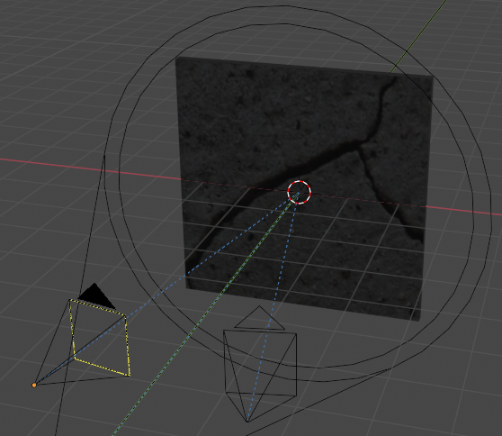
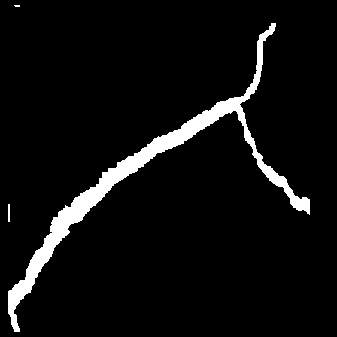
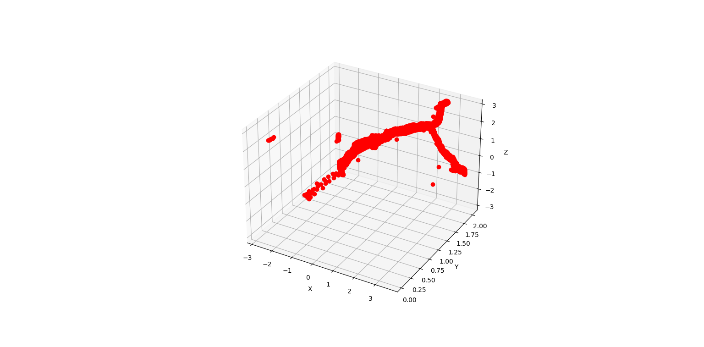


Study Method And Study Process
Virtual Environment
：Generate images
captured by the
left and right
camera
：Blender
Machine Learning
：Using Machine
learning to
segment the
image with crack
：Python、TensorFlow
Computer Vision
：Using CVIM
to get the 3D
coordinates of
crack
：Python、OpenCV
Notes:
This Study uses a virtual environment, machine learning, and computer vision technique to develop an Image-based Point-less Three-Dimensional Crack Information Algorithm.
In this study, I use Blender, Python, Tensorflow, and OpenCV as the tools to develop the Algorithm.

Slide 3
Study Method And Study Process
Machine Learning
Download the dataset from Kaggle
Training the segmentation model
Virtual Environment and Algorithm Development
Build a wall with crack in Virtual Environment
Set a left camera and a right camera
Render the image
Using Feature Match and get the feature points
Using least square to calculate the 3D coordinates of the crack pixel
Get crack pixel
ML Model Predict
Triangulation
Notes:
The study process is divided into two parts, one part is machine learning, and the other part is virtual environment and algorithm development.
In the part of machine learning, I download the segmentation training dataset of cracks from Kaggle in this study and use UNet3+ to train the model. UNet3+ is a model for segmentation improved by UNet.
In the part of the virtual environment and algorithm development, first, build a wall and post an image of cracked concrete on the wall in the virtual environment, set the left camera and right camera to aim at the wall, render images using the left and right cameras respectively, use the feature detector to detect the image and Match the feature points of the images of the left camera and the right camera, and triangulate the matched feature points. The camera’s intrinsic parameters and extrinsic parameters used in the triangulation are taken from Blender. After the triangulation, the depth range of the crack can be obtained, using machine learning to predict the image of the left camera to generate a crack segmentation image, use the crack segmentation image to find all the pixel positions with cracks in the image, use these pixel positions and least square to calculate the three-dimensional coordinates of all cracks, and use the least square The part of will limit the depth direction range before iterative calculation, that is the previously calculated depth direction range.

Slide 4
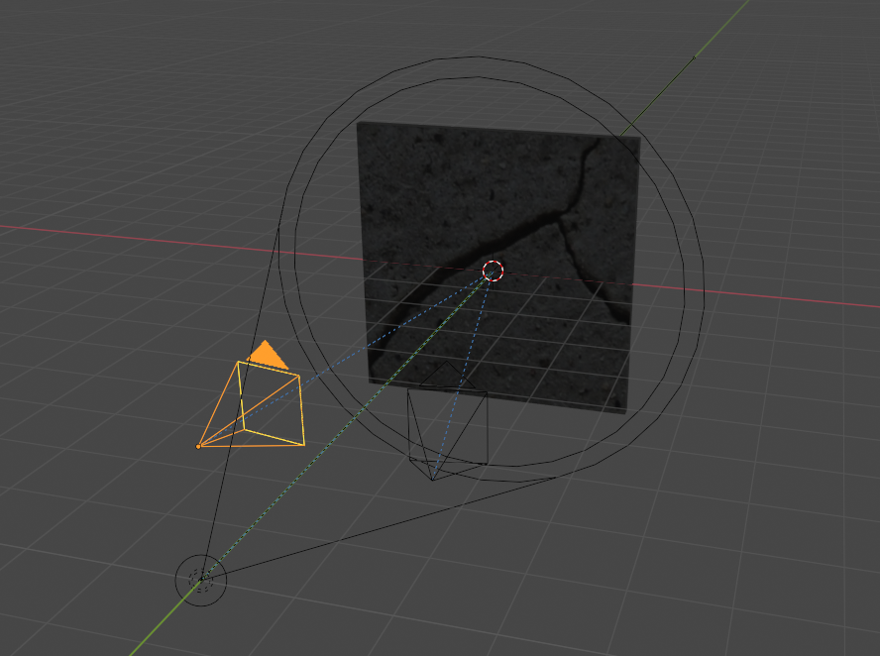
Study Method And Study Process
Notes:
This picture is a schematic diagram of building a wall in a virtual environment and posting an image of cracked concrete on the wall and setting the left and right cameras.

Slide 5
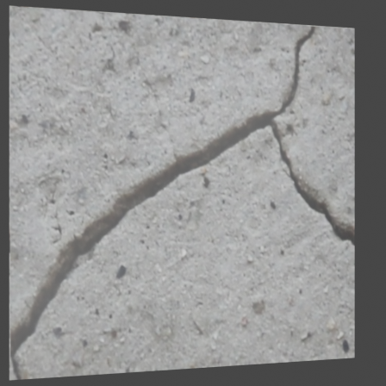
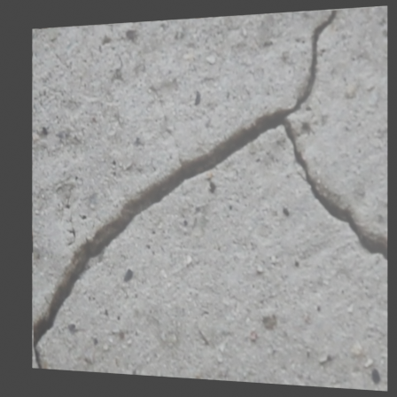
Study Method And Study Process
Notes:
Here are the images rendered by the left and right cameras respectively

Slide 6
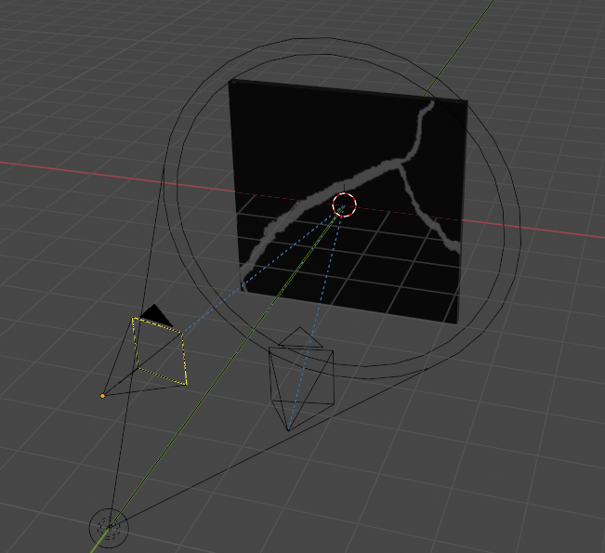
Study Method And Study Process
Notes:
This picture is a schematic diagram of building a wall in a virtual environment and posting a segmented image of cracked concrete on the wall and setting the left and right cameras. because of lack of time, the machine learning model has not been trained yet, so the segmented image is replaced by this method.

Slide 7
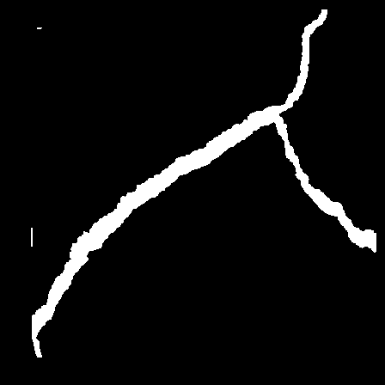
Study Method And Study Process
Notes:
Here are the images rendered by the left and right cameras respectively

Slide 8
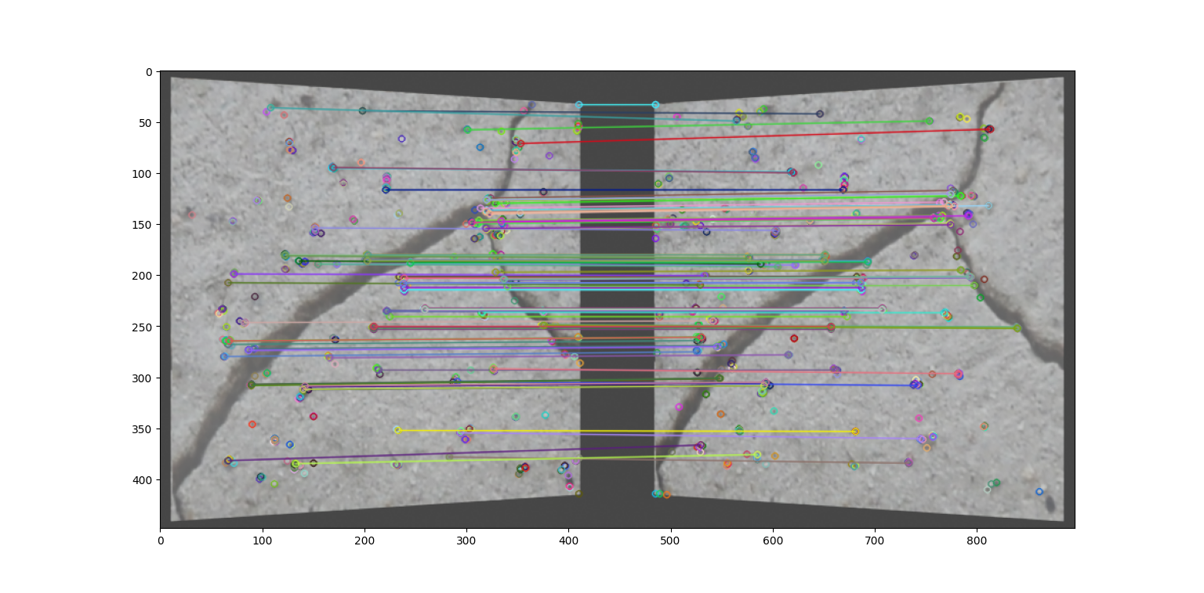
Study Method And Study Process
Notes:
This picture is to match the feature points of the images taken by the left camera and the right camera, and the corresponding relationship of the feature points can be seen on the picture

Slide 9
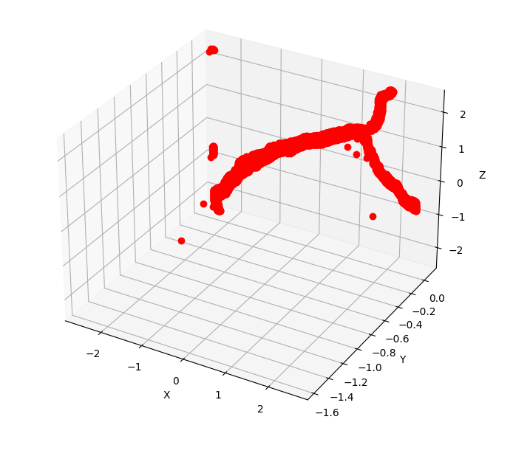
Study Method And Study Process
Notes:
This picture is the 3D coordinates of the crack calculated by the algorithm proposed in this study. The depth range here is calculated by matching the feature points of the original image

Slide 10
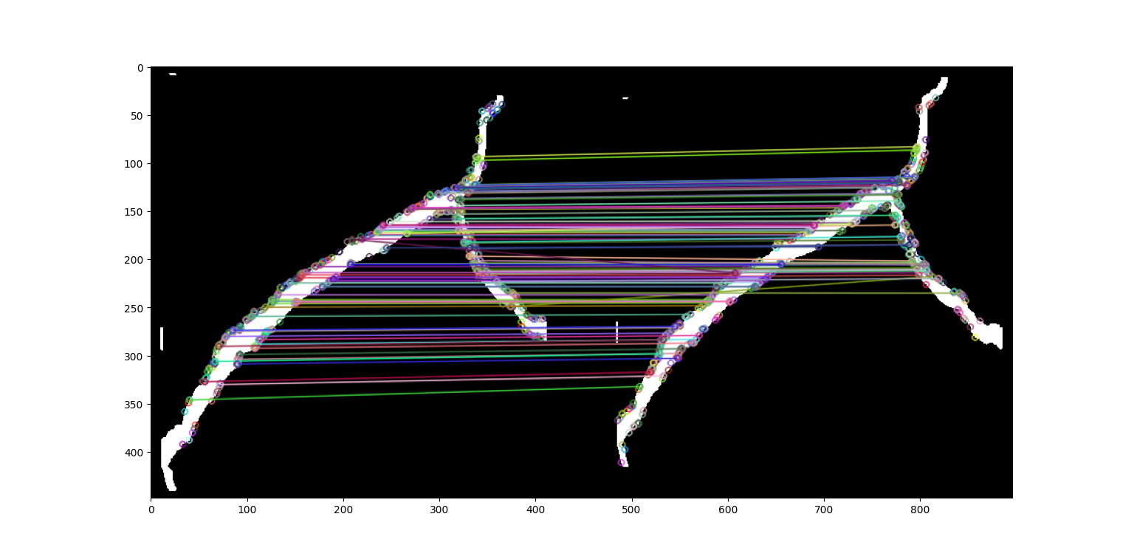
Study Method And Study Process
Notes:
Here we try to use segmented images for feature point matching, this picture is the result of feature point matching. The correspondence shown on this image seems to be better than matching the original image

Slide 11
Study Method And Study Process
Notes:
This picture is the 3D coordinates of the crack calculated by the algorithm proposed in this study. The depth range here is calculated by matching the feature points of the segmented image

Slide 12
Thank you for your listening
Notes:
That is all I have for today. Thank you for your listening.

