Slide 1
A very informal presentation
Getting back in the loop

Slide 2
THE TASK
I was tasked with implementing EMT in a python environment in order to generate optical constants for Inclusion Matrix Particles
This required a crash-course in learning basic python; including more advanced file reading and writing to read in data tables and output results; in addition to learning how to use the pythons stacks Numpy, Scipy, and MatPlotLib
From my own understanding and using the aforementioned stacks, I wrote several small modules which, when combined with a larger program body, read in optical constants from numerous data tables to generate new optical constants VIA EMT.

Slide 3
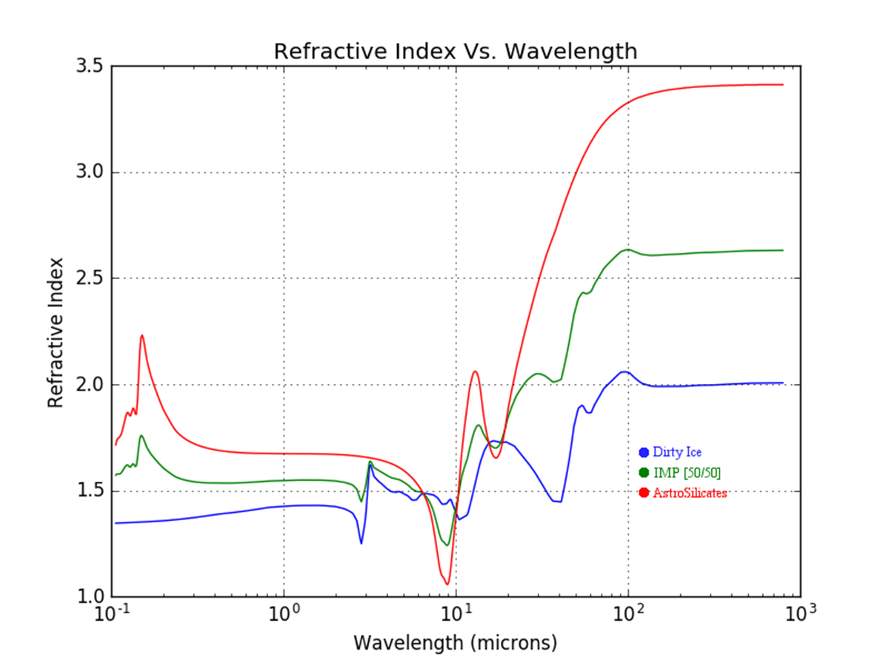
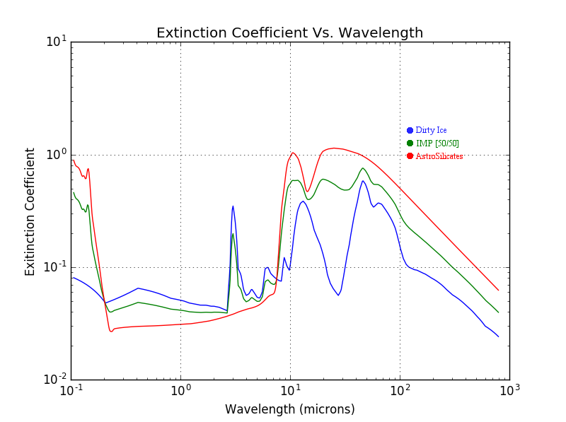
Graphical results of EMT from 50/50 volumetric ratio of a ‘dirty ice’ matrix with astro-silicate inclusions; plotted using MatPlotLib and labeled with GIMP

Slide 4
THE NEXT STEP(S)
From here the plan is to utilize a pre-written implementation of BHMIE for python in order to calculate the emissivities associated with the optical constants of the grains generated via EMT
These emissivities will be taken in by Jr. Dr. Bracks to calculate the temperatures of said grains given the temperature of the star and their orbital radius from it; this then used to generate a spectral curve
This spectral curve will then be taken in by Sr. Jr. Dr. Acuna to implement numerous fitting techniques to properly model the debris system(s)

