Slide 1
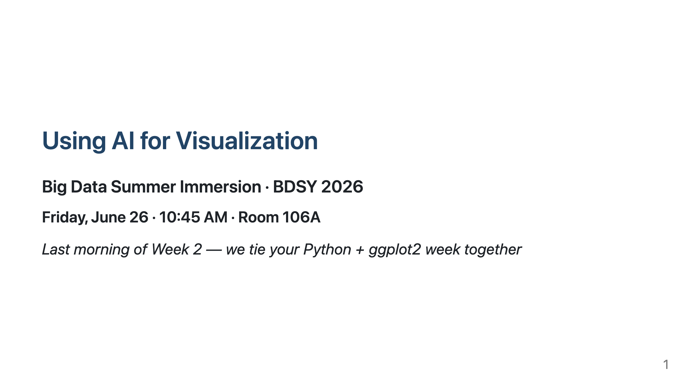
Notes:
HOW TO USE THIS DECK - It's a Marp deck (Markdown). Render it any of these ways: - VS Code: install the "Marp for VS Code" extension, open this file, click the preview / "Export slide deck" button (PDF, PPTX, or HTML). - CLI: npx @marp-team/marp-cli slides/ai-for-dataviz-intro.md --pdf npx @marp-team/marp-cli slides/ai-for-dataviz-intro.md --pptx (edit in Google Slides/PowerPoint) - Target ~5 minutes, ~1 slide every 40-50s. Open with slides 1-6, then jump into the notebook. Slide 7 (the trust checklist) is a callback to show again at the END. - Speaker notes live in these HTML comments (Marp shows them in presenter view). Open warm. One-liner: "You've written Python all week; yesterday you made charts in ggplot2. Today: charts in Python — with an AI doing the typing and YOU doing the thinking." Show of hands: who was in ggplot2 yesterday? Who used AI in 'Coding with Claude'? Anchor to both — we build on them, we don't start from scratch.

Slide 2
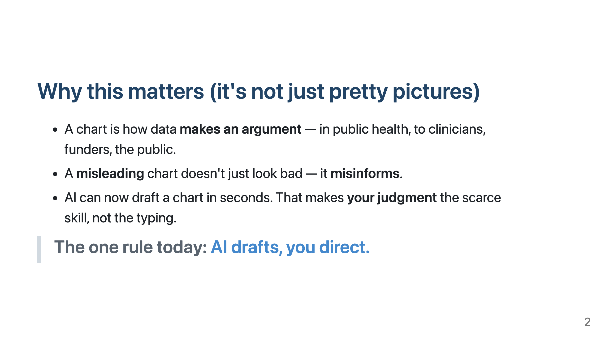
Notes:
This is the thesis slide — say the rule out loud and write it on the board if you can. Give one quick concrete example of a misleading chart (truncated y-axis that exaggerates a difference, or a wrong aggregation). Keep it to ~45s. Everything else today serves this rule.

Slide 3
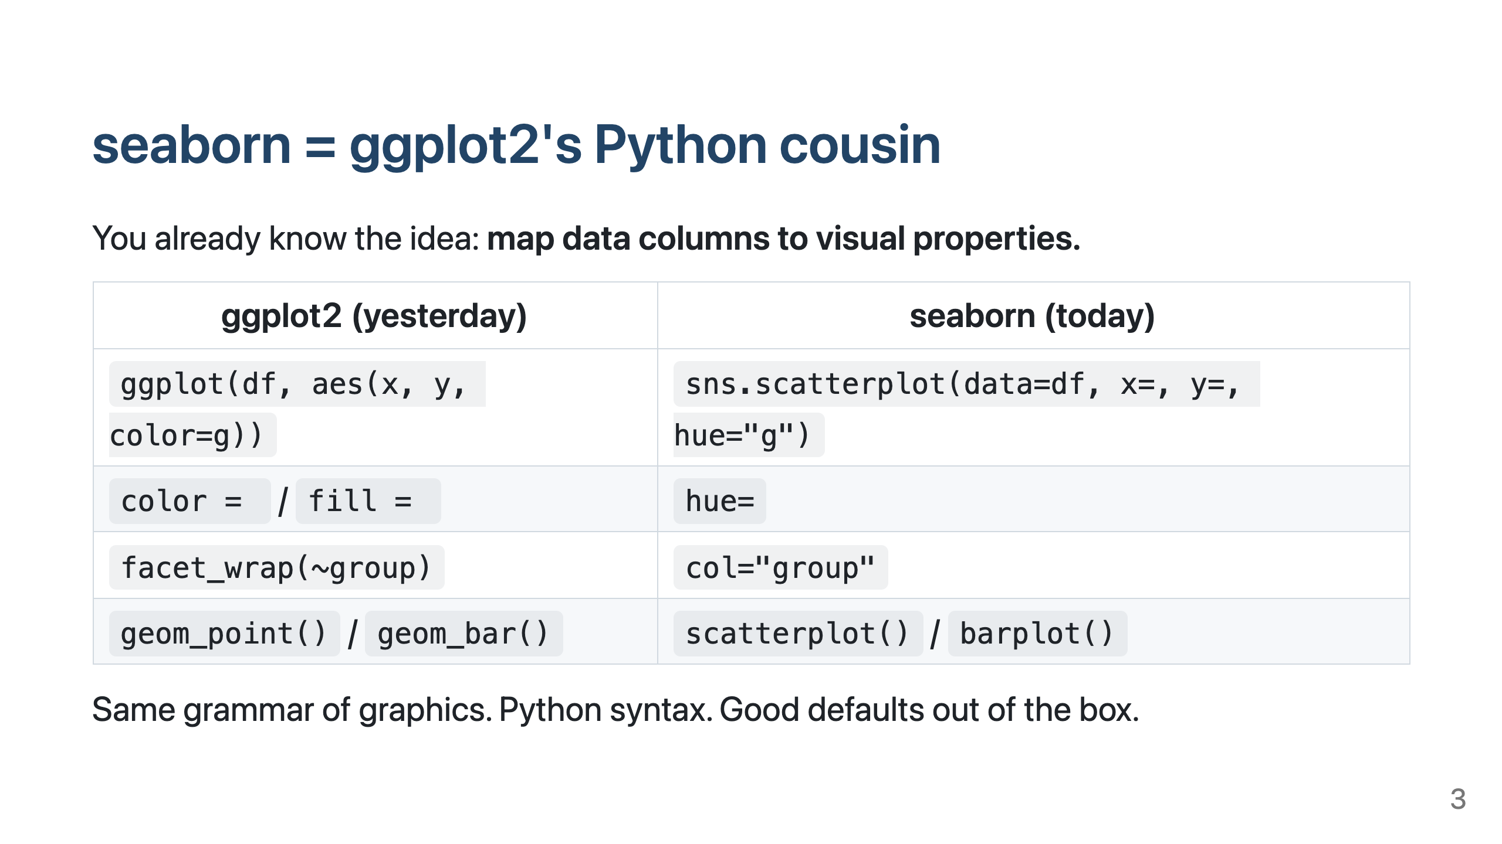
Notes:
Reassure the R crowd: "you are not starting over." Don't teach seaborn here — that's the notebook. Just land that the mental model transfers 1:1. ~40s.

Slide 4
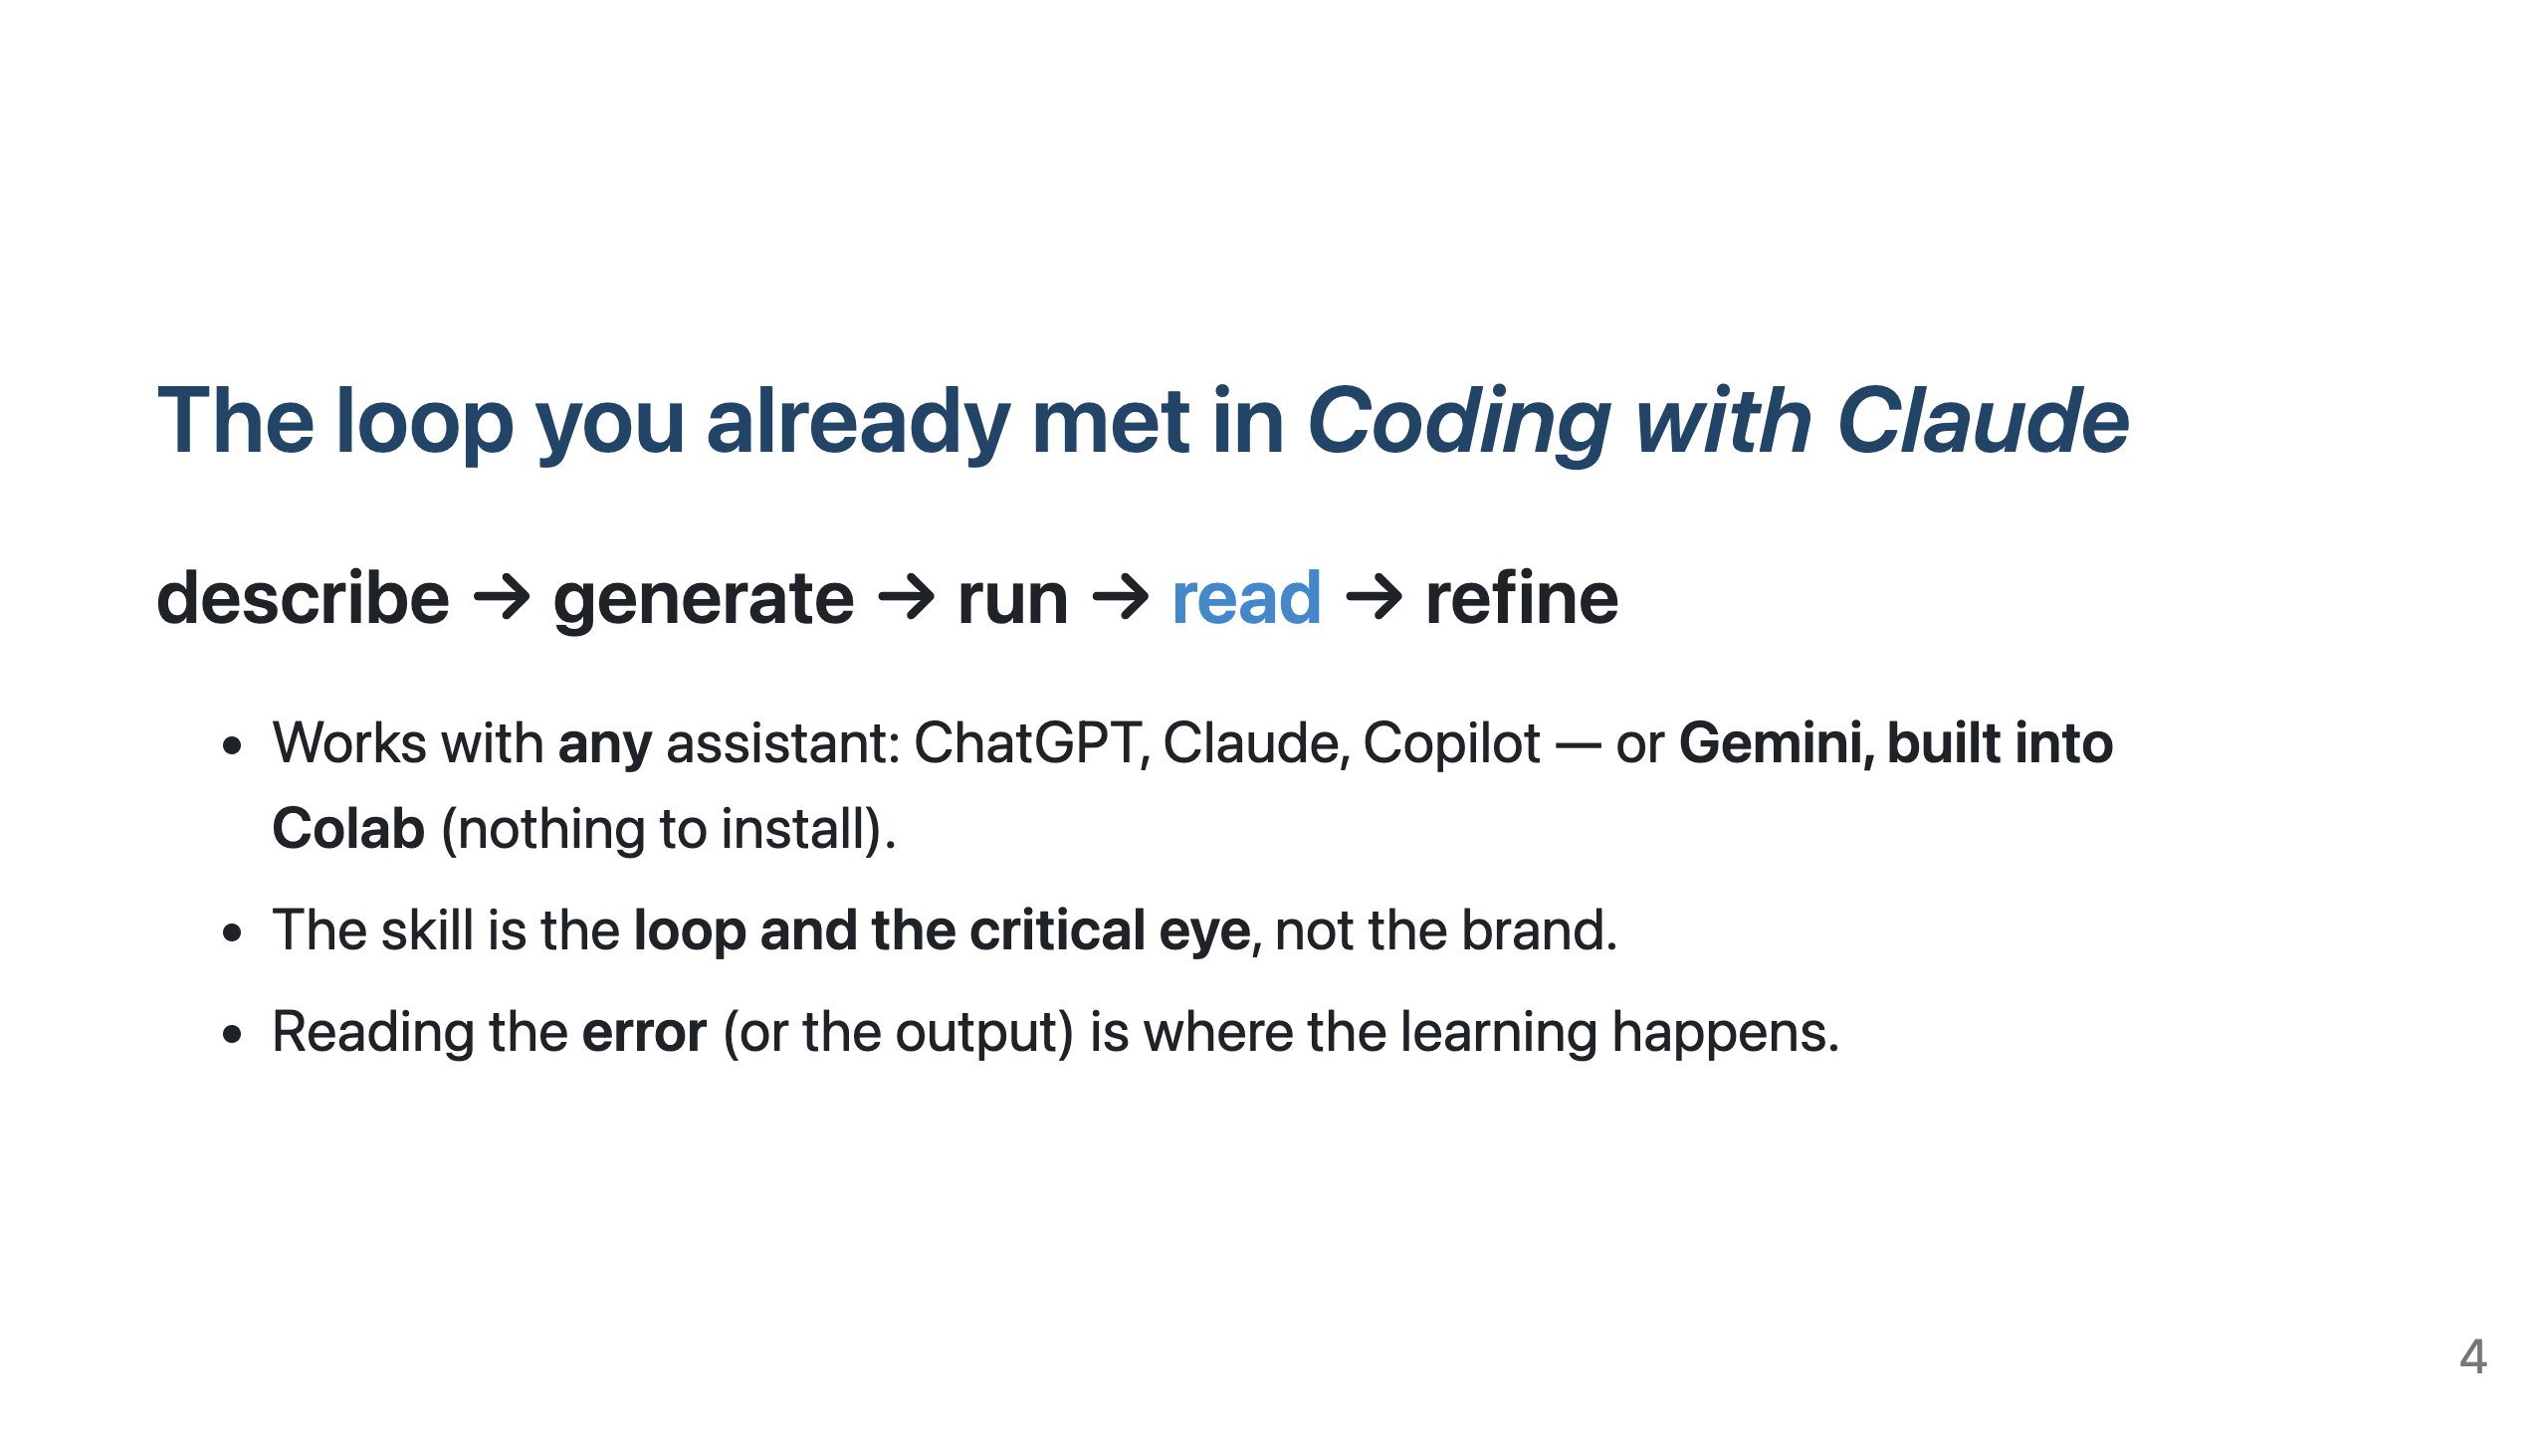
Notes:
Emphasize "read." Beginners ask, paste, and pray. The pros read what came back. In Colab: "+ Generate" / the ✨ icon to draft, "Explain error" when a cell breaks. Tell them the notebook has worked answers as a safety net so nobody is stuck on AI access. ~45s.

Slide 5
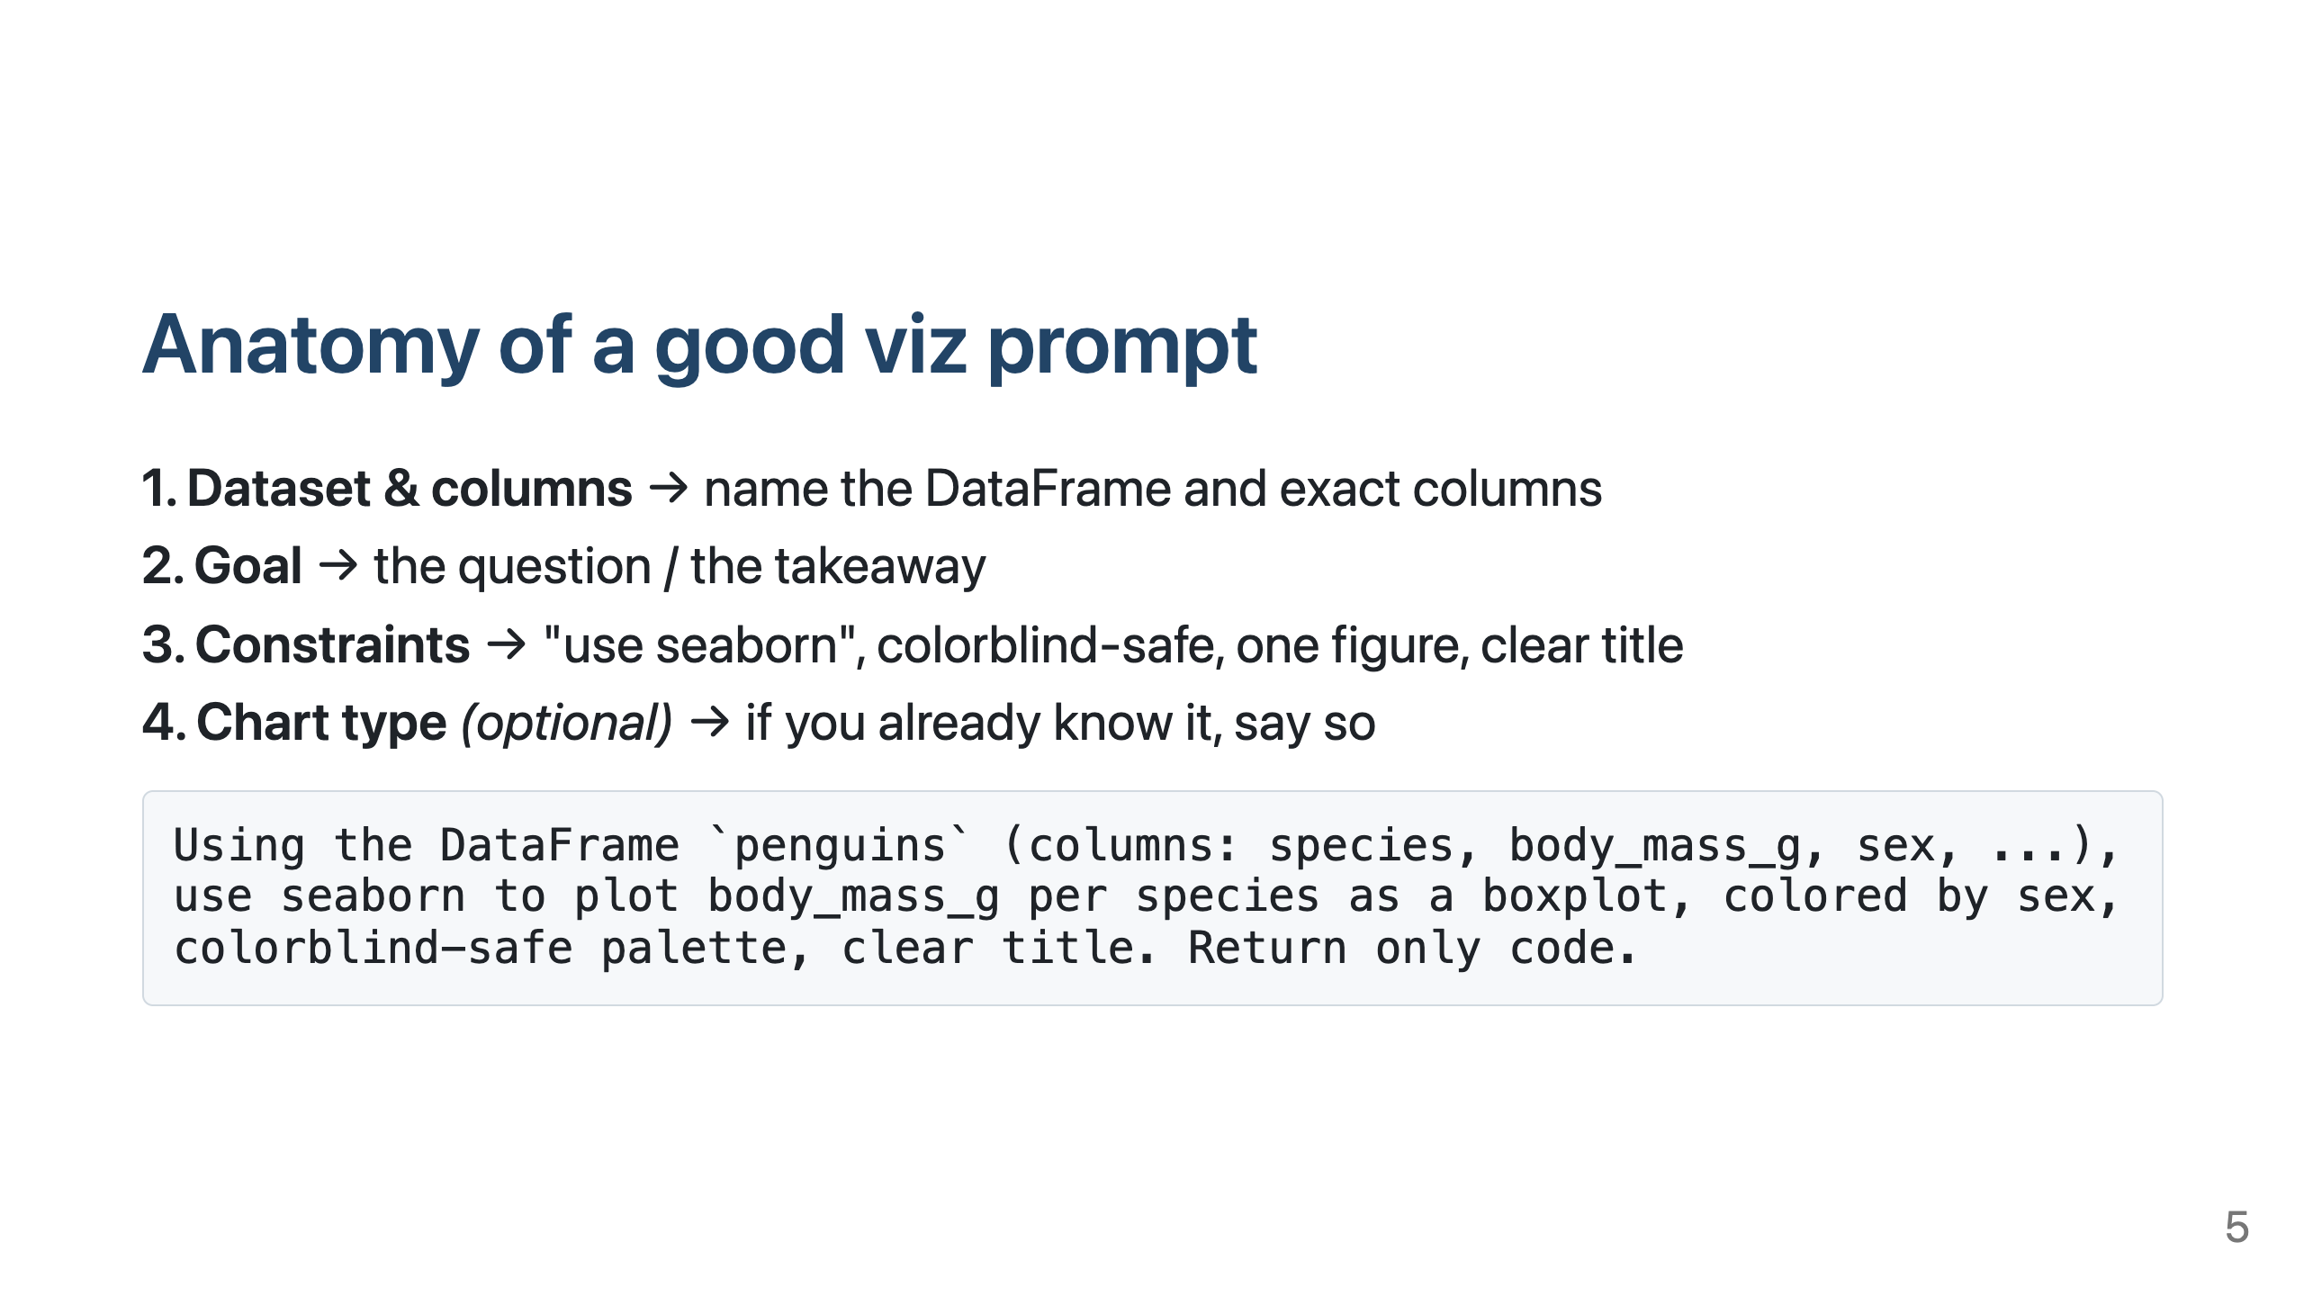
Notes:
The four-part structure is the single biggest lever on output quality. Contrast "plot body mass" (vague) vs the full prompt (specific). Tell them they'll reuse this skeleton all session. ~45s.

Slide 6
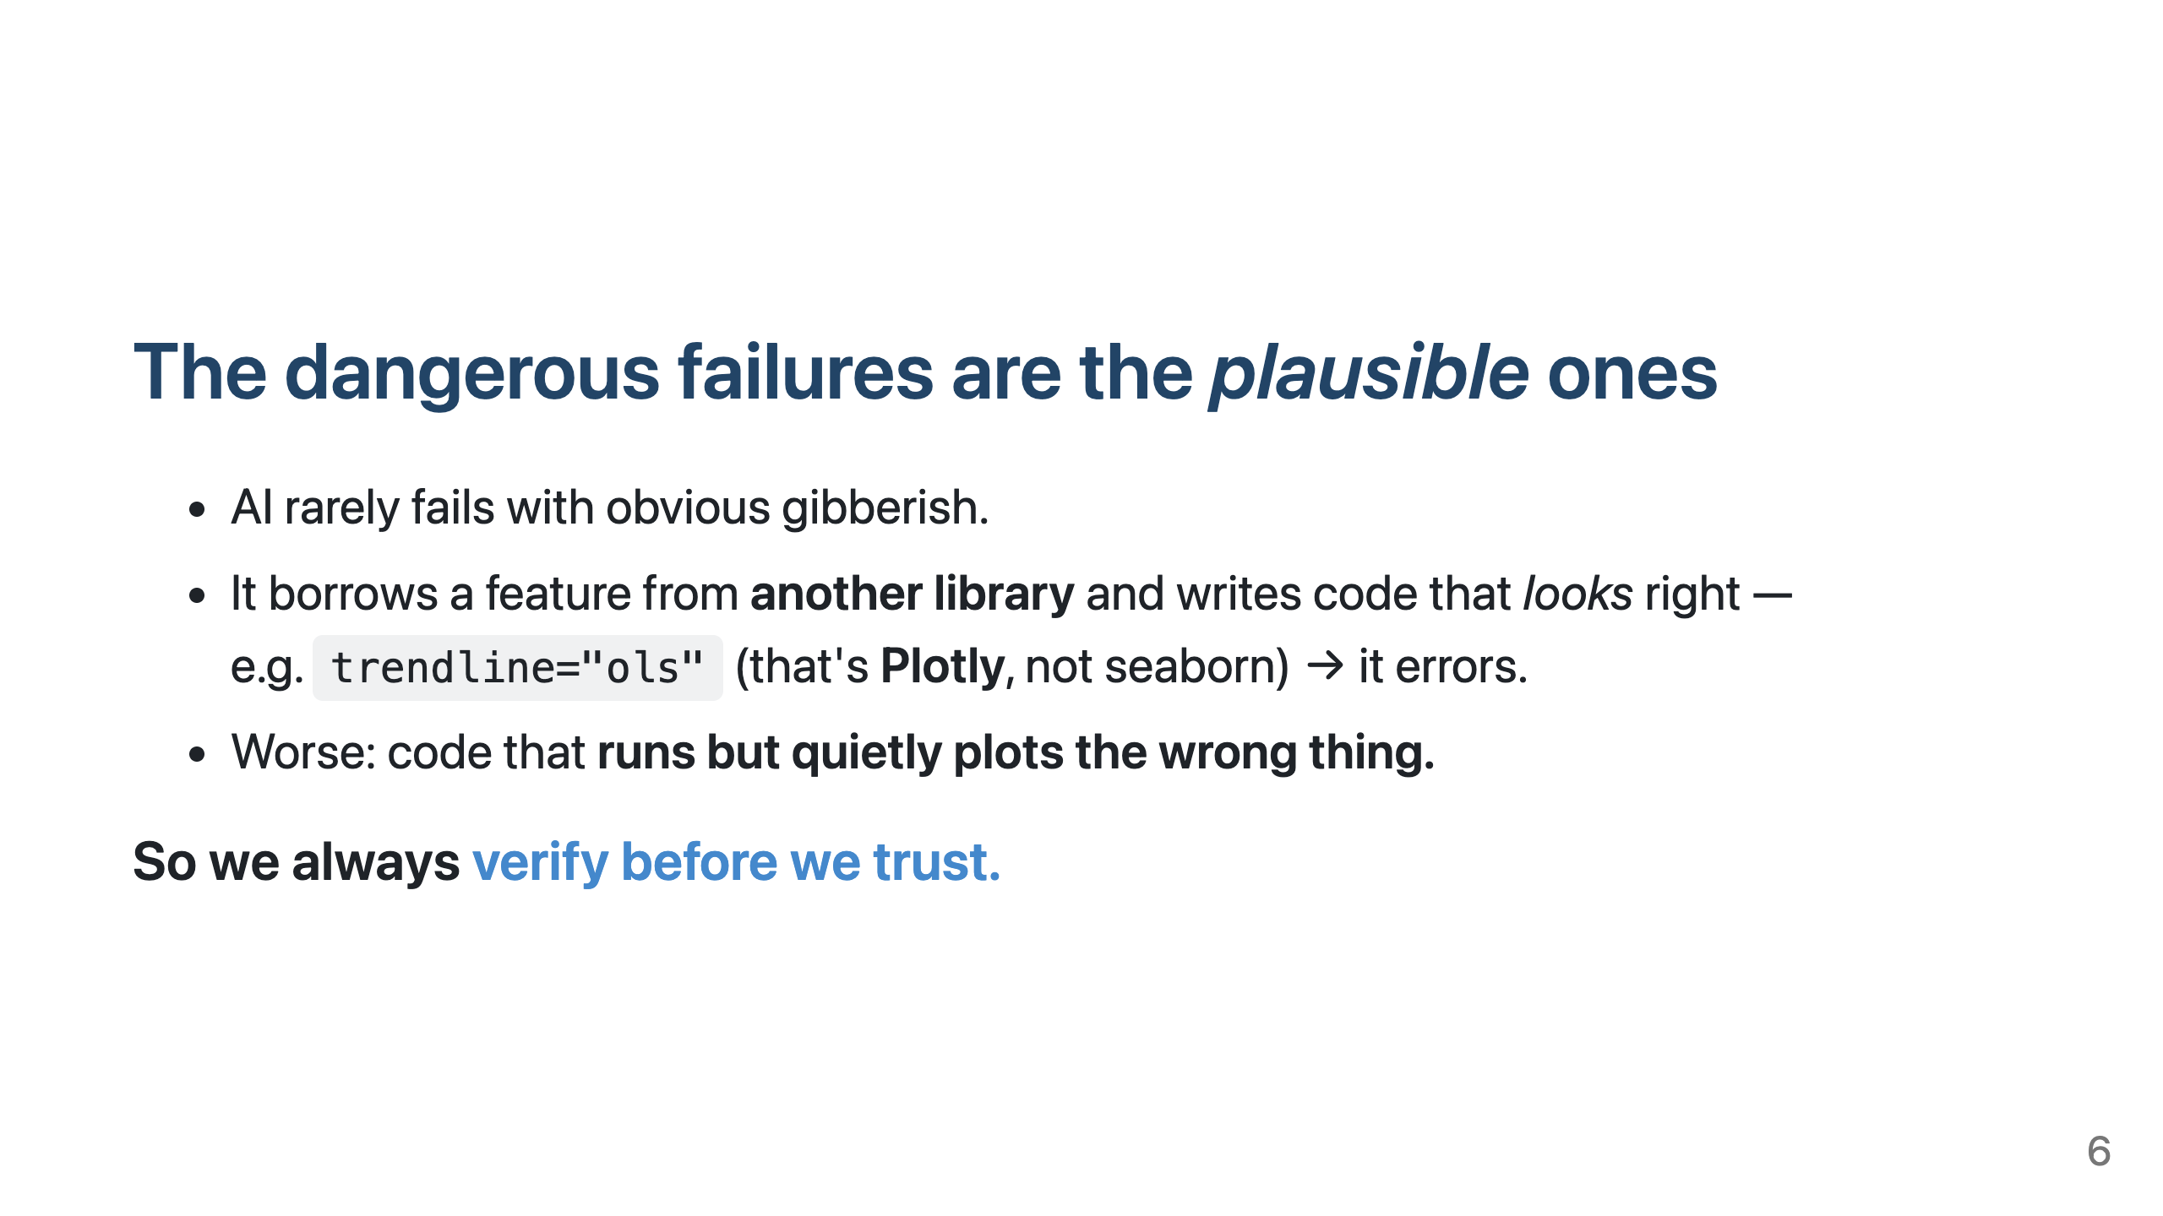
Notes:
Set up Exercise D and §5 of the notebook. The hallucination isn't scary because it crashes — it's scary because it's confident and plausible. This is the heart of "AI drafts, you direct." ~40s. Then transition: "open the notebook, run the setup cell."

Slide 7
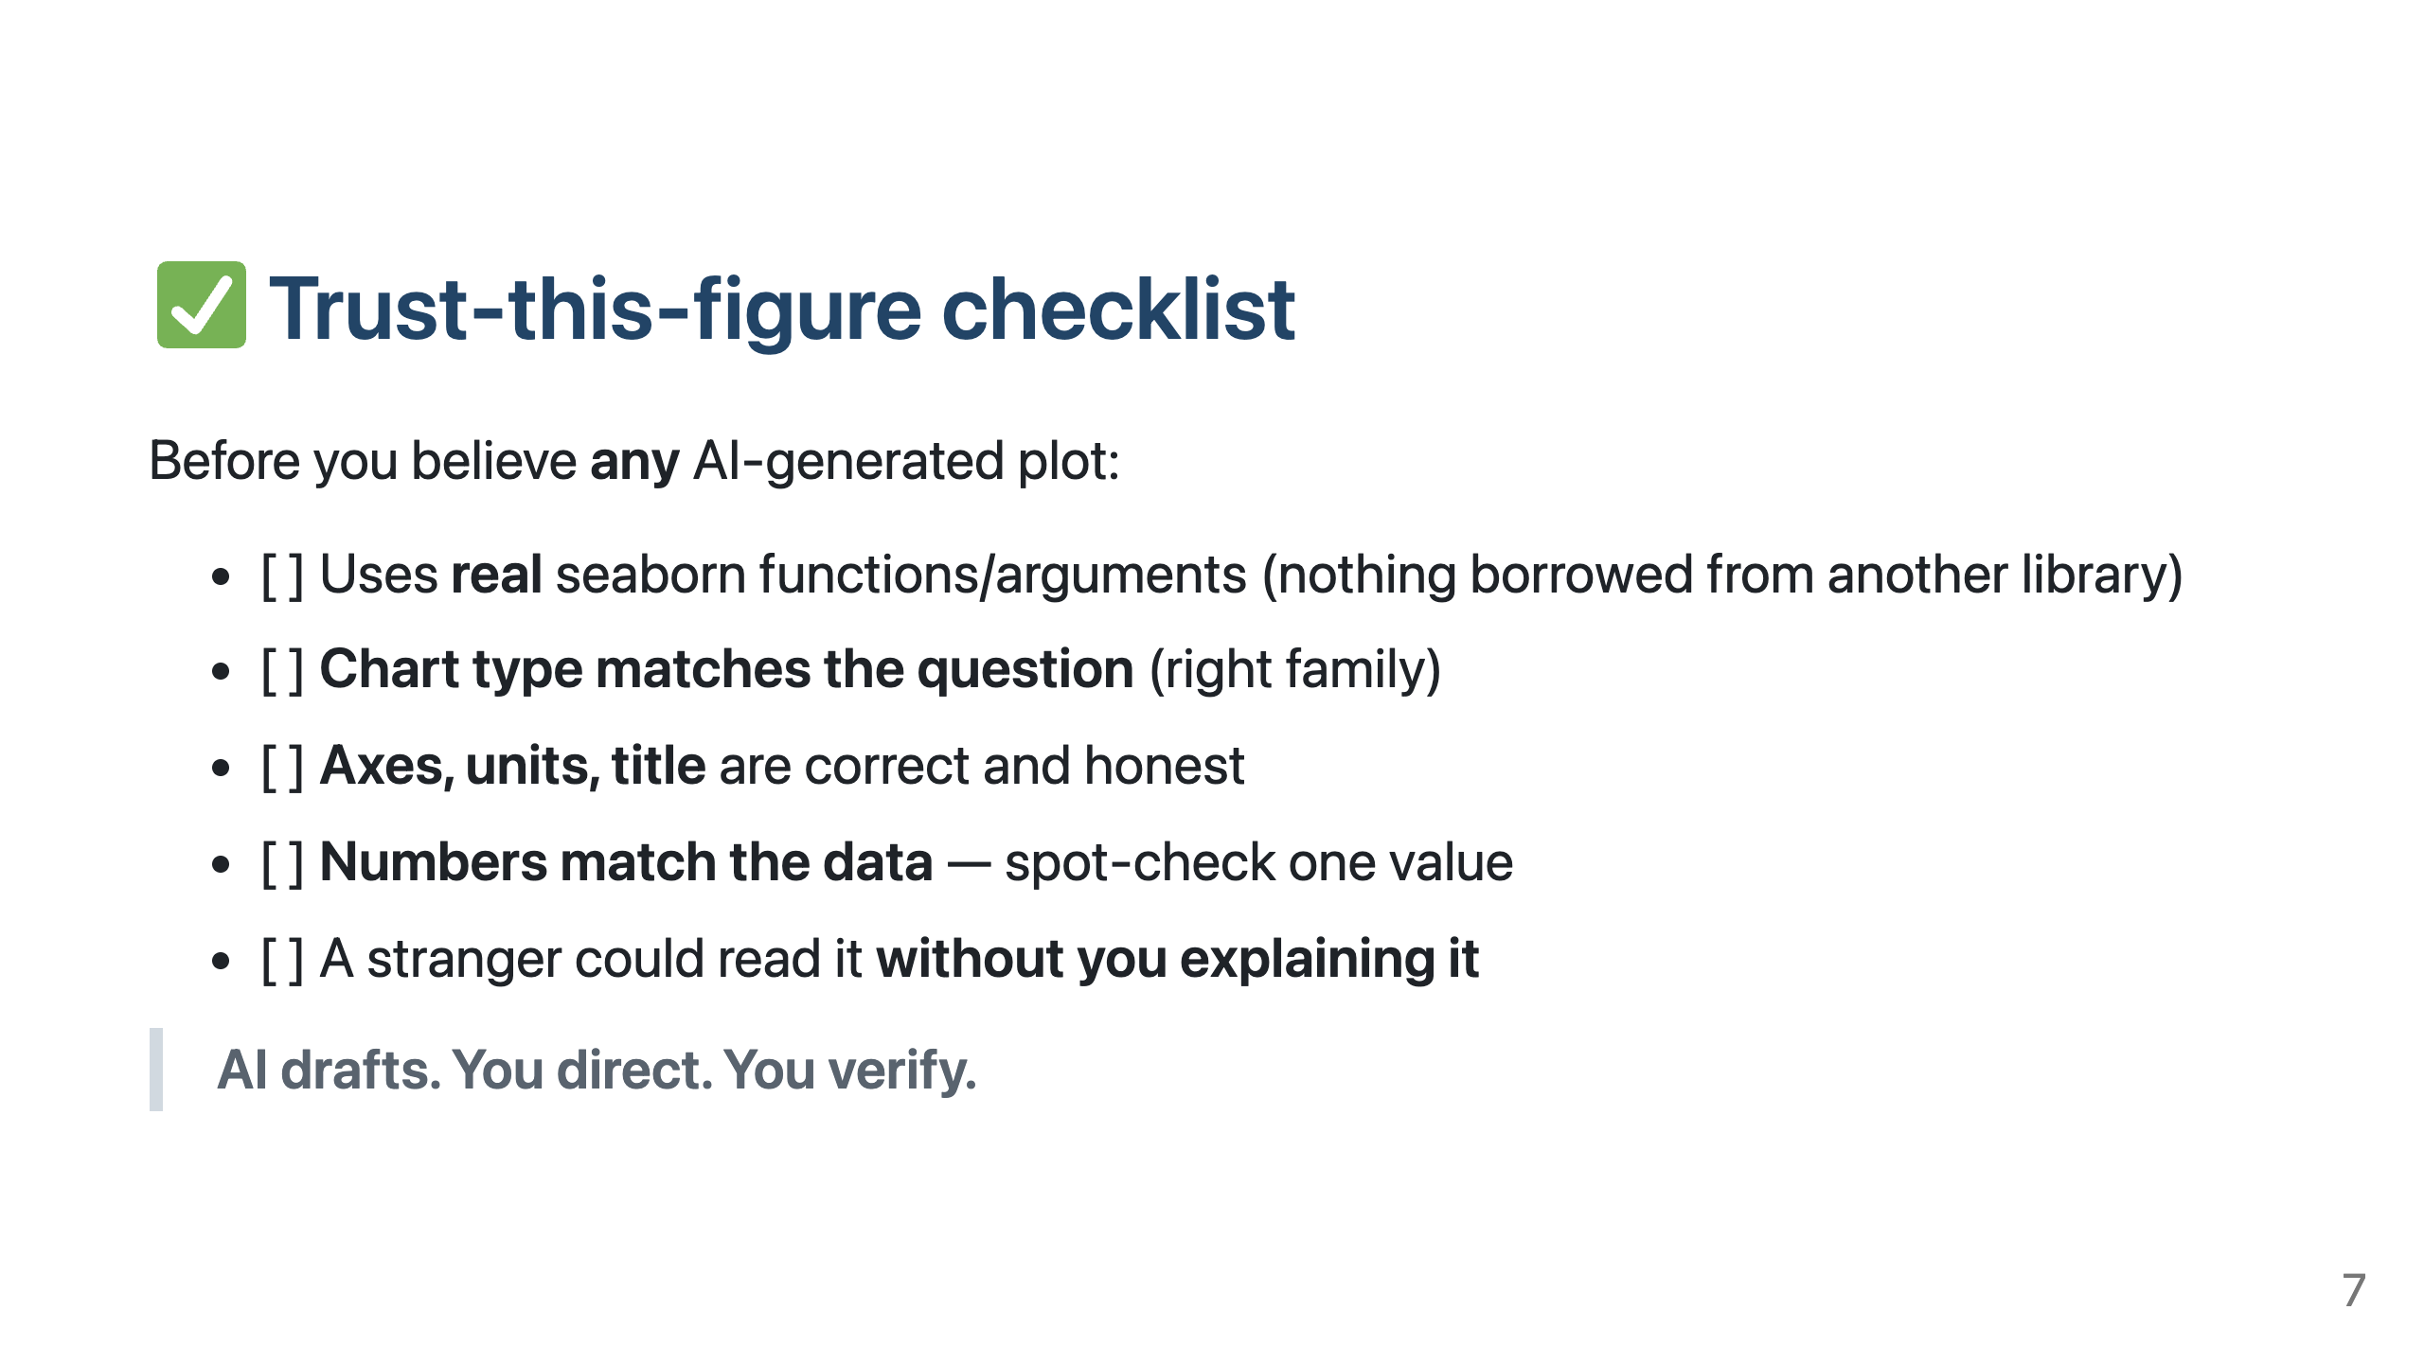
Notes:
Don't dwell on this at the open — flash it (~20s) so they know where we're headed. Bring it BACK at the very end of the session as the closing slide / takeaway. That bookends the whole 90 minutes on the one rule.

