Slide 1

All of Us Researcher Program:
Cohort and Dataset Building
Live Demonstration
MAXIMILIAN WEGENER, MPH
Biomedical Informatics Librarian, Cushing/Whitney Medical Library
Yale SCHOOL OF MEDICINE
Biomedical Informatics and Data Science
Yale Harvey Cushing/John Hay Whitney Medical Library

Slide 2
To participate in this course, you must have an active All of Us account, controlled tier access, and provide proof of your account to me before the course begins.
Prerequisites

Slide 3
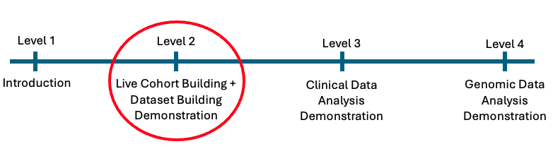
Course Progression
Current Level and Future Directions

Slide 4
Learning objectives
Quick overview
Creating and Sharing a workspace
Data storage and billing
Cohort builder
Dataset builder
Data analysis
Agenda

Slide 5
Create and manage a workspace
Share and collaborate within workspaces
Build cohorts and datasets
Navigate the analysis environment and run basic data cleaning and manipulations
Learning
Objectives
By the end of this course, participants will be able to:

Slide 6
A national initiative by the NIH
Launched in 2018
To gather health data from over 1 million people
Eligible participants join voluntarily
signing up via JoinAllofUs.org
participating health care provider
About the All of Us Research Program
Overview

Slide 7





Lifestyles, medical history, healthcare access, etc.
About the All of Us Research Program
Standardized using Observational Medical Outcomes Partnership (OMOP) Common Data Model (CDM)
Overview
Heart rate, activity, or sleep data from devices like Fitbit
Data Sources
Surveys
EHR
Wearables
Physical measurements
Genomic
Sources: EHRs, self-reported height and weight, in-person visits.
Whole genome sequencing and genotyping from blood, saliva, & urine
Notes:
OMOP (Observational Medical Outcomes Partnership) Common Data Model (CDM): A standardized data model designed to integrate diverse healthcare data sources into a common format.
Standard Vocabulary: OMOP utilizes a standardized vocabulary system, which includes standard concepts for drugs, conditions, procedures, and other clinical entities to ensure consistency across datasets.
Mapping to Standard Codes: Local codes from different healthcare databases are mapped to OMOP standard codes to enable cross-database analyses.
Applications: Widely used in observational health research, especially for large-scale data analyses, observational studies, and drug safety assessments.
Governance and Collaboration: Managed by OHDSI (Observational Health Data Sciences and Informatics) community, fostering collaboration and consistency in healthcare research.
OMOP codes are crucial because they standardize diverse healthcare data, enabling consistent and comprehensive large-scale analyses, thus advancing research and improving patient outcomes through better data interoperability.
https://athena.ohdsi.org/search-terms/start – this is the search interface and central repository for the Standardized Vocabularies used to map medical codes into the OMOP Common Data Model for health research.

Slide 8
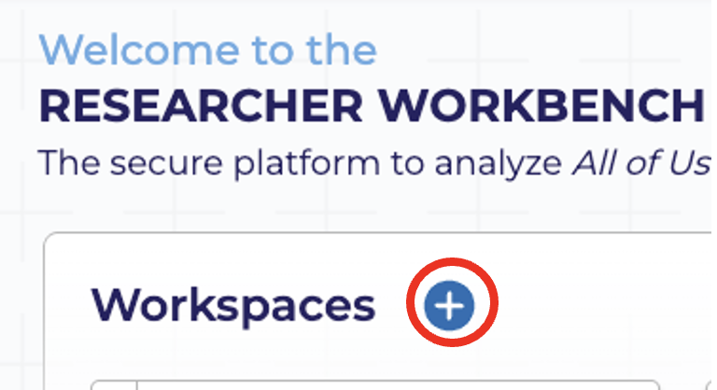
You create a new workspace from the AoU work bench
This takes you to a form that asks for the following information:
Intended use of AoU data
Workspace Name
Data Access Tier
Billing Information (optional at this point)
Research Use Statement
Population of Interest
Note: The information is publicly available but can be updated anytime
Creating a Workspace
Overview
Notes:
Before joining this session everyone was asked to create a workspace – so we will do a quick overview of a workspace for your future research projects

Slide 9
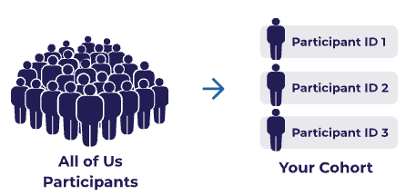
About the All of Us Research Program
Build your own SQL query within Jupyter Notebooks
Cohort Builder + Dataset Builder
Click and choose
Better for non-SQL users
Less processing
Better for limiting data to what you need
Overview
Accessing Data
Two options

Slide 10
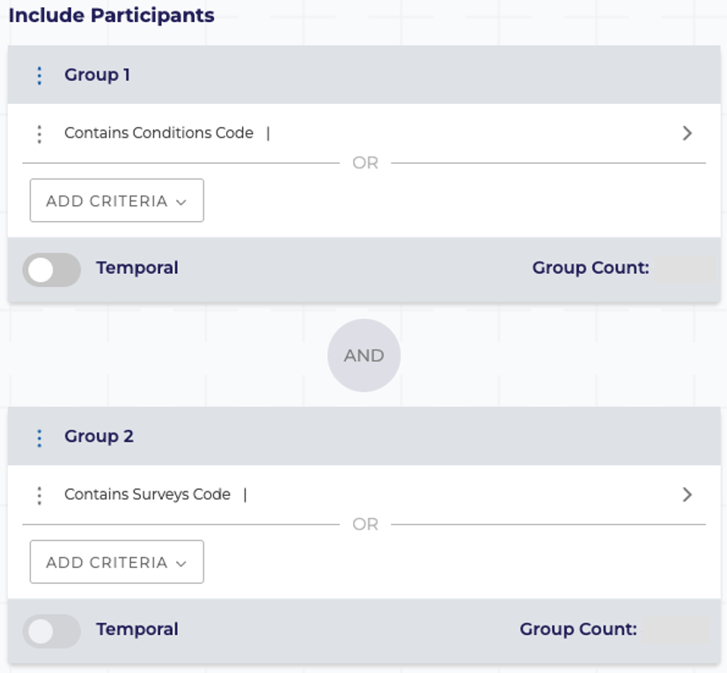
Subset your study population from all participants based on specified criteria using AND/OR operators
Demographics, conditions, measurements, medications, procedures, and surveys
Easily select inclusion and exclusion criteria
Add temporal events
Illness occurs N days before medication was prescribed
Accessing
Data
Cohort builder
Example criteria:
Race -> Asian, Black, White
Sex -> Woman
Age -> 65 or older
Condition - Diagnosed with breast cancer
Medication -Taking tamoxifen

Slide 11
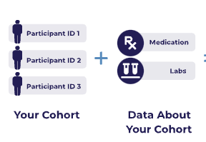
Variables to include in your analysis
Describe information from medical record
Demographics, conditions, prescription, physical measurements, etc.
Organized into concept domains which are the subject areas for each concept
Accessing
Data
Domain | Description
Conditions | Listed by ICD9 or ICD10 or SNOMED standard codes.
Procedures | Listed by ICD9, ICD10, CPT, or SNOMED standard codes.
Drugs or Medications | Listed by ingredient and organized by therapeutic uses.
Measurements | Laboratory tests and vital signs, organized in the LOINC code hierarchy.
Visits | Type of facility where medical care was received (ED, OP, IP).
Surveys | Questions and associated response options for participant-completed surveys.
Physical Measurements | At time of participant enrollment: BP, HR, height, weight, BMI, pregnancy, etc.
Demographics | Age, gender, race, ethnicity, and deceased status.
Concepts

Slide 12
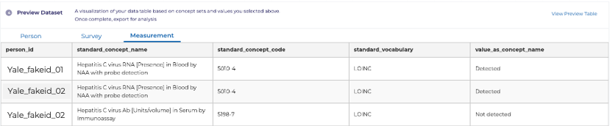
Concept sets are one or more concepts from a particular domain used to create the dataset for your analysis
The values from each concept set becomes its own table under the domain name in the analysis phase
Remember to include the same concepts from your cohort builder
After choosing your concept sets, select which values (columns) you’d like to keep
Measurements
(Domain)
HCV RNA
(Concept)
HBV surface antigen
(Concept)
HIV Ab
(Concept)
HCV, HBV, HIV labs
(“Measurement” Concept Set)
Accessing
Data
Concept sets

Slide 13
Concept Hierarchy for Condition “Atrial fibrillation”
Heart disease
Acute heart disease
Athlete's heart
Cardiac arrhythmia
Cardiac arrest
Supraventricular arrythmia
Atrial fibrillation
Etc.
Etc.
Etc.
General:
a larger pool of patients
Specific:
smaller pool of patients

Slide 14
OMOP CDM is an open-source standard that enables consistent analysis across multiple healthcare databases by standardizing how medical data are organized and coded
OMOP Concepts are standardized units of clinical meaning, each with a unique numeric identifier (concept_id) used for the following domains:
Medications (Drugs) - *RxNorm
Conditions - *SNOMED-CT
Procedures - *SNOMED-CT
Devices - *SNOMED-CT
Observations (including surveys) - *SNOMED-CT
Measurements (Labs) - *LOINC
Forces all variations of the same clinical concept to map to one Standard Concept IDs to use for all analytical work
Making research comparable across institutions by enabling reproducibility and sharing
Accessing
Data
Observational Medical Outcomes Partnership (OMOP) Common Data Model (CDM) Concepts
Explore these standardized vocabularies through Athena
*Denotes where standards concept IDs are derived from
Notes:
RxNorm = Normalized Names for Clinical Drugs
SNOMED-CT = Systematized Nomenclature of Medicine—Clinical Terms
LOINC =Logical Observation Identifiers, Names, and Codes
ATHENA
The purpose of Athena is to serve as a public, searchable resource for the standardized vocabularies utilized within the OMOP Common Data Model (CDM).
Specifically, Athena functions as:
1. A Searchable Database: Athena is a searchable database maintained by the Observational Health Data Sciences and Informatics (OHDSI) community, which manages OMOP.
2. A Vocabulary Explorer: Users can browse and explore the standardized vocabularies used in OMOP through this publicly available website.
3. A Mapping Tool: Its primary function is to help users identify terms and match them to their standard OMOP equivalent.
4. A Domain Navigator: Users can search the platform by typing terms into the search bar or by exploring topics organized according to the OMOP domain.
In essence, Athena supports the fundamental OMOP goal of standardization by providing easy access to the standardized concepts necessary for analysis across different healthcare data sources.

Slide 15
Domains that use SNOMED-CT, often use disparate, non-standard source codes primarily designed for billing
Source codes include:
ICD9/10 (international Classification of Diseases)
CPT4 (Current Procedural Terminology)
Local/Proprietary Codes
Source SNOMED-CT
SNOMED-CT is designated as the standard for OMOP Concept IDs because of its hierarchal structure and clinical granularity
This way a patient coded with ICD-10 in one site maps to the exact same ID as a patient coded with SNOMED CT in another site
*Explore these standardized vocabularies through Athena
Accessing
Data
Observational Medical Outcomes Partnership (OMOP) CDM Concepts
SNOMED-CT and OMOP CDM
Notes:
Sources and Standardization for Condition and Procedure Domains
1. What are the Sources?
For the Condition and Procedure domains, the data originates from a wide variety of Non-Standard and Local Source Vocabularies used by hospitals and health systems.
The most common sources that get mapped into the OMOP Standard Concepts are:
ICD-9-CM (International Classification of Diseases, 9th Revision, Clinical Modification)
ICD-10-CM (International Classification of Diseases, 10th Revision, Clinical Modification/Procedure Coding System)
CPT4 (Current Procedural Terminology, primarily for procedures)
Local/Proprietary Codes (Codes unique to a specific institution or vendor)
Source SNOMED CT (SNOMED codes used by the EHR, which are often already standard)
2. Why is SNOMED CT the Standard?
SNOMED CT (Systematized Nomenclature of Medicine - Clinical Terms) is designated as the primary OMOP Standard Vocabulary for these clinical domains because it offers the best balance of clinical precision, coverage, and structure:
Clinical Granularity: SNOMED CT provides codes for fine-grained clinical details and subtle distinctions that are necessary for research, unlike ICD codes, which are optimized for billing and public health statistics.
Hierarchical Structure: Its poly-hierarchical structure allows researchers to query data efficiently. For instance, a query can easily capture all specific types of Asthma (a broad SNOMED concept) without having to list every single source code (ICD-10 code) individually.
Unified Global Standard: As a globally accepted clinical standard, it acts as a superior "target language" to harmonize data from diverse systems (like the various ICD and CPT versions) into one consistent, research-ready format.
3. The Final Key (The "Why OMOP Concept ID?")
All SNOMED Concepts are assigned a single, stable OMOP Concept ID.
This ID is used for analysis, ensuring that a patient coded with ICD-10 in one site maps to the exact same ID as a patient coded with SNOMED CT in another site.

Slide 16
Data Storage and Platform
Cloud-based: The Researcher Workbench is built on the Google Cloud Platform (GCP) for security, scalability, and computational power.
Data Preparation
Curated Data Repository (CDR): Raw data from various sources (EHRs, surveys, etc.) are transformed and standardized into a curated dataset.
Data
Storage
All of Us Research Program

Slide 17
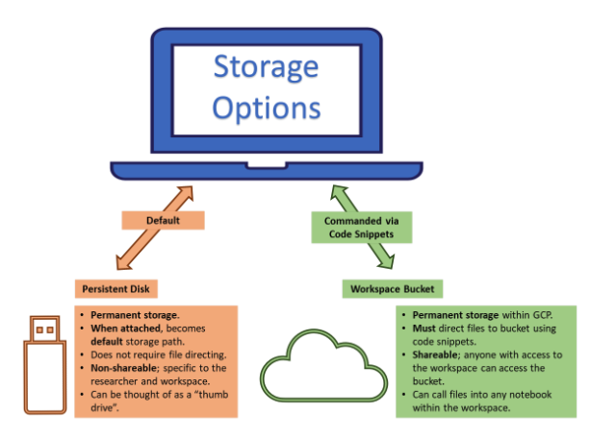
Cloud Analysis Environment
A temporary virtual machine (VM) that provides the computational resources for data analysis. It is separate from the persistent disk and workspace bucket, and it is where you run your code and perform analyses.
Persistent Disk
Personal storage attached to a virtual machine (VM); not shared and data is saved even if the environment is deleted – best for active work
Workspace Bucket
A shared, permanent storage area for the entire workspace. It is the most cost-effective option for long-term storage and can be accessed from multiple workspace notebooks (using code snippets)
Data
Storage
Workspace queried data
(aka, your study data)
*for standard
environments
Notes:
Persistent Disk: Think of this as a virtual computer's hard drive. You are billed for the total space you set aside, like buying a 50 GB hard drive, even if you only use 10 GB. It is attached to your virtual machine and is best for active work.
Workspace Bucket: Think of this as cloud storage, like Google Drive. You are only billed for data you store. It's a central, shared location for your team's files and is the most cost-effective option for long-term storage.

Slide 18
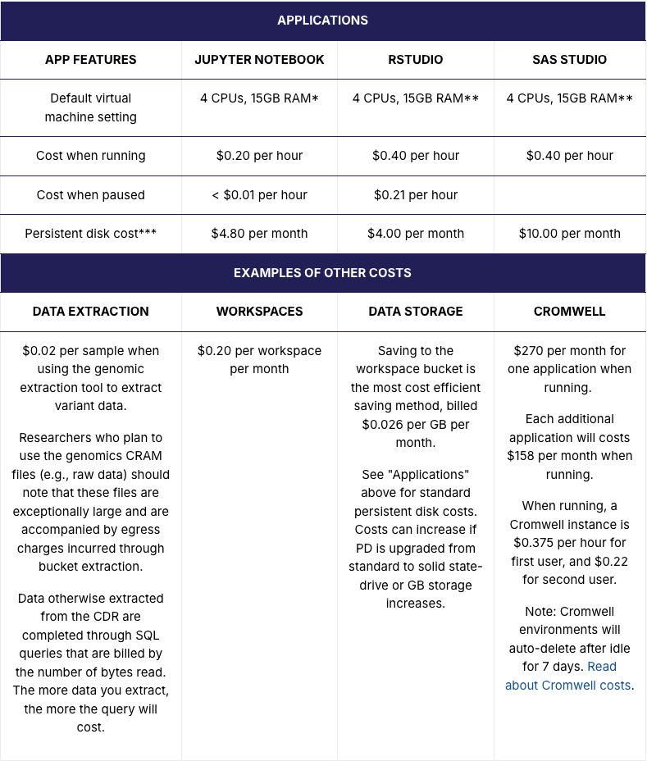
*Jupyter Notebook virtual machine settings can be customized. Customizing default settings will impact costs.
** RStudio and SAS virtual machine settings cannot be customized.
***Persistent disks incur a monthly charge until deleted. You can check for and delete unnecessary persistent disks by visiting your "Cloud Environments" page.
Billing
Link to this table
$300 credit for Google Cloud usage (will run out)
Set up a billing account to continue your work
Helpful video for billing and account setup

Slide 19
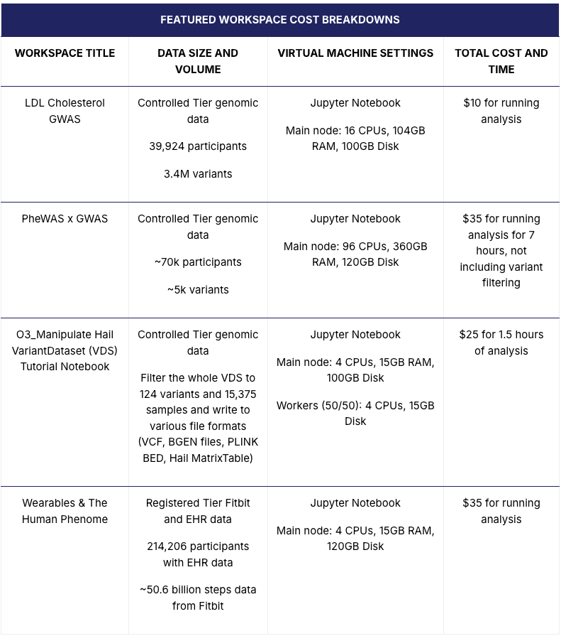
Billing
Link to this table
$300 credit for Google Cloud usage (will run out)
Set up a billing account to continue your work
Helpful video for billing and account setup

Slide 20
Once you save your data to the workspace bucket:
Delete your environment and persistent disk
Jupyter notebooks and code are saved in the workspace bucket and will not be deleted
You can always start a new environment to continue your analysis because your code and data in the workspace bucket remain intact
Once your data are in the workspace bucket you don’t need to run your initial queries again!
Saving Money!
How to Delete Persistent Disk and Environment
Notes:
Persistent Disk: Think of this as a virtual computer's hard drive. You are billed for the total space you set aside, like buying a 50 GB hard drive, even if you only use 10 GB. It is attached to your virtual machine and is best for active work.
Workspace Bucket: Think of this as cloud storage, like Google Drive. You are only billed for the amount of data you actually store. It's a central, shared location for your team's files and is the most cost-effective option for long-term storage.

Slide 21
Can use this application to estimate the following:
Upfront costs
Total compute costs
Data storage costs for duration of the project
Total project cost
My AoU Cost Estimator App
NOTES
Beta phase (updates will be made)
Not an official AoU app
Pay attention to the parameters you need
Please provide feedback

Slide 22
All of Us Publications
All of Us YouTube videos
Billing in the researcher workbench
Cohort builder and dataset builder
Using the concept set selector in the workbench
Setting up your Billing Account
Getting started (dictionaries, data types, OMOP, etc.)
Helpful
Resources

Slide 23

Questions

Slide 24

Course
Survey
https://yalesurvey.ca1.qualtrics.com/jfe/form/SV_cZOk3RQmTrQLhYy

Slide 25
Live Demonstration Time
Cohort Building
Dataset Building
Analysis Environment
Notes:
Example criteria:
Race -> White, Black, Asian
Gender -> Men and Woman
Age -> 25 to 65 years ole
Condition - Diagnosed with/without Diabetes
Survey –PTSD medications and PTSD medical provider

