Slide 1

All of Us Researcher Program:
Cohort and Dataset Building
Live Demonstration
MAXIMILIAN WEGENER, MPH
Biomedical Informatics Librarian, Cushing/Whitney Medical Library
Yale SCHOOL OF MEDICINE
Biomedical Informatics and Data Science
Yale Harvey Cushing/John Hay Whitney Medical Library

Slide 2
To participate in this course, you must have an active All of Us account, controlled tier access, and provide proof of your account to me before the course begins.
Prerequisites

Slide 3
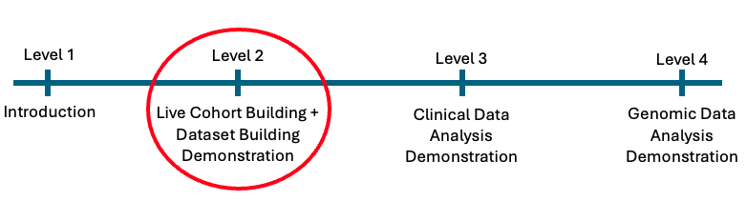
Course Progression
Current Level and Future Directions

Slide 4
Learning objectives
Quick overview
Creating and Sharing a workspace
Data storage and billing
Cohort builder
Dataset builder
Data analysis
Agenda

Slide 5
Create and manage a workspace (storage & billing)
Share and collaborate within workspaces
Build cohorts and datasets
Navigate the analysis environment and run basic data cleaning and manipulations
Learning
Objectives
By the end of this course, participants will be able to:

Slide 6
A national initiative by the NIH
Launched in 2018
To gather health data from over 1 million people
Eligible participants join voluntarily
signing up via JoinAllofUs.org
participating health care provider
About the All of Us Research Program
Overview

Slide 7





Lifestyles, medical history, healthcare access, etc.
About the All of Us Research Program
Standardized using Observational Medical Outcomes Partnership (OMOP) Common Data Model (CDM)
Overview
Heart rate, activity, or sleep data from devices like Fitbit
Data Sources
Surveys
EHR
Wearables
Physical measurements
Genomic
Sources: EHRs, self-reported height and weight, in-person visits.
Whole genome sequencing and genotyping from blood, saliva, & urine
Notes:
OMOP (Observational Medical Outcomes Partnership) Common Data Model (CDM): A standardized data model designed to integrate diverse healthcare data sources into a common format.
Standard Vocabulary: OMOP utilizes a standardized vocabulary system, which includes standard concepts for drugs, conditions, procedures, and other clinical entities to ensure consistency across datasets.
Mapping to Standard Codes: Local codes from different healthcare databases are mapped to OMOP standard codes to enable cross-database analyses.
Applications: Widely used in observational health research, especially for large-scale data analyses, observational studies, and drug safety assessments.
Governance and Collaboration: Managed by OHDSI (Observational Health Data Sciences and Informatics) community, fostering collaboration and consistency in healthcare research.
OMOP codes are crucial because they standardize diverse healthcare data, enabling consistent and comprehensive large-scale analyses, thus advancing research and improving patient outcomes through better data interoperability.
https://athena.ohdsi.org/search-terms/start – this is the search interface and central repository for the Standardized Vocabularies used to map medical codes into the OMOP Common Data Model for health research.

Slide 8
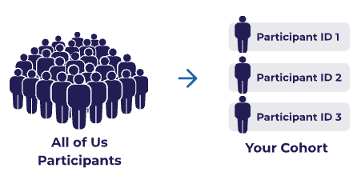
About the All of Us Research Program
Build your own SQL query within Jupyter Notebooks
Cohort Builder + Dataset Builder
Click and choose
Better for non-SQL users
Less processing
Better for limiting data to what you need
Overview
Accessing Data
Two options

Slide 9
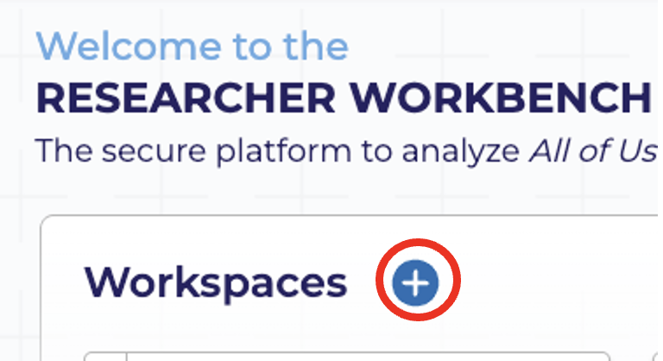
You create a new workspace from the AoU work bench
This takes you to a form that asks for the following information:
Intended use of AoU data
Workspace Name
Data Access Tier
Billing Information (optional at this point)
Research Use Statement
Population of Interest
Note: The information is publicly available but can be updated anytime
Creating a Workspace
Overview
Notes:
Before joining this session everyone was asked to create a workspace – so we will do a quick overview of a workspace for your future research projects

Slide 10
Data Storage and Platform
Cloud-based: The Researcher Workbench is built on the Google Cloud Platform (GCP) for security, scalability, and computational power.
Data Preparation
Curated Data Repository (CDR): Raw data from various sources (EHRs, surveys, etc.) are transformed and standardized into a curated dataset.
Data
Storage
All of Us Research Program

Slide 11
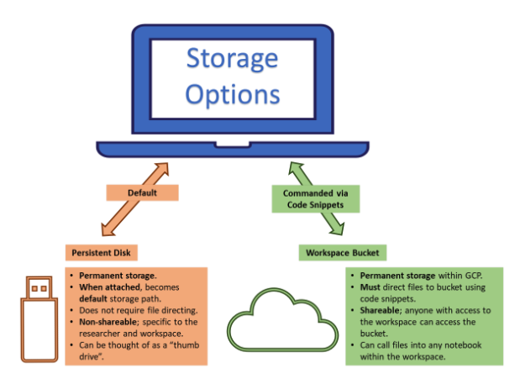
Cloud Analysis Environment
A temporary virtual machine (VM) that provides the computational resources for data analysis. It is separate from the persistent disk and workspace bucket, and it is where you run your code and perform analyses.
Persistent Disk
Personal storage attached to a virtual machine (VM); not shared and data is saved even if the environment is deleted – best for active work
Workspace Bucket
A shared, permanent storage area for the entire workspace. It is the most cost-effective option for long-term storage and can be accessed from multiple workspace notebooks (using code snippets)
Data
Storage
Workspace queried data
(aka, your study data)
*for standard
environments
Notes:
Persistent Disk: Think of this as a virtual computer's hard drive. You are billed for the total space you set aside, like buying a 50 GB hard drive, even if you only use 10 GB. It is attached to your virtual machine and is best for active work.
Workspace Bucket: Think of this as cloud storage, like Google Drive. You are only billed for data you store. It's a central, shared location for your team's files and is the most cost-effective option for long-term storage.

Slide 12
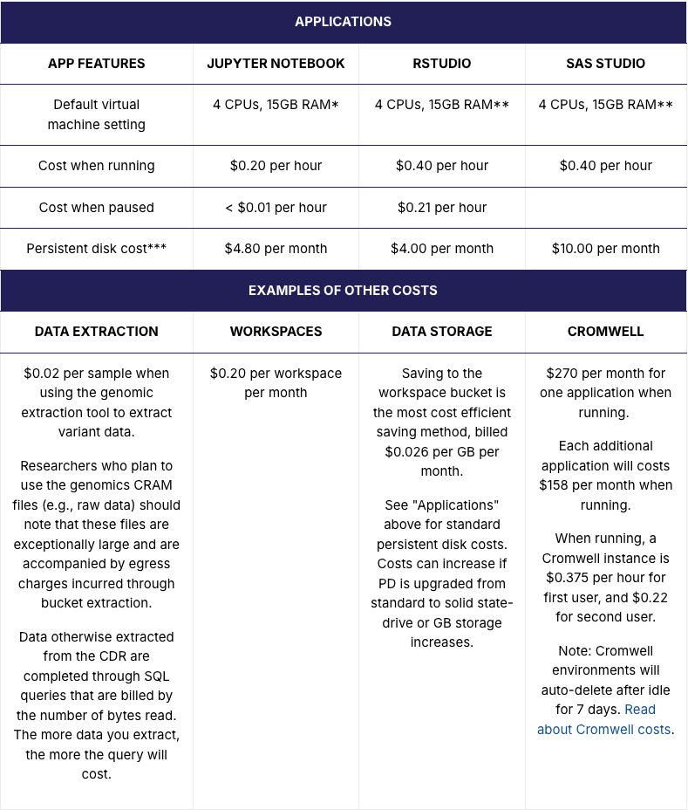
*Jupyter Notebook virtual machine settings can be customized. Customizing default settings will impact costs.
** RStudio and SAS virtual machine settings cannot be customized.
***Persistent disks incur a monthly charge until deleted. You can check for and delete unnecessary persistent disks by visiting your "Cloud Environments" page.
Billing
Link to this table
$300 credit for Google Cloud usage (will run out)
Set up a billing account to continue your work
Helpful video for billing and account setup

Slide 13
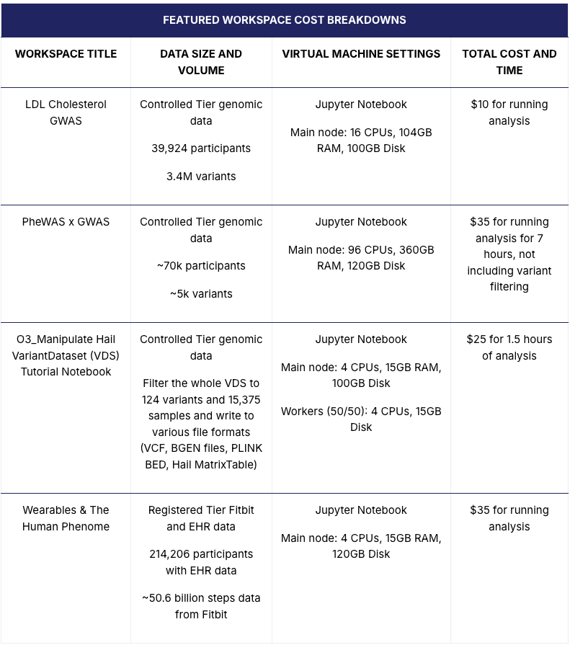
Billing
Link to this table
$300 credit for Google Cloud usage (will run out)
Set up a billing account to continue your work
Helpful video for billing and account setup

Slide 14
Once you save your data to the workspace bucket:
Delete your environment and persistent disk
Jupyter notebooks and code are saved in the workspace bucket and will not be deleted
You can always start a new environment to continue your analysis because your code and data in the workspace bucket remain intact
Saving Money!
How to Delete Persistent Disk and Environment
Notes:
Persistent Disk: Think of this as a virtual computer's hard drive. You are billed for the total space you set aside, like buying a 50 GB hard drive, even if you only use 10 GB. It is attached to your virtual machine and is best for active work.
Workspace Bucket: Think of this as cloud storage, like Google Drive. You are only billed for the amount of data you actually store. It's a central, shared location for your team's files and is the most cost-effective option for long-term storage.

Slide 15
Live Demonstration Time
Cohort Building
Dataset Building
Analysis Environment
Notes:
Example criteria:
Race -> White, Black, Asian
Gender -> Men and Woman
Age -> 25 to 65 years ole
Condition - Diagnosed with/without Diabetes
Survey –PTSD medications and PTSD medical provider

Slide 16
All of Us Publications
All of Us YouTube videos
Billing in the researcher workbench
Cohort builder and dataset builder
Using the concept set selector in the workbench
Setting up your Billing Account
Getting started (dictionaries, data types, OMOP, etc.)
Helpful
Resources

Slide 17

Questions

Slide 18
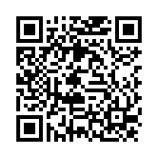
Course
Survey
https://yalesurvey.ca1.qualtrics.com/jfe/form/SV_cZOk3RQmTrQLhYy

