Slide 1

Getting Started with Data Analysis & Visualization Introduction to Python
Justin DeMayo
System and Application Specialist
Course Material:
https://github.com/CWML/Python1

Slide 2


Before We Begin
Welcome!
Interrupt if you have questions – especially when we start coding. (If you have a question, others probably do, too!)
You will get these slides, code, and more after this session ends.

Slide 3

Today’s Goals
Understand basic programming concepts
Write code in Python
Analyze data in Python

Slide 4
Why learn Python?
Popular
Versatile
”Readable”
Notes:
Among the most popular programming languages — and increasingly, the first language computer programming language people learn.
Python is very versatile:
Data Analysis and Visualization:
Python is ideal for analyzing and visualizing large biomedical datasets, including clinical trial data, genomic data, and imaging data. Libraries like NumPy, Pandas, and Matplotlib simplify these tasks.
Automating Repetitive Tasks:
Researchers and staff can use Python to automate time-consuming tasks like data cleaning, file processing, or report generation, saving time and minimizing errors.
Interdisciplinary Collaboration:
Python’s popularity and versatility across scientific disciplines make it a common language for collaboration, bridging the gap between medicine, biology, and data science.
Reproducibility and Transparency:
Python supports reproducible research by enabling easy sharing and review of code, which is essential for robust and transparent medical science.
Also, for a computer language, it has a simpler structure (called syntax) than some other languages.
Because of its popularity, it also has a big community, and a lot of libraries, toolkits, and guides.
I think of Python like a set of instructions you give to your computer - similar to writing down steps in a recipe, but using special words the computer understands. Just like you might tell a friend "get the milk from the fridge," you can tell Python "print this text" or "calculate this number."

Slide 5


What to Know Before We Code

Slide 6
General terms and concepts
Coding — solving problems with a computer programming language
Programming — the entire range of activities that happen before, during, and after large-scale coding such as planning, research, design, writing and running code, testing, troubleshooting, improving, maintaining
Notes:
A form of problem-solving.
A more formal definition: coding involves learning a programming language (its syntax, its semantics, its construction) so you can translate human speaking and language, conceptualizing, and problem-solving into machine-readable code.
Coding involves actually writing and running scripts. Programming is a much broader activity, which can involve research, design, analysis, and more. We’re going to mostly focus on coding today, but we’ll take the first steps of programming towards the end.
Wikipedia’s definition: “Programming involves tasks such as analysis, generating algorithms, profiling algorithms' accuracy and resource consumption, and the implementation of algorithms (usually in a chosen programming language, commonly referred to as coding).”
Don’t let ‘algorithm’ intimidate you — Wikipedia, again, defines it as “a finite sequence of well-defined instructions.”

Slide 7
Where Can You Use Python?
In your Browser
Jupyter Notebooks: Interactive browser-based environments like Jupyter Lab or Google Colab
Online Python interpreters: Websites like Replit, Python Tutor, or Trinket
On your computer
Command line interface: Running Python scripts through terminals or command prompts
Integrated Development Environments (IDEs): Full-featured tools like PyCharm, VS Code, or Spyder
In the cloud
AWS, GCP, MS Azure
Notes:
Integrated development environment (IDE) — software designed specifically for coding, often in a particular language, which has features meant to improve your coding experience

Slide 8
Two Ways to Write Python
Scripts (.py)
Plain Text Files
Run all at once
Used for applications
Used for batch programming jobs
Notebooks (.ipynb)
Interactive Documents
Run cell by cell
Used for exploration
Data
Analysis
Visualization

Slide 9
Today's Environment: Google Colab
Browser-based Python notebook
No installation needed
Code + results in one place
Perfect for learning and data analysis

Slide 10

Python basics
x = 75

Slide 11
General terms and concepts
Syntax — set of rules in a programming language; works similarly to syntax in spoken languages
Program, or script — one or more lines of code, usually meant to do something, such as a task, transformation, visualization
Function — a block of reusable code that performs a specific task; these can come standard in a language, be custom-written, or utilized via add-on modules
Method — is a function that is associated with an object and is called on that object. Methods are defined within a class and can access or modify the attributes of the object they belong to.
Notes:
In Python, a function is a block of reusable code that performs a specific task and can be called independently. Functions are not tied to any specific object and can be called using their name (e.g., print() or len()). Functions often take inputs (parameters) and may return outputs.
A method, on the other hand, is a function that is associated with an object and is called on that object. Methods are defined within a class and can access or modify the attributes of the object they belong to. The syntax for calling a method is object.method(), where the method may also take additional parameters.

Slide 12
Python terms
Strings — essentially text; technically arrays of bytes representing Unicode characters
Syntax: enclosed in quotes, either single or double ( ' ' or " " )
In this course, we will use double quotes
Integers and floats — numeric data types; integers are whole numbers and floats contain decimals
Lists — used to store multiple items in one variable
Syntax: enclosed in brackets, [ ]
Variables — contain information that can change over time; this information can be text, numbers, lists, other data types

Slide 13
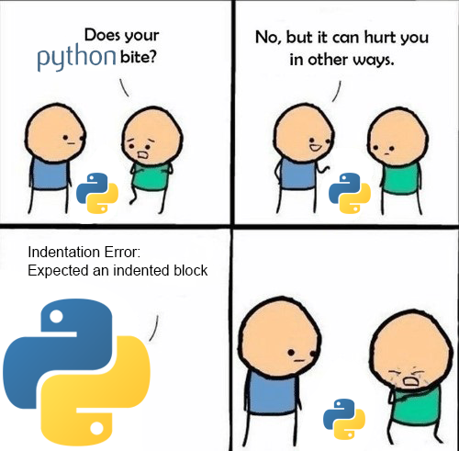
One more thing…
It’s okay to make mistakes!
Troubleshooting (i.e., debugging) is part of everyone’s day-to-day experience with coding, even for experts.
Via the Reddit community r/ProgrammerHumor

Slide 14
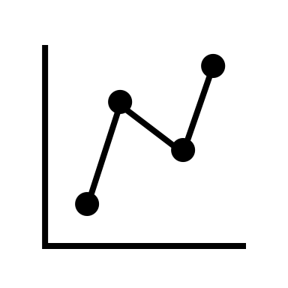
Next steps: Using Python to work with data
x = 75
Notes:
Python is a powerful tool for data analysis, with specialized libraries that make handling data easy and efficient
NumPy: lets you work with large arrays and perform complex mathematical operations efficiently - like processing thousands of numbers at once
Matplotlib.pyplot: creates graphs and charts to visualize your data, turning raw numbers into meaningful visual stories that anyone can understand
These libraries work together seamlessly - scientists often load data with NumPy, perform calculations, and create visualizations in Matplotlib to share their findings

Slide 15




Setting the scene
environment
import tool as t
import viztool as viz
library/package/tool
thing = t.function()
viz.function(thing)
input/code/functions
output/viz
Notes:
basic components of a data visualization workflow in programming.
four key elements of setting up a visualization:
1. Environment Setup – Configuring the basic controls.
2. Importing Libraries – Using Python’s import syntax to load necessary tools, such as 'tool' and 'viztool', with aliases 't' and 'viz'.
3. Writing Code – Creating a function that utilizes the imported tools.
4. Generating Output – Producing a visualization
• This structure is common in data visualization workflows, progressing step-by-step to build the final visual result.

Slide 16
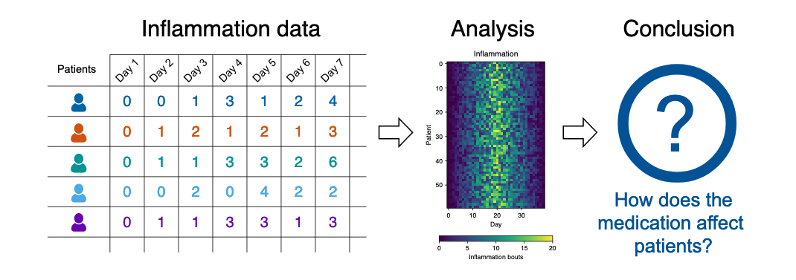
Our Scenario
Image credit: The Carpentries.
Notes:
Scenario: A Miracle Arthritis Inflammation Cure
Our imaginary colleague “Dr. Maverick” has invented a new miracle drug that promises to cure arthritis inflammation flare-ups after only 3 weeks since initially taking the medication! Naturally, we wish to see the clinical trial data, and after months of asking for the data they have finally provided us with a CSV spreadsheet containing the clinical trial data.
The CSV file contains the number of inflammation flare-ups per day for the 60 patients in the initial clinical trial, with the trial lasting 40 days. Each row corresponds to a patient, and each column corresponds to a day in the trial. Once a patient has their first inflammation flare-up they take the medication and wait a few weeks for it to take effect and reduce flare-ups.
To see how effective the treatment is we would like to:
Calculate the average inflammation per day across all patients.
Plot the result to discuss and share with colleagues.

Slide 17
Our Data
In CSVs where:
Rows = Patients (n = 60)
Columns = Days (n = 40)
Shape of data = 60 x 40
Image credit: The Carpentries.

Slide 18
Our Plan
Calculate the average inflammation per day across all patients.
Plot results.
Image credit: The Carpentries.

Slide 19
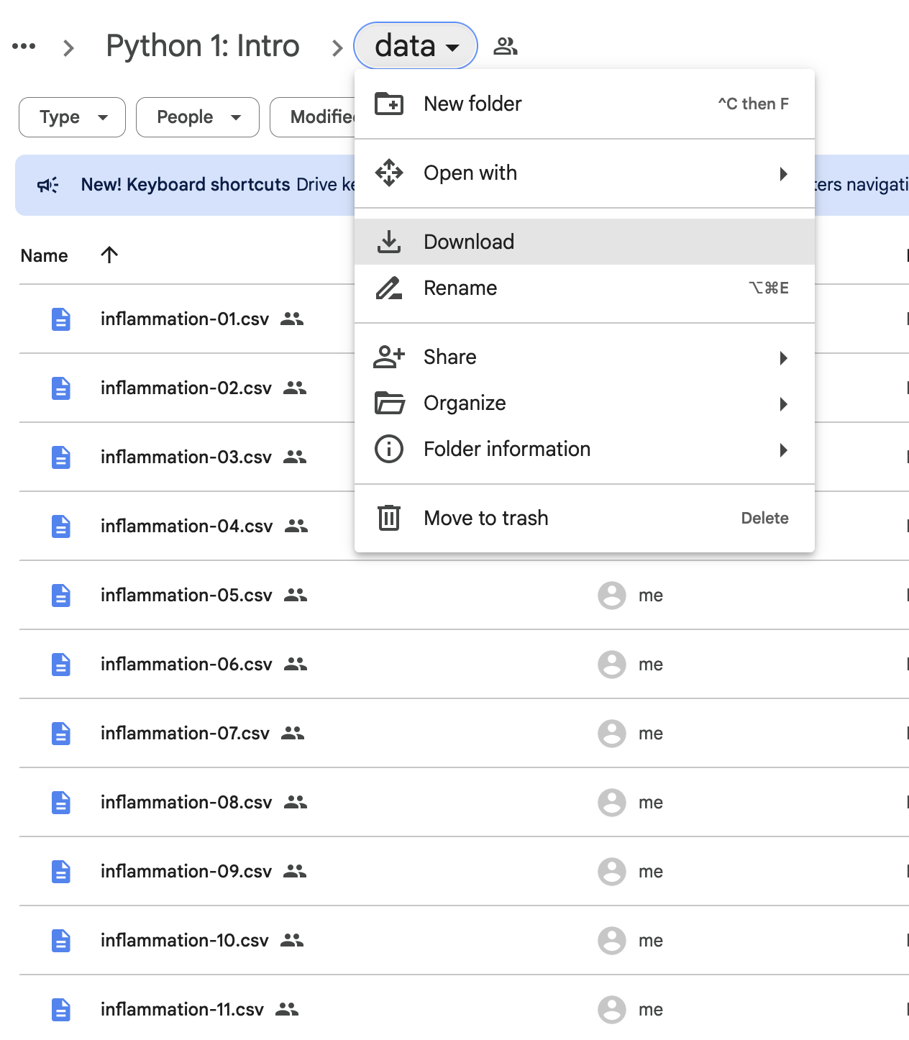
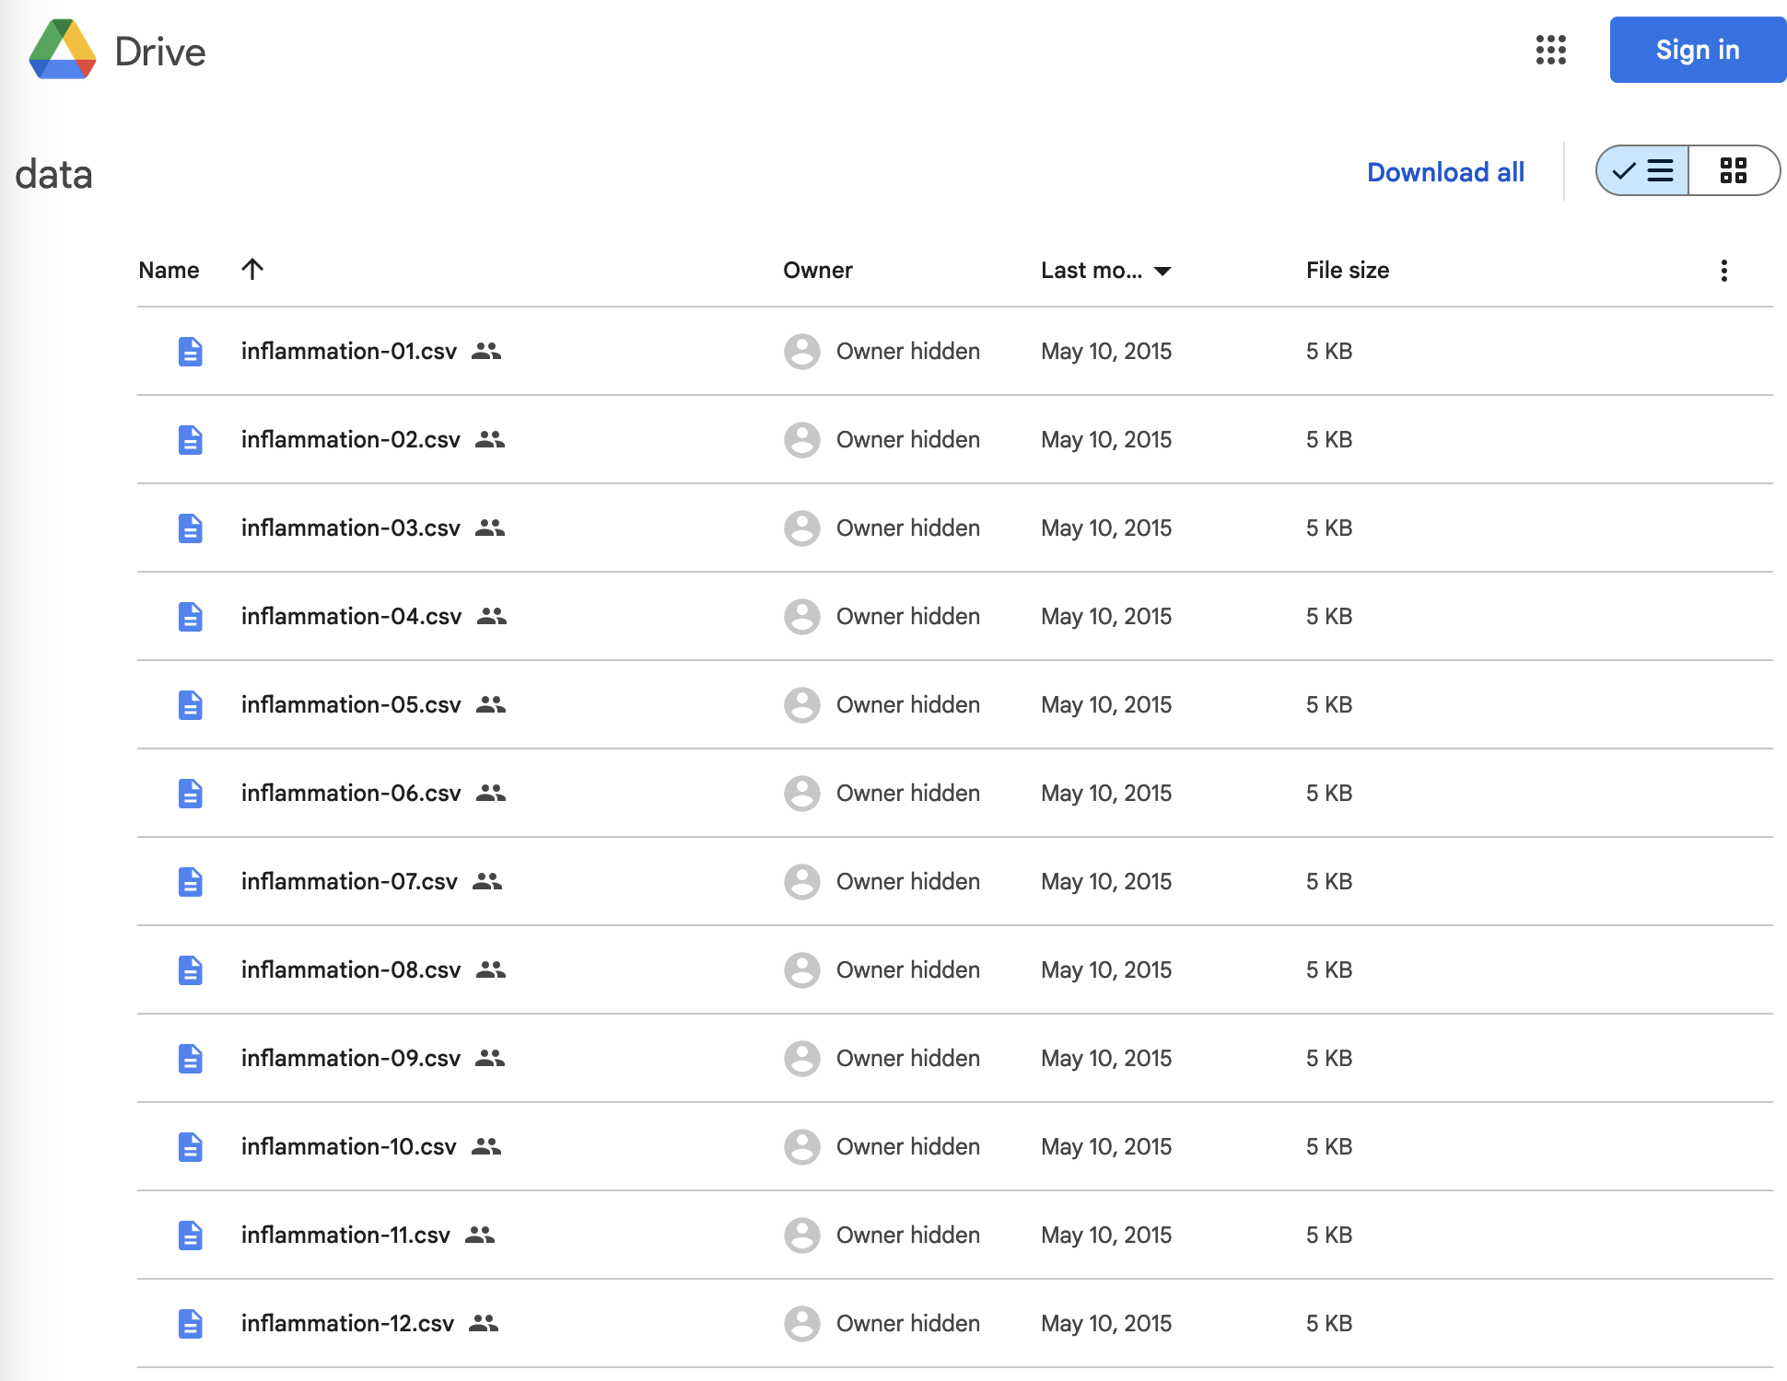
OR
Go to https://tinyurl.com/CWMLdata to download

Slide 20
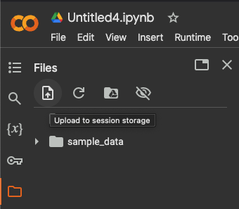
Downloading and organizing files
Download the entire Google Drive folder.
Go to your Downloads folder (via Finder on Mac; File Explorer on Windows) and unzip the .zip file.
In Google Colab, use the upload button to upload the files into your environment.
2)
1)

Slide 21
Onto using Python to work with data
x = 75

Slide 22

Illustrations

Slide 23
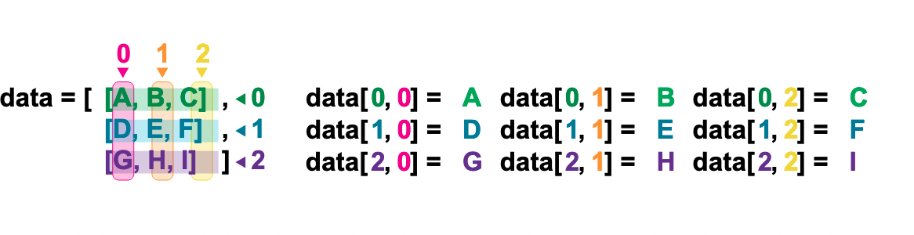
Indexing in numpy
Indexing a numpy data array in Python.
Image credit to the Carpentries, from this lesson, and thanks to a CC-BY-4.0 license.
Notes:
• “In NumPy, data is stored in arrays, which can be accessed using indexing.”
• “This example shows a 3x3 NumPy array, where rows and columns are indexed starting from 0.”
• “Each row is labeled with its index along the left: 0, 1, 2. Each column is labeled at the top: 0, 1, 2.”
• “To access a specific element, we use the format data[row, column].”
• “For example, data[0, 0] retrieves the first element, which is ‘A’.”
• “Similarly, data[1, 2] retrieves the element at row 1, column 2, which is ‘F’.”
• “This type of indexing allows precise access to elements within a NumPy array, making data manipulation efficient.”
• “NumPy also supports slicing and advanced indexing, which we’ll explore later.”

Slide 24
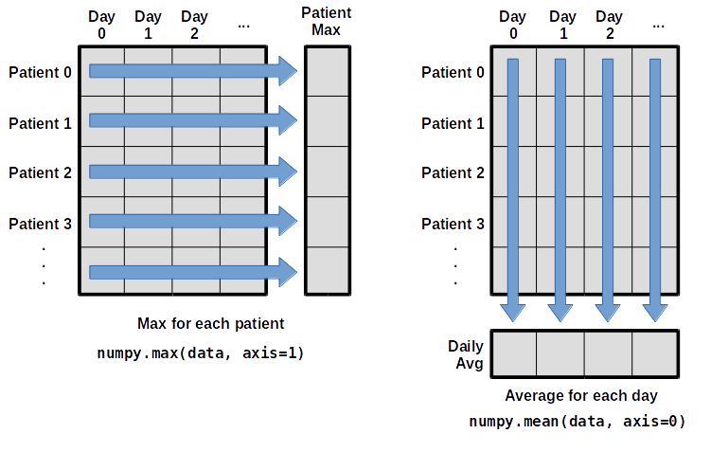
Using axes in numpy
Using array axes in numpy in Python.
Image credit to the Carpentries, from this lesson, and thanks to a CC-BY-4.0 license.
Notes:
“In NumPy, arrays can have multiple dimensions, and operations can be performed along different axes.”
• “Understanding axes is important when working with multi-dimensional data, such as patient health data over time.”
• “Here, we have a 2D NumPy array where rows represent different patients, and columns represent daily measurements.”
Left Diagram (Max for Each Patient)
• “On the left, we calculate the maximum value for each patient using numpy.max(data, axis=1).”
• “This means we are taking the max along each row, so the result is a 1D array where each value represents the highest measurement for that patient.”
Right Diagram (Average for Each Day)
• “On the right, we compute the daily average using numpy.mean(data, axis=0).”
• “This operation works along columns, meaning it averages across all patients for each day, producing a 1D array of daily averages.”
Key Takeaways
• ”axis=0 means operating along columns (reducing rows).”
• ”axis=1 means operating along rows (reducing columns).”
• “Understanding axes helps with efficient data analysis, especially when working with large datasets in machine learning and data science.”

Slide 25

Parting Words + Resources
x = 75

Slide 26
Top Tips for Learning to Code
Practice!
Start with projects that feel familiar and exciting to you.
Then, try more challenging projects with real-world applications.
Read documentation, cheatsheets, and other people’s code.
Be consistent and document, document, document.
Use standards and conventions where helpful and appropriate — code styles/templates (e.g. PEP8), etc.
Ask for help when you need it — from peers, mentors, the library, the literature, and the internet.
Get more help on CWML’s Learn to Work with Data site!

Slide 27
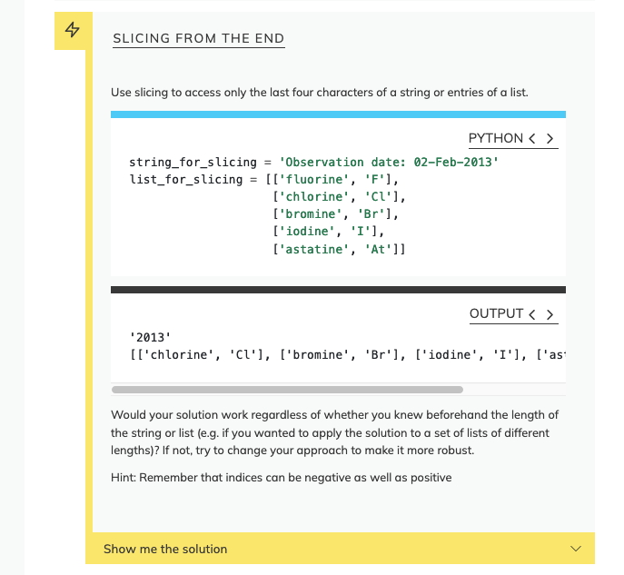
Practice
To practice what we learned today:
Go to the Programming with Python Carpentries lesson book: https://swcarpentry.github.io/python-novice-inflammation/index.html
Select an episode
Find exercises at the bottom, highlighted in yellow -->

Slide 28
Get in touch
Justin DeMayo
justin.demayo@yale.edu
Get more info on the library website:
library.medicine.yale.edu/research-data

Slide 29
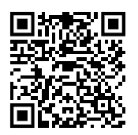
Short Survey!
Scan the QR code or visit
https://tinyurl.com/Py1Survey

Slide 30
Acknowledgements
Some of this material, including the inflammation data, is adapted from the Carpentries, using a CC-BY-4.0 license.

Slide 31
General Python Documentation
Official Python docs: https://python.org
Beginner guide: https://wiki.python.org/moin/BeginnersGuide
Cheatsheets:
Python: https://www.pythoncheatsheet.org/ + https://www.datacamp.com/cheat-sheet/getting-started-with-python-cheat-sheet
See more helpful learning resources (under Python): https://library.medicine.yale.edu/research-data/learn-work-data

Slide 32
Python Library Documentation
Each library we used today has its own documentation, for further reading.
numpy — docs | user guide
matplotlib — docs | user guide | cheatsheets
glob — docs
Markdown
markdown – guide | cheatsheet

