Slide 1

Coding with Clarity:
AI-Powered Programming for Researchers
MAXIMILIAN WEGENER, MPH
Justin DeMayo
Biomedical Informatics Librarian Cushing/Whitney Medical Library
System and Application Specialist Cushing/Whitney Medical Library
Yale Harvey Cushing/John Hay Whitney Medical Library

Slide 2

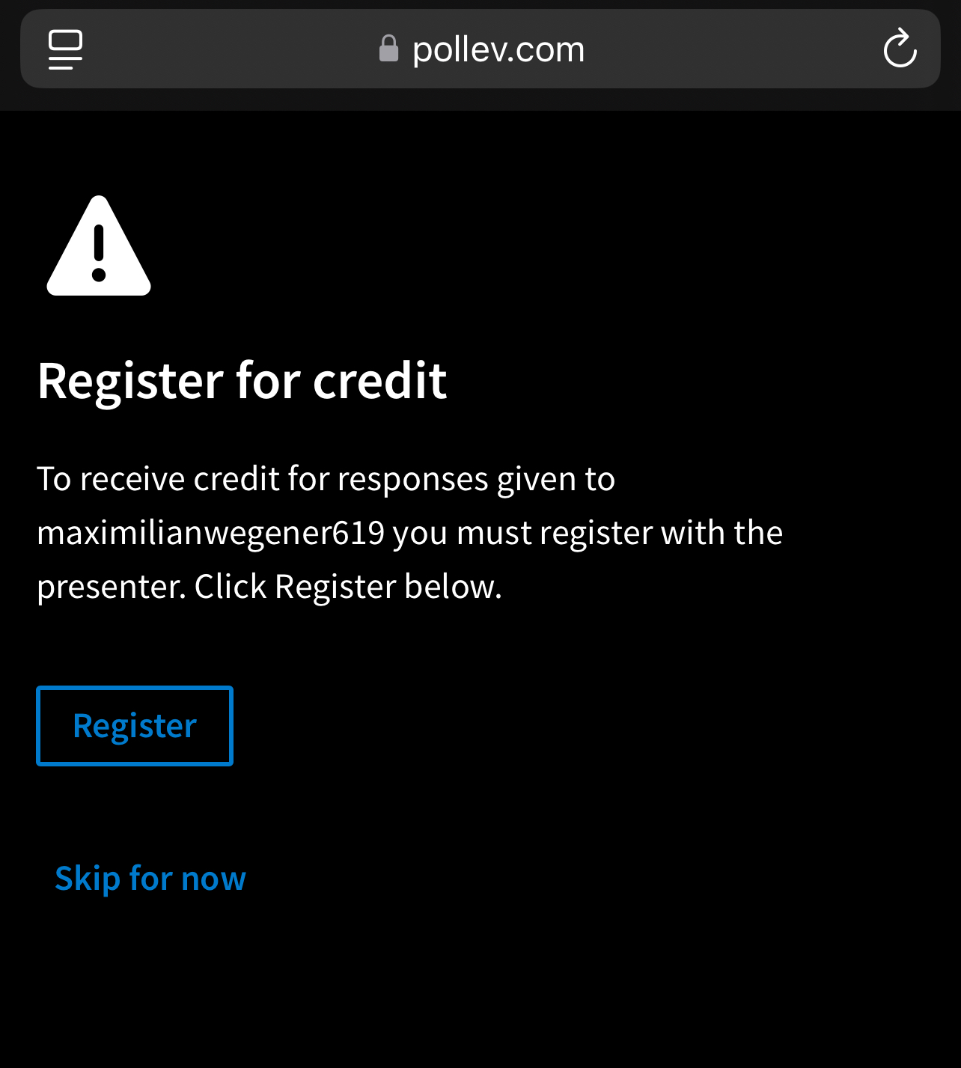
Interactive poll questions
Before we begin the lesson
Sign into Clarity at clarity.yale.edu
Download sample dataset from Github

Slide 3
Navigate to Yale’s Clarity Platform
Craft effective prompts to get better coding assistance
Implement AI coding assistants into your programming software
Apply best practices for AI-assisted programming
Import and clean data using coding assistant
Learning
Objectives
After this training, you should be able to:

Slide 4
Generative AI Overview
Yale’s Clarity Platform
Prompting
Workshop Activity – Hands on R Coding
Coding with AI Agents (Live demo)
Agenda

Slide 5
A subset of AI that uses deep-learning models to create new content (text, code, images) rather than just classifying existing data
Learns statistical patterns from massive datasets to predict and synthesize probable outputs
Converting natural language instructions into functional programming syntax
For use in programing, it understands the structural rules of R, Python, SQL, etc.
Can "read" and explain existing logic or debug errors.
Generative AI Overview
What is generative AI?

Slide 6
Generate code (R, Python, etc.) for data cleaning complex statistical tests
Create mock datasets used to test code or for teaching without the risks of exposing PHI data
Accelerate pipeline development used to automate multi-step omics processing
Extract clinical information from physician notes, discharge summaries, radiology reports, and pathology reports that would otherwise require manual chart review
Diagnoses, medications, procedures, lab values, symptoms, anatomical locations, etc.
Generative AI Overview
A few examples how it is used in research

Slide 7
Generates boilerplate code and initial drafts of functions instantly.
Speeds up routine data manipulation and cleaning
handling missing values, reformatting datasets, etc.
Rapid Visualization by creating complex plots from simple descriptions without you having to spend hours looking up syntax
Real-time troubleshooting by providing instant explanations for error messages and suggests specific fixes
Can acts as a personalized tutor for researchers switching between programming languages
Can automatically generate comments and docstrings to make research code reproducible
Generative AI Overview
How can it benefit you?

Slide 8
Precision Oncology
AI frameworks to integrate clinical, genetic, and phenotypic data to create patient-specific prognostic tests, particularly for aggressive cancers like glioblastoma.
Me-LLaMA Clinical Chatbot
clinical chatbot designed to assist in diagnosing complex medical cases and summarizing clinical data, built to handle the nuances of medical terminology better than general-purpose AI.
spEMO (Spatial Multi-Modal Embeddings)
A new tool from the YSPH that uses AI to combine tissue slide images with gene and protein activity. It helps scientists "see" how cells interact in diseased tissue and even drafts medical reports for pathologists.
CardioGenAI & Drug Discovery
Generative models designed to synthesize novel small molecules for autoimmune diseases and cancer, drastically shortening the time to validate new drug leads.
Science Dissemination (Neurology)
GenAI (Google Notebook-LM) to transform complex flagship guidelines into synthetic podcasts and FAQs to make cutting-edge stroke research more accessible to clinicians.
Digital Twin Simulations
Ongoing research in therapeutic radiology at Yale uses AI to build computational replicas of patients to simulate how they might respond to specific radiation therapies before treatment begins.
Generative AI Overview
How is it being used at Yale currently
Notes:
Precision Oncology: Yale researchers are developing AI frameworks to integrate clinical, genetic, and phenotypic data to create patient-specific prognostic tests, particularly for aggressive cancers like glioblastoma.
The "Me-LLaMA" Project: A Yale-developed clinical chatbot designed to assist in diagnosing complex medical casesand summarizing clinical data, built to handle the nuances of medical terminology better than general-purpose AI.
Spatial Multi-Modal Embeddings (spEMO): A new tool from the Yale School of Public Health that uses AI to combine tissue slide images with gene and protein activity. It helps scientists "see" how cells interact in diseased tissue and even drafts medical reports for pathologists.
+1
CardioGenAI & Drug Discovery: Yale-affiliated ventures are using generative models to design and synthesize novel small molecules for autoimmune diseases and cancer, drastically shortening the time to validate new drug leads.
Science Dissemination (Neurology): Researchers in the Department of Neurology are using GenAI (Google Notebook-LM) to transform complex flagship guidelines into synthetic podcasts and FAQs to make cutting-edge stroke research more accessible to clinicians.
The "Digital Twin" Concept: Ongoing research in therapeutic radiology at Yale uses AI to build computational replicas of patients to simulate how they might respond to specific radiation therapies before treatment begins.

Slide 9
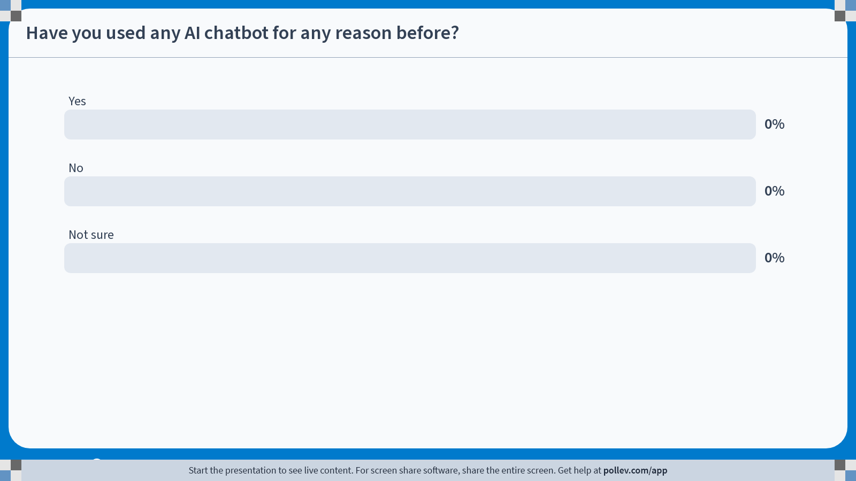
Notes:
Do not modify the notes in this section to avoid tampering with the Poll Everywhere activity. More info at polleverywhere.com/support Have you used any AI chatbot for any reason before?
https://www.polleverywhere.com/multiple_choice_polls/viXjqA8KjImbZMPArxaVL?state=opened&flow=Default&onscreen=persist

Slide 10
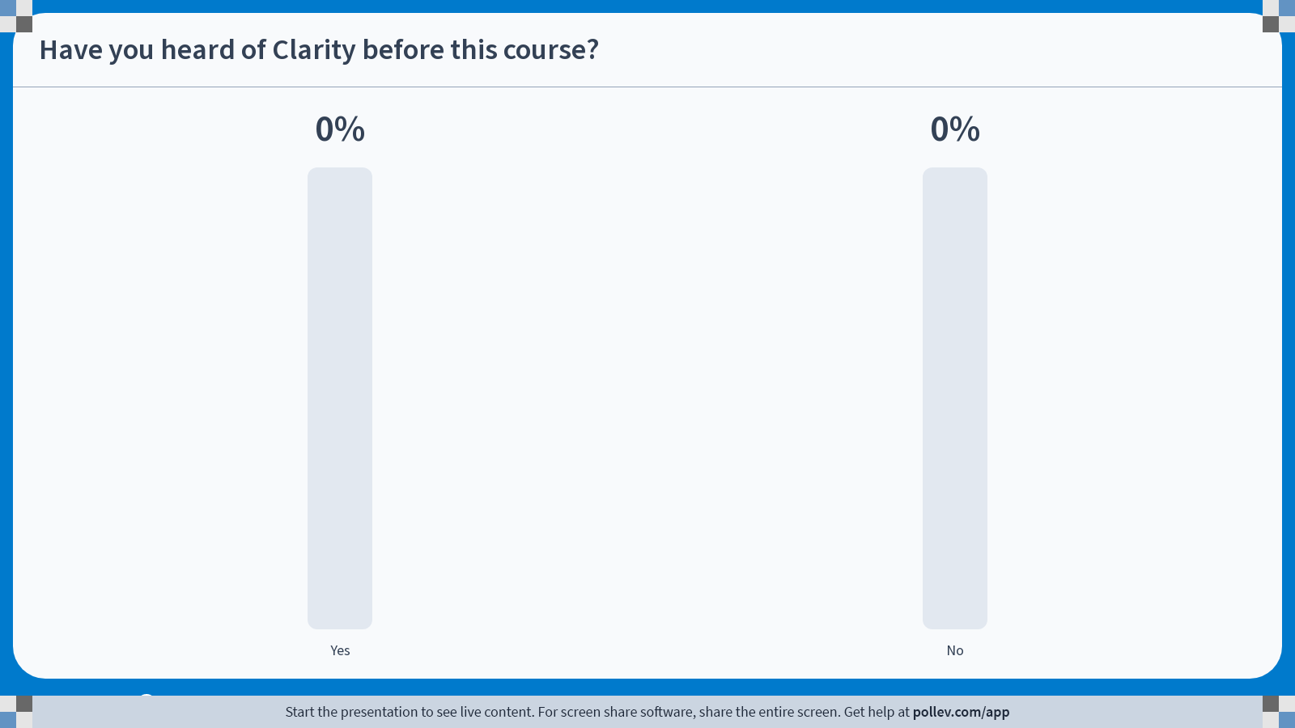
Notes:
Do not modify the notes in this section to avoid tampering with the Poll Everywhere activity. More info at polleverywhere.com/support Have you heard of Clarity before this course?
https://www.polleverywhere.com/multiple_choice_polls/gFSc3Cu7azVJShfC6M9zV?state=opened&flow=Default&onscreen=persist

Slide 11
Yale’s secure home for generative AI
Secure AI Gateway
Provides access to multiple advanced AI models (GPT-4o, Claude 3.5 Sonnet, Gemini Pro, and others) within a secure, Yale-controlled environment
Free for Yale community (students, faculty, staff) with Yale NetID authentication
Enterprise-grade security infrastructure maintained by Yale IT
Data Privacy Guarantee
Your conversations and uploaded data are NOT used to train external AI models
Suitable for working with de-identified health data (check current Yale IRB guidance for specific use cases)
Information stays within Yale's controlled systems, not sent to public AI services
Meets Yale's data governance and security requirements
Model Flexibility
Allows researchers to "toggle" between different AI models to compare results (i.e. validating code accuracy)
Yale’s Clarity Platform
Overview

Slide 12
Upload large script files
Save your file as (save as) a text (.txt) file
This can be used on common script file types: .R, .md, .rmd, .qmd, .py, .ipnyd (might be easier to do this manually)
Copy/paste smaller code chunks directly into prompt bar
De-identify data (remove names, MRNs, etc.) before uploading to the platform unless specifically required for the analysis
Always test AI-generated code before using in production research
Iterative Prompting (building block approach):
Don’t write complex 200-line script at once
Load data; Clean data; Run analysis; Create plot.
Always evaluate and manually review code generated by AI, especially for statistical calculations or data-cleaning steps that impact study results
Yale’s Clarity Platform
Best practices

Slide 13
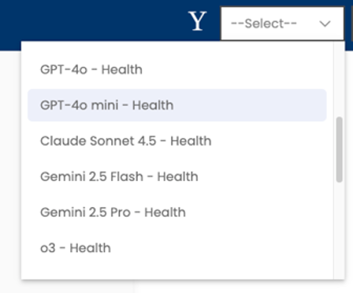
Use is limited to approved workflows and must align with HIPAA, IRB, and Yale data governance requirements and, for clinical use cases, approval by the Enterprise Healthcare AI Governance process.
When users log into the Clarity platform, individuals in the Yale University HIPAA Covered Entity will see a new “Health” option in the chatbot drop-down menu by default
Only approved tools may be used for sensitive Health Sciences work (non-approved commercial and public chatbots are not permitted).
Users who are not in the Yale University HIPAA Covered Entity who want access to the new Health chatbots must submit a request to the ITS helpdesk.
Clarity now Supports ePHI
HSIT email sent on 3/26/2026

Slide 14
AI tools may not be used for independent clinical decision making such as diagnosis or treatment planning unless formally approved for that purpose.
Research use involving identifiable data requires IRB review or exemption.
Users are responsible for the accuracy, appropriateness, and compliance of all AI-assisted outputs, as well as for meeting any additional reporting obligations required by other organizations.
When using AI tools in Health Sciences environments, apply Yale’s AI Review Framework for Trustworthy AI Systems and CHAI principles which guide Yale’s AI governance and Enterprise Healthcare AI Governance frameworks.
Clarity now Supports ePHI

Slide 15
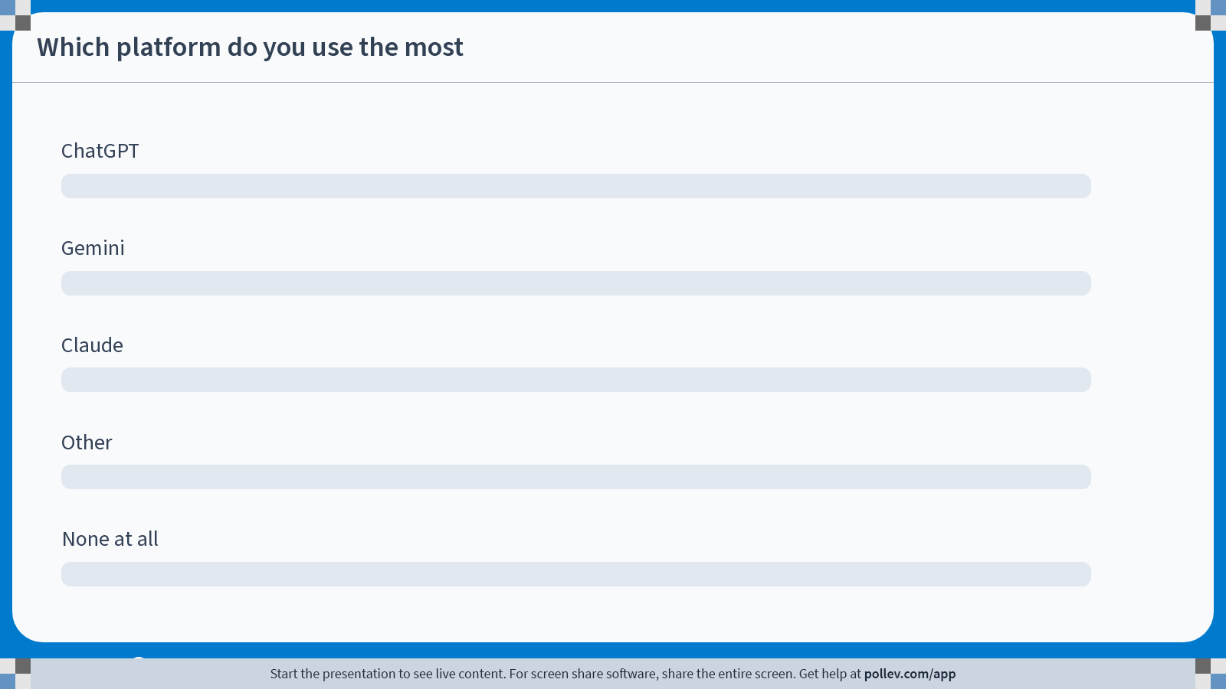
Notes:
Do not modify the notes in this section to avoid tampering with the Poll Everywhere activity. More info at polleverywhere.com/support Which platform do you use the most
https://www.polleverywhere.com/ranking_polls/6V0rBP2FWxZcxNCaVjD7y

Slide 16
What is a prompt?
A clear, structured instruction given to an AI model
Acts as the interface between human intent and machine output
Key elements of effective prompts:
Unambiguous language and explicit instructions
Relevant background information and constraints
Precise details about data, methods, software, and expected outputs
Defined structure for the desired result
Why good prompting matters for research:
Reduces errors and misinterpretation
Ensures consistent, replicable results
Minimizes iterations and saves time
The iterative nature of prompting:
Less is more
Refine prompts based on initial outputs
Adjust specificity and context as needed
Prompting
Overview

Slide 17
Role
Assign the AI a persona:
You are an expert Bioinformatician
You are a senior data scientist
This sets the tone and complexity of the code
Task
Define the specific goal clearly
Write a Python script to perform a t-test
Write R code to change the values of variable X from 0 to Yes
Context
Provide the "environment”
My data is a CSV with 10 columns; the variable 'Group' is categorical”
Provide DF names, variable names, etc. -> i.e upload str() outputs
Constraints
Set boundaries
Use the tidyverse in R
Do not use deprecated functions
Output (Format)
Specify how you want the code
In a single block with detailed comments for each line
Examples (Ask for)
Show input/output sample
Show the Expected output
What data for this analysis usually looks like
Prompting
Framework for success

Slide 18
Test (Never assume code works)
Copy it into your local RStudio or Jupyter Notebook and run it with a subset of your data first
Verification (Read the code line-by-line)
Do the methods the AI chose match your study design
Check for Hallucinated Libraries
AI occasionally invents packages, functions, dataset names that don't exist
Security
Before running, ensure the AI hasn't suggested an external API call that might send your data to an unverified third-party server.
Consistency Check
Ask something like "Explain the logic behind the function you just wrote" If the explanation doesn't match the code, the output is unreliable
Case Testing
Ask the AI, "What happens to this code if my data has missing values (NAs)?" Ensure the script handles medical data realities
Prompting
Evaluation

Slide 19
Bad
“Write a Python script to analyze this CSV file and make a plot.”
Why it fails: It lacks Context and Constraints. The AI doesn't know which columns to use, what kind of analysis to perform, or what library (Matplotlib? Plotly? Seaborn?) you prefer.
Good
Role: Act as a Senior Data Scientist.
Task: Create a Python script using pandas and seaborn to analyze a dataset named sales_data.csv.
Context: The data contains columns for 'Date', 'Revenue', and 'Product_Category’.
Constraints: I need to handle missing values by filling them with the median.
Output: Generate a line chart showing total monthly revenue trends and a bar chart of revenue by category. Include comments explaining each step.
Prompting
Bad vs Good

Slide 20
Bad
"How do I filter data in R?”
Why it fails: This is too broad. Are you using Base R, dplyr, or data.table? What is the condition for filtering?
Good
Role: Act as an R Programming Expert.
Task: Provide a code snippet to filter a dataframe called survey_results.
Context: I am using the tidyverse library.
Constraints: I only want to keep rows where the age is over 18 AND the status is 'Complete’.
Output: Provide the dplyr code and show how to pipe the output into a new object called cleaned_data.
Prompting
Bad vs Good

Slide 21
Bad
"Convert this SAS code to Python:
proc means data=work.test; var age; run;”
Why it fails: While the AI might get it right, it often misses the "Why." It might provide a basic result without considering how Python handles dataframes vs. SAS libraries.
Good
Task: Translate the provided SAS PROC MEANS step into Python code.
Context: I am migrating a clinical trial workflow from SAS to a Jupyter Notebook environment using pandas.
Constraints: Ensure the output includes the mean, standard deviation, and N (count), matching the default SAS output format.
Evaluation: Does the Python output handle NaN values the same way SAS excludes missing values in summary statistics?
Prompting
Bad vs Good

Slide 22
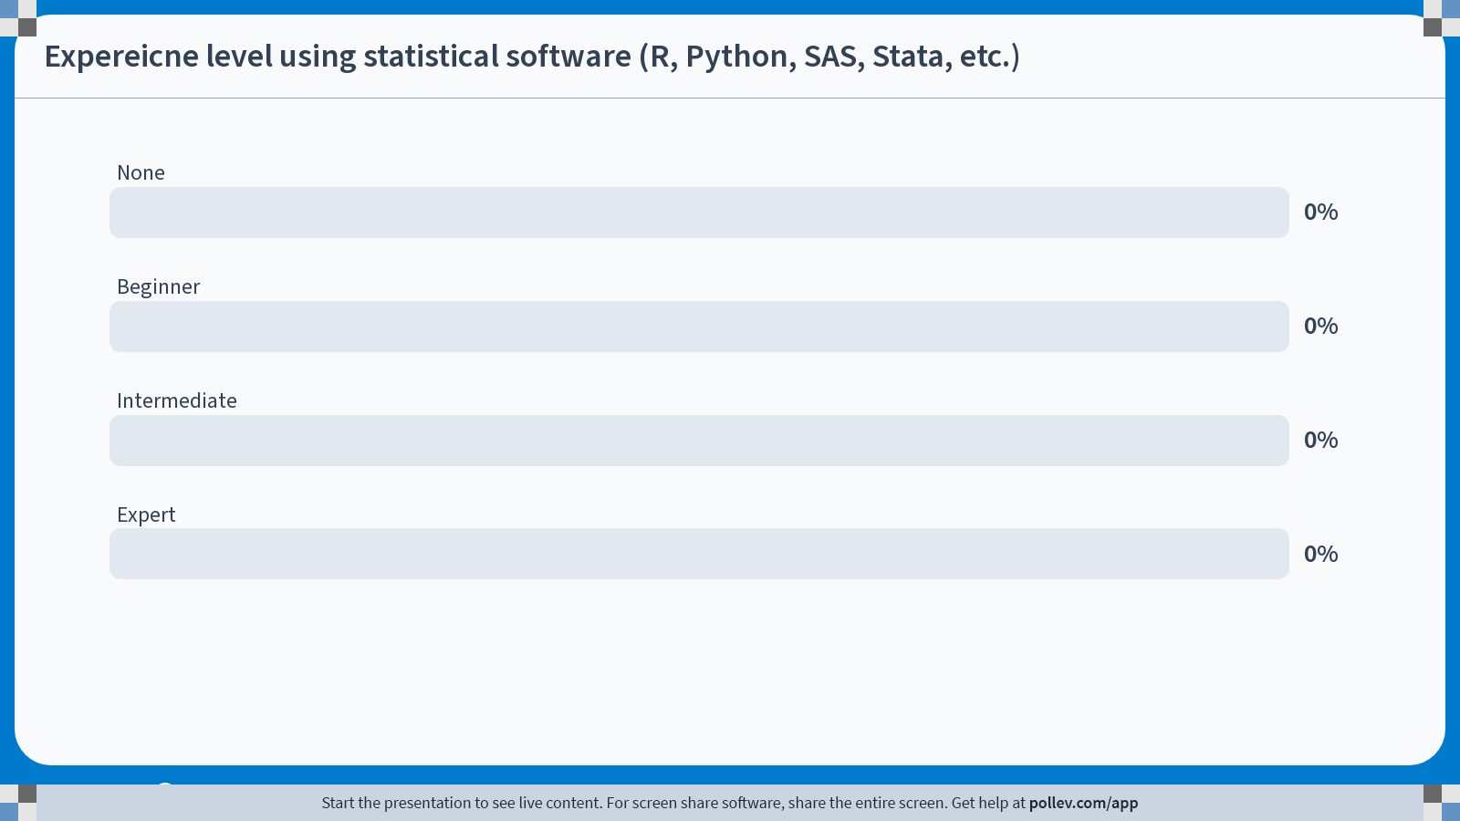
Notes:
Do not modify the notes in this section to avoid tampering with the Poll Everywhere activity. More info at polleverywhere.com/support Expereicne level using statistical software (R, Python, SAS, Stata, etc.)
https://www.polleverywhere.com/multiple_choice_polls/BJYxlK9hpVgbmrRRtfpvr?state=opened&flow=Default&onscreen=persist

Slide 23
Using Clarity and what you’ve learned about prompting complete the following:
Import dataset into Rstudio or Positron environment
Inspect data
str(), glimpse(), skim()
Clean the data using the following directions:
Clean column names (get rid of spaces and uppercase letters)
Make sure age is an interger
Update: anemia, diabetes, high blood pressure, smoking
0=no; 1=yes
Update sex
0=woman; 1=man
Update death event
0=dead; 1=alive
Create a new variable called age_group
40-49; 50-59; 60-69, 70-79, 80+
Visualize
Create a boxplot showing the distribution of ejection_fraction grouped by death_event
Create a bar chart showing the death rate for smokers vs. non-smokers who also have diabetes.
Create line graph showing the mean high blood pressure by age group stratified by sex
Exercise

Slide 24
The Core Shift
▸ From Web to Workspace — natively embedded AI agents.
▸ Full Context Awareness — agents read your files, variables, and project structure.
▸ No copy-paste context-switching from browser to IDE.
▸ Expanding from Yale Clarity's secure web gateway → secure API / IDE integrations.
Beyond the Chatbot –
AI Pair Programming
Chatbot vs. Coding Agent
Web Browser Chat | IDE Agent (Copilot / Claude Code / Positron Assistant)
You copy/paste code | Agent reads your open files directly
No env awareness | Sees your loaded variables & packages
Manual error copy | Highlight error → instant fix in context
One-shot Q&A | Iterative pair-programming loop

Slide 25
The Academic Approach to AI Agents
Applying the Prompting Framework inside your IDE
Framework for Success: Role → Task → Context → Constraints → Output
Deterministic Intent
Continuous Auditability
Reproducibility
Human-in-the-loop
Dictate exact methods, transformations, and packages. Never leave statistical decisions to the model's defaults.
Force the AI to comment every line. You must be able to explain and defend every transformation it produces.
Build scripts that are mathematically sound and publication-ready. Structured prompts → structured, auditable outputs.
Every AI output must pass through domain expert review before it informs any decision. Prompting discipline reduces errors — it does not eliminate them.
⚠ We cannot rely on 'vibe coding' — a vague instruction does not guarantee correct statistics. Strict prompting is more critical in the IDE, not less.

Slide 26
AI Coding Agents vs. Pair Programmer IDEs
Two approaches to AI-assisted development — different workflows, different strengths
Pair Programmer IDEs
CLI Coding Agents
How they work: Embedded inside a graphical code editor (VS Code, Cursor, Positron). AI assists as you type.
Best for: Real-time autocomplete, inline chat, iterative editing within a single file or small project.
Interaction style: You drive; AI suggests. Tab-complete, inline diffs, chat sidebar.
Examples:
▸ VS Code w/ Copilot - 2K completions/mo free
▸ Cursor IDE — 2K completions + 50 chat/mo free
▸ Google Antigravity — Free during preview
▸ Positron + Assistant — Trial, then $20/mo
How they work: Run in your terminal. Autonomous agents that read, write, and execute across your entire project.
Best for: Multi-file refactors, scaffolding, running tests, orchestrating complex workflows end-to-end.
Interaction style: AI drives; you review. Give a high-level prompt, agent plans and executes steps.
Examples:
▸ Claude Code — Requires Pro/Max subscription
▸ Gemini CLI — 1K requests/day free
▸ OpenAI Codex — ChatGPT Plus ($20/mo)
▸ OpenCode — Free/open-source (BYOK)
Notes:
- Also note, there are many other plugins, and coding agents can be installed as plugins and possible stand alone desktop applications.

Slide 27
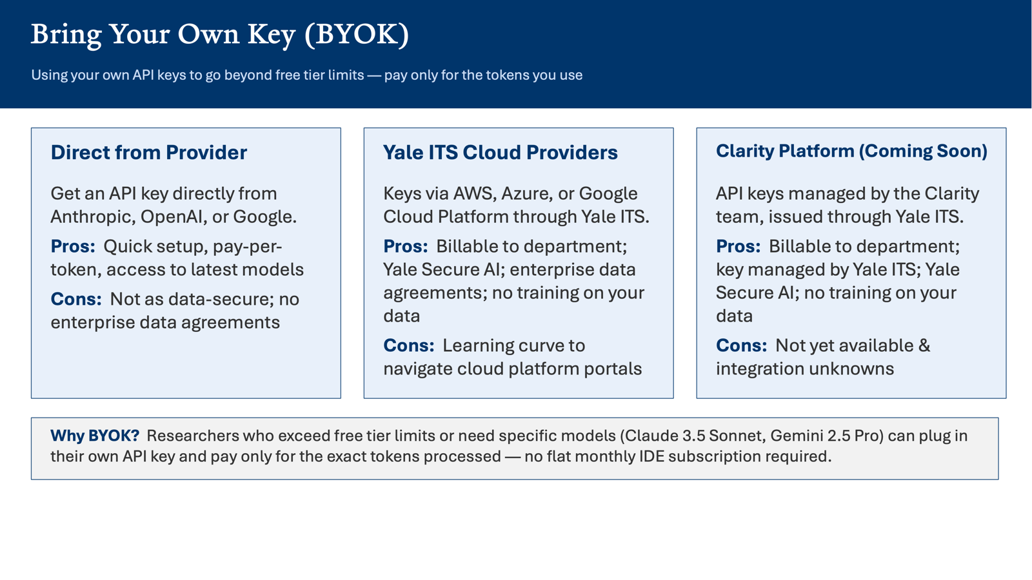

Slide 28
License Options for Yale's Claude Enterprise Environments
Yale offers two Claude environments: 1) a general environment, and 2) a HIPAA compliant environment for users working with ePHI. Users will be able to select from the following license types in each environment.
“Standard” $20/month license: Includes access to the platform up to the usage limit* for a Standard seat.
“Premium” $50/month license: A higher-usage Claude offering with approximately 5x the session-based usage limits* of a Standard seat and access to the latest advanced tools, features, and models.
Claude is Coming

Slide 29
Questions

Slide 30

Course
Survey
https://yalesurvey.ca1.qualtrics.com/jfe/form/SV_cZOk3RQmTrQLhYy

Slide 31
Resources
AI at Yale - Guidance
AI at Yale - Using AI Safely and Responsibly in Health Care and Research
AI at Yale - Yale Standards for Using AI Tools and Chatbots in Health Sciences
AI at Yale - Yale’s AI Tools and Resources
Yale AI Resources – AI Tools (github.io)

