Slide 1
Defend Against the Top Ten: OWASP
Notes:
Shijit

Slide 2
Introduction to Speakers
Notes:
Shijit will ask each speaker to introduce themselves.

Slide 3

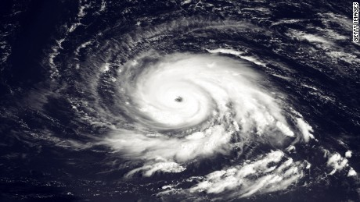


Why the world needs you
Our lives and our data are “online”
We face increased scope, scale and impact of threats
Human and Organization Threats: Nation States, Organized Crime, Terrorists, Industrial Espionage, Hacktivists, Lone Hackers
Natural and Environmental Threats: Storms, Floods, Earthquakes, Power Failures from cyber attacks on infrastructure.
Notes:
Sridhar + Mike
https://www.zdnet.com/article/cyber-attacks-are-a-top-three-risk-to-society-alongside-natural-disaster-and-extreme-weather/

Slide 4
Cybersecurity + Cloud Computing + Data
How are all three interrelated? Or are they?
Why must companies move to the cloud? How does this impact Cybersecurity?
Is “Data” the new gold? Why is this all about Data?
Notes:
Sridhar + Mike
This slide is just meant to inspire discussion on the three. Since Code With Me will have a Cloud and Data series and all three are connected - it’s good to start the discussion to see how all three are connected.

Slide 5
Infamous Breaches
OPM Breach: 21.5 Million SSNs and other privacy data stolen using a variant of PlugX, a remote-access tool commonly deployed by Chinese-­speaking hacking units
Command and Control and Data Exfiltration
Equifax: Apache Struts Update mishandled by one engineer – CEO
Not a Fault Tolerant System
Fault Tolerance and Communication
Deep Root Analytics Data Leak
200 million voter information leaked. 1.1 terabytes of data was available to download and not password protected.
Answer: Configure S3 Servers with proper security configurations (A3).
WannaCry Ransomware/FBI Malware Attack
Malware on personal laptop
Content Filter/Antivirus/regular security scans.
Notes:
OPM Breach - Sridhar
Equifax - Mark Salter
Deep Root - Ameet Nayak and/or David D’Agostino
WannaCry Ransomware - Drake Aronhalt

Slide 6
CIA : Goals of CyberSecurity
Confidentiality: “Preserving authorized restrictions on information access and disclosure, including means for protecting personal privacy and proprietary information…” [44 U.S.C., Sec. 3542] - A loss of confidentiality is the unauthorized disclosure of information.
Since SQL databases generally hold sensitive data, loss of confidentiality is a frequent problem with SQL Injection vulnerabilities.
Integrity: “Guarding against improper information modification or destruction, and includes ensuring information non-repudiation and authenticity…” [44 U.S.C., Sec. 3542] A loss of integrity is the unauthorized modification or destruction of information.
SQL Injections can make changes or even delete sensitive data.
Availability: “Ensuring timely and reliable access to and use of information…” [44 U.S.C., SEC. 3542] A loss of availability is the disruption of access to or use of information or an information system.
A botnet could overwhelm a system by flooding requests: DNS Flood Attacks, UDP Reflection/Amplification
Notes:
Ameet Nayak and/or David D’Agostino

Slide 7
Which Certification to Take?
CISSP - Certified Information Systems Security Professional
CEH - Certified Ethical Hacker
CompTIA Security+
What if you already code? For those with no knowledge of IT? GIAC Certifications
Notes:
Mark Salter

Slide 8
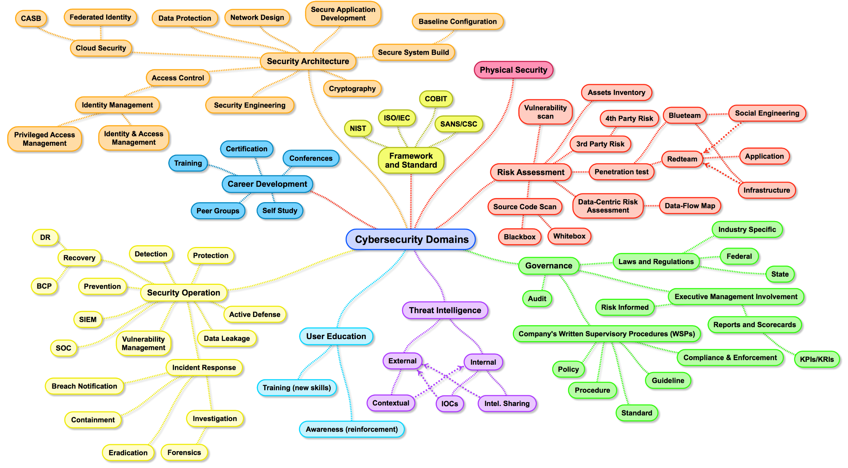
Credit to Henry Jiang for Graphic
Notes:
Drake Aronhalt
There needs to be cross industry and federal government collaboration to address cyber threats, risks, and vulnerabilities

Slide 9
DEMO Video
Be Careful with Web Forms…
http://www.techpanda.org/index.php
Notes:
In Username: abc@abc.com In Password: Enter xxx') OR 1 = 1 -- ]

Slide 10
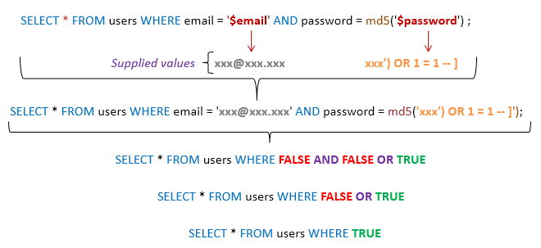
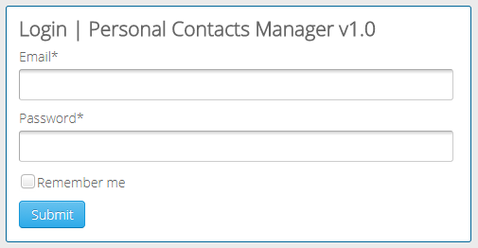
It is too easy - Live SQL Injection Attack
Web Application Explanation
Java Form
Web Form
Email
Password
Pings Database with true condition
Returns all Re
Accepts Input and thinks it’s a query for the Database
Displays to user entire repository
Email Login
Database
Notes:
Shijit Dasgupta

Slide 11
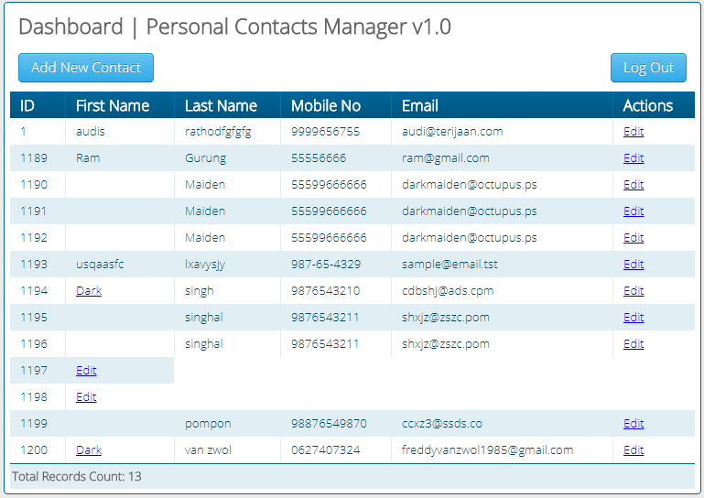
Live SQL Injection Attack pt. 2
Result
How to Prevent?
Don’t use strings for Query searches.
In Java a “prepared statement” variable can be used to defend against this.
Perform a Risk Assessment of your application to discover all vulnerabilities.
Notes:
Shijit Dasgupta

Slide 12
Workshops
June 14th to July 25th

Slide 13
Symplicity on June 14th
Symplicity develops a suite of Software-as-a-Service products that serve higher-education institutions worldwide. Our products connect students and employers, and help manage all aspects of student life on campus.
We run mission-critical systems on behalf of universities, and we are entrusted with institutions’, students’, and employers’ data. At Symplicity, we employ secure practices at every stage of our process to ensure the security and availability of our systems and data.
During Symplicity’s session in this series, we will cover the following topics:
A1: Injection - SQL, File, and JavaScript
A3: Sensitive Data Exposure
A6: Security Misconfiguration
Notes:
Ameet Nayak and/or David D’Agostino

Slide 14
Sevatec on June 27th
Sevatec is a National Security Services firm specializing in Agile and DevOps, cyber engineering, data sciences, and cloud solutions. Sevatec has achieved CMMI Maturity Level 3 ratings for both Development (DEV) and Services (SVC) and maintains ISO 9001:2015, 20000-1:2011, and 27001:2013 certifications.
400+ personnel focused on mission critical cyber security, IT, and related consulting services
– Business Resiliency
– Active Cyber Defense to address DHS IDC, APT, and Emerging TVRs
Specific to Code with Me
•Increase awareness and knowledge exchange
•Meetup discussions to improve application and services security
•Focus on Authentication (A2) , Access (A5), and Logging (A10)

Slide 15
Capital One on July 18th
At Capital One, we’re building a leading information-based technology company. Still founder-led by Chairman and Chief Executive Officer Richard Fairbank, Capital One is on a mission to help our customers succeed by bringing ingenuity, simplicity, and humanity to banking. We measure our efforts by the success our customers enjoy and the advocacy they exhibit. We are succeeding because they are succeeding.
Workshop will focus on:
A4 XML External Entities
A8 Insecure Deserialization
Critical Stack Endoi

Slide 16
The Media Trust on July 25th
The Media Trust provides real time malware scanning for websites and third party code providers
Our workshop will be about how malicious compromises can occur through the use of cross-site scripting attacks and through the use of third party open source code.
A7 (Cross-Site Scripting)
A9 (Using Components with Known Vulnerabilities)

