Slide 1
Secure with Sevatec
Shijit Dasgupta
Ali Hanif
Mike McKinney

Slide 2
Agenda
Arrival, Food, and Introductions | 6:30 - 7:15 PM
Broken Authentication(A2)
Broken Access Control(A5)
Insufficient Monitoring and Logging (A10)
Tech Demo of Website
Azure and AWS Discussion of Monitoring
Discussion and Networking | 8 - 8:30 PM

Slide 3
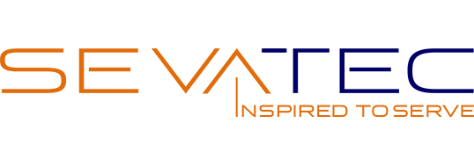
Introduction to Sevatec
Founded by Sonny Kakar, Sevatec based its name on the concept of “Seva,” a Punjabi word that means “Inspired to Serve.” We are trusted talent partnered with government to protect and improve the lives of Americans. Sevatec’s expertise and workplace culture are verified by an esteemed combination of industry certifications and awards.
DevOps & Agile Data Sciences Cyber Engineering Cloud Services Learning & Training
Since 2003, Sevatec has been dedicated to serving the mission-critical needs of the federal government:
Homeland Security & Law Enforcement Defense & Intelligence International Diplomacy & Affairs Transportation & Public Safety

Slide 4
Broken Authentication (A2)
What is it?
An unwanted/disallowed user gains access to or control over your system by subverting login/authentication systems.
Real Life Examples?
Malicious user gains access via a known or default account/password combination.
Token’s used for authentication never expire. A malicious user can get this token from a user with valid access and then access the system.
Uses plain text, encrypted, or weakly hashed passwords
Notes:
Example #1 is poor system admin - keeping default accounts or accounts that are dev/test accounts in open source still in the system
Example #2 is not using token expiration. Particularly bad in a shared pc environment.
Example #3 is using a weak hash for passwords without a salt - will be show in tech demo

Slide 5
Broken Access Control
What is it?
A malicious user is able to gain access to a resource they are not intended to have access to.
Real Life Examples?
User browses directly to an admin page or a page with another user’s information or ability to get to a page without supplying credentials
If a page relies on a parameter to be correct as a means of access control - it’s vulnerable to someone modifying it.
Notes:
Example #1 assumes that a system secures a set of pages with links to other pages. The problem is they didn’t secure all pages and make the poor assumption that no one will navigate directly to the other links OR web application is not forcing authentication checks
Example #2 is giving users too much access assuming the pages are safe. If you have a page that calls something like db.getAccountInfo(“300400300”) and the user has read access to the whole db then someone can modify the page to access other accounts.

Slide 6
Insufficient Logging and Monitoring
Why is this bad?
You need to be able to understand what your service is doing from logs. But just logging isn’t enough. Something/someone needs to be continually checking the logs for attacks.
Real Life examples?
Not logging repeated access attempts to a resource means you can’t tell what’s being attacked.
Logging information about scans or attacks, but no alert or trigger for automated action.
No application level logging
In 2016, identifying a breach took an average of 191 days – plenty of time for damage to be inflicted.
Notes:
Example #1 is not having enough information to know what’s going on.
Example #2 is having information but not the right process or systems to alert you to the attack.

Slide 7
Tech Demo

Slide 8
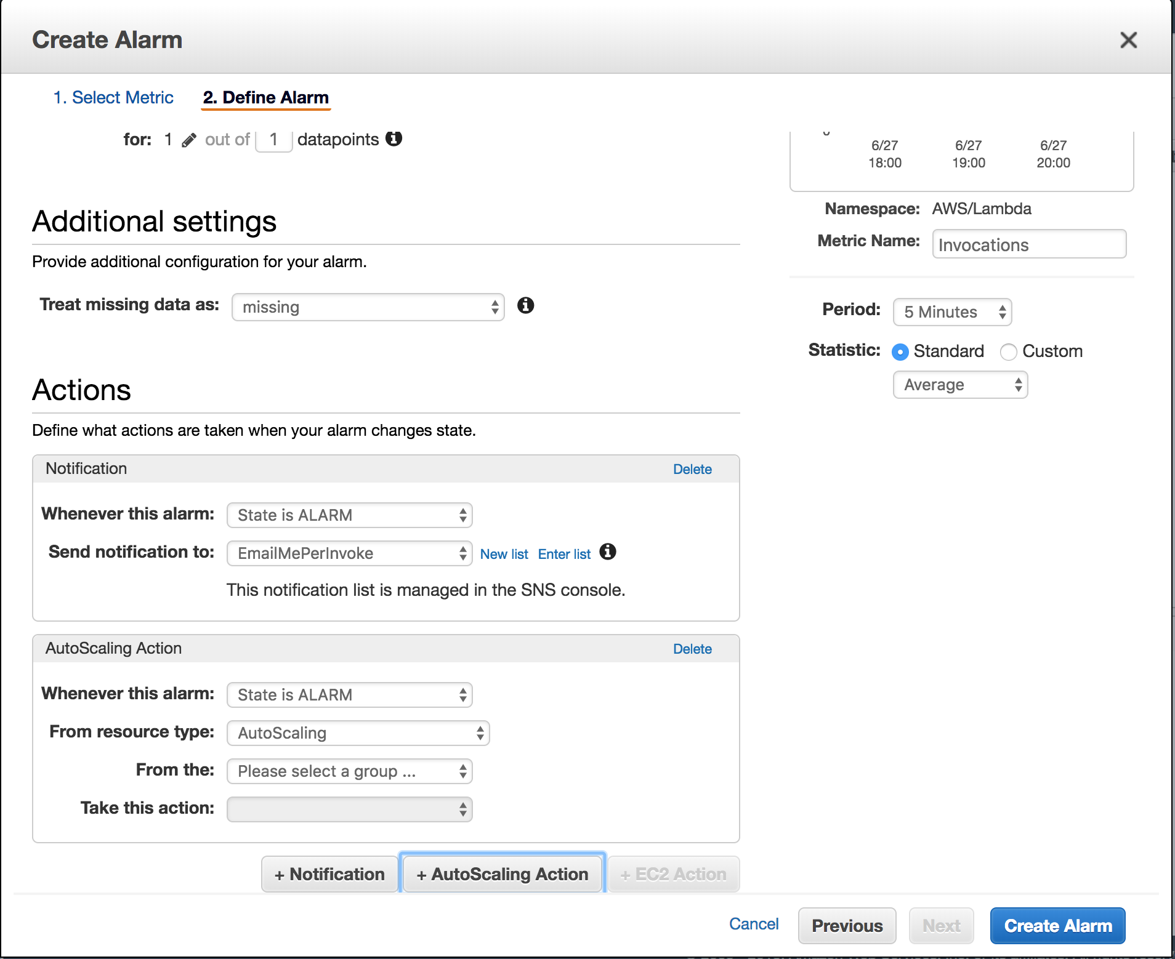
AWS: Cloudwatch
Can set up a Slack Webhook to Alert you
Can set up a SNS Feature with “Alarm Levels”
Can even set up actions such as terminating instances to avoid high usage.

Slide 9
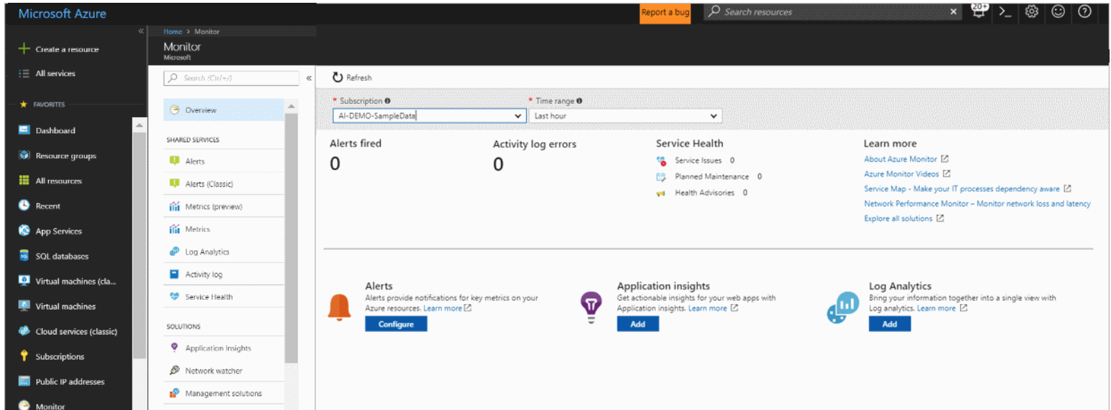
Azure: Monitor and Application Insights

