Slide 1
Javascript
night #3
Build FAKEflix
for fun! and unlikely profit$

Slide 2
Introductions:
CodeWith-Me.com
(the –dash– is absolutely required)
Your presenter tonight

Slide 3
Tonight:
Four exercises to build a frontend to an API.
Get world class support from the people around you!

Slide 4
After each exercise, we’ll review a solution together (I’ll push the code to the repo when the clock strikes…)
But DO NOT wait to get help. Work in pairs, work alone, work out loud.

Slide 5
it’s a pattern!
Find everything in the repo:
github.com/joeldevlearning/javascript-3
Exercises are in folders exercise-1, exercise-2, exercise-3, exercise-4
pattern inccccception!

Slide 6
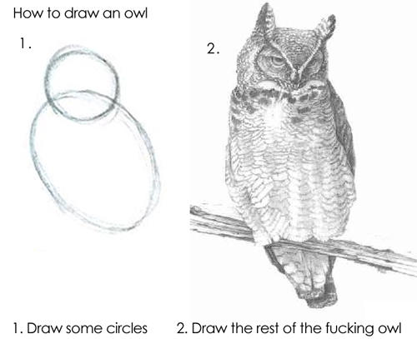
Missing a step?
Ask for help!

Slide 7
Exercise #1
TODO: create a movie profile page
remember how to unwrap a promise? we’ll review that quickly…
then we get to work on calling the omdb API and displaying the results

Slide 8
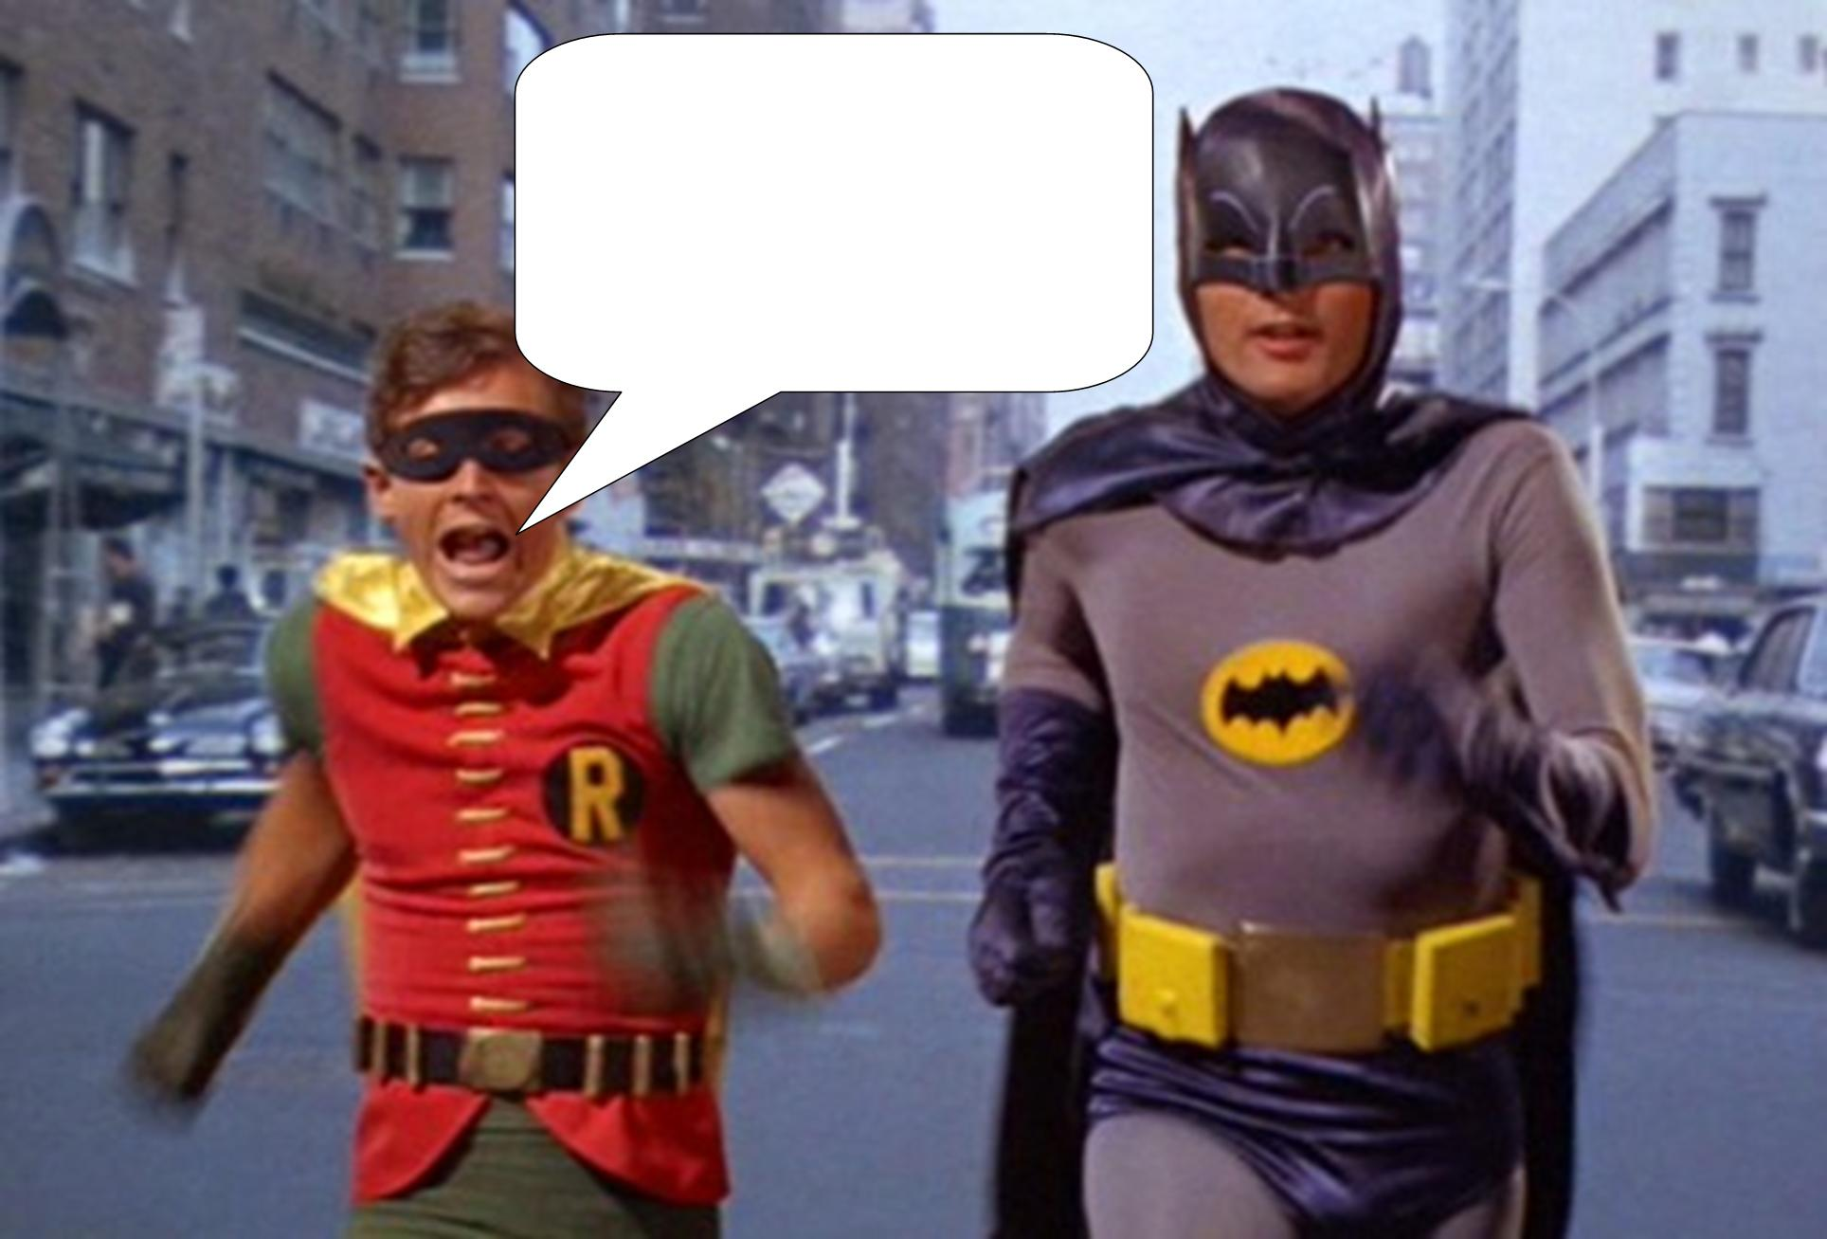
To the repo!
github.com/joeldevlearning
/javascript-3/exercise-1

Slide 9
Exercise #2
TODO: create a basic templating function
remember how to pass data to a function? easy stuff…
let’s create a function that returns our HTML dynamically, instead of hardcoding it

Slide 10

Into the repo!
github.com/joeldevlearning
/javascript-3/exercise-2

Slide 11
Exercise #3
TODO: create a movie search page
remember how to loop over results from a promise we’ll review that quickly…
then we get to work on creating a search box and using its input to call the API

Slide 12

Down the repo!
github.com/joeldevlearning
/javascript-3/exercise-3

Slide 13
Exercise #4
TODO: create a class to count search results
remember how to loop over results from a promise we’ll review that quickly…
then we get to work on creating a search box and using its input to call the API

Slide 14

Enter the repo!
github.com/joeldevlearning
/javascript-3/exercise-4

Slide 15

Back to the repo!
github.com/joeldevlearning
/javascript-3/exercise-5

