Slide 1
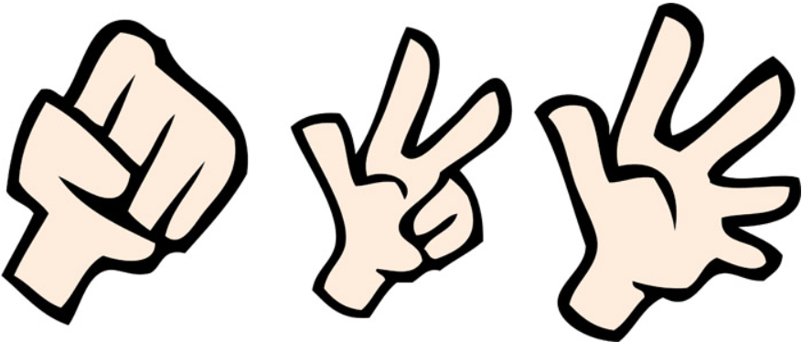



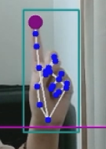
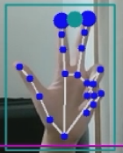

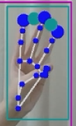

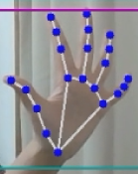


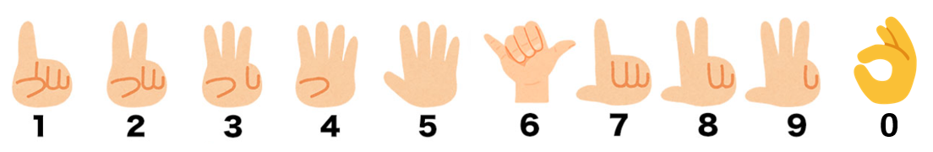







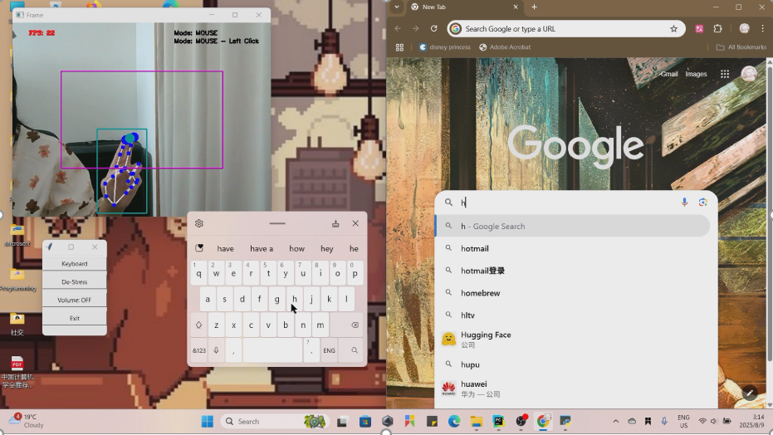
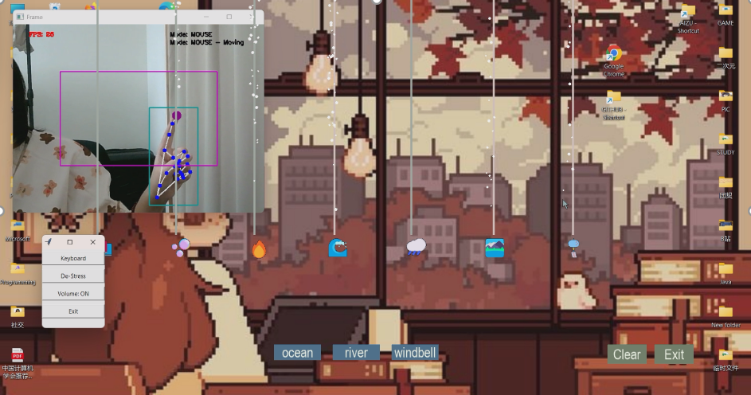
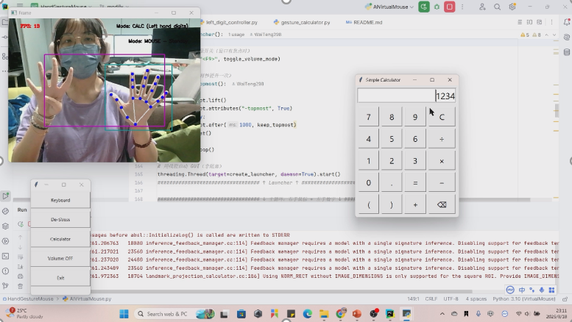
Hand Gesture Mouse: Vision-Based Virtual Mouse Control
Real-Time Cursor Interaction with OpenCV & MediaPipe
HAND GESTURES
Background
Traditional mouse requires physical contact
Touch-free interaction useful for accessibility
Aim: Build a virtual mouse controlled by hand gestures
Moving
Right
Click
Left
Click
Double Click
Scroll
Standby
Dragging
Workflow
Webcam captures hand video
MediaPipe detects landmarks
OpenCV maps hand position to screen coordinates
Gesture recognition → mouse actions (move, click, drag, scroll, etc.)
Main Features
Cursor movement (index finger tracking)
Left & right click (finger distance)
Drag & drop mode (open hand → fist)
Volume control (gesture-based)
Launcher GUI (keyboard, calculator, ASMR mixer)
Outcomes
No extra hardware, only camera
Real-time gesture recognition, low latency
Extendable (keyboard, ASMR mixer, calculator)
Validated with multiple gestures; stable in real-time use
M5291009 CHING WAI TENG & M5291029 JIANG YI CFS01

