Slide 1

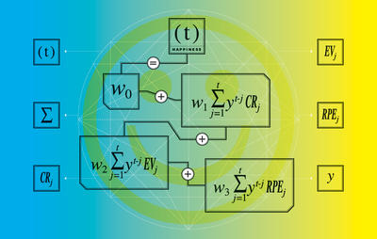

Using R
Day 2 Morning
Plotting (ggplot2)
Correlations
Simple Model Building
Multivariate Analysis
Export Figures
Cory Whitney, Lisa Biber-Freudenberger
How to ride a bicycle

Slide 2
Extract or Replace Parts of an Object
?“$”

Slide 3
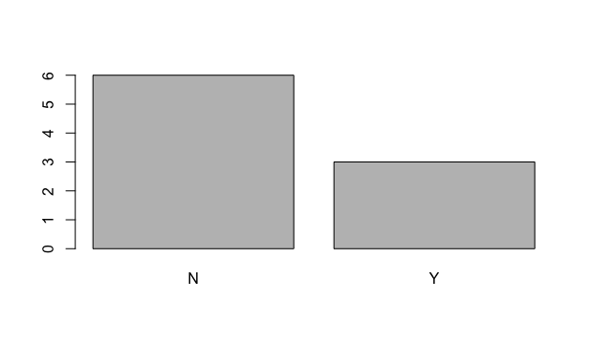
Plotting
R has several systems for making graphs
Base R
?plot READ
plot(participants_data$academic_parents)
Bar plot of number of observations of binary data related to academic parents

Slide 4
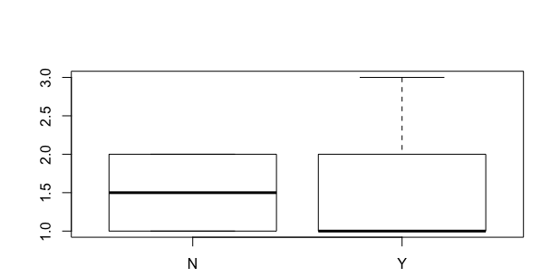
Plotting
R has several systems for making graphs
Base R
plot(participants_data$academic_parents, participants_data$days_to_email_response)
Boxplot of days to email response grouped by binary data related to academic parents

Slide 5
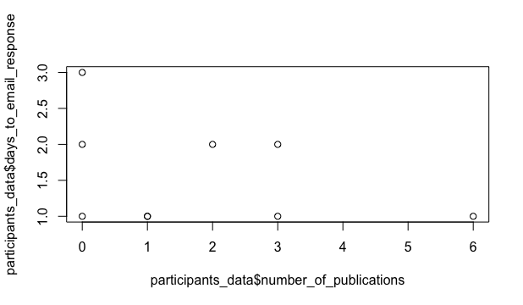
Plotting
R has several systems for making graphs
Base R
plot(participants_data$number_of_publications, participants_data$days_to_email_response)
Scatterplot of days to email response (y-axis) as a function of the number of publications (x-axis)

Slide 6
Plotting
R has several systems for making graphs
ggplot2 is one of the most elegant and most versatile.
ggplot2 implements the grammar of graphics to describe and build graphs.
Do more faster by learning one system and applying it in many places.
Learn more about ggplot2 in “The Layered Grammar of Graphics”
http://vita.had.co.nz/papers/layered-grammar.pdf.

Slide 7
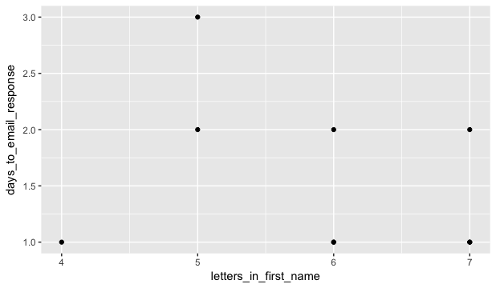
Plotting quick plot
qplot(participants_data, days_to_email_response, letters_in_first_name)
Scatterplot of days to email response as a function of the letters in your first name
Notes:
Maybe the most useful tool

Slide 8
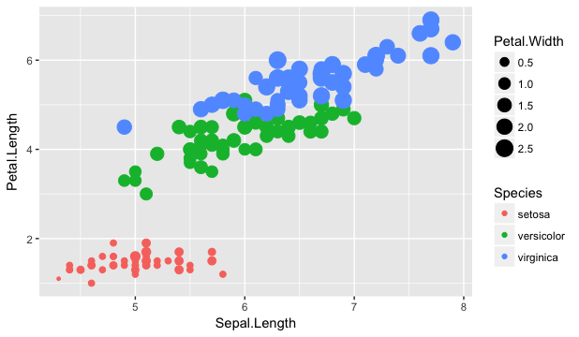
Plotting
?qplot READ
Example from built in R data
?iris READ
qplot(Sepal.Length, Petal.Length, data=iris, color=Species, size=Petal.Width)
Scatterplot of iris petal length as a function of sepal length with colors representing iris species and petal width as bubble sizes.

Slide 9
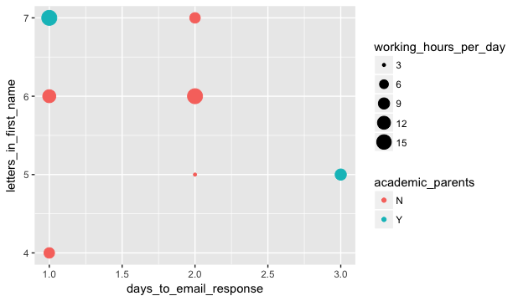
Plotting
Example from your data OFFER SUGGESTIONS
qplot(days_to_email_response, letters_in_first_name, color=academic_parents, size=working_hours_per_day, data=participants_data)
Scatterplot of letters in your first name as a function of days to email response with colors representing binary data related to academic parents and working hours per day as bubble sizes.
If time create more graphs

Slide 10
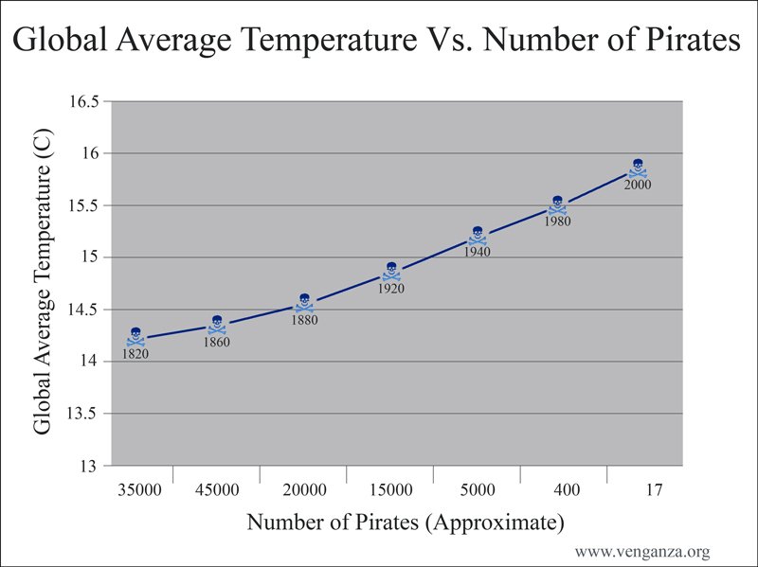
Correlations

Slide 11
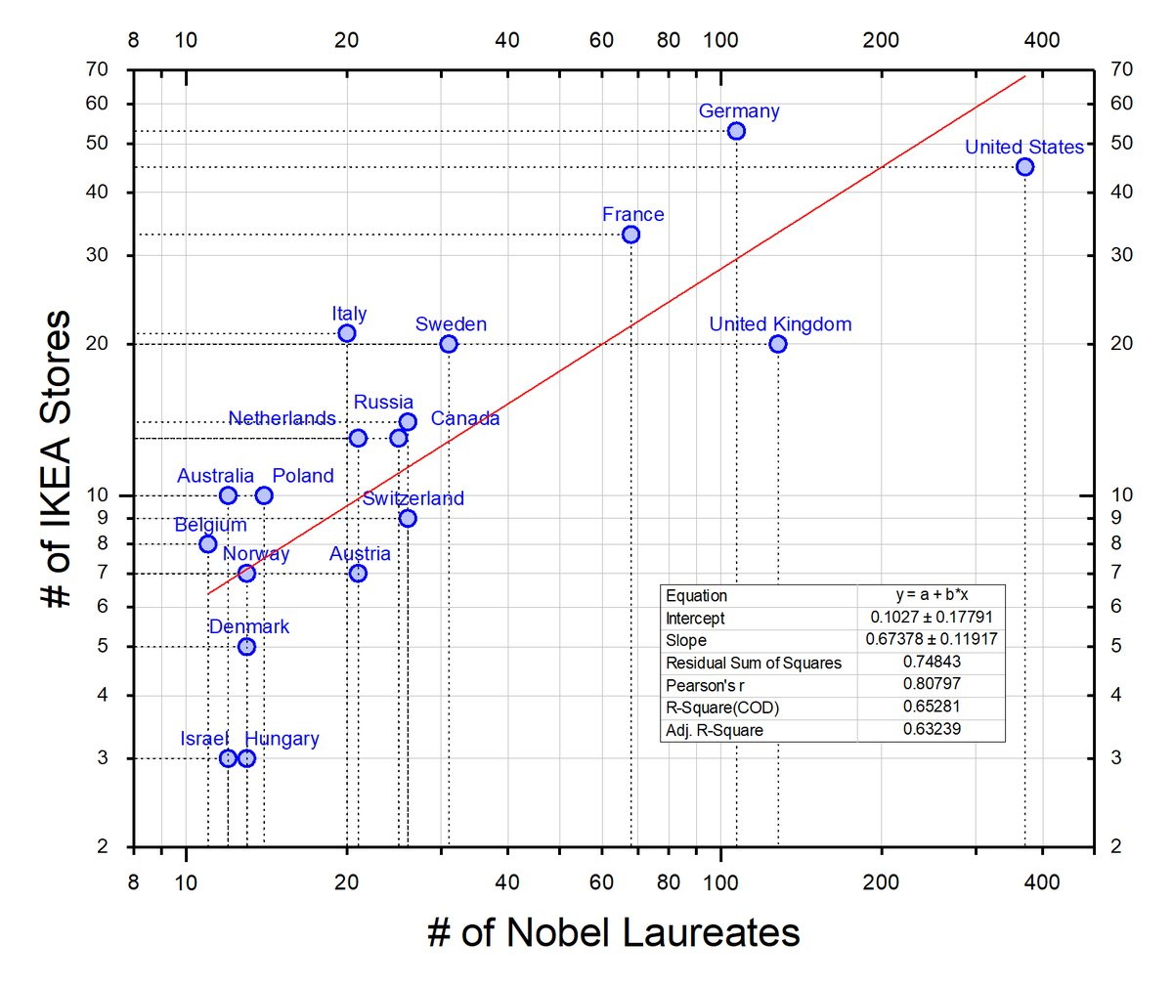
Correlations
Number of #IKEA stores vs. number of #Nobel Laureates per country. #dataviz
Clearly, the Nobel Committee is biased toward countries with more IKEA stores!
Randy Olson
@randal_olson

Slide 12
Correlations
?cor READ
cor(participants_data$days_to_email_response, participants_data$letters_in_first_name)
-0.2357798

Slide 13
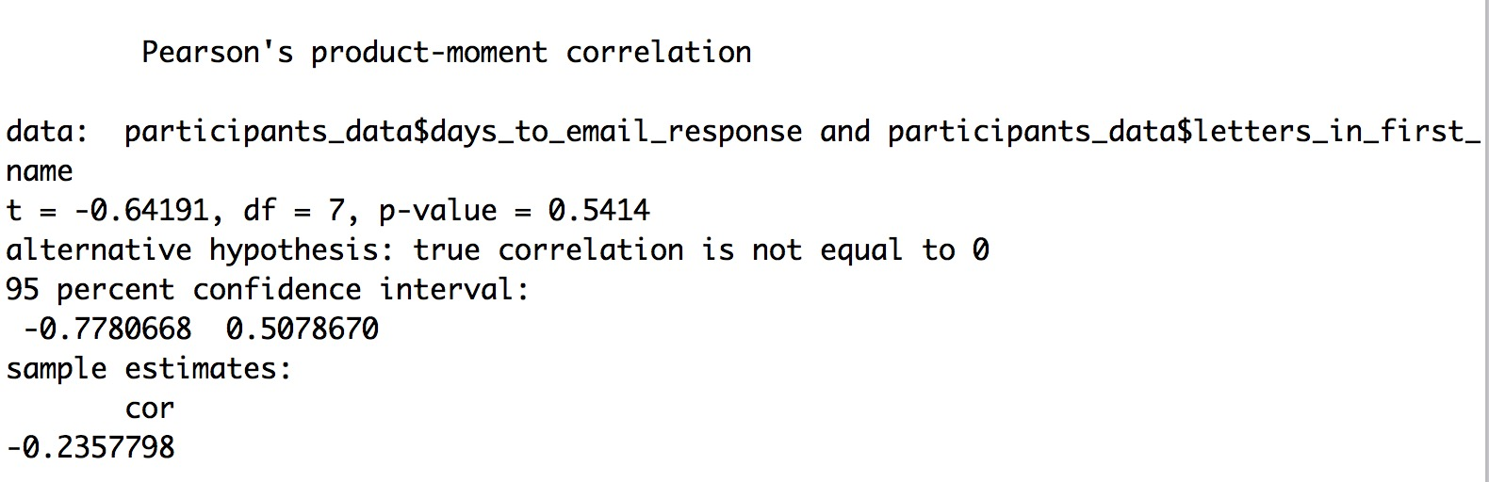
Correlations
?cor.test READ
cor.test(participants_data$days_to_email_response, participants_data$letters_in_first_name)

Slide 14
Correlations
Pearson's R=-0.06
Justin Matejka, George Fitzmaurice, Datasaurus Dozen

Slide 15

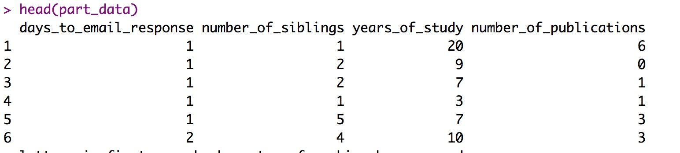
dplyr select()
select()
part_data<-select(participants_data, days_to_email_response, number_of_siblings, years_of_study, number_of_publications, letters_in_first_name, km_home_to_zef, working_hours_per_day, days_to_email_response)
head(part_data)
Continued …

Slide 16
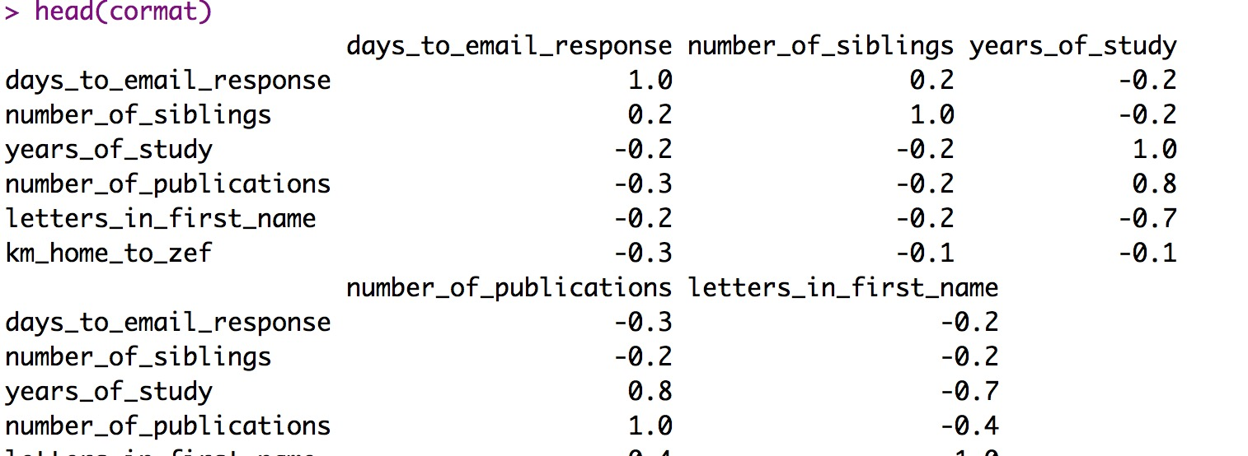
Base R round()
?round
cormat <- round(cor(part_data), 1)
head(cormat)
Continued …

Slide 17

Package reshape
Install.packages(“reshape2”)
library(reshape2)
reshape2: Flexibly Reshape Data: A Reboot of the Reshape Package
Flexibly restructure and aggregate data using just two functions: melt and 'dcast' (or 'acast').

Slide 18
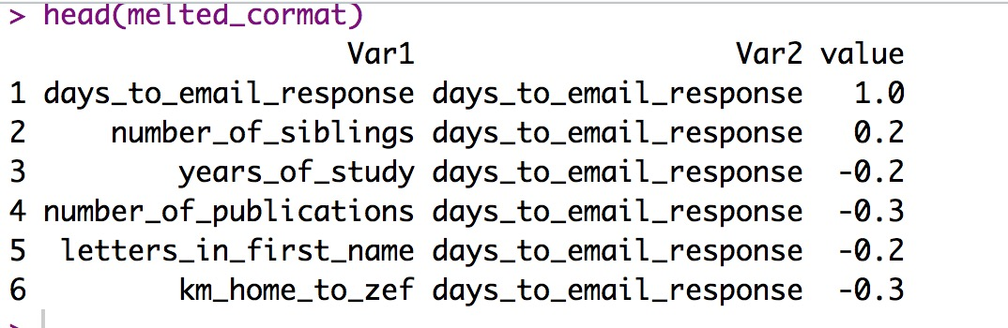
Correlations
Create a correlation heatmap
melted_cormat <- melt(cormat)
head(melted_cormat)

Slide 19
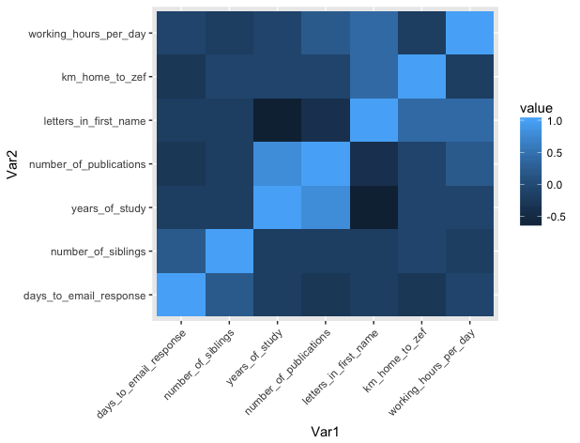
Correlations
Create a correlation heatmap
library(ggplot2)
ggplot(data = melted_cormat, aes(x=Var1,
y=Var2, fill=value)) +
geom_tile()

Slide 20
Export Figures
?pdf
?png
Check with journal about size, resolution etc.

Slide 21
Export Figures
png(file = "cortile.png", width = 7, height = 6, units = "in", res = 300)
ggplot(data = melted_cormat, aes(x = Var1, y = Var2, fill = value)) + geom_tile() + theme(axis.text.x = element_text(angle = 45, hjust = 1))
dev.off()
list.files()
If time create more lm() and aov() models of participants data

Slide 22
Simple Model Building
Types of Variables Determine Type of Model
The explanatory variables
All continuous Regression
All explanatory variables categorical Analysis of variance (Anova)
Explanatory variables both continuous and categorical Analysis of covariance (Ancova)

Slide 23
Simple Model Building
Types of Variables Determine Type of Model
The response variable
Continuous Normal Regression, Anova, Ancova
Proportion Logistic regression
Count Log linear models
Binary Binary logistic analysis

Slide 24
Simple Model Building
Model formulas formation
Y ~ X1 + X2 + Z * W
Y is the explanatory variable
∼ means “is modeled as a function of”
the right hand side is an expression in the explanatory variables.

Slide 25
Simple Model Building
Linear regression
Given continuous variables x and y, the relationship of a linear regression of y on x is described as
y ~ x
The actual linear regression is executed by
lm(y ~ x)

Slide 26
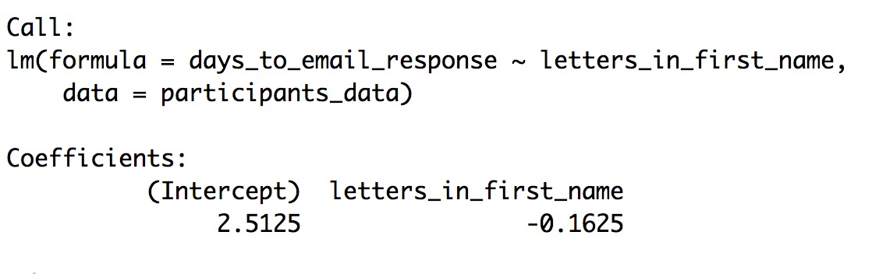
Simple Model Building
Linear regression
lm(days_to_email_response ~ letters_in_first_name, data=participants_data)

Slide 27
Simple Model Building
Anova
If y is continuous and z is categorical we use the same model formula
y ~ z
to express that we’ll model y as a function of z, however in this case the model will be an anova, executed as
aov(y ~ z)

Slide 28
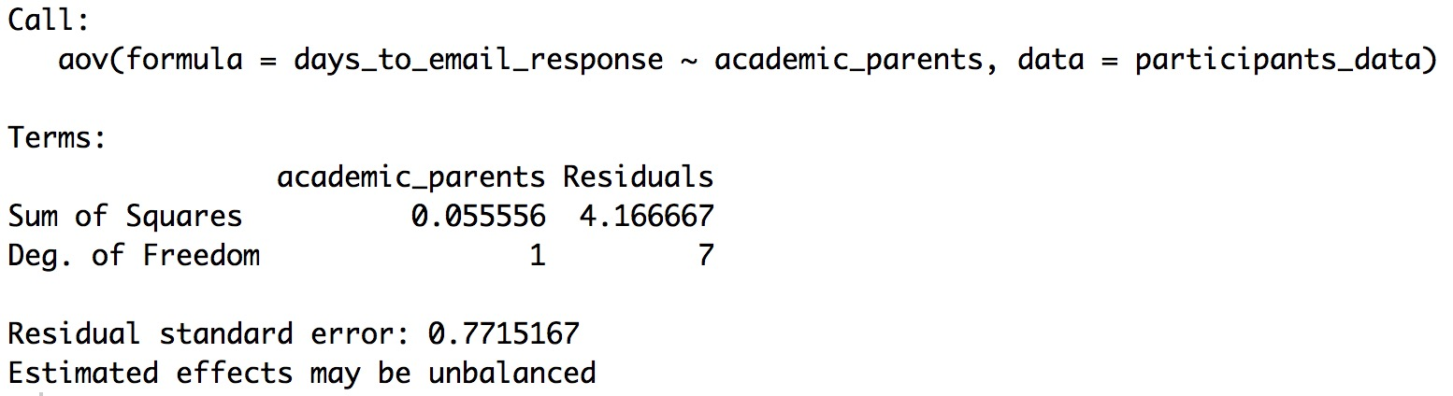
Simple Model Building
Anova
aov(days_to_email_response ~ academic_parents)

Slide 29
Simple Model Building
Multiple explanatory variables
The + symbol denotes additional explanatory variables
The formula
y ~ x1 + x2 + x3
denotes that y is modeled as a function of x1, x2, x3. If all of these are continuous,
lm(y ~ x1 + x2 + x3)
executes a multiple linear regression of y on x1, x2, x3.

Slide 30
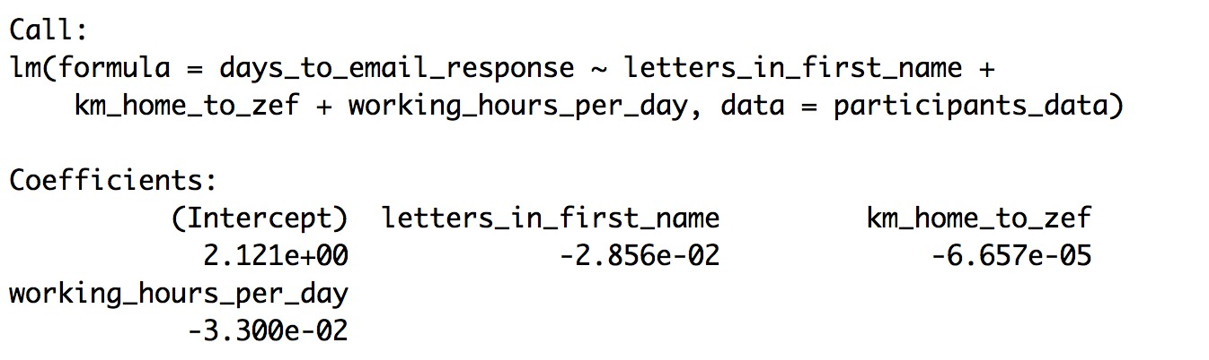
Simple Model Building
lm(days_to_email_response ~ letters_in_first_name + km_home_to_zef + working_hours_per_day, data=participants_data)
If time create more lm() and aov() models of participants data

