Slide 1

Scrum-Agile
Courtney Warner
02/20/2024
CS 250 Final
ChadaTech
A Different Approach to Development

Slide 2

Introducing Scrum-Agile Development
Definition: Scrum-Agile emphasizes flexibility, collaboration, and iterative progress.
Key aspects:
Iterative Development
Incremental Releases
Continuous Feedback
Collaboration and Adaptability

Slide 3

Key Roles in a Scrum Team
PRODUCT OWNER:
SCRUM MASTER
DEVELOPMENT TEAM

Slide 4

Product Owner
Steering the Ship:
Responsibilities:
Describes Product Backlog Items
“Represents the business sponsor, is a decision maker for the product” (Cobb, 2015, p. 35)
“Clearly expressing the Product Backlog” (Cobb, 2015, p. 35)
“Ordering items in the Product Backlog to achieve goals and missions” (Cobb, 2015, p. 35)
Prioritizes Backlog
“Ordering items in the Product Backlog to achieve goals and missions” (Cobb, 2015, p. 35)
Ensures transparency
Ensures the “Product Backlog is visible, transparent, and clear to all, and shows what the Scrum Team will work on next” (Cobb, 2015, p. 35)
Importance:
Guides development towards business objectives.
Acts as the voice of the customer.

Slide 5

Scrum Master
Facilitator of Success
Responsibilities:
Ensures adherence to Scrum principles
“Leading and coaching the organization in its Scrum adoption” (Cobb, 2015, p. 37)
Facilitates Scrum events
“Facilitating Scrum events as requested or needed” (Cobb, 2015, p. 36)
For example :
Sprint Planning, Daily Stand-ups, and Sprint Retrospective.
Removes “impediments to the Development Team’s progress” (Cobb, 2015, p. 36)
Identifies and addresses issues that hinder the team’s productivity.
Encourages a culture of continuous improvement.
Importance:
Supports and enhances team productivity.
Ensures the Scrum process is followed effectively.

Slide 6

Development Team
The powerhouse
Responsibilities:
Cross-functional and self-organizing
Diverse teams “with all of the skills as a team necessary to create a product increment” (Cobb, 2015, p. 38)
“Scrum recognizes no sub-teams in the Development Team, regardless of the domains that need to be addressed like testing or business analysis” (Cobb, 2015, p. 38)
Importance:
Encourages collaboration and collective ownership.
Drives actual development work to meet Sprint goals.

Slide 7
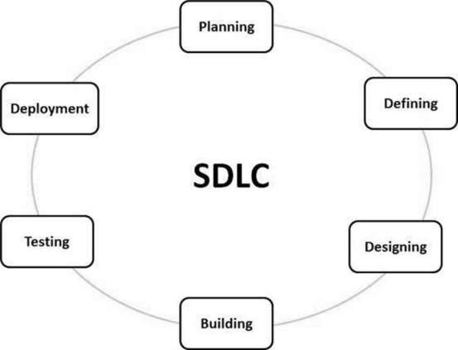
Software development life cycle
Planning and Requirements:
Importance: “Sets project approach, conducts feasibility studies, and identifies risks.” (Tutorials Point, 2024)
Defining Requirements:
Importance: “Clearly documents product requirements through Software Requirement Specification (SRS), guiding development.” (Tutorials Point, 2024)
Designing the Product Architecture:
Importance: “Develops the best architecture based on SRS, ensuring a robust and organized structure for efficient development.” (Tutorials Point, 2024)
Building or Developing the Product:
Importance: “Involves actual coding based on detailed design, ensuring smooth code generation and product development.” (Tutorials Point, 2024)
Testing the Product:
Importance: “Focuses on product testing to identify, report, and fix defects until it meets quality standards.” (Tutorials Point, 2024)
Deployment in the Market Maintenance:
Importance: “Formal release of the product, involving UAT and post-release maintenance for ongoing support and improvements.” (Tutorials Point, 2024)
(Tutorials Point, 2024)

Slide 8
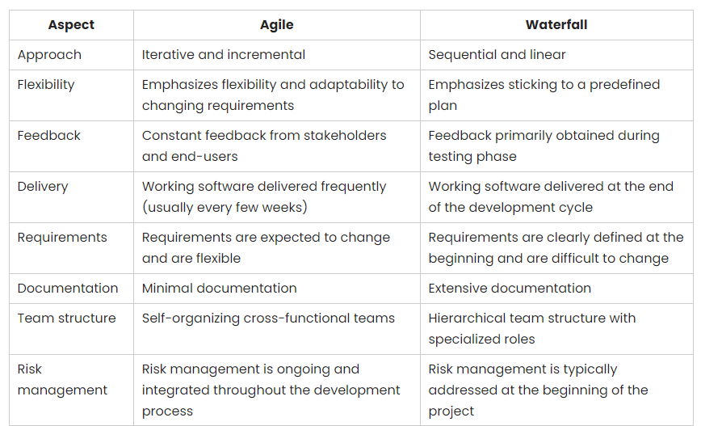
considering AGILE VS WATERFALL
APPROACH
APPROACH
(Visual Paradigm, 2023)

Slide 9
AGILE VS WATERFALL
APPROACH
For SNHU Travel
APPROACH
For SNHU Travel
Project Requirements and Scope
Ex: Seamless adaption when client requirements changed during Scrum Review
Flexibility and Adaptability
Ex: Use story-based iterative development
Communication and Collaboration
Ex: Daily Stand-ups for quick communication and issue resolution
Project Control and Predictability
Ex: Continuous risk management throughout development
Frequent client interaction
Ex: Continuous client involvement and regular feedback loops
Project Visibility
Ex: Regular Scum events for project process visibility
Project Requirements and Scope
Changes might cause delays and increase costs due to rigid sequential nature
Flexibility and Adaptability
Less flexibility with phases completed sequentially
Communication and Collaboration
Formalized and less frequent communication may slow issue resolution
Project Control and Predictability
Addressing risks in predefined phases, potentially leading to delayed issue resolution
Frequent client interaction
Limited client interactions, potentially leading to delayed client feedback
Project Visibility
Less Frequent progress updates, issues surface mainly during major milestones

Slide 10

THANK YOU

Slide 11

Works Cited
Visual Paradigm (2023, March 28). Agile Methodology: Embracing Flexibility, Collaboration, and Continuous Improvement for Effective Project Management. Retrieved February 24, 2024, from https://guides.visual-paradigm.com/agile-methodology-embracing-flexibility-collaboration-and-continuous-improvement-for-effective-project-management/
Tutorials Point (2024). SDLC Systems development life cycle. Tutorialspoint. Retrieved February 24, 2024, from https://www.tutorialspoint.com/sdlc/sdlc_overview.htm
Cobb, C. G. (2015). The Project Manager's Guide to Mastering Agile: Principles and Practices for an Adaptive Approach (pp. 35, 36, 37, 38). Wiley. https://search-ebscohost-com.ezproxy.snhu.edu/login.aspx?direct=true&db=nlebk&AN=937009&site=ehost-live

