Slide 1
GPA1-B
01/19/2026 Chatoya Wells

Slide 2
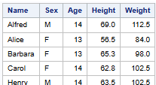

Slide 3
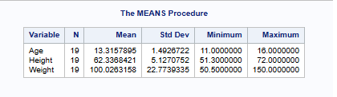

Slide 4
