Slide 1
Python Fever! Testing a disease model with Python
Notes:
I’m here to talk about testing an Epi model with python. Not going to do too much science

Slide 2
Context
Going to talk (repeatedly) about
What IDM testing has done
What you can do
Useful python libraries
Not going to talk about
Science of epidemiology
Statistics and visualization
For you if
You have scientific SW to test
You find software test interesting

Slide 3
Overview
Testing science is hard!
Software testing
IDM and EMOD
How we got to now
Where to start
Integration testing
Knowing your customer
Where we are going
Even more python
Entering data science

Slide 4


What is the job of test?
Find all of the bugs!
Prove a negative
Represent the customer
Necessary, not sufficient
“Do all of the crazy things!”
Aren’t particularly helpful

Slide 5

Functional testing in a nutshell
Report on software quality
Under specified conditions
In context of expected customers
Yep, still makes donuts.
Notes:
We tell people what we tested, how we tested it, and what results we got. There are other things that test can do- stress and performance, security testing, etc. But the real question you ought to be asking…

Slide 6
Institute for Disease Modeling
Gates-funded through Global Good Fund at Intellectual Ventures
Not for profit
Team of about fifty people
Malaria, Polio, and HIV/TB Centers
Applied Math and Epi Sections
2/3 researchers, 1/3 software
Create professionally built and tested, re-usable tools

Slide 7
Getting Started
Source control
Regression tests
From build validation to test harness

Slide 8
EMOD is our model
Software
Command line executable
Compiled C++ code
Tools are mostly Python
Available on GitHub right now
Epidemiological model
Agent-based
Stochastic
This makes testing challenging

Slide 9
What EMOD Does
-C config_starter.json
Eradication.exe
output/
reports
config_starter.json
sample_demographics.json
console time:1 pop:1000 infected: 10
console time:2 pop:1000 infected: 15
console time:3 pop:1000 infected: 20
console time:4 pop:1000 infected: 30
console time:5 pop:1000 infected: 45…
sample_campaign.json

Slide 10
Getting Started: IDM’s regression harness
regression_test.py
Research and Dev tool
Single python file
Positives
Portable
Charting
Overlay functionality
Problems
Cluster abuse
Unmanageable code
Failure investigation hard

Slide 11
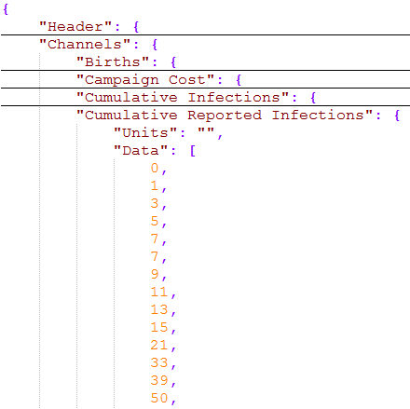
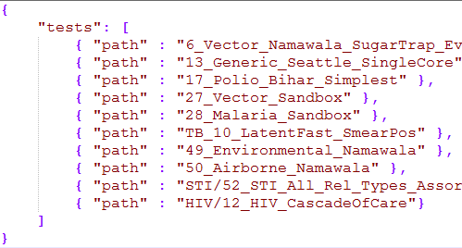
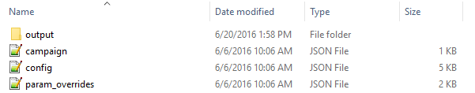
Getting Started: How RT.py worked
Console app
JSON suites
Specified with sys.argv
Lists folder paths
Regression tests
param_overrides.json
campaign.json (usually)
output folder with InsetChart.json
Verification
Match all channels
Local plotting of failures

Slide 12
Getting Started: Problems, and fixing them
Unmanageable code
1400 lines
12 classes
17 global variables
Cluster abuse
Load tests in a queue
Multithreading
Failure investigation
HPC Job / folder naming
Copy outputs locally

Slide 13
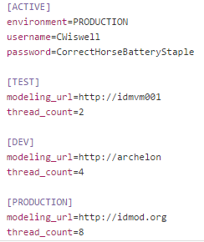
Getting Started: Source & Builds
Source control
SVN, Git, VSOnline
Not just on your laptop
Build harness
Atlassian Bamboo, Jenkins
Multiple environments?
Permissions?
ConfigParser!
Leave all configs on disk
Pick the one you want

Slide 14


Getting Started: Execute regression tests
End-to-end scenario tests
Feed Inputs, check outputs
Run from command line
Why command line?
Easily automatable
Build harnesses love this
Argparse!
Built in help functionality
Far more readable than sys.argv

Slide 15
From Getting started to Integrating
What we know now
The model runs
Integration / Dogfooding
Using our own scheduler
Using our own data
The special case of climate validation (if time)

Slide 16
Integration at IDM
IDM’s software suite
COMPS is our HPC scheduler
LD Service is where we generate data
Bamboo is our build service for the model
A word on independent component testing
Integrating in stages

Slide 17
Dogfooding: Regression
EMOD -> COMPS
Nightly regression run
Scheduled through Bamboo
Required dev and test work
Features we gained
Test results in a relational database
Web interface for free
Output visualization
Access to output folders
EMOD
COMPS

Slide 18
Dogfooding: Integration scenarios
Component review
COMPS is our HPC scheduler
LD Service is where we generate data
Bamboo is our build service for the model
Development process
Identified integration holes
Input file delivery
Migration files
Better tooling for LD
TestRail integration
Large Data
EMOD
COMPS

Slide 19
Dogfooding: Parameter sweeps
COMPS Builder Worker
JSON driven, server side python
Tables of parameters converted to lists of simulations
Parameter testing
Tables of parameters to sweep
Compare results
Check for failure cases
Sweep builder through Python Interop
Multi-sim Charting
Client side python
Java Client
Python Builder
EMOD

Slide 20
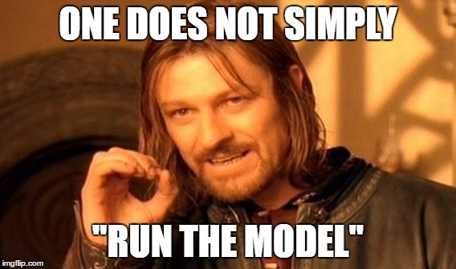
Future work: Automated validation
Working on this now!
How do researchers run the model?
Calibrate, calibrate, calibrate
Mathematical / statistical validation
R, Matlab… and Python
What we can use here
Simple statistical validation
Simple tuning validation
Better failure analysis for Regression tests

Slide 21
Practical takeaways
Where to start
Source control
Regression tests
Dogfood when you can
Regression harness
Things you’ll need to add
Automated scheduling
Failure tracking (NUnit, xmlrunner in python)
Speedy failure investigation

Slide 22
Thank you!
Software available here
https://github.com/CWiswell-IDM/PyLadiesSamples
https://github.com/InstituteforDiseaseModeling
Information on modeling and IDM
http://idmod.org
Epidemics: https://www.coursera.org/learn/epidemics
Model Thinking: https://www.coursera.org/learn/model-thinking
Useful content
http://devopsreactions.tumblr.com
http://www.thedailywtf.com

Slide 23
Afterward: How did we do this?
Test team mission
Researchers more focused on Science
Broadening our reach
Understanding our customer
Push requirements into development
Standardize spatial output
Force toolsets to be aware
Define new model requirements
Cross-train test team
Modelers do it all

Slide 24


Python + JSON
JSON is a data format (like XML)
Python allows creation of “whatever”
My_obj = {}
My_obj[“sport”] = “basketball”
My_obj[“games”] = [“Catan”,”Rhino Hero”]
Import json!
Dump to file
Load from file

Slide 25
What about Climate validation
Malaria model very climate dependent
LD Service generates climate data
Flaws in data very dangerous
Subtle
Can really disrupt model
“Focus more on science, less on software”
Needed validation to show data quality
Ended up being a way to test it

