Slide 1
Stock Market Trend Forecasting Based on Multiple Textual Features: A Deep Learning Method
姓名 王曦 学号 2021192010 学院 数学与统计学院
同组其他成员：王曦 孙沐阳 陈婷
组长：王曦

Slide 2

Significance
To explore what?
Influence
Stock news information Stock market development trend
What can be achieved?
Get Useful Information
Improved ability to predict stock market trends

Slide 3

Problems
Questions to be discussed：
The influence of stock news information on the development trend of stock market
Characteristics targeted at：
theme feature
emotional characteristics
Semantic features (extracted from text)

Slide 4

Introductions
For example:
Support Vector Machine （SVM）
Artificial Neural Network （ANN）
Represents model importance:
Long short term memory（LSTM）
Deconvolution neural network（CNN）
What industries are growing?
Big data
artificial intelligence technology
machine learning methods

Slide 5

Introductions
In finance
Information that reflects investor behavior→ Enhance the stock forecasting model
NLP technology→Stock market trend forecast
News media
Bloomberg
Two important input characteristics
Characteristics of financial Data
Text data characteristics

Slide 6

Introductions
A news text embedding construction method
Vector of embedding→ Reflect the emotional, semantic and subject information of the text
Deep learning approach→Short-term stock market trend forecast
Empirical experiment→ Models can effectively predict market trends

Slide 7
Solution —— Menu
Related Work
Stock Forecasting Based on Deep Learning
Stock Forecasting with Social Media Sentiment Analysis
Proposed Method
Problem Formulation
Proposed Method

Slide 8
Related Work —— Stock Forecasting Based on Deep Learning
LSTM & CNN
-> the most typical models which have been commonly used
Example:
A) a hybrid model combined LSTM and Genetic Algorithm by Chuang
B) CEEMD-PCA-LSTM by Zhang’s team
C) Hierachical Attention Networks (HAN) by Zheng
etc.

Slide 9
Related Work —— Stock Forecasting with Social Media Sentiment Analysis
enhance stock movement prediction by public sentiment
eg. news,articles, tweets, blog posts, other texts.
Step1: text -> understandable form for machines
Step2: utilize statistical models or machine learning models
to make prediction
Innovation: utilize multiple news textual features for prediction

Slide 10


Proposed Method —— Problem Formulation
three-class classification: up(1), hold(0), down(-1)
stock prices sequences:
multiple textual features:

Slide 11

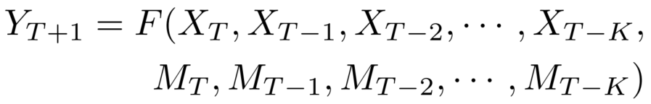


Proposed Method —— Problem Formulation
the stock price trend of the next day:
Equation:
the mapping function from input to output:
the size of the sliding window:

Slide 12






Proposed Method —— Problem Formulation
multiple textual features consist of topic features
sentiment features:
semantic features:
equation:
the operation to combine different textual features:

Slide 13
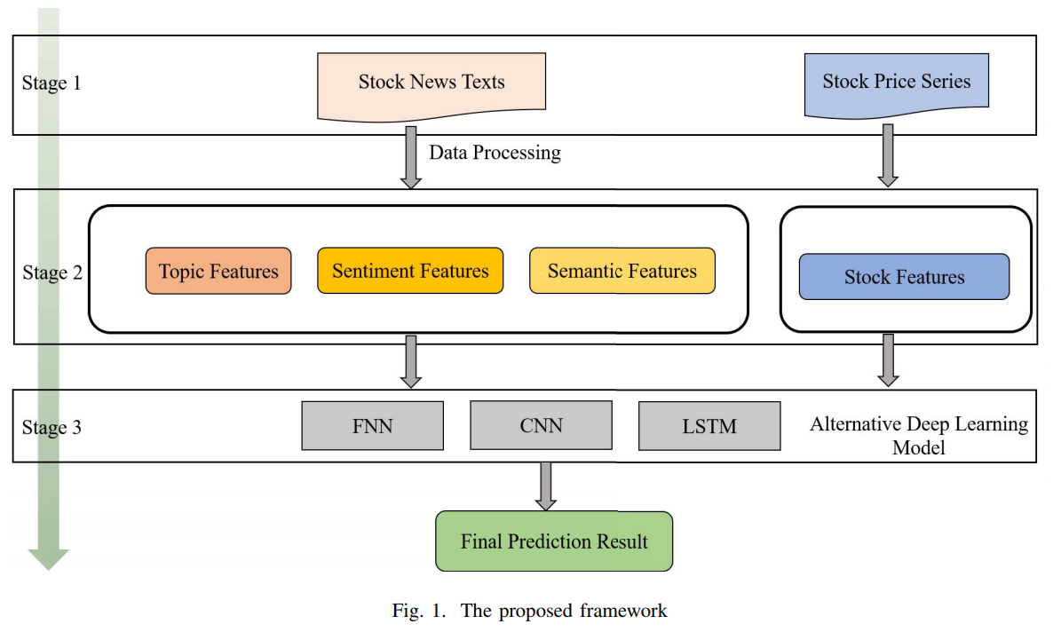
Proposed Method —— Proposed Method

Slide 14
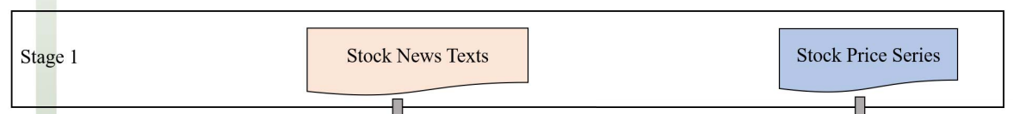
Proposed Method —— Stage1
Step1: use coherence score to evaluate the LDA model
determine the optimal number of topics
Step2: represent each document as an n-dimensional vector

Slide 15
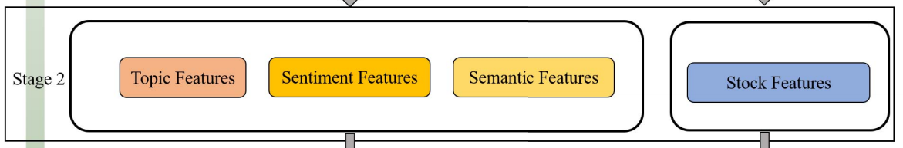
Proposed Method —— Stage2
Step1: use NLTK Valence Awareness Dictionary for Sentiment
Reasoning(VADER) to obtain compound score
Step2: use pre-trained embeddings from a subset of the Google
News, generate two 300-dimensional vectors
Step3: decide the optimal size of sliding window

Slide 16
Proposed Method —— Stage3
Step1: compare the performance of different DL models
Step2: adopt the most suitable model for proposed method

Slide 17
Experiments and Discussion —— Menu
Details
Data sets
Data preprocessing
Experimental setup
Experimental Results
Decide on the Optimal Sliding Window Size K
Results for Baseline Models
Results for the Proposed Method
Evaluation metrics
Accuracy rate
F1-score

Slide 18

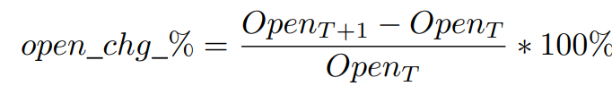


Details —— Dataset && Data Processing
news data
Over 109,000
Oct 2006 to Nov 2013
daily folders
financial data
Oct 2006 to Nov 2013
Open, High, Low, Close
1,782 trading days.

Slide 19
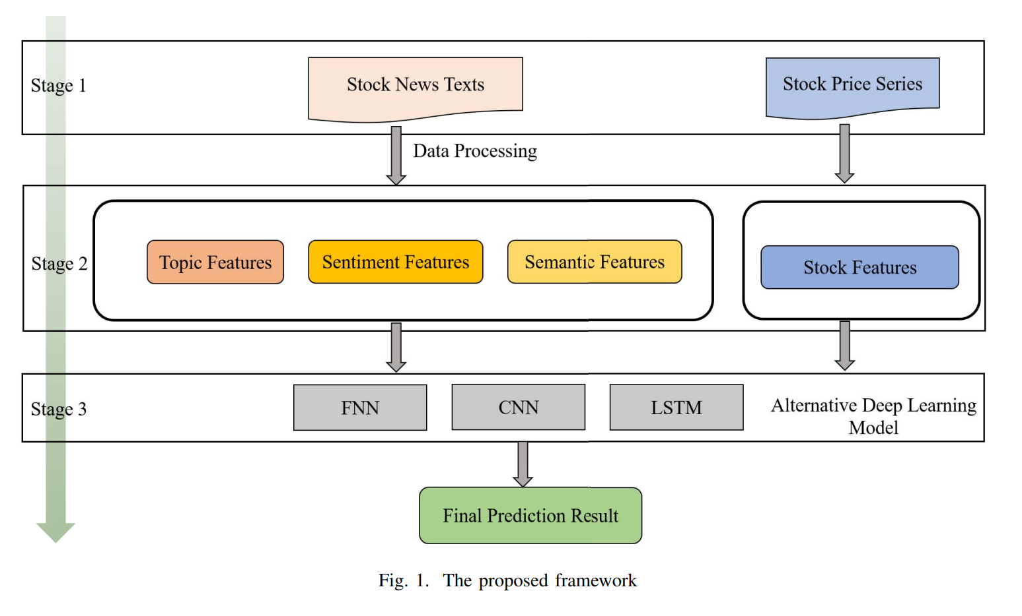
Details —— Experimental Setup
SentimentIntensityAnalyzer
70% training set
30% testing set
t, b: aver-polarity score
300->600
LDA，6
word2vec

Slide 20
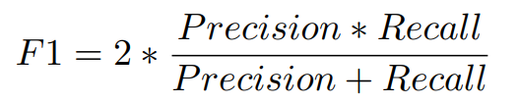
Evaluation metrics
Accuracy rate：correct predictions -> total
F1-score：

Slide 21
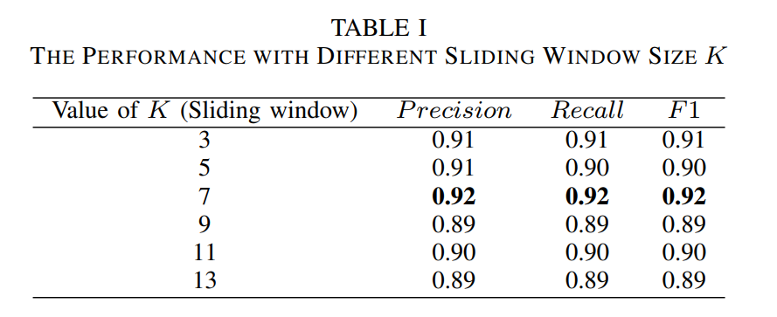
Decide on the Optimal Sliding Window Size K

Slide 22
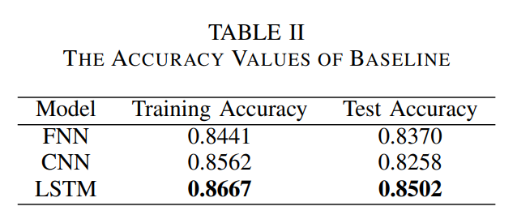
Experimental Results for Baseline Models

Slide 23
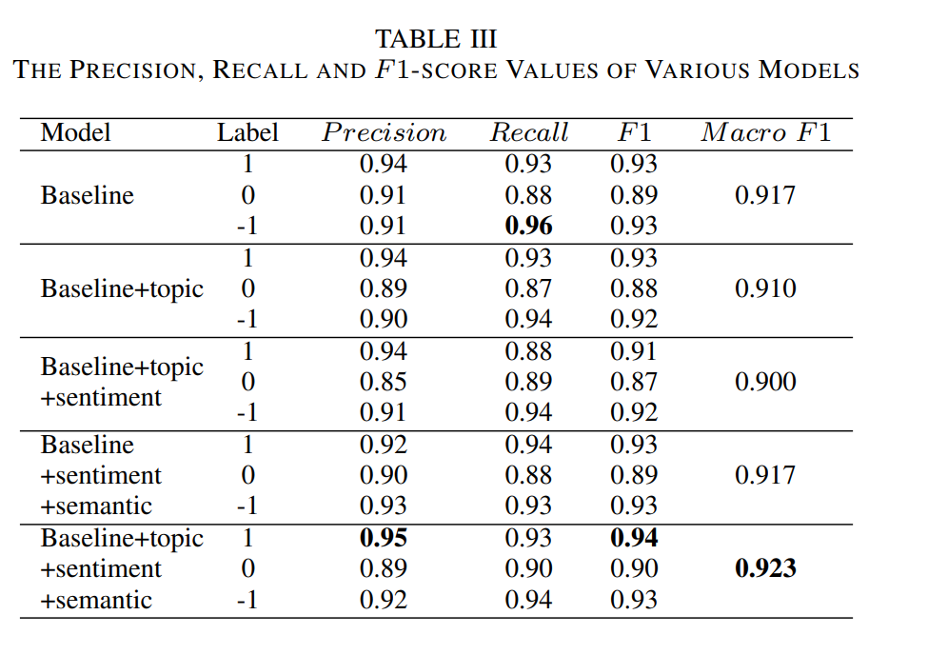














Results for the Proposed Method
cmp
Suitable combinations

Slide 24
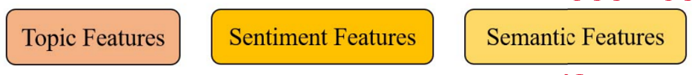
Conclusions
stock market trend prediction
financial data features
textual data features
A suitable dataset
Best baseline model: with three multiple textual,
The highest F1-score: 0.94
Limitation
a single news source
Lack of new techniques and multi-modal pattern recognition
further research on explore whether rumours may help to improve the prediction performance

