Slide 1
第7章 人机界面设计专题

Slide 2
软件工程主要开发模型
模型 | 优点 | 缺点
瀑布模型 | 文档驱动 | 系统可能不满足客户的需求
快速原型模型 | 关注满足客户需求 | 可能导致系统设计差、效率低，难于维护
增量模型 | 开发早期反馈及时，易于维护 | 需要开放式体系结构，可能会设计差、效率低
螺旋模型 | 风险驱动 | 风险分析人员需要有经验且经过充分训练
喷泉模型 | 支持迭代开发、开发活动无缝过渡 | 可能导致开发过程过分无序和开发的随意性

Slide 3
快速原型模型（rapid prototype model）
基本思想：
在获取一组基本的需求定义后，利用高级软件工具的可开发环境，快速建立一个能反映用户主要需求的原型系统（目标系统的最初版本），让用户在计算机上试用它并提出修改意见；
补充和修改原型系统，再次请用户试用；
反复进行这个过程，直到用户满意，开发人员可据此书写规格说明文档，进行目标系统的开发。

Slide 4
快速原型模型
快速建立起来的可以在计算机上运行的程序，它所能完成的功能往往是最终产品能完成的功能的一个子集。

Slide 5
适用情况
用户定义了一组一般性目标，但不能标识出详细的输入、处理及输出需求；
开发者可能不能确定算法的有效性、操作系统的适应性或人机交互的形式；
……
原型模型可能是最好的选择

Slide 6
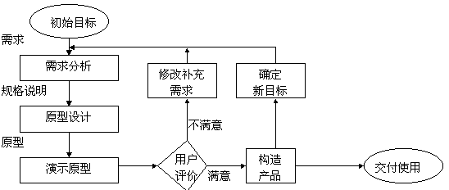
快速原型模型

Slide 7
人机界面设计问题
系统响应时间
用户帮助设施
出错信息处理
命令交互

Slide 8
系统响应时间
概念：指从用户完成某个控制动作到软件给出预期响应的这段时间
重要属性
长度
过长：用户紧张、沮丧
过短：用户紧张、易错
易变性：系统响应时间相对于平均响应时间的偏差

Slide 9
用户帮助设施
设施类型：集成、附加
信息提供范围：部分功能、全部功能
用户请求方式：帮助菜单、特殊功能键、HELP命令
信息显示方式：在独立窗口中指出参考某个文档、在屏幕固定位置显示简短提示
用户返回方式：屏幕上的返回按钮、功能键
信息组织方式：平面结构（关键字）、层次结构、超文本结构

Slide 10
出错信息处理
以用户可理解的术语描述问题
提供有助于从错误中恢复的建设性意见
指出错误可能导致哪些负面后果
伴随听觉或视觉上的提示
不能带有指责色彩

Slide 11
命令交互
是否每个菜单选项都有对应的命令
命令形式：控制序列、功能键、键入命令
学习、记忆、回忆命令的难度
用户是否可以定制或缩写命令
一致的命令使用方法

Slide 12
设计人-机交互子系统
虽然好的人机交互部分不可能挽救一个功能很差的软件, 但性能很差的人机交互部分将使一个功能很强的产品变得不可接受!

Slide 13
设计人-机交互界面的准则
一致性
减少步骤
及时提供反馈信息
提供撤消命令
无须记忆
易学
富有吸引力

Slide 14
设计人-机交互子系统的策略
分类用户（技能、职务、集团）
描述用户
设计命令层次
研究现有的人-机交互含义和准则（Windows）
确定初始的命令层次
精化命令层次：次序、整体-部分关系、宽度与深度、操作步骤
设计人-机交互类（如 VC++ 的MFC类库）

Slide 15
人机界面设计过程
创建界面设计模型
用原型实现设计模型
用户试用、评估
修改模型

Slide 16
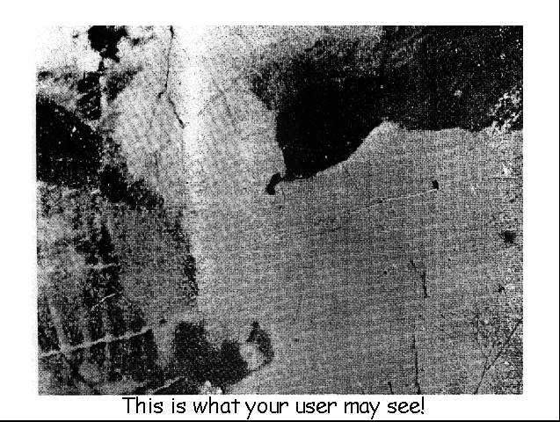

Slide 17
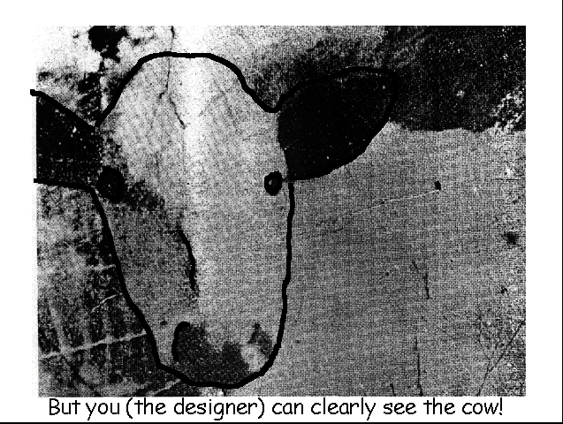

Slide 18
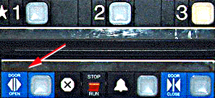
Example of bad and good design
Elevator controls and labels on the bottom row all look the same, so it is easy to push a label by mistake instead of a control button
People do not make same mistake for the labels and buttons on the top row. Why not?
From: www.baddesigns.com

Slide 19
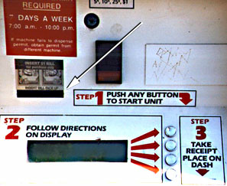
Why is this vending machine so bad?
Need to push button first to activate reader
Normally insert bill first before making selection
Contravenes well known convention
From: www.baddesigns.com

Slide 20
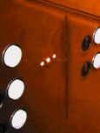
Visibility
• This is a control panel for an elevator.
• How does it work?
• Push a button for the floor you want?
• Nothing happens. Push any other button? Still nothing. What do you need to do?
It is not visible as to what to do!
From: www.baddesigns.com

Slide 21
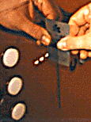
Visibility
…you need to insert your room card in the slot by the buttons to get the elevator to work!
How would you make this action more visible?
• make the card reader more obvious
• provide an auditory message, that says what to do (which language?)
• provide a big label next to the card reader that flashes when someone enters
• make relevant parts visible
• make what has to be done obvious

Slide 22
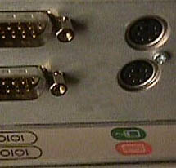
Logical or ambiguous design?
Where do you plug the mouse?
Where do you plug the keyboard?
top or bottom connector?
Do the color coded icons help?
From: www.baddesigns.com

Slide 23


How to design them more logically
(i) A provides direct adjacent mapping between icon and connector
(ii) B provides color coding to associate the connectors with the labels
From: www.baddesigns.com

Slide 24
Which are universal and which are culturally-specific?

Slide 25
Mapping
Relationship between controls and their movements and the results in the world
Why is this a poor mapping of control buttons?

Slide 26
Mapping
Why is this a better mapping?
The control buttons are mapped better onto the sequence of actions of fast rewind, rewind, play and fast forward

Slide 27
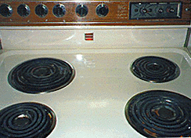
Activity on mappings
Which controls go with which rings (burners)?
A
B
C
D

Slide 28

Why is this a better design?

Slide 29
Keypad numbers layout
A case of external inconsistency
(a) phones, remote controls
(b) calculators, computer keypads
1
2
3
7
8
9
4
5
6
4
5
6
7
8
9
1
2
3
0
0

Slide 30

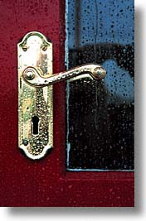
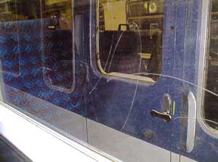

Activity
Physical affordances:
How do the following physical objects afford? Are they obvious?

Slide 31
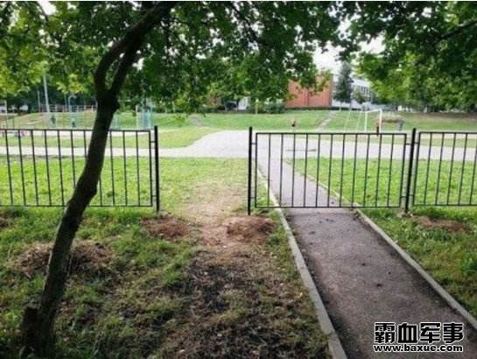

Slide 32
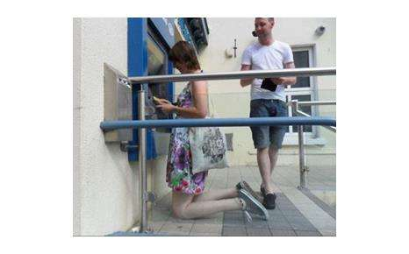

Slide 33
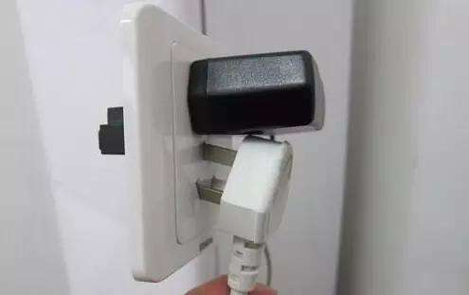

Slide 34
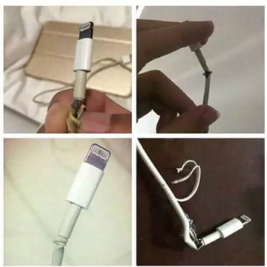

Slide 36
Human Computer Interaction
Design and graphics design in computer human interaction
Notes:
This week we are looking at design and graphics design in computer human interaction.

Slide 37
Good design
商业成功的主要因素
掌握一系列的设计原则
Notes:
Good design
Good design is a major factor in determining the commercial success of an application
The major design principles to be mastered come from particular areas of study in psychology, art, linguistics and computing.

Slide 38
Design principles
短时记忆7 + 2 信息块
审美观：对比、平衡、均衡、协调、一致
像素、颜色、层次构成基本的模块：
语言和术语
建立友好人机界面的规则
Notes:
The cognitive psychologist has identified that peoples short term memory is limited and can only remember 7 + 2 chunks of information at any one time.
Aesthetics, which include contrast, balance, proportion, rhythm, harmony, movement, and unity, need to be used to design a system to appeal to the emotions and intellect.
The aesthetic elements along with picture elements, colour and layout form fundamental building blocks for art and GUI design.
Language is used to impart meaning and convey information. The language used in software systems must use the language of the culture (user group).
Human-computer system research have identified a number of ‘rules’ of good interface design to create user-friendly systems.

Slide 39
Responses to poor design
混乱
挫折
恐慌
厌倦
放弃系统
系统不完善的使用
非直接使用
使用需要补偿
重新编程
Notes:
The type of responses to poor design include:
confusion - detail overwhelms the user
frustration - result from inability to convey intentions to system
panic - caused by excessive delays without feedback
boredom - from simplistic jobs or slow responses
abandonment of system - if alternatives available
incomplete use of system - easy parts only used
indirect use of system - managerial response, get someone else to use it.
task modification - task changed to match system
compensatory action - additional action undertaken to fit task to system requirements
reprogramming - sophisticated users may resort to rewriting application

Slide 40
Some basic rules of thumb
不要用一个像素的水平线作为边框
不要设计物体控件只有1,2个像素的大小
热点区域应该定义清楚明了
图标应该被理解
不要使用过多的线条描述一个对象
每一个对象应该有一个目的
Notes:
Some basic rules of thumb:
Don’t use horizontal lines with a thickness of one pixel for borders as on interlaced monitors they will be blurry
Never design objects whose handles are one or two pixels in dimensions. Users have trouble picking them.
Hotspots for selection should be clear and well defined
If no-one understands an icon use a label instead
do not use too many lines in your objects. Use outlines for the object’s frame and then colour and shade to define overall shape
Every object on the display should be there for a purpose.

Slide 41
Four fundamental building blocks
图形元素
颜色
文字
布局
Notes:
The four fundamental building blocks of design are graphics elements, colour, text and layout.
These are combined to produce the final artwork.

Slide 42
Benefits and Problems with colour
Benefits
引起注意
增加现实感
增加美观
意味深长
Problems
转移用户注意力
给整体添加混乱
减少有效的应用
Notes:
Used properly colour helps:
to draw attention
to add realism
in visual discrimination
to make aesthetically pleasing
increase meaningfulness
Used improperly colour:
distracts the user
adds confusion to the overall scene
reduces the effectiveness of the application

Slide 43
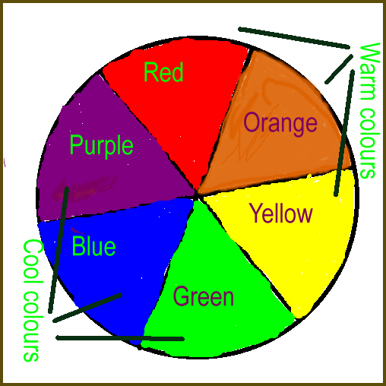
The colour wheel
Notes:
The colour wheel
Warm colours can be made cooler by adding blue.
Cool colours can be made warmer by adding red/yellow
Hue: is the purest shade of a colour
Shade: the colour you get after you add black to the colour
Tint: is the colour you get after you add white to it.

Slide 44
Colour hints
在像素级别的颜色交替可以用于模仿一个比较宽的色彩系列
黑色不应该用作阴影部分
深色调看上去沉重，而浅色调看上去轻松
暖色调显示靠近观测者
蓝色是较好的背景色
单色设计然后填色
用色彩区分不同的区间
色彩使用应该协调一致
Notes:
Alternating colour at the pixel level can be used to simulate a wider colour set than actually used.
Shadows should not be black but a darker shade of the hue. If an object falls in a shadow alternate black/grey with the objects colour
Dark colours look heavy, light ones look light. A large dark area on a paper/white screen draws attention
Warm colours appear closer to the viewer
Blue is a good colour for large background as it is neutral and matches most colours
Design in monochrome and then fill in, in colour
Colours are used to effectively divide areas without lines, or outlines. Lines and outlines tend to take the realism out of the picture.
Be consistent in your colour usage.

Slide 45
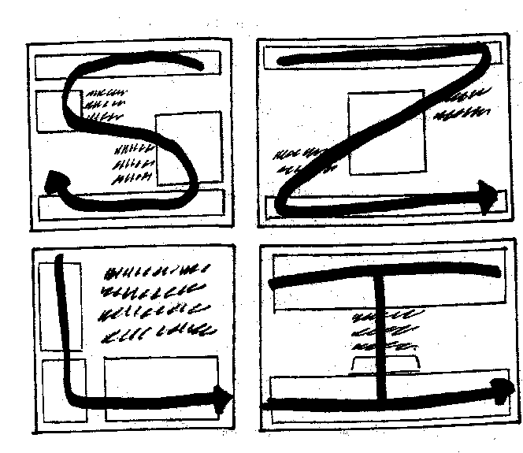
Screen layout
Notes:
Here are four screen layouts
A good layout is often hard to achieve. If an operation is linear try putting the controls/widgets in the path of the layout. This way users don’t have to backtrack.
If a process can be completed with as little mouse movement as powwible - so much the better. That is economy of movement.

Slide 46
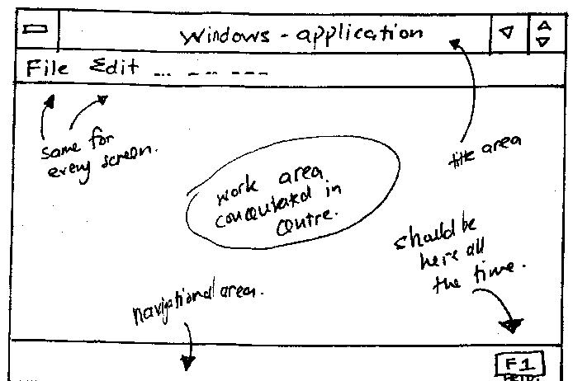
Functional areas
Notes:
Divide the workspace up into functional areas and stick to using the areas in a consistent way.

Slide 47
Visual discrimination
用空间或间隔物区分不同的小型功能部件
Notes:
Use space or dividers to help separate one group of widgets from another.
Space and dividers have been used in this case.

Slide 48
保持足够的边界
Notes:
Keep critical widgets separate so that users do not accidentally select the wrong widget.
Give users margins for error

Slide 49
Text
字体大小
字体式样
文本长度
大小写
段落中文本的左右对齐
文本的区别标记
文本的颜色
Notes:
Section 5 looks at Text
As you all know there are a number of words that represent text, such as letters, typefaces, and fonts. Usually on a computer the term used is fonts.
However, Typography is the technical term for the reproduction of words. It is a combination of technology and art. It gives the designer the ability to convey more than just informational content with text.
Words are graphic elements with pictorial qualities as important as any illustration.
Typography is a subject in itself and we cannot cover it in any detail here.
In this section we consider, point size, style, text length, upper and lower case text, paragraph justification, textual discrimination and text colour.

Slide 50
Point size
This is 12 point
This is 14 point
This is 18 point
This is 20 point
This is 24 point
This is 28 point
This is 32 point
This is 36 point
This is 44 point
Notes:
Point size - refers to the size of the text
In a text document
Use 12 point for normal body text
15 pt for headers
When using text for presentations, you will obviously require bigger text sizes. Which is the smallest text size you can read.
Look at the different thickness of the line of the individual letters as the text increases in size.
Look at the increase in length of the line as the text increases in size.
Look at the size of the X height as the text increases.
You can use different text sizes to emphasise.

Slide 51
Styles
This is Ariel
This is Bookman
This is Courier
This is Garamond
This is Perpetua
This is Rockwell
This is Times
This is Ariel
This is Bookman
This is Courier
This is Garamond
This is Perpetua
This is Rockwell
This is Times
Notes:
Use fairly simple styles such as these. Others tend to be too fancy.
Notice how different the styles are, even though they are all 32 point.
Notice the different weight, x height, and length of line. If you are limited for space it is better to use a small, clear typeface such as Perpetua or Times.
Courier is the typeface from typewriters. Each letter is given the same amount of space. So it does not look so neat.
Times was designed for use in newspapers, that is why it is quite narrow but still clear. It allowed the printers to put far more words in a small space.
You can use, Normal, Italics, Bold, underlined, or a combination of these.
Underlined is used less and less these days for emphasis.
Use no more than three different fonts types in a document.

Slide 52
UPPERCASE or lowercase text
大写表示大喊大叫
小写表示轻言细语
Notes:
Use all Uppercase to shout words
Use all lower case to whisper words
Uppercase should not be used for paragraphs, because it is slow to read.

Slide 53
