Slide 1
Discrete Mathmaticis
Dr. xiaogang peng
(1nd semester of year 2022-2023)

Slide 2
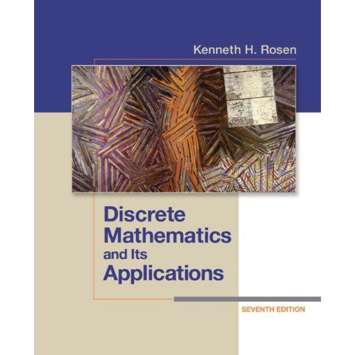
Textbook
Discrete Mathematics and Its Applications
by Kenneth H. Rosen, 7th edition, McGraw Hill

Slide 3
Grading
Class performance matters
15% Homework & quiz
15% midterm
10% paper on DM application (group project)
60% Final

Slide 4
Dr. Xiaogang Peng
Zhiteng Building 823
pengxg@szu.edu.cn

Slide 5
Basic topics
ch1. logic and proofs
ch2. sets functions sequences sum and matrix
ch3. algorithms
ch4.number theory and cryptography
ch5. induction and recursion
ch6. counting
ch9. relations
ch10. graph
ch11. tree
ch12. boolean algebra* (if time permits)

Slide 6
Some Specials:
Not very difficult final exam.
Focus on topics listed on ppt (topic- based learning)
Try your best to understand in class
Reviews are needed after class
Summarize the topics and try to fit them into a whole picture.

Slide 7
A group project which will contribute 10% to your final grade.
You will gain the experience of grading
You will enjoy some new thoughts and teaching methods
In class Exercise EVERY week

Slide 8
Group Project
DM application in the real world.
Use the knowledge in DM area to analyse a realworld case or a problem then provide a solution.
A group with up to 3 members
2 reports:
1) midterm report. (what problem? which way to go?)
2) Final Report(15th week) and ppt

Slide 9
NEVER CHEAT!
Will lead to a 0 in my class (definitely fail) and
subject to a penalty of low scores because your bad credit in all of my classes.

Slide 10
Suggestions on learning in English
Focus more on the “terms”
Ask when you are not quite understand
Don’t be upset by the slow reading speed
Be bold in using it

Slide 11
If you…
Want to have a less challenging class
Just Want to have a D
Want to play around.
DROP THIS COURSE!
BUT!
If you’ve tried your best and show it,
NO ONE WILL BE FAILED.

