Slide 1
Chapter 6 Graphs
6.1 Graphs and Graph Models
6.2 Graph Terminology and Special Types of Graphs
6.3 Representing Graphs and Graph Isomorphism
6.4 Connectivity
6.5 Euler and Hamilton Paths
6.6 Shortest-Path Problems
6.7 Planar Graphs
6.8 Graph Coloring
图
同构
连通
欧拉图、哈密顿图
最短路问题
平图
图着色

Slide 2

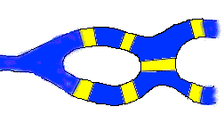
Euler Graph
History:
Leonhard Euler (1707 -1783)
In Konigsberg, German, a river ran through the city. After passing an island in its center, the river broke into two branches. Seven bridges were built so that the people of the city could get from one part to another.

Slide 3
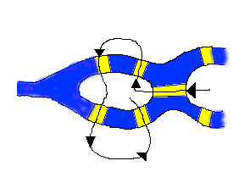
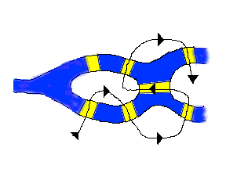
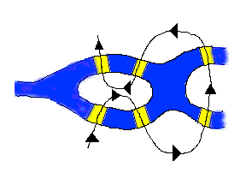
Konigsberg Bridges Problem
People wondered whether or not one could walk around the city in a way that would involve crossing each bridge exactly once. Now, you have a try!
How about if a bridge is removed?

Slide 4
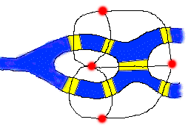
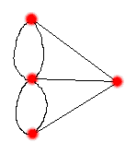
Why?

Slide 5
6.1 Graphs and Graph Models
Undirected graph
Definition 1 A graph G=(V, E) consists of V, a nonempty set of vertices (or nodes) and E, a set of edges. Each edge has either one or two vertices associated with it, called its endpoints. An edge is said to connect its endpoints.
图，顶点，点，边
端点，连接，关联

Slide 6
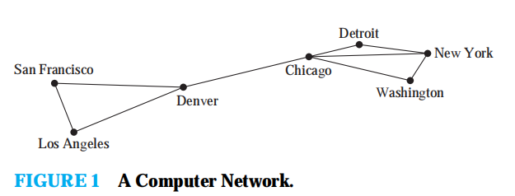
6.1 Graphs and Graph Models
Undirected graph
Definition A graph in which each edge connects two different vertices and where no two edges connect the same pair of vertices is called a simple graph.
简单图

Slide 7
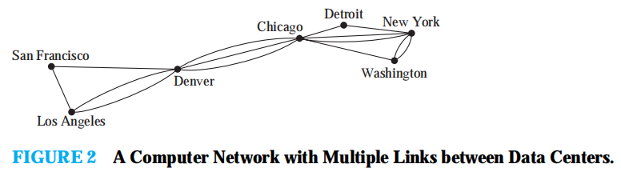
6.1 Graphs and Graph Models
多重边
多重图
Undirected graph
Definition Graphs that may have multiple edges connecting the same vertices are called multigraphs.

Slide 8
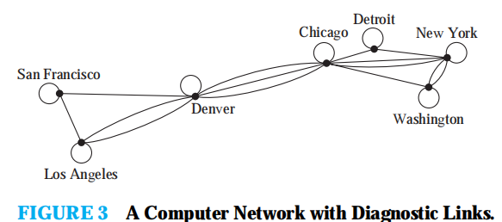
6.1 Graphs and Graph Models
Undirected graph
自环
伪图
Definition Graphs that may include loops (edges that connect a vertex to itself), and possibly multiple edges connecting the same pair of vertices, are sometimes called pseudographs.

Slide 9
6.1 Graphs and Graph Models
Undirected graph
Definition An undirected graph is an orderly dual group G=(V,E), in which V≠∅ is a set of vertices, and E is a multiset of unordered pairs of elements of V called edges.

Slide 10
6.1 Graphs and Graph Models
Undirected graph
Definition A multigraph G=(V,E) consists of a set V of vertices, a set E of edges, and a function f from E to { {u, v} | u,v∈V, u≠v }.
The edges e₁ and e₂ are called multiple or parallel edges if f(e₁)=f(e₂).

Slide 11
6.1 Graphs and Graph Models
Undirected graph
Definition A pseudograph G=(V, E) consists of a set V of vertices, a set E of edges, and a function f from E to { {u, v} | u,v∈V }. An edge is a loop if f(e)={u,u}={u} for some u∈V.

Slide 12
6.1 Graphs and Graph Models
有向图
弧
Directed Graph
Definition 2 A directed graph D=(V, E) consists of a nonempty set of vertices V and a set of directed edges (or arcs) E. Each directed edge is associated with an ordered pair of vertices. The directed edge associated with the ordered pair (u, v) is said to start at u and end at v.

Slide 13
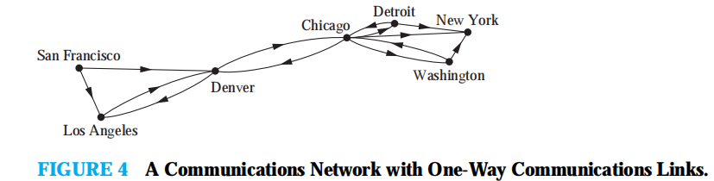
6.1 Graphs and Graph Models
Directed Graph
Definition When a directed graph D=(V, E) has no loops and has no multiple directed edges, it is called a simple directed graph.

Slide 14
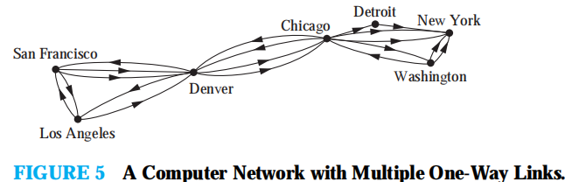
6.1 Graphs and Graph Models
Directed Graph
Definition A Directed graph that may have multiple directed edges is called a directed multigraph.
An edge of multiplicity m
有向多重图

Slide 15
6.1 Graphs and Graph Models
Directed Graph
Definition A directed multigraph D=(V,E) consists of a nonempty set V of vertices, a set E of edges, and a function f from E to { (u,v) | u,v∈V }. The edges e₁ and e₂ are multiple edges if f(e₁)=f(e₂).

Slide 16
6.1 Graphs and Graph Models
Mix Graph
Definition A graph with both directed and undirected edges is called a mixed graph.

Slide 17
6.1 Graphs and Graph Models
type | edges | Multiple edges allowed? | Loops allowed?
Simple graph | undirected | no | no
Multigraph | undirected | yes | no
Pseudograph | undirected | yes | yes
Simple directed graph | directed | no | no
Directed multigraph Mixed graph | Directed Undirected and directed | Yes yes | Yes yes

Slide 18
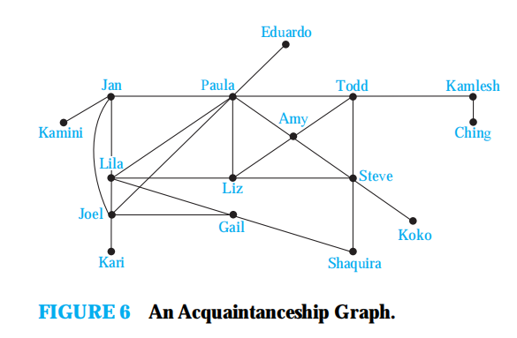
6.1 Graphs and Graph Models
Graph models
Acquaintanceship graphs

Slide 19
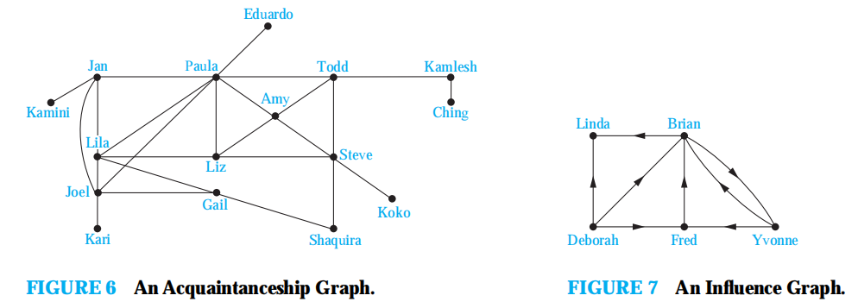
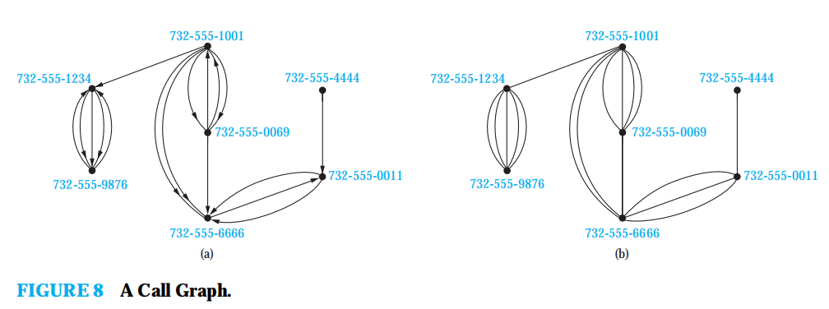

Slide 20
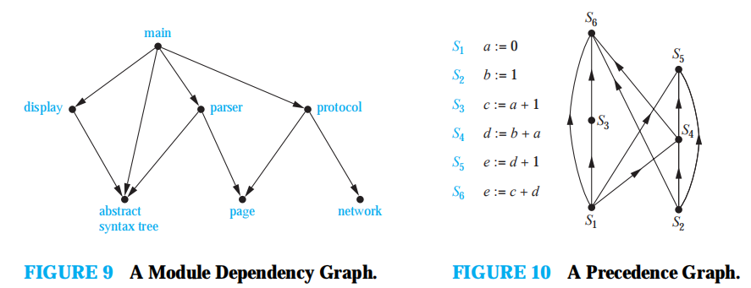
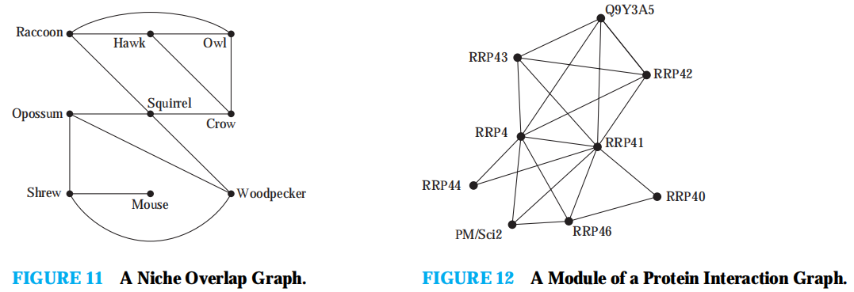

Slide 21
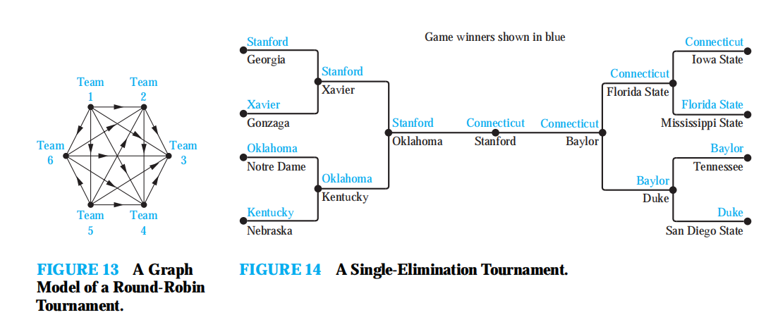

Slide 22
6.2 Graph Terminology and Special Types of Graphs
相邻，邻居
关联，连接
端点
Basic Terminology
Definition 1 Two vertices u and v in an undirected graph G are called adjacent or neighbors in G if {u,v} is an edge of G. If e={u, v}, the edge e is called incident with the vertices u and v. The edge e is also said to connect u and v. The vertices u and v are called endpoints of the edge {u, v}.

Slide 23
6.2 Graph Terminology and Special Types of Graphs
度数
孤立点
悬挂点
Basic Terminology
Definition 2 The degree of a vertex in an undirected graph is the number of edges incident with it, except that a loop at a vertex contributes twice to the degree of that vertex. The degree of the vertex v is denoted by deg(v).
A vertex of degree zero is called isolated. A vertex of degree one is called pendant.

Slide 24
6.2 Graph Terminology and Special Types of Graphs
Basic Terminology
Definition 2 The set of all neighbors of a vertex v of G = (V , E), denoted by N (v), is called the neighborhood of v. If A is a subset of V , we denote by N (A) the set of all vertices in G that are adjacent to at least one vertex in A.
So,
N (A) = ∪_{v∈A} N (v).

Slide 25
6.2 Graph Terminology and Special Types of Graphs
度数
孤立点
悬挂点
Basic Terminology
Definition 3 The degree of a vertex in an undirected graph is the number of edges incident with it, except that a loop at a vertex contributes twice to the degree of that vertex. The degree of the vertex v is denoted by deg(v).
A vertex of degree zero is called isolated. A vertex of degree one is called pendant.

Slide 26
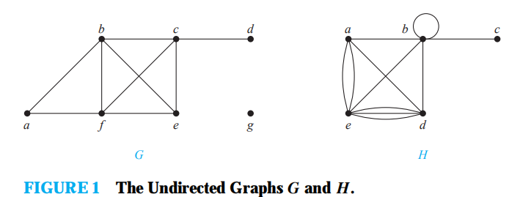
6.2 Graph Terminology and Special Types of Graphs
Example：What are the degrees and what are the neighborhoods of the vertices in the graphs G and H displayed in Figure 1?

Slide 27
6.2 Graph Terminology and Special Types of Graphs
Basic Terminology
Basic theorem
Theorem 1 The handshaking theorem
Let G = (V, E) be an undirected graph with e edges. Then
|E|=e

Slide 28
6.2 Graph Terminology and Special Types of Graphs
Basic Terminology
Theorem 2 An undirected graph has an even number of vertices of odd degree.
Proof …

Slide 29
6.2 Graph Terminology and Special Types of Graphs
初始点，尾
终点，头
Basic Terminology
Directed graph
Definition 4 When (u,v) is an edge of the graph G with directed edges, u is said to be adjacent to v and v is said to be adjacent from u. The vertex u is called the initial vertex of (u,v) , and v is called the terminal or end vertex of (u,v) , The initial vertex and terminal vertex of a loop are the same.

Slide 30
6.2 Graph Terminology and Special Types of Graphs
入度
出度
Basic Terminology
Definition 5 In a graph with directed edges the in-degree of a vertex v, denoted by deg⁻(v), is the number of edges with v as their terminal vertex. The out-degree of v, denoted by deg⁺(v), is the number of edges with v as their initial vertex.

Slide 31
6.2 Graph Terminology and Special Types of Graphs
Basic Terminology
Directed graph
Theorem 3 Let G=(V,E) be a graph with directed edges. Then

Slide 32
6.2 Graph Terminology and Special Types of Graphs
Some Special Simple Graphs
（1）Complete graphs
完全图
圈
轮
N维立方
正则图
（2）Cycles
（3）Wheels
（4）n-Cubes，n-dimensional hypercube
（5）Regular graph

Slide 33
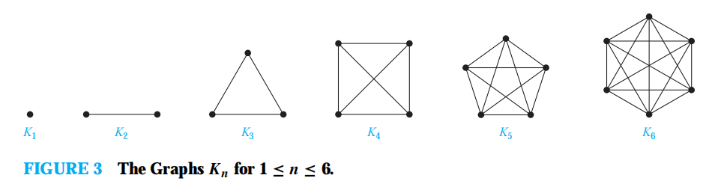
Complete Graphs： A complete graph on n vertices, denoted by Kn, is a simple graph that contains exactly one edge between each pair of distinct vertices.

Slide 34
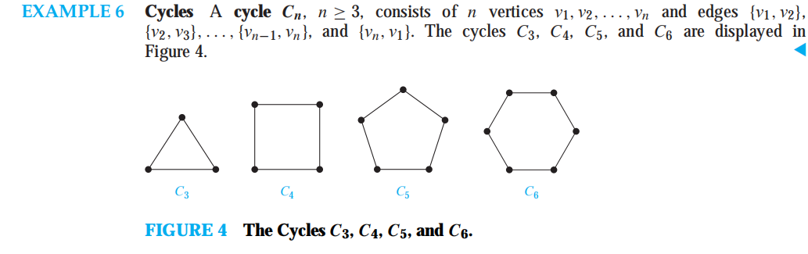

Slide 35
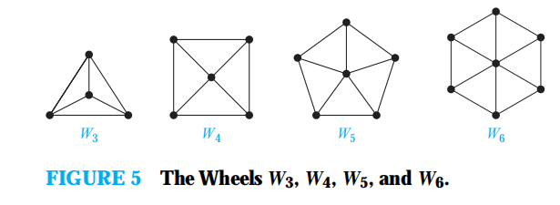
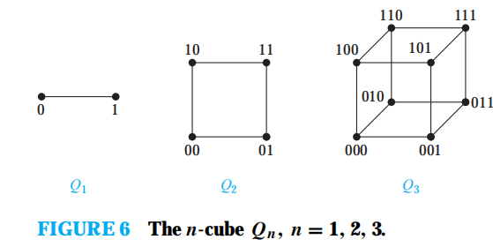

Slide 36
6.2 Graph Terminology and Special Types of Graphs
Bipartite Graphs
二分图
Definition 5 A simple graph G is called bipartite if its vertex set V can be partitioned into two disjoint sets V₁ and V₂ such that every edge in the graph connects a vertex in V₁ and a vertex in V₂. We call (V₁, V₂) a bipartition of the vertex set V of G.

Slide 37
6.2 Graph Terminology and Special Types of Graphs
Bipartite Graphs
triangles

Slide 38
6.2 Graph Terminology and Special Types of Graphs
Bipartite Graphs
二分图
Theorem 4 A simple graph is bipartite if and only if it is possible to assign one of two different colors to each vertex of the graph so that no two adjacent vertices are assigned the same color.

Slide 39
6.2 Graph Terminology and Special Types of Graphs
Bipartite Graphs
完全二分图
Definition A complete bipartite graph K_{m,n} is a graph that has its vertex set partitioned into two subset of m and n vertices, respectively. There is an edge between two vertices if and only if one vertex is in the first subset and the other vertex is in the second subset.

Slide 40
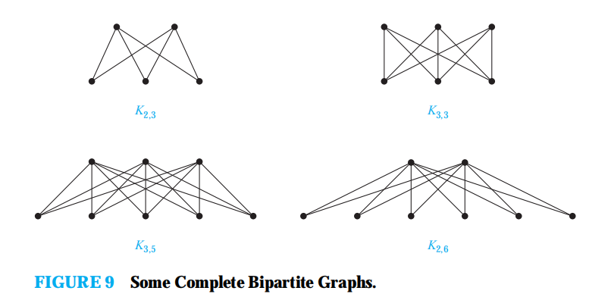

Slide 41
6.2 Graph Terminology and Special Types of Graphs
Some Applications of Special Types of Graphs
Skim
Matching
Maximal matching
匹配，对集
最大匹配
完美匹配

Slide 42
Matching
A matching is a subset of edges such that if {s,t} and {u, v} are distinct edges of the matching,then s, t, u, and v are distinct. A vertex that is the endpoint of an edge of a matching M is said to be matched in M; otherwise it is said to be unmatched. A maximum matching is a matching with the largest number of edges.
We say that a matching M in a bipartite graph
G = (V , E)with bipartition (V1, V2) is a complete matching from V1 to V2 if every vertex in V1 is the endpoint of an edge in the matching, or equivalently, if |M|=|V1|.

Slide 43
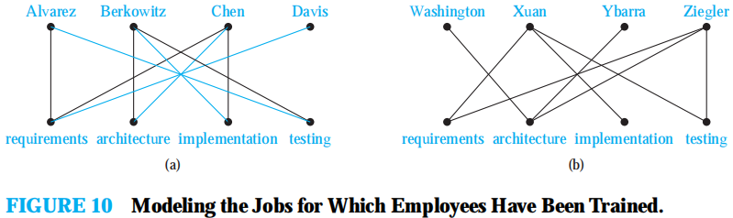

Slide 44
Matching
HALL’S MARRIAGE THEOREM：
The bipartite graph G = (V , E) with bipartition (V1, V2) has a complete matching from V1 to V2 if and only if |N (A)|≥|A| for all subsets A of V1.
Proof： Strong Induction
BUT：we cannot construct an algorithm based on this proof that finds a complete matching in a bipartite graph.

Slide 45
HALL’S MARRIAGE THEOREM： Example
A => {1, 2, 3}
B => {4}
C => {3, 4}
D => {3}
1 => {A, B, C}
2 => {B, C, D}
3 => {B, C}
4 => {C}

Slide 46
6.2 Graph Terminology and Special Types of Graphs
子图
真子图
New Graphs From Old
Subgraph
Definition 7 A subgraph of a graph G=(V,E) is a graph H=(W,F) where W⊆V and F⊆E.
A subgraph H of G is a proper subgraph of G if H≠G.

Slide 47
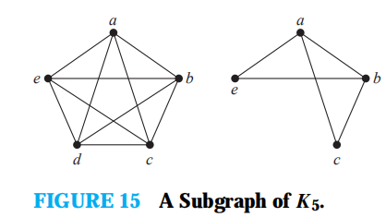
6.2 Graph Terminology and Special Types of Graphs
导出子图，生成子图
Induced Subgraph
Definition 8 Let G = (V , E) be a simple graph. The subgraph induced by a subset W of the vertex set V is the graph (W, F ), where the edge set F contains an edge in E if and only if both endpoints of this edge are in W.
what is the induced subgraph of with abce within K₅

Slide 48
6.2 Graph Terminology and Special Types of Graphs
导出子图
New Graphs From Old
Induced subgraph （edge）

Slide 49
6.2 Graph Terminology and Special Types of Graphs
New Graphs From Old
Union
Definition 7 The union of two simple graph G₁=(V₁,E₁) and G₂=(V₂,E₂)is the simple graph with vertex set V₁∪V₂ and edge set E₁∪E₂.The union of G₁ and G₂ is denoted by G₁∪G₂.

Slide 50
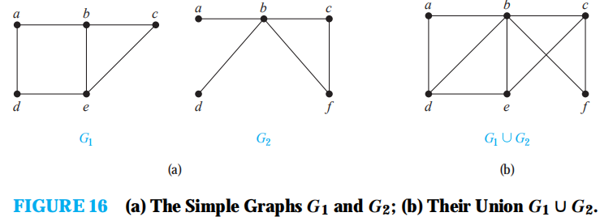

Slide 51
6.3 Representing Graphs and Graph Isomorphism
图同构
Isomorphic
Introduction
Representing Graphs
(1) Adjacency Lists
邻接表
邻接矩阵
关联矩阵
(2) Adjacency Matrices
(3) Incidence Matrices

Slide 52
6.3 Representing Graphs and Graph Isomorphism
Representing Graphs
邻接表
(1) Adjacency Lists

Slide 53
6.3 Representing Graphs and Graph Isomorphism
Representing Graphs
邻接表
(1) Adjacency Lists

Slide 54
6.3 Representing Graphs and Graph Isomorphism
Representing Graphs
邻接矩阵
(2) Adjacency Matrices

Slide 55
6.3 Representing Graphs and Graph Isomorphism
Representing Graphs
邻接矩阵
(2) Adjacency Matrices

Slide 56
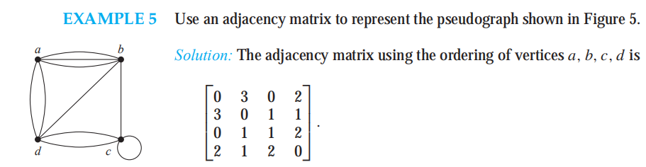

Slide 57
6.3 Representing Graphs and Graph Isomorphism
Representing Graphs
关联矩阵
(3) Incidence Matrices

Slide 58
6.3 Representing Graphs and Graph Isomorphism
Isomorphism of Graphs
Definition 1
The simple graphs G₁=(V₁,E₁) and G₂=(V₂,E₂) are isomorphic if there is a one-to-one and onto function f from V₁ to V₂ with the property that a and b are adjacent in G₁ if and only if f(a) and f(b) are adjacent in G₂, for all a and b in V₁.
Such a function f is called an isomorphism.

Slide 59
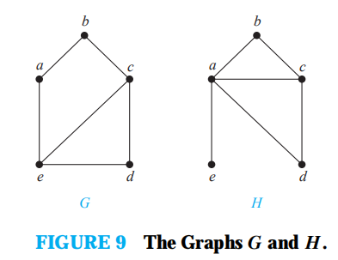
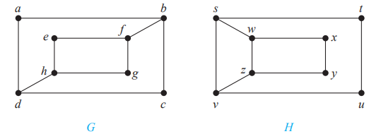
6.3 Representing Graphs and Graph Isomorphism
Determine the Isomorphism of Graphs
Difficult to determine if they are isomophic: n!
Not that difficult if they are not isomophic.
graph invariant: |V|,|E|, deg(V) with positions....

Slide 60
6.3 Representing Graphs and Graph Isomorphism
Isomorphism of Graphs
Graph invariant

Slide 61
The best algorithms known for determining whether two graphs are isomorphic have exponential worst-case time complexity (in the numberof vertices of the graphs).
However, linear average-case time complexity algorithms are known that solve this problem.
There is some hope, but also skepticism, that an algorithm with polynomial worst-case time complexity for determining whether two graphs are isomorphic can be found.
Applications: Chemistry, The design of electronic circuits, Bioinformatics and Computer vision.

Slide 62
6.4 Connectivity
Introduction
Paths
通路
Definition 1 Let n be a nonnegative integer and G an undirected graph. A path of length n from u to v in G is a sequence of n edges e₁,e₂,..,e_{n} of G such that e₁={x₀,x₁}, e₂={x₁,x₂},…,
e_{n}={x_{n-1},x_{n}}, where x₀=u and x_{n}=v. When the graph is simple, we denote this path by its vertex sequence x₀,x₁,…,x_{n}.

Slide 63
6.4 Connectivity
Paths
回路
简单通路
Definition 1 A path,….
The path is a circuit if it begins and ends at the same vertex, that is, if u=v, and has length greater then zero. The path or circuit is said to pass through the vertices x₁,x₂,…,x_{n-1} or traverse the edges e₁,e₂,…,e_{n}.
A path or circuit is simple if it does not contain the same edge more than once.

Slide 64
6.4 Connectivity
Paths
Definition 2 Let n be a nonnegative integer and G a directed multigraph. A path of length n from u to v in G is a sequence of n edges e₁,e₂,..,e_{n} of G such that e₁=(x₀,x₁), e₂=(x₁,x₂),…,e_{n}=(x_{n-1},x_{n}), where x₀=u and x_{n}=v.

Slide 65
6.4 Connectivity
Paths
通路
回路,圈
简单的
Definition 2 A path is ….
When there are no multiple edges in the directed graph, this path is denoted by its vertex sequence x₀,x₁,…,x_{n}. A path of length greater then zero that begins and ends at the same vertex is called a circuit or cycle.
A path or circuit is called simple if it does not contain the same edge more than once.

Slide 66
6.4 Connectivity

Slide 67
6.4 Connectivity
Connectedness in Undirected Graphs
连通性
连通
Definition 3 An undirected graph is called connected if there is a path between every pair of distinct vertices of the graph.

Slide 68
6.4 Connectivity
Connectedness in Undirected Graphs
Theorem 1 There is a simple path between every pair of distinct vertices of a connected undirected graph.

Slide 69
A connected component of a graph G is a connected subgraph of G that is not a proper subgraph of another connected subgraph of G.
That is, a connected component of a graph G is a maximal connected subgraph of G.
A graph G that is not connected has two or more connected components that are disjoint and have G as their union.

Slide 70
6.4 Connectivity
Connectedness in Undirected Graphs
connected components

Slide 71
6.4 Connectivity
Connectedness in Undirected Graphs
Connected Components
连通分支
割点
割边
Cut Vertices or Articulation points
Cut Edge or Bridge

Slide 72
The removal from a graph of a vertex and all incident edges produces a subgraph with more connected components. Such vertices are called cut vertices(or articulation points).
An edge whose removal produces a graph with more connected components than in the original graph is called a cut edge or bridge.
Connected graphs without cut vertices are called nonseparable graphs : ex. K_{n}
A more granulated measure of graph connectivity based on the minimum number of vertices that can be removed to disconnect a graph

Slide 73
6.4 Connectivity
Connectedness in Directed Graphs
strongly connected
Definition 4 A directed graph is strongly connected if there is a path from a to b and from b to a whenever a and b are vertices in the graph.
强连通
强连通分支

Slide 74
6.4 Connectivity
Connectedness in Directed Graphs
弱连通
（2） weakly connected
Definition 5 A directed graph is weakly connected if there is a path between every two vertices in the underlying undirected graph.
单向连通A directed graph is unilaterally connected if there is a path from a to b or from b to a whenever a and b are vertices in the graph.

Slide 75
6.4 Connectivity
Connectedness in Directed Graphs
strongly connected
unilateral connected
weak connected

Slide 76
6.4 Connectivity
Connectedness in Directed Graphs

Slide 77
6.4 Connectivity
Paths and Isomorphism:
Another graph invariant: the lengths of paths
path of length 3

Slide 78
6.4 Connectivity
Counting Paths Between Vertices
(1) counting

Slide 79
6.4 Connectivity
Counting Paths Between Vertices
Theorem 2 Let G be a graph with adjacency matrix A with respect to the ordering v₁,v₂,…,v_{n} (with directed or undirected edges, with multiple edges and loops allowed). The number of different paths of length r from v_{i} to v_{j}, where r is a positive integer, equals the (i, j)th entry of A^{r}.

Slide 80
6.4 Connectivity
Counting Paths Between Vertices
Example How many paths of length four are there from a to d?
a
b
d
c

Slide 81
6.5 Euler and Hamilton Paths
Introduction
欧拉通路
欧拉回路
Euler Paths and Circuits
Definition 1 An Euler circuit in a graph G is a simple circuits containing every edge of G.
An Euler path in G is a simple path containing every edge of G.

Slide 82
6.5 Euler and Hamilton Paths
Euler Circuits
Theorem 1 A connected multigraph with at least two vertices has an Euler circuit if and only if each of its vertices has even degree. (undirected)
For a connected directed graph, iff every vertex v, deg⁺(v)=deg⁻(v)

Slide 83
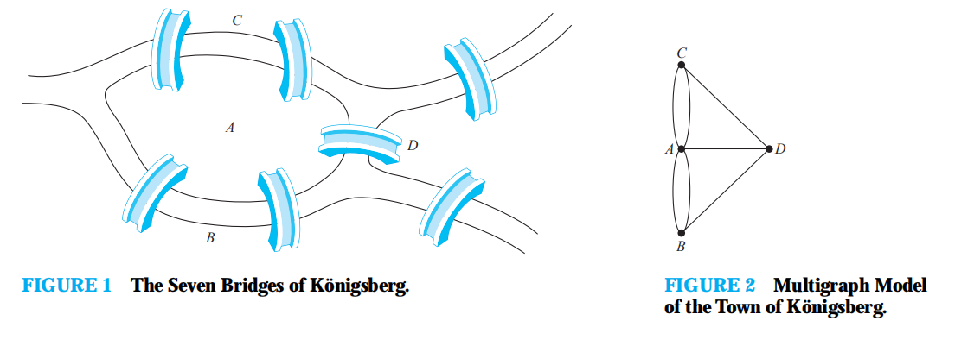

Slide 84
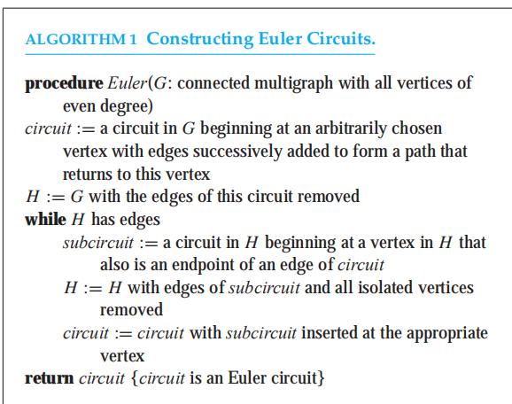
6.5 Euler and Hamilton Paths

Slide 85
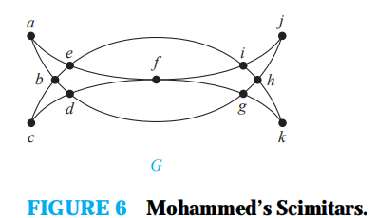
First, we form the circuit a, b, d, c, b, e, i, f, e, a.
Remove edges in H
Then we form the circuit d, g, h, j, i, h, k, g, f, d in H
Euler circuit a, b, d, g, h, j, i, h, k, g, f, d, c, b, e, i, f, e, a

Slide 86
6.5 Euler and Hamilton Paths
Euler Paths
Theorem 2 A connected multigraph has an Euler path but not an Euler circuit if and only if it has exactly two vertices of odd degree.
For a connected directed graph, iff ∃a,b∈V, deg⁺(a)=deg⁻(b)+1 and deg⁺(b)=deg⁻(a)+1
and ∀c ∈V（c≠a and c≠b and deg⁺(c)=deg⁻(c)）

Slide 88
6.5 Euler and Hamilton Paths
Hamilton Paths and Circuits
哈密尔顿通路
哈密尔顿圈
Definition 2 A path x₀,x₁,x₂,…,x_{n} in the graph G = (V,E) is called a Hamilton path if V = { x₀, x₁, x₂,…, x_{n} } and x_{i} ≠ x_{j} for 0 ≤ i < j ≤ n . A circuit x₀,x₁,x₂,…,x_{n},x₀ (with n>1) in a graph G = (V,E) is called Hamilton circuit if x₀,x₁,x₂,…,x_{n} is a Hamilton path.

Slide 89
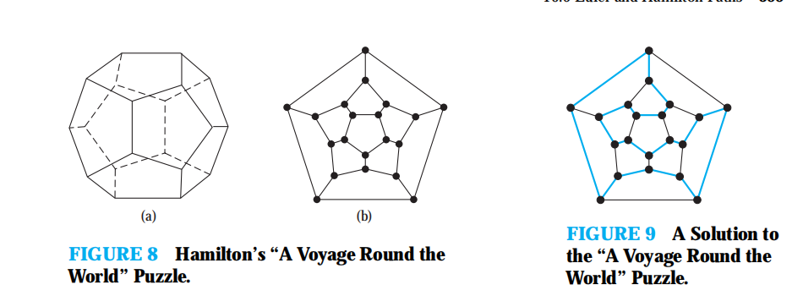
Hamilton circuit

Slide 90
Determine Hamilton Circuit
There are no known simple necessary and sufficient criteria for the existence of Hamilton circuits.
However, many theorems are known that give sufficient conditions for the existence of Hamilton circuits. Also, certain properties can be used to show that a graph has no Hamilton circuit.

Slide 91
some Halmiton circuit cases
vertex of degree one ,no circuit
degree two, must be part of any Hamilton circuit. (pass a vertex twice?)
A Hamilton circuit has passed through a vertex, then all remaining edges incident with this vertex can be removed for consideration.
A Hamilton circuit cannot contain a smaller circuit within it.

Slide 92
no hamilton circuit
G_{V}=(V,E),Let ω (G_{V}-G_{V1}) be the number of connected subgraphs of (G_{V}-G_{V1}) , if there exist a G_{V1} making |V₁| ≤ ω (G_{V}-G_{V1}) , then there is no hamilton circuit in G_{V}
去掉非空子图后，该非空子图顶点数小于连通分支数，无哈密顿回路

Slide 93
在下图(a)中，取S＝｛v₁，v₄｝，则（G－S）有3个连通分支，故该图无Hamilton circuit。

Slide 94
.如果一个图的顶点可以用两种颜色染色，相邻节点不同色。那若结果染完两种颜色的顶点数量不一致，则一定不是哈密顿图。

Slide 95
G with Hamilton curicuit
DIRAC’S THEOREM： If G is a simple graph with n vertices with n ≥ 3 such that the degree of every vertex in G is at least n/2, then G has a Hamilton circuit.
ORE’S THEOREM： If G is a simple graph with n vertices with n ≥ 3 such that deg(u) + deg(v) ≥ n for every pair of nonadjacent vertices u and v in G, then G has a Hamilton circuit。

Slide 96
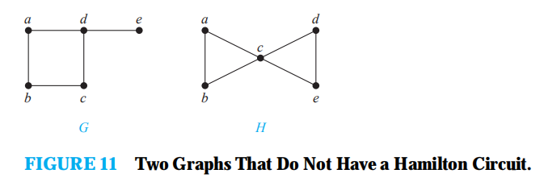
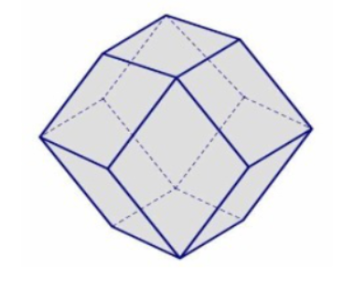
Does K_{n} n ≥ 3 have a Hamilton circuit?
Notes:
利用dirac，每个节点都n-1，大于n/2,

Slide 97
6.6 Shortest-Path Problems
Introduction
加权图
权图
Weighted graphs
length
Graphs that have a number assigned to each edge are called weighted graphs.

Slide 98
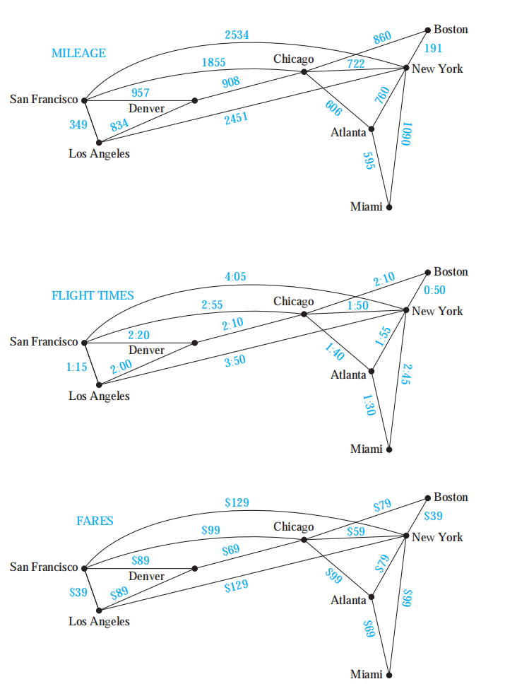

Slide 99
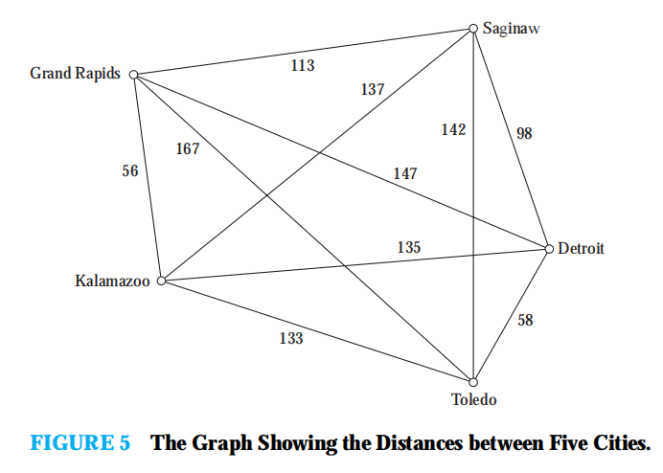
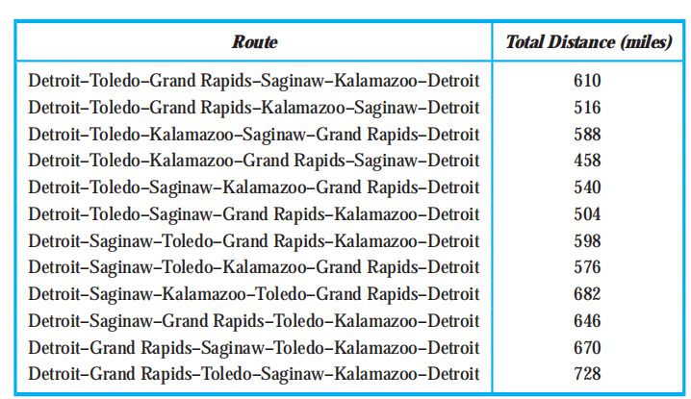
TSP：
A traveling salesperson wants to visit each of n cities exactly once and return to his starting point.
(n − 1)! different Hamilton circuits
NO GOOD SOLUTION

Slide 100
6.6 Shortest-Path Problems
最优解
贪心算法：最近邻法求解

Slide 101
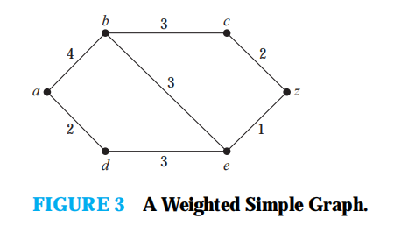
6.6 Shortest-Path Problems
Dijkstra, 1959年提出的
可以求出G中一点u₀到其余各点的最短路及距离，它至今是解最短路问题的最好算法。
1 只讨论简单图
2 假定所有边的权均为正数。
What is the length of a shortest path between a and z in the weighted graph shown in Figure 3?

Slide 102
6.6 Shortest-Path Problems
6.6.2 Shortest-Path Problems
Theorem 1 (迪克斯特(屈)拉)
Dijkstra’s algorithm finds the length of a shortest path between two vertices in a connected simple undirected weighted graph.

Slide 103
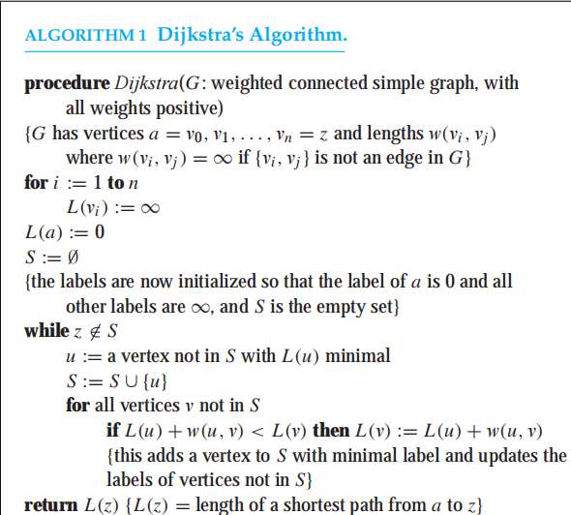

Slide 104
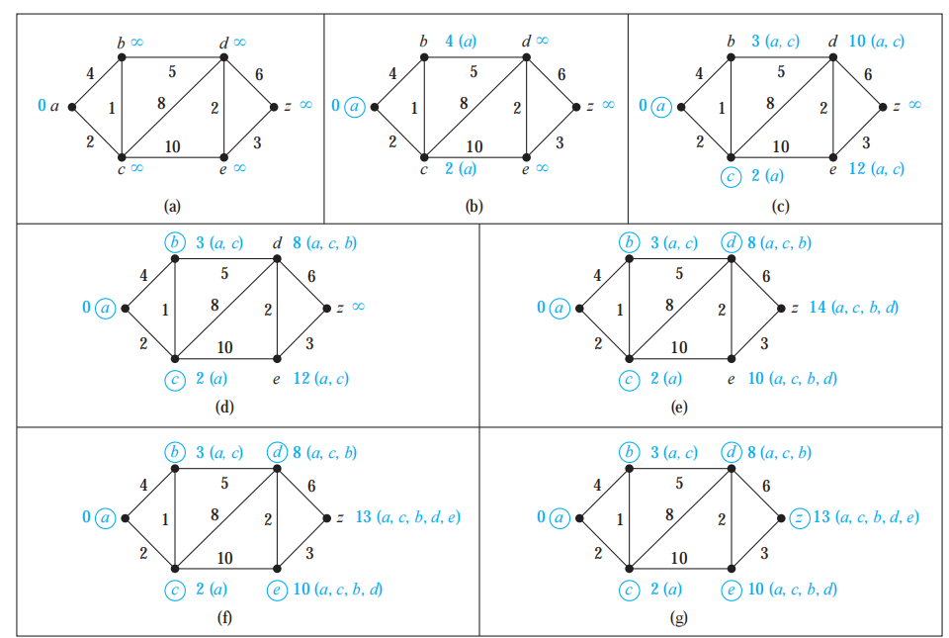

Slide 105
6.6 Shortest-Path Problems
6.6.2 Shortest-Path Problems
Theorem 2 Dijkstra’s algorithm uses O(n²) operations (additions and comparisons) to find the length of a shortest path between two vertices in a connected simple undirected weighted graph with n vertices.

Slide 106
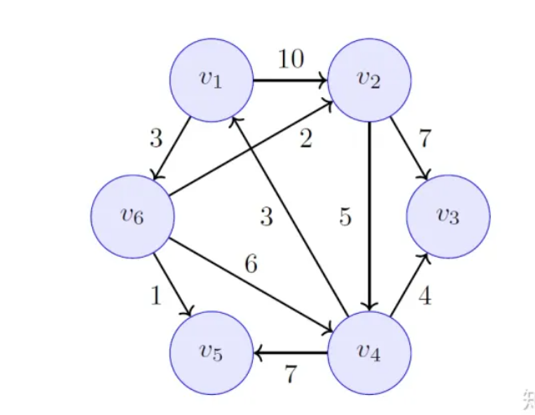
Notes:
5,12,9,4,3,

Slide 107
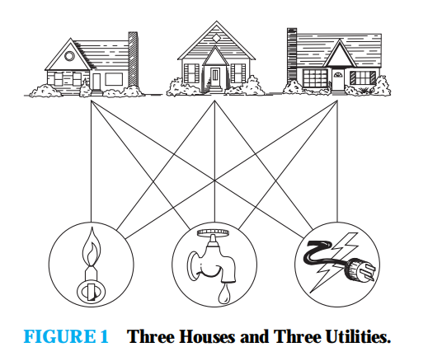
Is it possible to find at least one way to represent this graph in a plane without any edges crossing?（K_{3，3}）
6.7 Planar Graphs

Slide 108
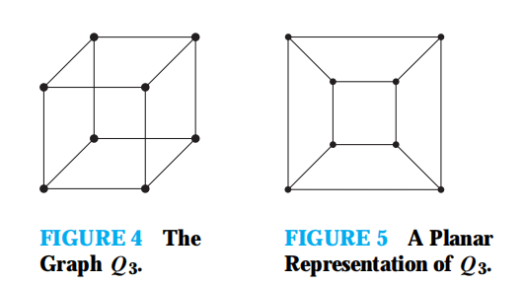
6.7 Planar Graphs

Slide 109
6.7 Planar Graphs
6.7.1 The concept of planar graphs
Definition：
A graph is called planar if it can be drawn in the plane without any edges crossing.Such a drawing is called a planar representation of the graph .
planar graph
imbedding
plane graph

Slide 110
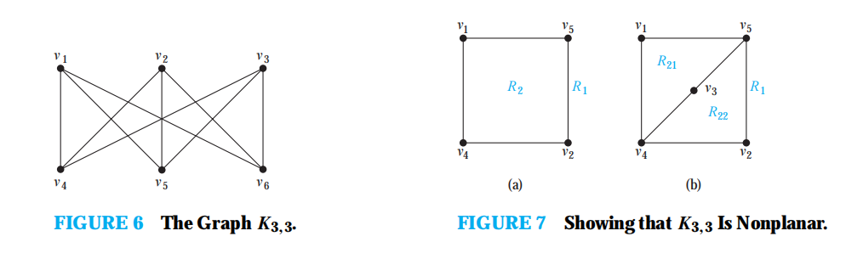
V1,V5,v4,v3-->R1,R2->V3 in R2,(R21,R22)
Then V6?
Application: Circuit without crossing, Roads without underpasses or over passes

Slide 111
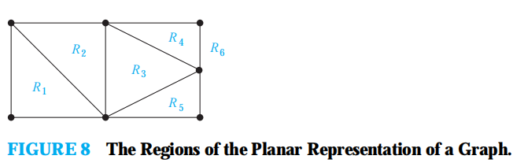
6.7 Planar Graphs
6.7.2 Euler’s Formula
Euler’s Formula：
Let G be a connected planar simple graph with e edges and v vertices.
Let r be the number of regions in a planar representation of G.Then
r = e – v + 2.

Slide 112
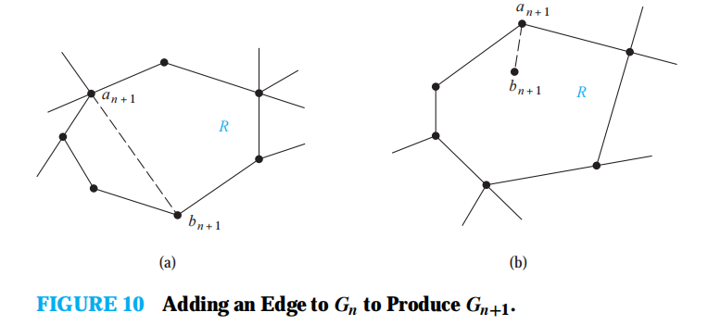
Proof: induction, n->n+1

Slide 113
6.7 Planar Graphs
6.7.2 Euler’s Formula
Corollary 1：
If G is a connected planar simple graph with e edges and v vertices where v ≥ 3, then e ≤ 3v-6.
So:The graph K5 has 5 vertices and 10 edges. However, the inequality e ≤ 3v − 6 is not satisfied for this graph because e = 10 and 3v − 6 = 9. Therefore, K5 is not planar

Slide 114
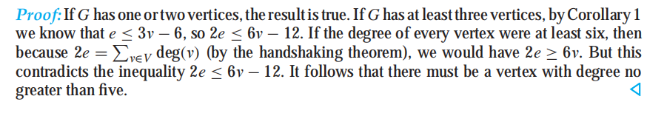
6.7 Planar Graphs
6.7.2 Euler’s Formula
Corollary 2：
If G is a connected planar simple graph , then G has a vertex of degree not exceeding five.

Slide 115
6.7 Planar Graphs
the fact that the inequality e ≤ 3v − 6 is satisfied does not imply that a graph is planar:Ex. K_{3,3}
Corollary 3：
If a connected planar simple graph has e edges and v vertices with v≥3 and no circuits of length three,then e≤2v-4.
According to Corollary 3, K_{3,3} is nonplanar

Slide 116
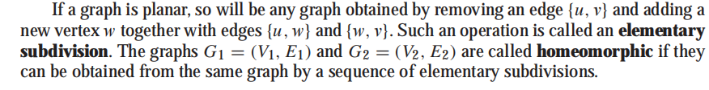
homeomorphic: 同胚性 不是ISOMOPHIC（同构） elementary subdivision 初等细分

Slide 117
6.7 Planar Graphs
6.7.3 Kuratowsiki’s theorem
Theorem：
A graph is nonplanar if and only if it contains a subgraph homeomorphic to K_{3,3} or K₅.

Slide 118
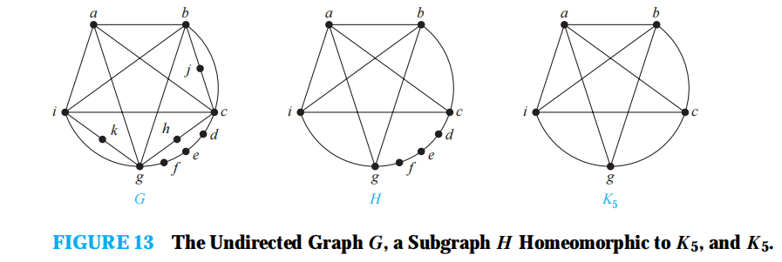
Is G planar？

Slide 119

Is planar?？

Slide 120
6.8 Graph Coloring
6.6.2 Graph coloring
Definition：
A coloring of a simple graph is the assignment of a color to each vertex of the graph so that no two adjacent vertices are assigned the same color.

Slide 121

6.8 Graph Coloring

Slide 122
6.8 Graph Coloring
Definition：
The chromatic number of a graph is the least number of colors needed for a coloring of this graph. The chromatic number of a graph G is denoted by χ (G). (Here χ is the Greek letter chi.)
Each region of the map is represented by a vertex. Edges connect two vertices if the regions represented by these vertices have a common border. Two regions that touch at only one point are not considered adjacent. The resulting graph is called the dual graph of the map

Slide 123



Slide 124
6.8 Graph Coloring
6.6.2 Graph coloring
The four color theorem
The chromatic number of a planar graph is no greater than four.
Nonplanar graphs can have arbitrarily large chromatic numbers

Slide 125

in G： abc must have 3 colors。
in H，another color is needed

Slide 126


χ (K_{n}) = n
χ (K_{m,n}) = 2

Slide 127

χ (C_{n}) = 2 if n is an even positive integer with n ≥ 4
and χ (C_{n}) = 3, if n is an odd positive integer with n ≥ 3.

Slide 128

6.8 Graph Coloring
6.6.3 Applications of graph colorings

Slide 129


Slide 130
Frequency Assignments
Television channels 2 through 13 are assigned to stations in North America so that no two stations within 150 miles can operate on the same channel. How can the assignment of channels be modeled by graph coloring?
Solution: Construct a graph by assigning a vertex to each station. Two vertices are connected by an edge if they are located within 150 miles of each other.An assignment of channels corresponds to a coloring of the graph, where each color represents a different channel.

