Slide 1
Discrete Mathematics SZU CS
xiaogang peng

Slide 2
Topics
Logic
Proof
Sets
Functions
Number theory
Counting
Relations
Graph
Boolean algebra

Slide 3
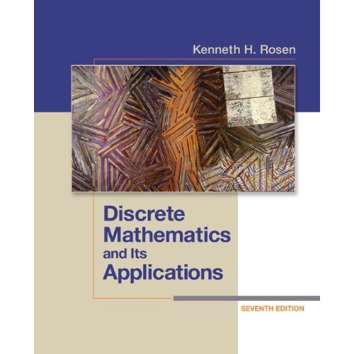
Textbook
Discrete Mathematics and Its Applications
by Kenneth H. Rosen, 7th edition, McGraw Hill

Slide 4
1.1 Propositional logic
Understand and construct correct mathematical arguments
Give precise meaning to mathematical statements
Rules are used to distinguish between valid (true) and invalid arguments
Used in numerous applications: circuit design, programs, verification of correctness of programs, artificial intelligence, etc.

Slide 5
Proposition
A declarative sentence that is either true or false, but not both
Washington, D.C., is the capital of USA
California is adjacent to New York
1+1=2
X+2=5
What time is it?
Read this carefully
if it is sunny, i will go swimming
Every person has his name

Slide 6
Logical operators
Negation operator
Conjunction (and, ^)
Disjunction (or v )
Conditional statement →
Biconditional statement ←→
Exclusive Or

Slide 7
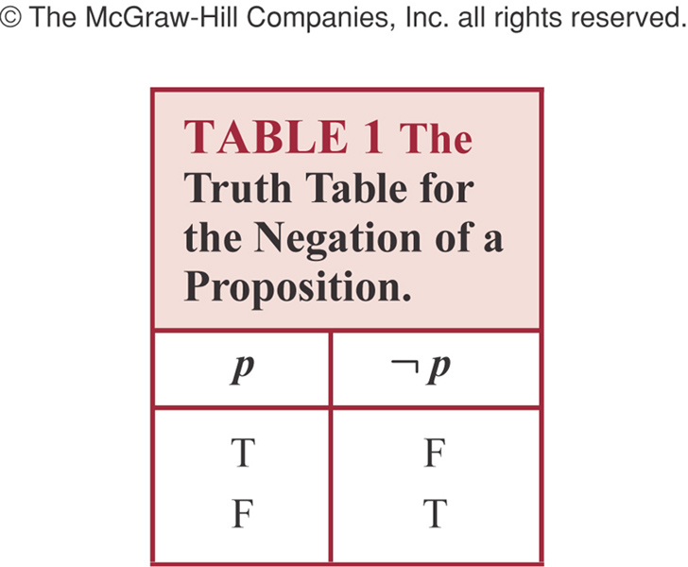
Negation

Slide 8
Example
“Today is Friday”
It is not the case that today is Friday
Today is not Friday
At least 10 inches of rain fell today in Miami
It is not the case that at least 10 inches of rain fell today in Miami
Less than 10 inches of rain fell today in Miami

Slide 9
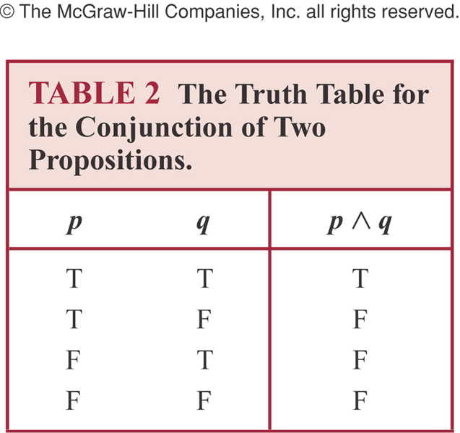
Conjunction
Conjunction: p ^ q is true when both p and q are true. False otherwise

Slide 10
Example
p: “Today is Friday”, q: “It is raining today”
p˄q “Today is Friday and it is raining today”
true: on rainy Fridays
false otherwise:
Any day that is not a Friday
Fridays when it does not rain

Slide 11

Disjunction
Disjunction: p v q is false when both p and q are false. True otherwise

Slide 12
Example
p ˅ q: “Today is Friday or it is raining today”
True:
Today is Friday
It is raining today
It is a rainy Friday
False
Today is not Friday and it does not rain

Slide 13
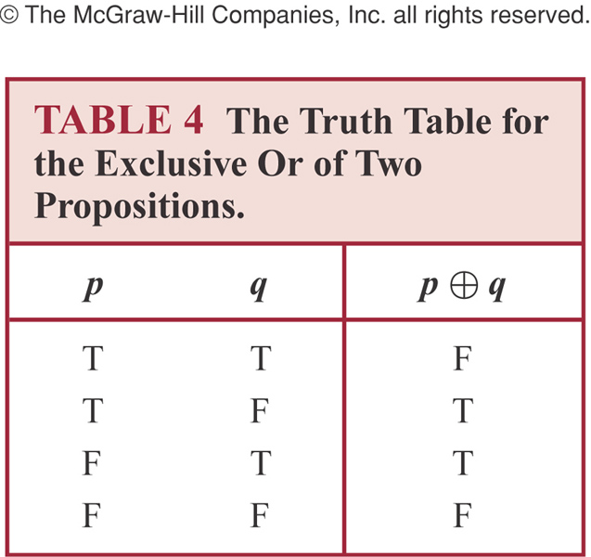

Exclusive or
Exclusive Or is true when exactly one
of p, q is true. False otherwise

Slide 14
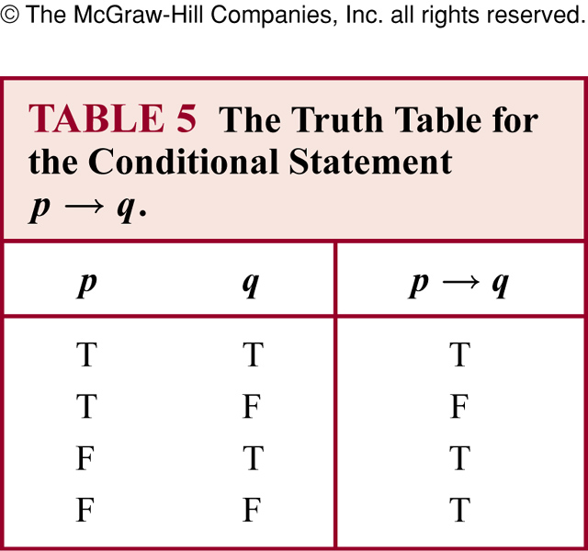
Conditional statement
Conditional Statement:
p is called the premise (or antecedent) and q is called the conclusion (or consequent)
p→ q is false when p is true and q is false. True otherwise

Slide 15
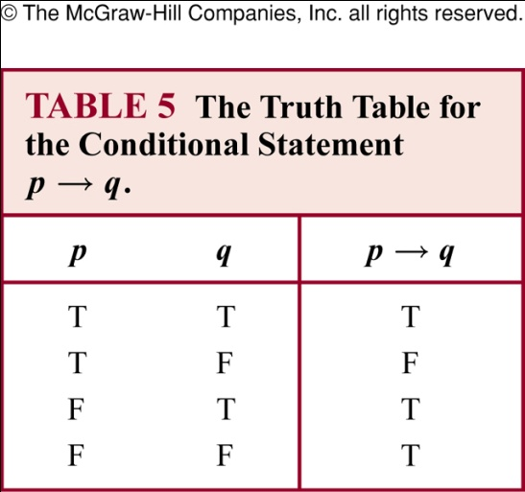
Conditional statement p→q
Also called an implication
if p, then q | p implies q
if p, q | p only if q
p is sufficient for q | a sufficient condition for q is p
q if p | q whenever p
q when p | q is necessary for p
a necessary condition for p is q q unless ┐ p | q follows from p
Conditional Statement: p→q is false when p is true and q is false. True otherwise
Example
p: you go, q: I go. p→q means “If you go, then I go” is equivalent to p only if q “You go only if I go” (not the same as “I go only if you go” which is q only if p)

Slide 16
p→q
p only if q:
p cannot be true when q is not true
The statement is false if p is true but q is false
When p is false, q may be either true or false
Not to use “q only if p” to express p→q
q unless ┐ p
If ┐ p is false, then q must be true
The statement is false when p is true but q is false, but the statement is true otherwise

Slide 17
Example
If Maria learns discrete mathematics, then she will find a good job
Maria will find a good job when she learns discrete mathematics (q when p)
For Maria to get a good job, it is sufficient for her to learn discrete mathematics (sufficient condition for q is p)
Maria will find a good job unless she does not learn discrete mathematics (q unless not p)

Slide 18
Common mistake for p→q
Correct: p only if q
Mistake to think “q only if p”

Slide 19
Example
“If today is Friday, then 2+3=6”
The statement is true every day except Friday even though 2+3=6 is false

Slide 20
Converse, contrapositive and inverse
For conditional statement p→ q
Converse: q→ p
Contrapositive: ┐q → ┐ p
Inverse: ┐p → ┐ q
Contrapositive and conditional statements are equivalent

Slide 21
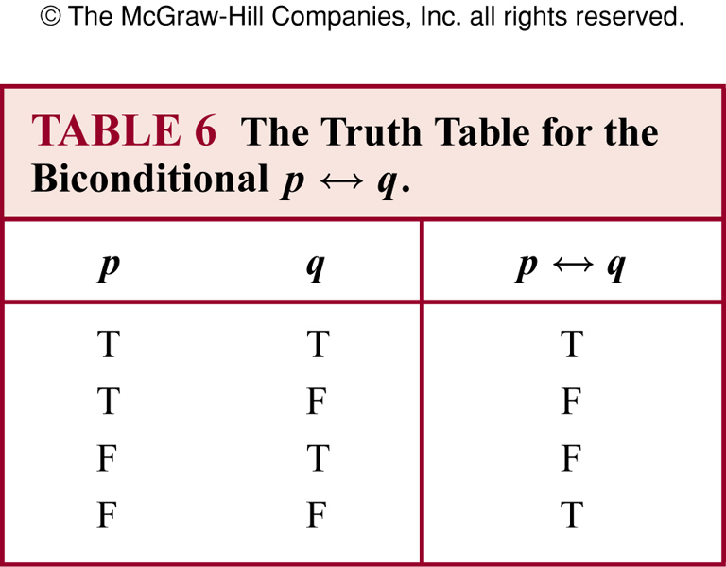
Biconditional statement
Biconditional Statement: “p if and only if q”
p ←→ q is true when p, q have the same truth value. False otherwise
Also known as bi-implications

Slide 22
Example
P: “you can take the flight”, q: “you buy a ticket”
P ←→ q: “You can take the flight if and only if you buy a ticket”
This statement is true
If you buy a ticket and take the flight
If you do not buy a ticket and you cannot take the flight

Slide 23
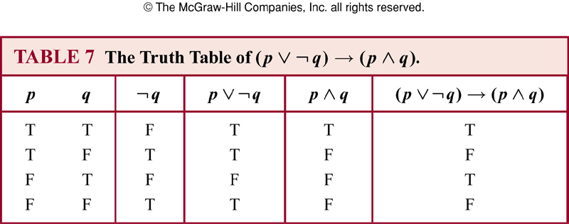
Truth table of compound propositions

Slide 24
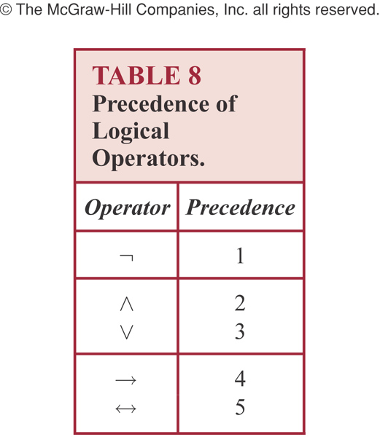
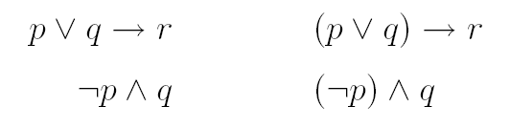
Precedence of logic operators

Slide 25
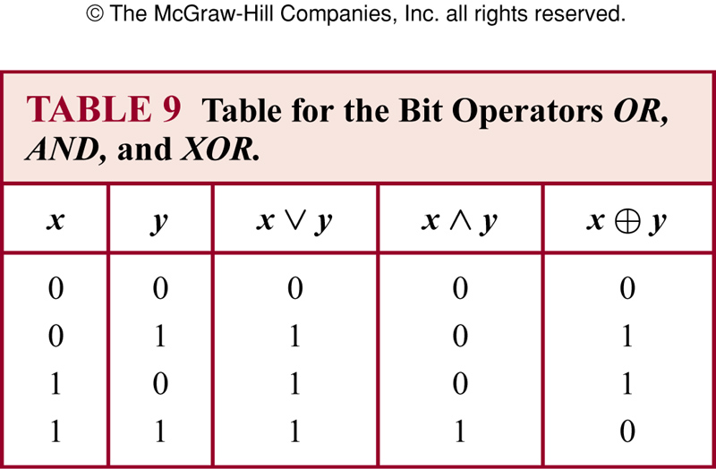
Bit operations

Slide 26
1.2 Translating English to logical expressions
Why?
English is often ambiguous and translating sentences into compound propositions removes the ambiguity
Using logical expressions, we can analyze them and determine their truth values
We can use rules of inferences to reason about them

Slide 27
Example
“ You can access the internet from campus only if you are a computer science major or you are not a freshman.
p : “You can access the internet from campus”
q : “You are a computer science major”
r : “You are freshmen”
p → ( q v ┐r )

Slide 28
System specification
Translating sentences in natural language into logical expressions is an essential part of specifying both hardware and software systems.
Consistency of system specification.
Example: Express the specification “The automated reply cannot be sent when the file system is full”

Slide 29

Example
Let p denote “The automated reply can be sent”
Let q denote “The file system is full”
The logical expression for the sentence “The automated reply cannot be sent when the file system is full” is

Slide 30
Example
Determine whether these system specifications are consistent:
1. The diagnostic message is stored in the buffer or it is retransmitted.
2. The diagnostic message is not stored in the buffer.
3. If the diagnostic message is stored in the buffer, then it is retransmitted.

Slide 31
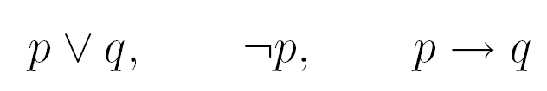
Example
Let p denote “The diagnostic message is stored in the buffer”
Let q denote “The diagnostic message is retransmitted”
The three specifications are

Slide 32
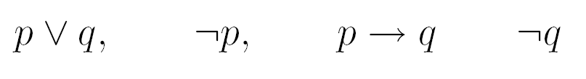
Example
If we add one more requirement “The diagnostic message is not retransmitted”
The new specifications now are
This is inconsistent! No truth values of p and q will make all the above statements true

Slide 33
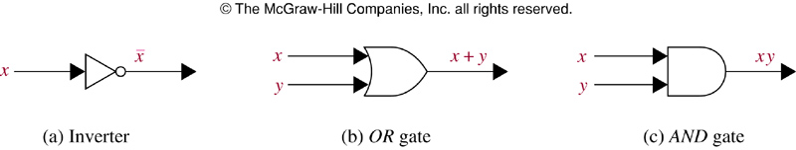
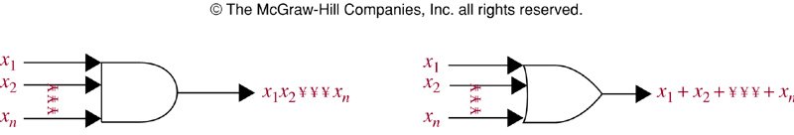
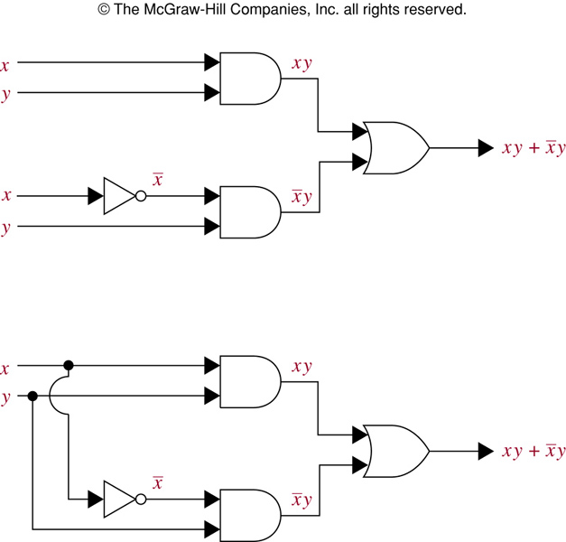
Logic gates

