Slide 1
Discrete Mathematics SZU CS
peng xiaogang

Slide 2
1.3 Propositional equivalences
Replace a statement with another statement with the same truth value
For efficiency (speed-up) or implementation purpose (e.g., circuit design)

Slide 3
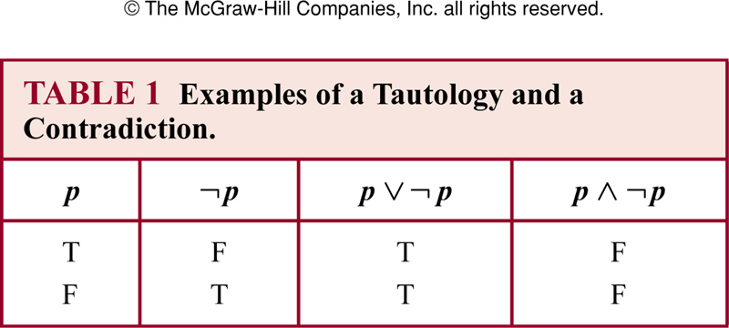
Tautology and contradiction
A compound proposition:
Tautology: always true
Contradiction: always false
Contingency: neither a tautology nor a contradiction

Slide 4
Logical equivalence
p ≡ q : the compound propositions p and q are logically equivalent if p ↔ q is a tautology
!!!The symbol ≡ is not a logical connective, and p ≡ q is not a compound proposition
Can use truth table to determine whether two propositions are equivalent or not

Slide 5
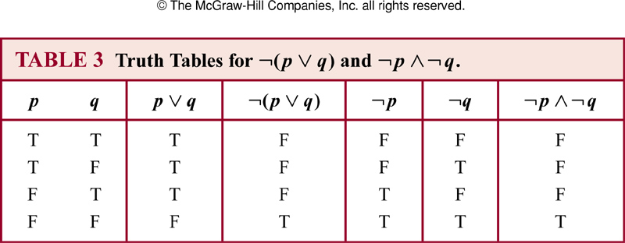
Example
Show that ¬(p v q) and ¬p ˄ ¬ q are equivalent

Slide 6
p | q | p→q | ¬p˅q
T | T | T | T
T | F | F | F
F | T | T | T
F | F | T | T

Slide 7
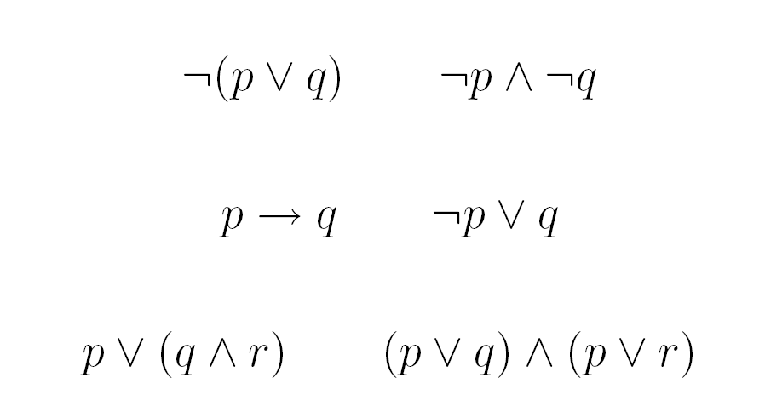
Example

Slide 8
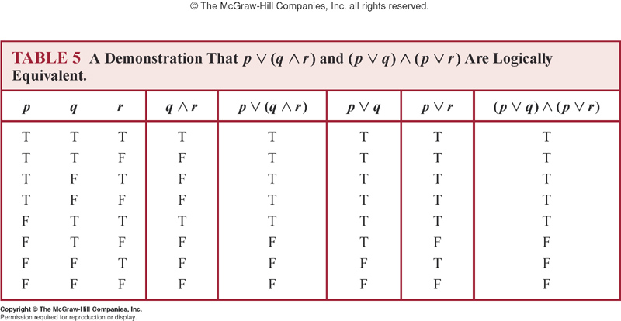
Example

Slide 9
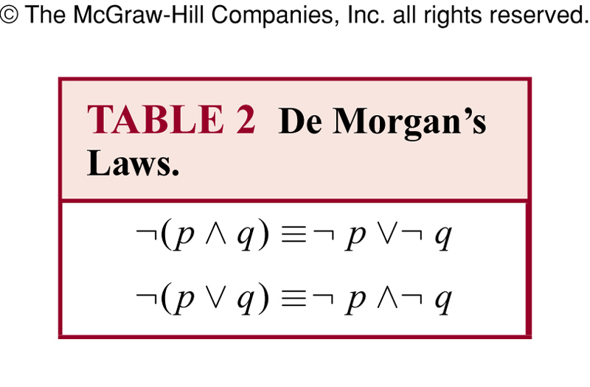
De Morgan’s laws

Slide 10
Example
Express the negation of “Heather will go to the concert or Steve will go to the concert”
Negation:
Heather will not go to the concert AND Steve will not go to the concert.

Slide 11
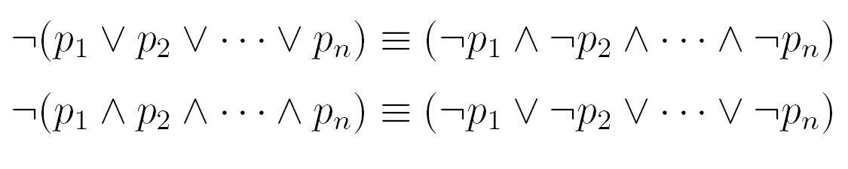
De Morgan’s law: general form
The first example above is known as the De Morgan’s law

Slide 12
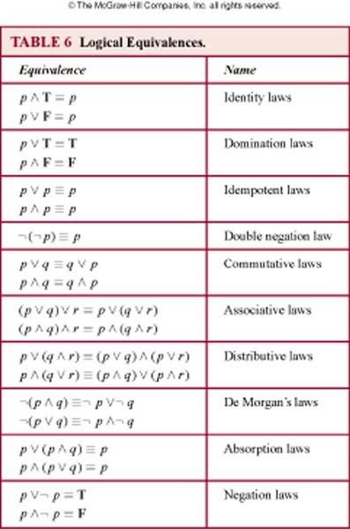
Logical equivalences

Slide 13
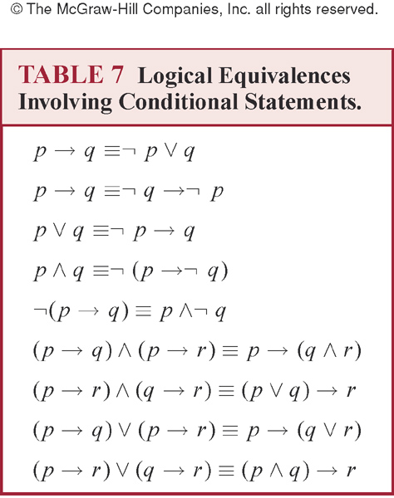

Slide 14
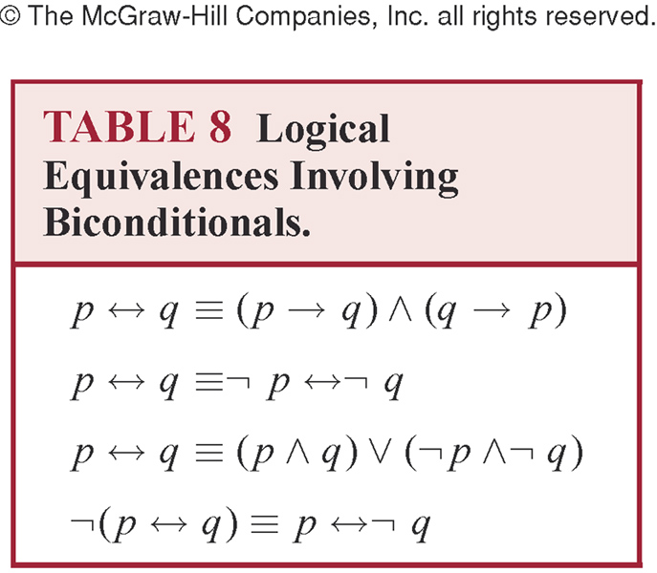

Slide 15
Constructing new logical equivalences
Show (p → q) ≡ p ˄ ¬ q
¬ (p → q) ≡ ¬ (¬ p ˅ q)
≡ ¬ (¬ p) ˄ ¬ q
≡ p ˄ ¬ q

Slide 16
Constructing new logical equivalences
Show ¬ (p ˅ (¬ p ˄ q) ) ≡ ¬ p ˄ ¬ q
¬ (p ˅ (¬ p ˄ q) ) ≡ ¬ p ˄ (¬ (¬ p ˄ q))
≡ ¬ p ˄ (¬ (¬ p) ˅ ¬ q)
≡ ¬ p ˄ (p ˅ ¬ q)
≡ (¬ p ˄ p ) ˅ (¬ p ˄ ¬ q)
≡ F ˅ (¬ p ˄ ¬ q)
≡ ¬ p ˄ ¬ q

Slide 17
Limitations of proposition logic
Proposition logic cannot adequately express the meaning of statements
Suppose we know
“Every computer connected to the university network is functioning property”
No rules of propositional logic allow us to conclude
“MATH3 is functioning property”
where MATH3 is one of the computers connected to the university network

Slide 18
Example
Cannot use the rules of propositional logic to conclude from
“CS2 is under attack by an intruder”
where CS2 is a computer on the university network
to conclude the truth
“There is a computer on the university network that is under attack by an intruder”

Slide 19
1.4 Predicate and quantifiers
Can be used to express the meaning of a wide range of statements
Allow us to reason and explore relationship between objects
Predicates: statements involving variables, e.g., “x > 3”, “x=y+3”, “x+y=z”, “computer x is under attack by an intruder”, “computer x is functioning property”

Slide 20
Example: x > 3
The variable x is the subject of the statement
Predicate “is greater than 3” refers to a property that the subject of the statement can have
Can denote the statement by P(x) where P denotes the predicate “is greater than 3” and x is the variable
P(x): also called the value of the propositional function P at x
Once a value is assigned to the variable x, P(x) becomes a proposition and has a truth value

Slide 21
Example
Let P(x) denote the statement “x > 3”
P(4): setting x=4, thus p(4) is true
P(2): setting x=2, thus p(2) is false
Let A(x) denote the statement “computer x is under attack by an intruder”. Suppose that only CS2 and MATH1 are currently under attack
A(CS1)? : false
A(CS2)? : true
A(MATH1)?: true

Slide 22
N-ary Predicate
A statement involving n variables, x₁, x₂, …, x_{n}, can be denoted by P(x₁, x₂, …, x_{n})
P(x₁, x₂, …, x_{n}) is the value of the propositional function p at the n-tuple (x₁, x₂, …, x_{n})
P is also called n-ary predicate

Slide 23
Quantifiers
Express the extent to which a predicate is true
In English, all, some, many, none, few
Focus on two types:
Universal: a predicate is true for every element under consideration
Existential: a predicate is true for there is one or more elements under consideration
Predicate calculus: the area of logic that deals with predicates and quantifiers

Slide 24
Universal quantifier
“P(x) for all values of x in the domain”
Read it as “for all x P(x)” or “for every x P(x)”
A statement is false if and only if P(x) is not always true
An element for which P(x) is false is called a counterexample of
A single counterexample is all we need to establish that is not true

Slide 25
Example
Let P(x) be the statement “x+1>x”. What is the truth value of ?
Implicitly assume the domain of a predicate is not empty
Best to avoid “for any x” as it is ambiguous to whether it means “every” or “some”
Let Q(x) be the statement “x<2”. What is the truth value of where the domain consists of all real numbers?

Slide 26
Example
Let P(x) be “x²>0”. To show that the statement
is false where the domain consists of all integers
Show a counterexample with x=0
When all the elements can be listed, e.g., x₁, x₂, …, x_{n}, it follows that the universal quantification is the same as the conjunction P(x₁) ˄P(x₂) ˄…˄ P(x_{n})

Slide 27
Example
What is the truth value of where p(x) is the statement “x² < 10” and the domain consists of positive integers not exceeding 4?
is the same as P(1)˄P(2)˄P(3)˄P(4)

Slide 28
Example
Let p(x) be the statement “x>3”. Is true for the domain of all real numbers?
Let q(x) be the statement “x=x+1”. Is
true for the domain of all real numbers?
When all elements of the domain can be listed, , e.g., x₁, x₂, …, x_{n}, it follows that the existential quantification is the same as disjunction p(x₁) ˅p(x₂) ˅ … ˅ p(x_{n})

Slide 29
Existential quantification
“There exists an element x in the domain such that P(x) (is true)”
Denote that as where is the existential quantifier
In English, “for some”, “for at least one”, or “there is”
Read as “There is an x such that P(x)”, “There is at least one x such that P(x)”, or “For some x, P(x)”

Slide 30
Example
What is the truth value of where P(x) is the statement “x² > 10” and the domain consists of positive integers not exceeding 4?
is the same as P(1) ˅P(2) ˅P(3) ˅ P(4)

Slide 31
Uniqueness quantifier
There exists a unique x such that P(x) is true
“There is exactly one”, “There is one and only one”

Slide 32
Quantifiers with restricted domains
What do the following statements mean for the domain of real numbers?
Be careful about → and ˄ in these statements

Slide 33
Precedence of quantifiers
have higher precedence than all logical operators from propositional calculus

Slide 34
Binding variables
When a quantifier is used on the variable x, this occurrence of variable is bound
If a variable is not bound, then it is free
All variables occur in propositional function of predicate calculus must be bound or set to a particular value to turn it into a proposition
The part of a logical expression to which a quantifier is applied is the scope of this quantifier

Slide 35
Example
What are the scope of these expressions?
Are all the variables bound?
The same letter is often used to represent variables
bound by different quantifiers with scopes
that do not overlap

