Slide 1
Discrete Mathematics
Rules of inference 推理规则

Slide 2
1.6 Rules of Inference（推导规则）
Proof（证明）: valid arguments that establish the truth of a mathematical statement
Argument（论证）: a sequence of statements that end with a conclusion
Valid: the conclusion or final statement of the argument must follow the truth of proceeding statements or premise of the argument

Slide 3
Argument and inference
An argument is valid if and only if it is impossible for all the premises to be true and the conclusion to be false
Rules of inference: use them to deduce (construct) new statements from statements that we already have
Basic tools for establishing the truth of statements

Slide 4
Valid arguments in propositional logic
Consider the following arguments involving propositions
“If you have a correct password, then you can log onto the network”
“You have a correct password”
therefore,
“You can log onto the network”
premises
conclusion

Slide 5
Valid arguments
is tautology
When ((p→q)˄p) is true, both p→q and p are ture, and thus q must be also be true
This form of argument is true because when the premises are true, the conclusion must be true

Slide 6
Example
p: “You have access to the network”
q: “You can change your grade”
p→q: “If you have access to the network, then you can change your grade”
“If you have access to the network, then you can change your grade” (p→q)
“You have access to the network” (p)
so “You can change your grade” (q)

Slide 7
Example
“If you have access to the network, then you can change your grade” (p→q)
“You have access to the network” (p)
so “You can change your grade” (q)
Valid arguments
But the conclusion is not true，(p→q) is false
Argument form论证形式: a sequence of compound propositions involving propositional variables

Slide 8
Rules of inference for propositional logic
Can always use truth table to show an argument form is valid
For an argument form with 10 propositional variables, the truth table requires 2¹⁰ rows
The tautology is the rule of inference called modus ponens 假言推理(mode that affirms), or the law of detachment

Slide 9
Example
If both statements “If it snows today, then we will go skiing” and “It is snowing today” are true.
By modus ponens, it follows the conclusion “We will go skiing” is true

Slide 10
Example
The premises of the argument are p→q and p, and q is the conclusion
This argument is valid by using modus ponens
But one of the premises is false, consequently we cannot conclude the conclusion is true
Furthermore, the conclusion is not true

Slide 11
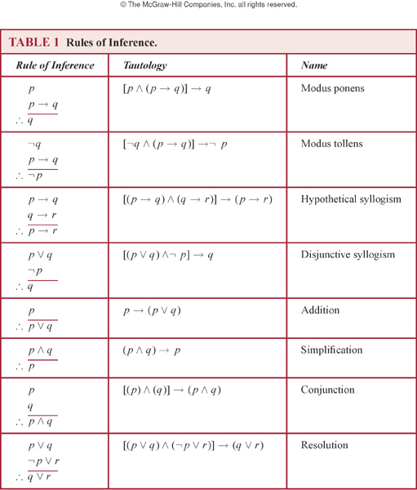

Slide 12
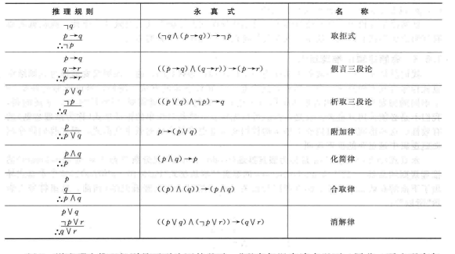

Slide 13
Example
“It is not sunny this afternoon and it is colder than yesterday”
“We will go swimming only if it is sunny”
“If we do not go swimming, then we will take a canoe trip”
“If we take a canoe trip, then we will be home by sunset”
Can we conclude
“We will be home by sunset”?

Slide 14
Example
“If you send me an email message, then I will finish my program”
“If you do not send me an email message, then I will go to sleep early”
“If I go to sleep early, then I will wake up feeling refreshed”
“If I do not finish writing the program, then I will wake up feeling refreshed”

Slide 15
Resolution（归结，消解）
Based on the tautology
Resolvent（消解式）:
Let q=r, we have
Let r=F, we have
（rules of inference）
Important in logic programming, AI, etc.

Slide 16
Example
“Jasmine is skiing or it is not snowing”
“It is snowing or Bart is playing hockey”
imply
“Jasmine is skiing or Bart is playing hockey”

Slide 17
Example
To construct proofs using resolution as the only rule of inference, the hypotheses and the conclusion must be expressed as clauses
Clause: a disjunction of variables or negations of these variables

Slide 18
Fallacies
Inaccurate arguments：Several common fallacies arise in incorrect arguments. These fallacies resemble rules of inference, but are based on contingencies rather than tautologies.
is not a tautology as it is false when p is false and q is true

Slide 19
If you do every problem in this book, then you will learn discrete mathematics. You learned discrete mathematics
Therefore you did every problem in this book
q？

Slide 20
Example
what is ？ is it correct to conclude ¬q?
Fallacy: the incorrect argument is of the form as ¬p does not imply ¬q
An example of the fallacy of denying the hypothesis.

Slide 21
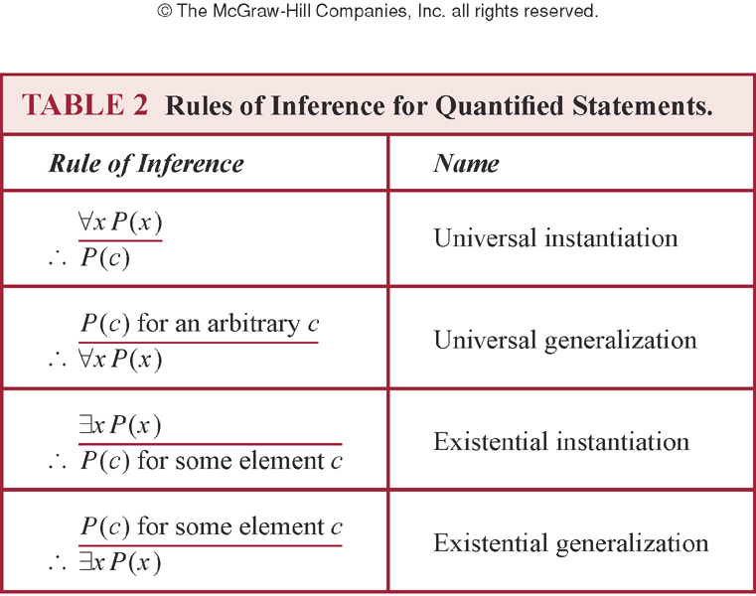
Inference with quantified statements
Instantiation:
c is one particular member
of the domain
Generalization:
for an arbitrary member c

Slide 22
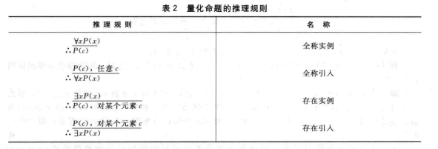

Slide 23
Example
“Everyone in this discrete mathematics has taken a course in computer science” and “Marla is a student in this class” imply “Marla has taken a course in computer science”

Slide 24
Example
“A student in this class has not read the book”, and “Everyone in this class passed the first exam” imply “Someone who passed the first exam has not read the book”

Slide 25
Universal modus ponens
Use universal instantiation and modus ponens to derive new rule
Assume “For all positive integers n, if n is greater than 4, then n² is less than 2^{n}” is true. Show 100²<2¹⁰⁰

Slide 26
Assume that “For all positive integers n, if n is greater than 4, then n² is less than 2n” is true.
Use universal modus ponens to show that 100² < 2¹⁰⁰.

Slide 27
Universal modus tollens
Combine universal modus tollens and universal instantiation

Slide 28
exercise
If Superman were able and willing to prevent evil,he would do so. If Superman were unable to prevent evil, he would be impotent; if he were unwilling to prevent evil, he would be malevolent. Superman does not prevent evil. If Superman exists, he is neither impotent nor malevolent. Therefore, Superman does not exist.
Notes:
a and w -prevent, not a- i, not w- m, not prevent, e-not i and w

