Slide 1
Discrete Mathematics
Number theory

Slide 2
4.1 Divisibility and modular arithmetic
Number theory: the branch of mathematics involves integers and their properties
If a and b are integers with a≠0, we say that a divides b if there is an integer c s.t. b=ac
When a divides b we say that a is a factor of b and that b is a multiple of a
The notation a | b denotes a divides b. We write a ∤ b when does not divide b

Slide 3
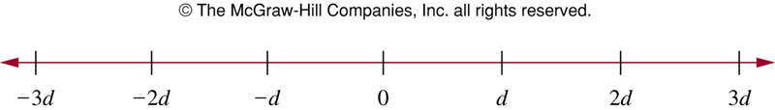
Example
Let n and d be positive integers. How many positive integers not exceeding n are divisible by d?
The positive integers divisible by d are all integers of them form dk, where k is a positive integer
Thus, there are positive integers not exceeding n that are divisible by d

Slide 4
Theorem and corollary
Theorem: Let a, b, and c be integers, then
If a | b and a| c, then a | (b+c)
If a | b, and a | bc for all integers c
If a | b and b | c, then a | c
Corollary: If a, b, and c are integers s.t. a | b and a | c, then a | mb+nc whenever m and n are integers

Slide 5
The division algorithm
Let a be integer and d be a positive integer. Then there are unique integers q and r with 0 ≤ r < d,
s.t. a=dq+r
In the equality, q is the quotient, r is the remainder
q = a div d, r = a mod d
-11 divided by 3
-11=3(-4)+1, -4=-11 div 3, 1=-11 mod 3
-11=3(-3)-2, but remainder cannot be negative

Slide 6
Modular arithmetic
If a and b are integers and m is a positive integer, then a is congruent to b modulo m if m divides a-b
We use the notation a≡b (mod m) to indicate that a is congruent to b modulo m
If a and b are not congruent modulo m, we write a ≢b (mod m)
Let a and b be integers, m be a positive integer. Then a≡b (mod m) if and only if a mod m = b mod m

Slide 7
Example
Determine whether 17 is congruent to 5 modulo 6, and whether 24 and 14 are not congruent modulo 6
17-5=12, we see 17≡5 (mod 6)
24-14=10, and thus 24≢14 (mod 6)

Slide 8
Theorem
Karl Friedrich Gauss developed the concept of congruences at the end of 18th century
Let m be a positive integer. The integer a and b are congruent modulo m if and only if there is an integer k such that a=b+km
(→) If a=b+km, then km=a-b, and thus m divides a-b and so a≡b (mod m)
(←) if a≡b (mod m), then m | a-b. Thus, a-b=km, and so a=b+km

Slide 9
Theorem
Let m be a positive integer. If a ≡ b (mod m) and c ≡ d (mod m), then a+c=b+d (mod m) and ac ≡ bd (mod m)
Since a ≡ b (mod m) and c ≡ d (mod m), there are integers s.t. b=a+sm and d=c+tm
Hence, b+d=(a+c)+m(s+t), bd=(a+sm)(c+tm)=ac+m(at+cs+stm)
Hence a+c ≡ b+d (mod m), and ac ≡ bd (mod m)

Slide 10
Example
7 ≡ 2 (mod 5) and 11 ≡ 1 (mod 5), so
18=7+11 ≡ 2+1=3 (mod 5)
77=7∙11 ≡2∙1=2(mod 5)

Slide 11
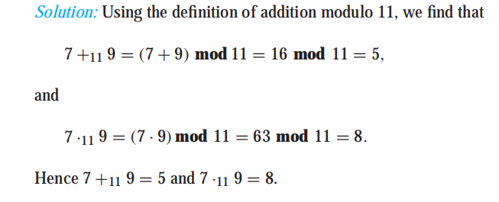
Arithmetic Modulo m
We can define arithmetic operations on Z_{m}, the set of nonnegative integers less than m, that is,the set {0, 1,...,m − 1}. In particular, we define addition of these integers,define：
a +_{m} b = (a + b) mod m,a ·_{m} b = (a · b) mod m,

Slide 12
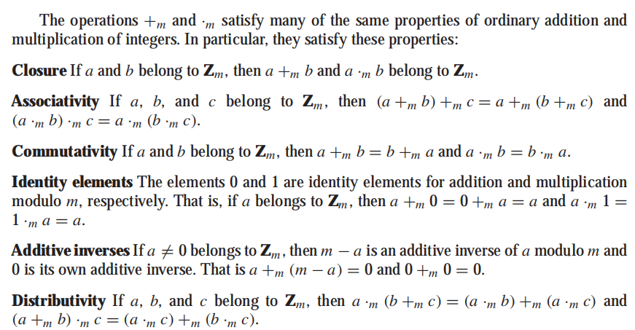

Slide 13
Corollary
Let m be a positive integer and let a and b be integers, then
(a+b) mod m=((a mod m) +(b mod m)) mod m
ab mod m = ((a mod m)(b mod m)) mod m
Proof: By definitions mod m and congruence modulo m, we know that a≡(a mod m)(mod m) and b≡(b mod m)(mod m). Hence
(a+b) ≡((a mod m)+(b mod m)) (mod m)
ab ≡ (a mod m)(b mod m)(mod m)

Slide 14
exercise：
Show that if n is an integer then
n² ≡ 0 or 1 (mod 4).
Show that if m is a positive integer of the form 4k + 3 for some nonnegative integer k, then m is not the sum of the squares of two integers.
Notes:
4.1-38,39

Slide 15
4.2 Integer representations and algorithms
Base b expansion of n
For instance, (245)₈=2*8²+4*8+5=165
Hexadecimal expansion of (2AE0B)16
(2AE0B)₁₆=2*16⁴+10*16³+14*16²+0*16+11=175627
Constructing base b expansion

Slide 16
Base conversion
Constructing the base b expansion
n=bq₀+a₀, 0 ≤a₀<b
The remainder a₀, is the rightmost digit in the base b expansion of n
Next, divide q₀ by b to obtain
q₀=bq₁+a₁, 0≤a₁<b
We see a₁ is the second digit from the right in the base b expansion of n
Continue this process, successively dividing the quotients by b, until the quotient is zero

Slide 17
Example
Find the octal base of (12345)₁₀
First, 12345=8*1543+1
Successively dividing quotients by 8 gives
1543=8*192+7
192=8*24+0
24=8*3+0
3=8*0+3
(12345)₁₀=(30071)₈

Slide 18
Modular exponentiation
Need to find b^{n} mod m efficiently in cryptography
Impractical to compute b^{n} and then mod m
Instead, find binary expansion of n first, e.g., n=(a_{k-1} … a₁ a₀)
To compute b^{n} , first find the values of b, b², …, (b⁴)²=b⁸, …
Next multiple the where a_{j}=1

Slide 19
Example
To compute 3¹¹
11=(1011)₂ ,So 3¹¹=3⁸ 3² 3¹ . First compute 3²=9, and then 3⁴=9²=81, and 3⁸=(3⁴)²=(81)²=6561, So 3¹¹=6561*9*3=177147
The algorithm successively finds b mod m, b² mod m, b⁴ mod m, …, mod m, and multiply together those terms
ab mod m = ((a mod m)(b mod m)) mod m

Slide 20
b^{n} mod mAlgorithm
procedure modular exponentiation (b:integer, n=(a_{k-1}a_{k-2}a₁a₀, …, a_{n})₂, m:positive integer)
x := 1
power:=b mod m
for i:=0 to k-1
if a_{i} =1 then x:=(x⋅ power) mod m
power:=(power⋅power) mod m
end
{x equals b^{n} mod m}
It uses O((log m)² long n) bit operations

Slide 21
Example
Compute 3⁶⁴⁴ mod 645
First note that 644=(1010000100)₂
At the beginning, x=1, power=3 mod 645 = 3
i=0, a₀=0, x=1, power=3² mod 645=9
i=1, a₁=0, x=1, power=9² mod 645=81
i=2, a₂=1, x=1*81 mod 645=81, power=81² mod 645=6561 mod 645=111
i=3, a₃=0, x=81, power=111² mod 645=12321 mod 645=66
i=4, a₄=0, x=81, power=66² mod 645=4356 mod 645=486
i=5, a₅=0, x=81, power=486² mod 645=236196 mod 645=126
i=6, a₆=0, x=81, power=126² mod 645=15876 mod 645=396
i=7, a₇=1, x=(81*396) mod 645=471, power=396² mod 645=156816 mod 645=81
i=8, a₈=0, x=471, power=81² mod 645=6561mod 645=111
i=9, a₉=1, x=(471*111) mod 645=36
3⁶⁴⁴ mod 645=36

Slide 22
4.3 Primes and greatest common divisions
Prime: a positive integer p greater than 1 if the only positive factors of p are 1 and p
A positive integer greater than 1 that is not prime is called composite
Fundamental theorem of arithmetic: Every positive integer greater than 1 can be written uniquely as a prime or as the product of two or more primes when the prime factors are written in order of non-decreasing size

Slide 23
Example
Prime factorizations of integers
100=2∙2∙5∙5=2²∙5²
641=641
999=3∙3∙3∙37=3³∙37
1024=2∙2∙2∙2∙2∙2∙2∙2∙2∙2=2¹⁰

Slide 24
Theorem
Theorem: If n is a composite integer, then n has a prime division less than or equal to
As n is composite, n has a factor 1<a<n, and thus n=ab
We show that a≤ or b ≤ (by contraposition)
Thus n has a divisor not exceeding
This divisor is either prime or by the fundamental theorem of arithmetic, has a prime divisor less than itself, and thus a prime divisor less than less than
In either case, n has a prime divisor b ≤

Slide 25
Example
Show that 101 is prime
The only primes not exceeding are 2, 3, 5, 7
As 101 is not divisible by 2, 3, 5, 7, it follows that 101 is prime

Slide 26
Procedure for prime factorization
Begin by diving n by successive primes, starting with 2
If n has a prime factor, we would find a prime factor not exceeding
If no prime factor is found, then n is prime
Otherwise, if a prime factor p is found, continue by factoring n/p
Note that n/p has no prime factors less than p
If n/p has no prime factor greater than or equal to p and not exceeding its square root, then it is prime
Otherwise, if it has a prime factor q, continue by factoring n/(pq)
Continue until factorization has been reduced to a prime

Slide 27
Example
Find the prime factorization of 7007
Start with 2, 3, 5, and then 7, 7007/7=1001
Then, divide 1001 by successive primes, beginning with 7, and find 1001/7=143
Continue by dividing 143 by successive primes, starting with 7, and find 143/11=13
As 13 is prime, the procedure stops
7007=7∙7 ∙11 ∙13=7² ∙11 ∙13

Slide 28
4.3 Theorem
Theorem: There are infinitely many primes
Proof by contradiction
Assume that there are only finitely many primes, p₁, p₂, …, p_{n}. Let Q=p₁p₂…p_{n}+1
By Fundamental Theorem of Arithmetic: Q is prime or else it can be written as the product of two or more primes

Slide 29
Theorem
However, none of the primes p_{j} divides Q, for if p_{j} | Q, then p_{j} divides Q-p₁ p₂ … p_{n} =1
Hence, there is a prime not in the list p₁, p₂, …, p_{n}
This prime is either Q, if it is prime, or a prime factor for Q
This is a contradiction as we assumed that we have listed all the primes

Slide 30
Mersenne primes
As there are infinite number of primes, there is an ongoing quest to find larger and larger prime numbers
The largest prime known has been an integer of special form 2^{p}-1 where p is also prime
Furthermore, currently it is not possible to test numbers not of this or certain other special forms anywhere near as quickly as determine whether they are prime

Slide 31
Mersenne primes
2²-1=3, 2³-1=7, 2⁵-1=31 are Mersenne primes while 2¹¹-1=2047 is not a Mersenne prime (2047=23 ∙ 89)
Mersenne claims that 2^{p}-1 is prime for p=2, 3, 5, 7, 13, 17, 19, 31, 67, 127, 257 but is composite for all other primes less than 257
It took over 300 years to determine it is wrong 5 times
For p=67, p=257, 2^{p}-1 is not prime
But p=61, p=87, and p=107, 2^{p}-1 is prime
The largest Mersenne prime known (as of early 2011) is 2^{43,112,609}-1, a number with over 13 million digits

Slide 32
Distribution of primes
The prime number theorem: The ratio of the number of primes not exceeding x and x/ln x approaches 1 as x grows without bound
Can use this theorem to estimate the odds that a randomly chosen number is prime
The odds(机率) that a randomly selected positive integer less than n is prime are approximately
(n/ ln n)/n=1/ln n
The odds that an integer near 10¹⁰⁰⁰ is prime are approximately 1/ln 10¹⁰⁰⁰, approximately 1/2300

Slide 33
Open problems about primes
Goldbach’s conjecture: every even integer n, n>2, is the sum of two primes
4=2+2, 6=3+3, 8=5+3, 10=7+3, 12=7+5, …
As of 2011, the conjecture has been checked for all positive even integers up to 1.6 ⋅10¹⁸
"任一充分大的偶数都可以表示成为一个素因子个数不超过a的个数与另一个素因子不超过b的个数之和"记作"a+b"。1966年陈景润证明了"1+2"成立，

Slide 34
Twin prime conjecture:
Twin primes are primes that differ by 2. There are infinitely many twin primes
2013年5月14日，《自然》杂志在线报道张益唐证明了“存在无穷多个之差小于7000万的素数对”，这一研究随即被认为在孪生素数猜想这一终极数论问题上取得了重大突破，甚至有人认为其对学界的影响将超过陈景润的“1+2”证明。
maximum value known: 2,996,863,034,895×2^{1,290,000}±1

Slide 35
Greatest common divisors
Let a and b be integers, not both zero. The largest integer d such that d | a and d | b is called the greatest common divisor (GCD) of a and b, often denoted as gcd(a,b)
The integers a and b are relative prime if their GCD is 1
gcd(10, 17)=1, gcd(10, 21)=1, gcd(10,24)=2
The integers a₁, a₂, …, a_{n} are pairwise relatively prime if gcd(a_{i}, a_{j})=1 whenever 1 ≤ i < j ≤ n

Slide 36
Prime factorization and GCD
Finding GCD
Least common multiples of the positive integers a and b is the smallest positive integer that is divisible by both a and b, denoted as lcm(a,b)

Slide 37
Least common multiple
Finding LCM
Let a and b be positive integers, then
ab=gcd(a,b)∙lcm(a,b)

Slide 38
Euclidean algorithm
Need more efficient prime factorization algorithm
Example: Find gcd(91,287)
287=91 ∙ 3 +14
Any divisor of 287 and 91 must be a divisor of 287- 91 ∙ 3 =14
Any divisor of 91 and 14 must also be a divisor of 287= 91 ∙ 3
Hence, the gcd(91,287)=gcd(91,14)
Next, 91= 14 ∙ 6+7
Any divisor of 91 and 14 also divides 91- 14 ∙ 6=7 and any divisor of 14 and 7 divides 91, i.e., gcd(91,14)=gcd(14,7)
14= 7 ∙ 2, gcd(14,7)=7, and thus gcd(287,91)=gcd(91,14)=gcd(14,7)=7

Slide 39
Euclidean algorithm
Lemma: Let a=bq+r, where a, b, q, and r are integers. Then gcd(a,b)=gcd(b,r)
Proof: Suppose d divides both a and b. Recall if d|a and d|b, then d|a-bk for some integer k. It follows that d also divides a-bq=r. Hence, any common division of a and b is also a common division of b and r
Suppose that d divides both b and r, then d also divides bq+r=a. Hence, any common divisor of b and r is also common divisor of a and b
Consequently, gcd(a, b)=gcd(b,r)

Slide 40
Euclidean algorithm
Suppose a and b are positive integers, a≥b. Let r₀=a and r₁=b, we successively apply the division algorithm
Hence, the gcd is the last nonzero remainder in the sequence of divisions

Slide 41
Example
Find the GCD of 414 and 662
662=414 ∙ 1+248
414=248 ∙ 1+166
248=166 ∙ 1+82
166=82 ∙ 2 + 2
82=2 ∙ 41 +0
gcd(414,662)=2 (the last nonzero remainder)
a=bq+r
gcd(a,b)=gcd(b,r)

Slide 42
The Euclidean algorithm
procedure gcd(a, b: positive integers)
x := a
y:=b
while (y≠0)
begin
r:=x mod y
x:=y
y:=r
end {gcd(a,b)=x}
The time complexity is O(log b) (where a ≥ b)

Slide 43
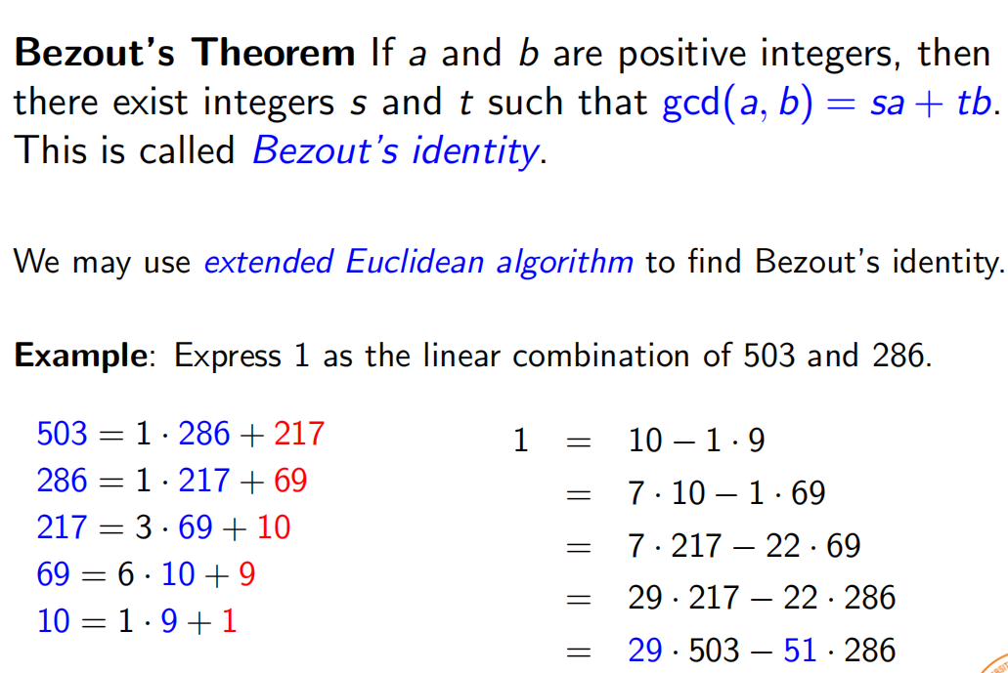
GCD as Linear Combinations
s,t is called Bézout coefficients of a and b
gcd(6, 14) = 2, and 2 = (−2) · 6 + 1 · 14.

Slide 44
Express gcd(252, 198) = 18 as a linear combination of 252 and 198.
252 = 1 · 198 + 54, 198 = 3 · 54 + 36
54 = 1 · 36 + 18, 36 = 2 · 18.
then
18 = 54 − 1 · 36 and 36 = 198 − 3 · 54
18 = 54 − 1 · 36 = 54 − 1 · (198 − 3 · 54)
= 4 · 54 − 1 · 198.
and 54=252 - 1 · 198
18 = 4 · (252 − 1 · 198) − 1 · 198
= 4 · 252 − 5 · 198,

Slide 45
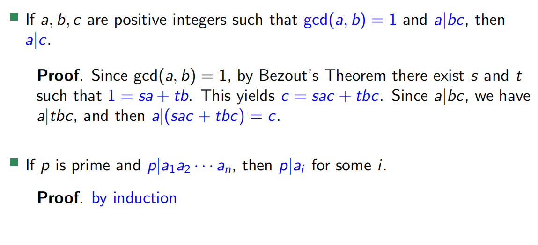
Corollaries of Bezout’s Theorem

Slide 46
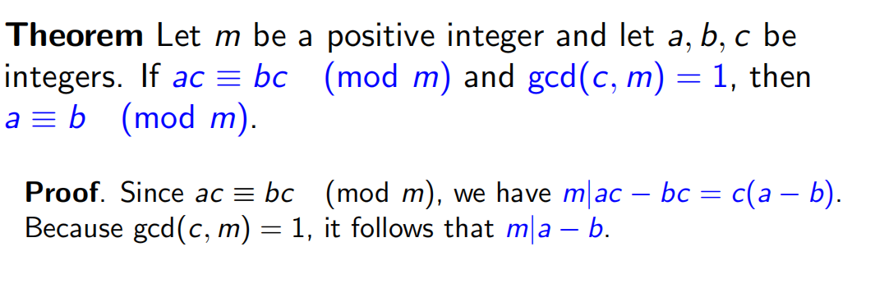
Dividing Congruences by an Integer
The congruence 14 ≡ 8 (mod 6) holds, but both sides of this congruence cannot be divided by 2
to produce a valid congruence because 14/2 = 7 and 8/2 = 4, but 7 ≡ 4 (mod 6)is false. we can if this integer is relatively prime to m

Slide 47
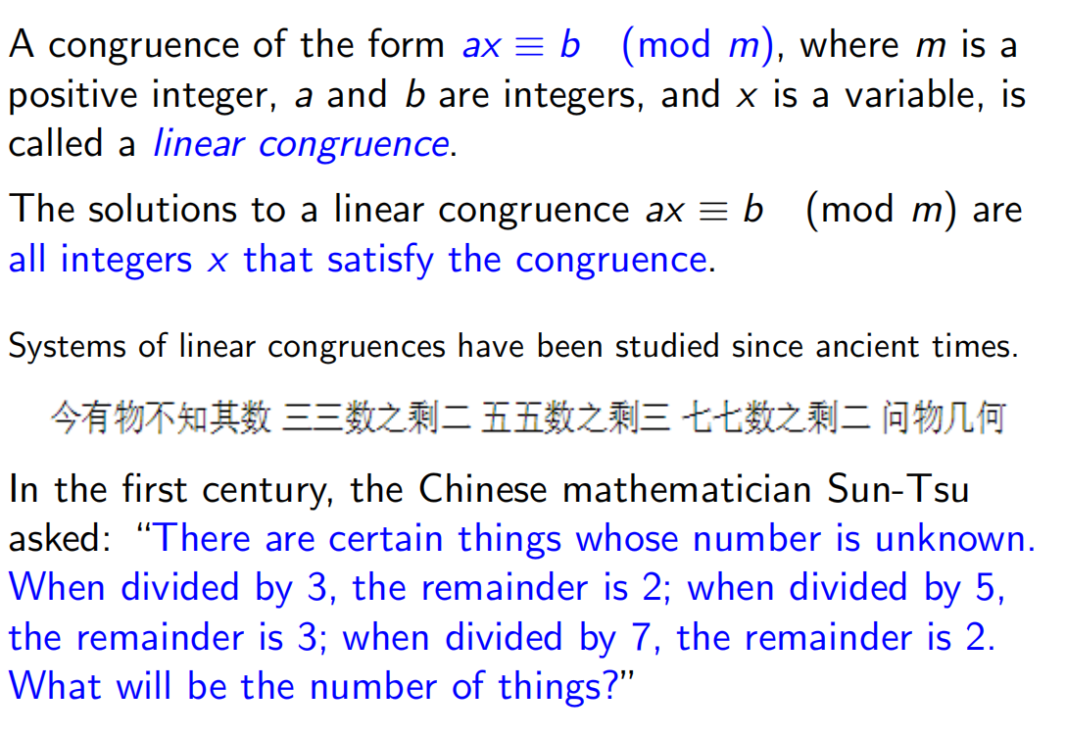
Linear Congruences

Slide 48
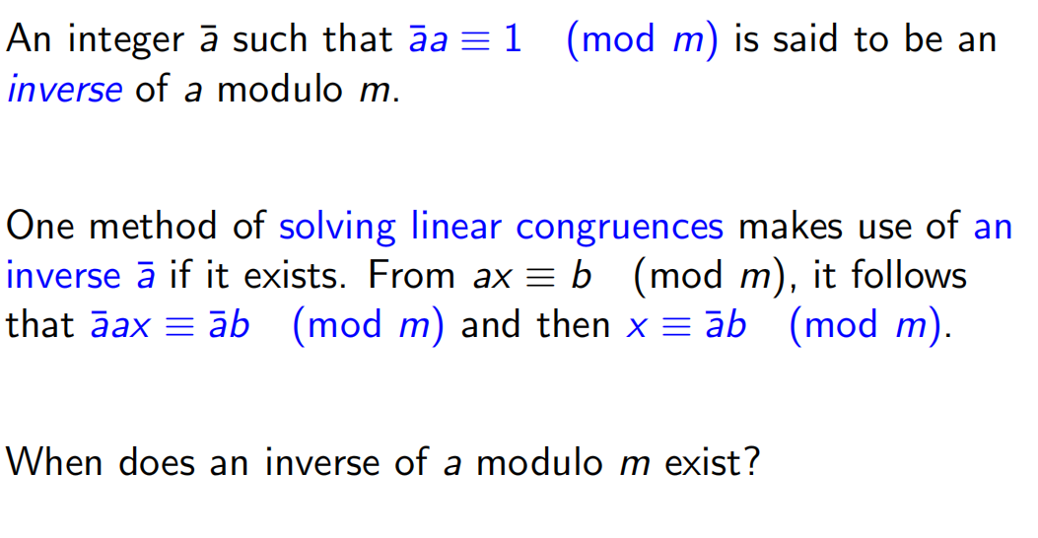
Modular Inverse

Slide 49
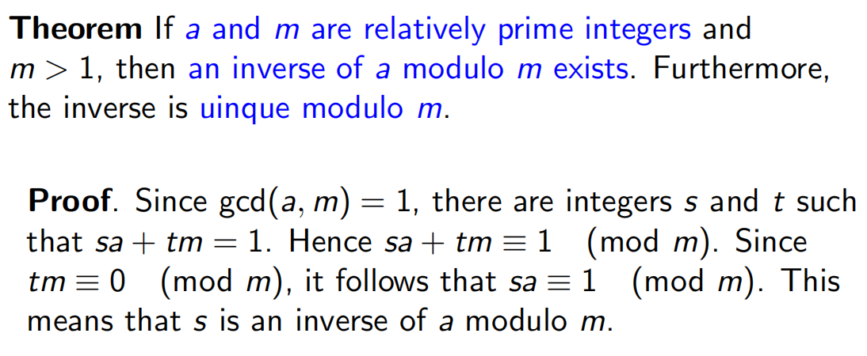
Inverse of a modulo m

Slide 50
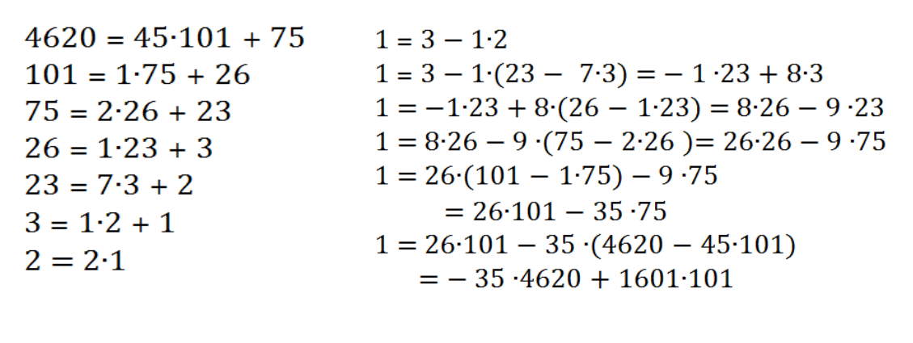
Find an inverse of 101 modulo 4620.

Slide 51
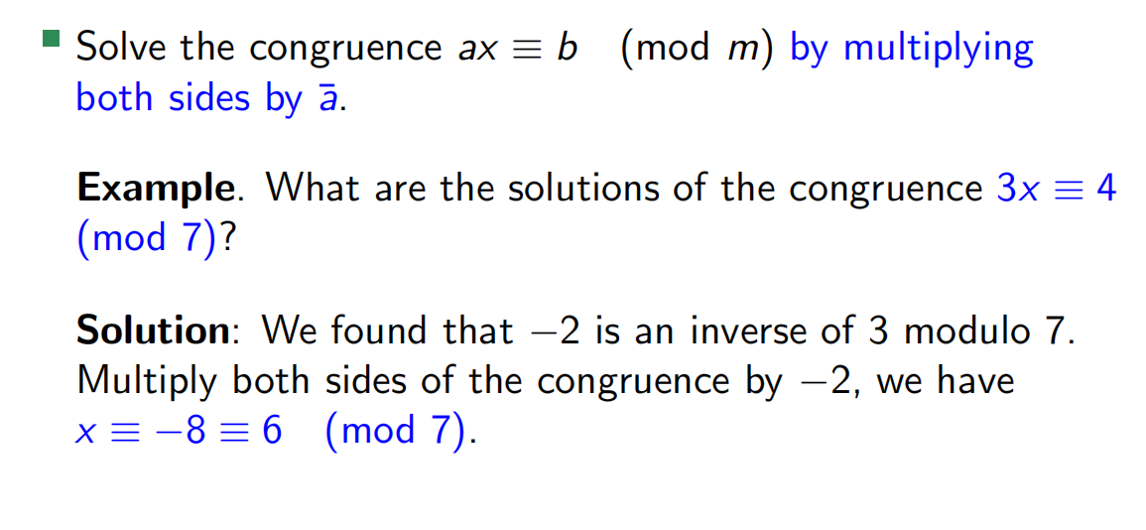
Using Inverses to Solve Congruences

Slide 52
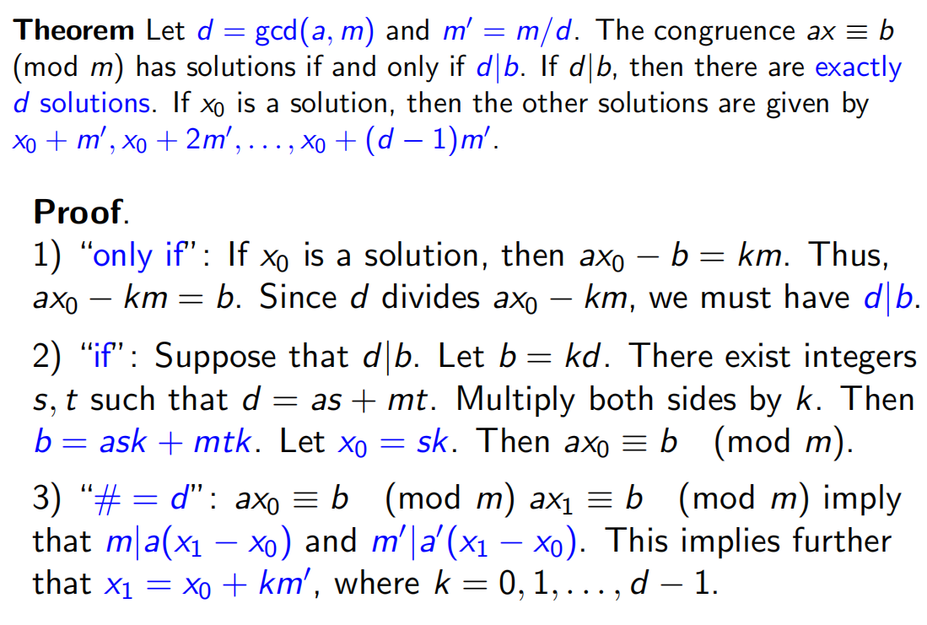
Number of Solutions to Congruences ∗

Slide 53
The Chinese Remainder Theorem
In the first century, the Chinese mathematician Sun-Tsu
asked:
“There are certain things whose number is unknown. When
divided by 3, the remainder is 2; when divided by 5, the
remainder is 3; when divided by 7, the remainder is 2. What
will be the number of things?”
x ≡ 2 (mod 3)
x ≡ 3 (mod 5)
x ≡ 2 (mod 7)

Slide 54
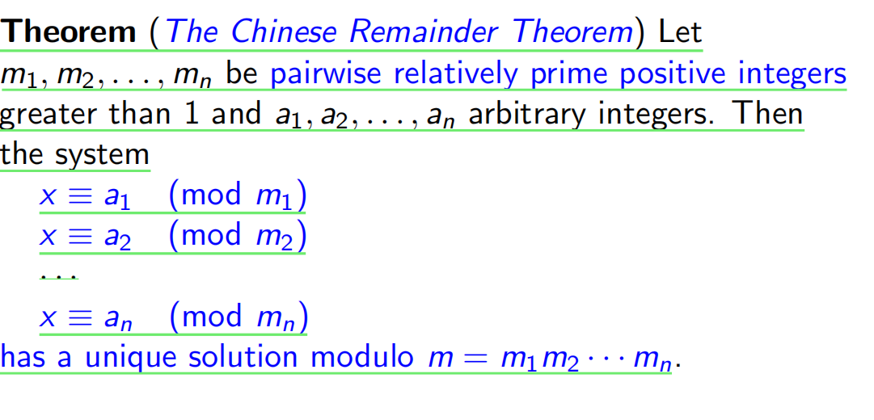
The Chinese Remainder Theorem

Slide 55
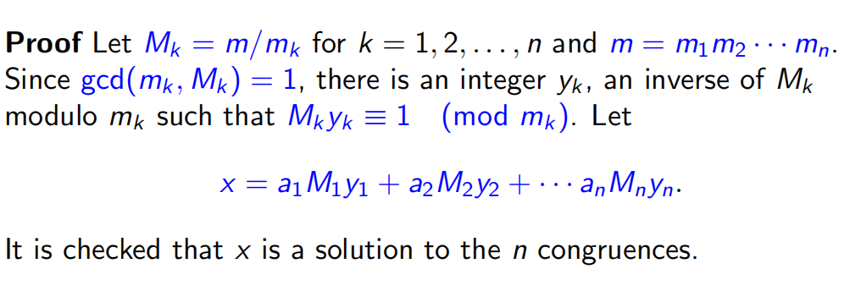


Slide 56
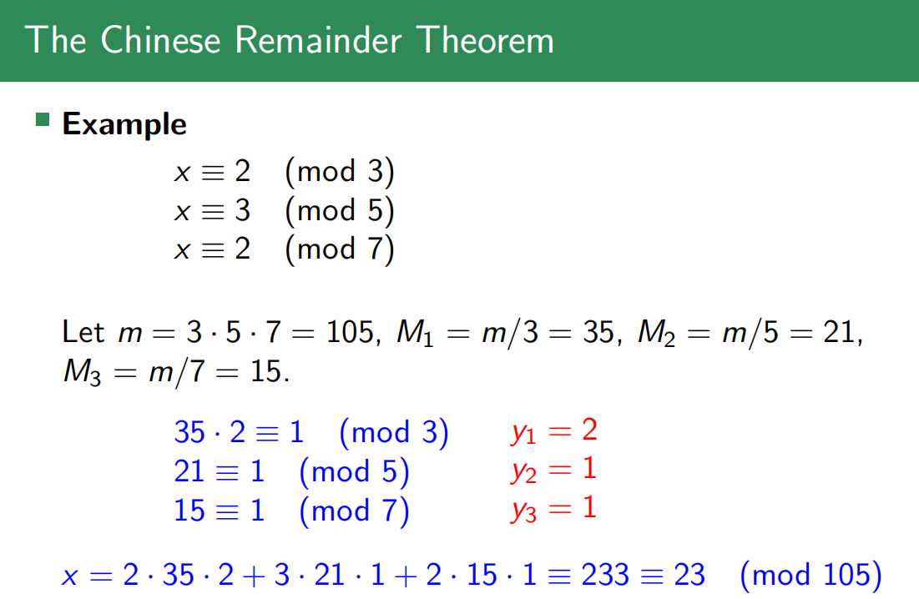

Slide 57
back substitution
Use the method of back substitution to find all integers x such that x ≡ 1 (mod 5), x ≡ 2 (mod 6), and x ≡ 3 (mod 7)
from first: x = 5t + 1 where t is an integer. Substituting this expression for x into the second congruence
5t + 1 ≡ 2 (mod 6),---e2
solution: t ≡ 5 (mod 6)---e1,e2

Slide 58
let: t = 6u + 5, and x = 5t + 1 --e1
x = 5(6u + 5) + 1 = 30u + 26.
insert this into the third equation to obtain
30u + 26 ≡ 3 (mod 7) then:
30u≡ 5 (mod 7) that is u ≡ 6 (mod 7),
let u=7v+6 and x = 30u + 26 then x = 30(7v + 6) + 26 = 210v+ 206
so: x ≡ 206 (mod 210).

Slide 59
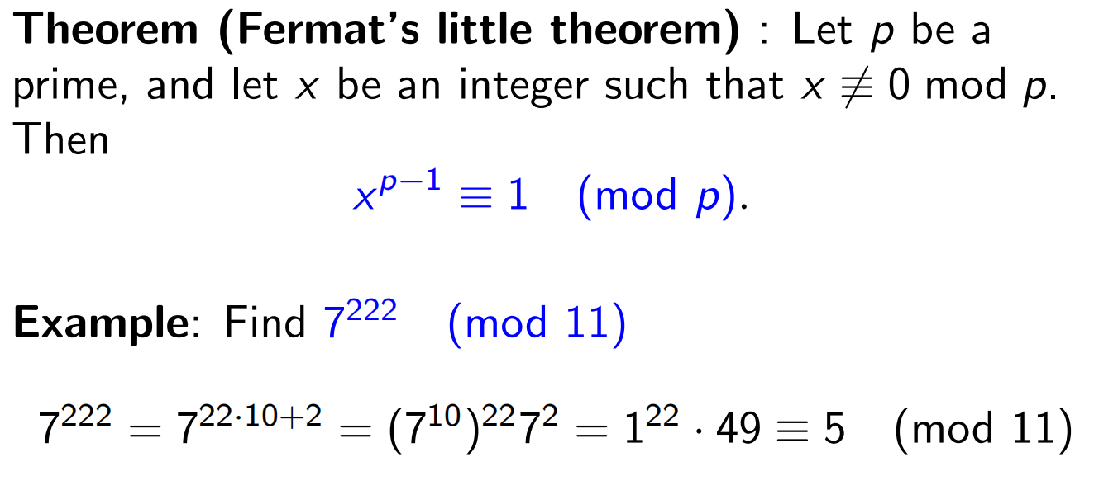
ab mod m = ((a mod m)(b mod m)) mod m

Slide 60
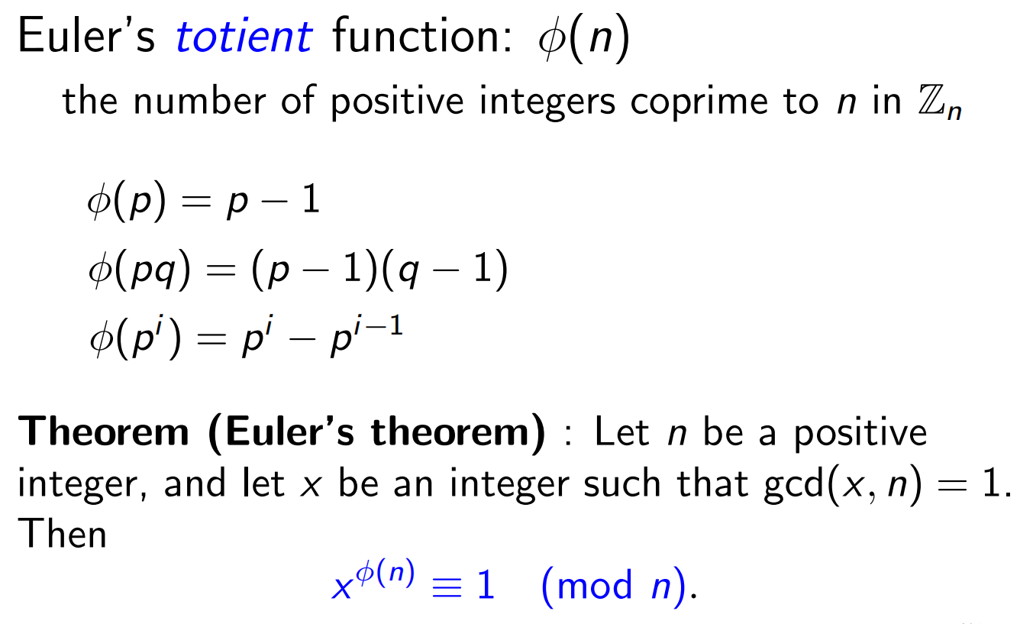
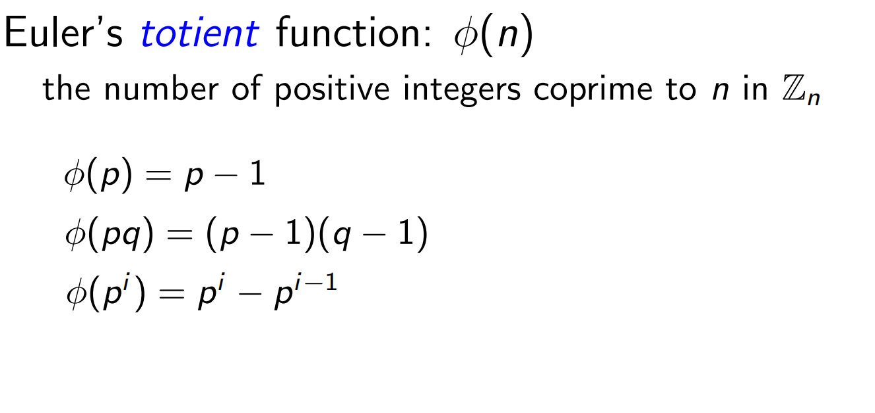
p and q are primes

Slide 61
4.5 Applications of congruence
Hashing function: h(k) where k is a key
One common function: h(k)=k mod m where m is the number of available memory location
For example, m=111,
h(064212848)=064212848 mod 111=14
h(037149212)=037149212 mod 111=65
Not one-to-one mapping, and thus needs to deal with collision
h(107405723)=107405723 mod 111 = 14
Assign to the next available memory location

Slide 62
Pseudorandom numbers
Generate random numbers
The most commonly used procedure is the linear congruential method
Modulus m, multiple a, increment c, and seed x₀, with 2≤a<m, 0 ≤c<m, and 0≤x₀<m
Generate a sequence of pseudorandom numbers {x_{n}} with 0 ≤ x_{n} < m for all n, by
x_{n+1}=(ax_{n}+c) mod m

Slide 63
Example
Let m=9, a=7, c=4, x₀=3
x₁=7x₀+4 mod 9=(21+4) mod 9=25 mod 9 = 7
x₂=7x₁+4 mod 9=(49+4) mod 9=53 mod 9 = 8
x₃=7x₂+4 mod 9=(56+4) mod 9=60 mod 9 = 6
x₄=7x₃+4 mod 9=(42+4) mod 9=46 mod 9 = 1
x₅=7x₄+4 mod 9=(7+4) mod 9=11 mod 9 = 2
x₆=7x₅+4 mod 9=(14+4) mod 9=18 mod 9 = 0
x₇=7x₆+4 mod 9=(0+4) mod 9=4 mod 9 = 4
x₈=7x₇+4 mod 9=(28+4) mod 9=32 mod 9 =5
x₉=7x₈+4 mod 9=(35+4) mod 9=11 mod 9 = 3
A sequence of 3, 7, 8, 6, 1, 2, 0, 4, 5, 3, 7, 8, 6, 1, 2, 0, 4, 5, 3, …
Contains 9 different numbers before repeating
x_{n+1}=(ax_{n}+c) mod m

Slide 64
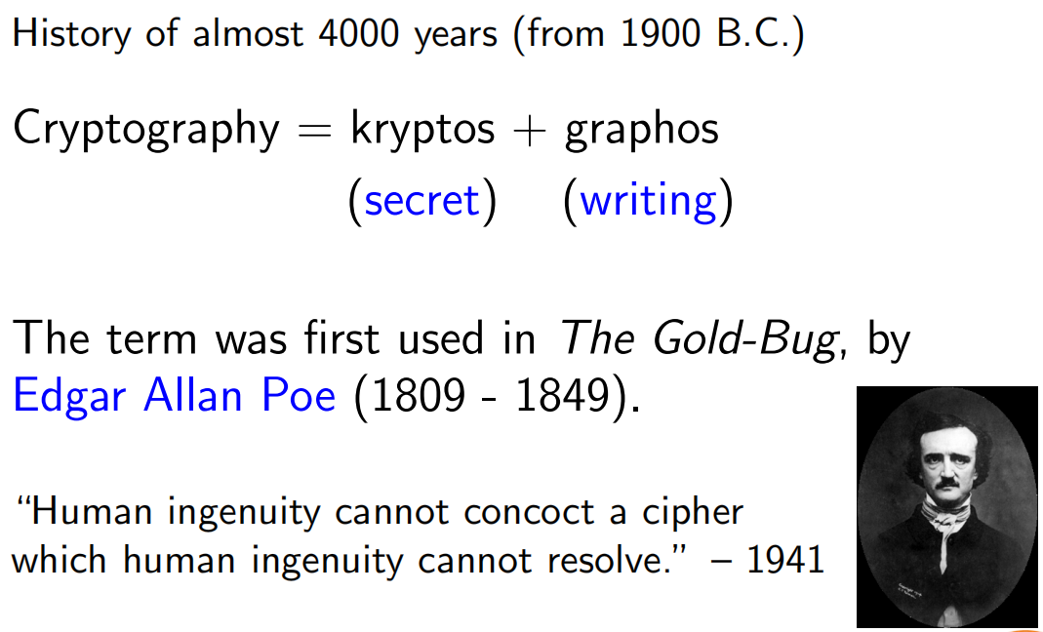
4.6 cryptography

Slide 65
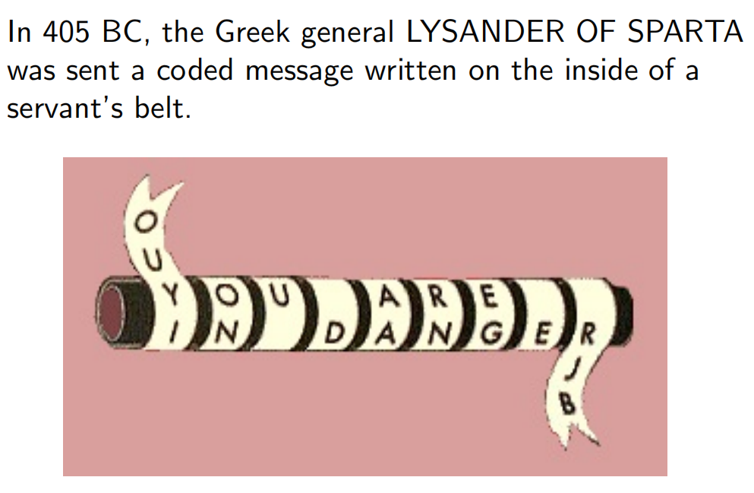
example

Slide 66
4.6 Cryptology
One of the earliest known use is by Julius Caesar, shift each letter by 3
f(p)=(p+3) mod 26
Translate “meet you in the park”
12 4 4 19 24 14 20 8 13 19 7 4 15 0 17 10
15 7 7 22 1 17 23 11 16 22 10 7 18 3 20 13
“phhw brx lq wkh sdun”
To decrypt, f⁻¹(p)=(p-3) mod 26

Slide 67
Example
Other options: shift each letter by k
f(p)=(p+k) mod 26, with f⁻¹(p)=(p-k) mod 26
f(p)=(ap+k) mod 26

Slide 68
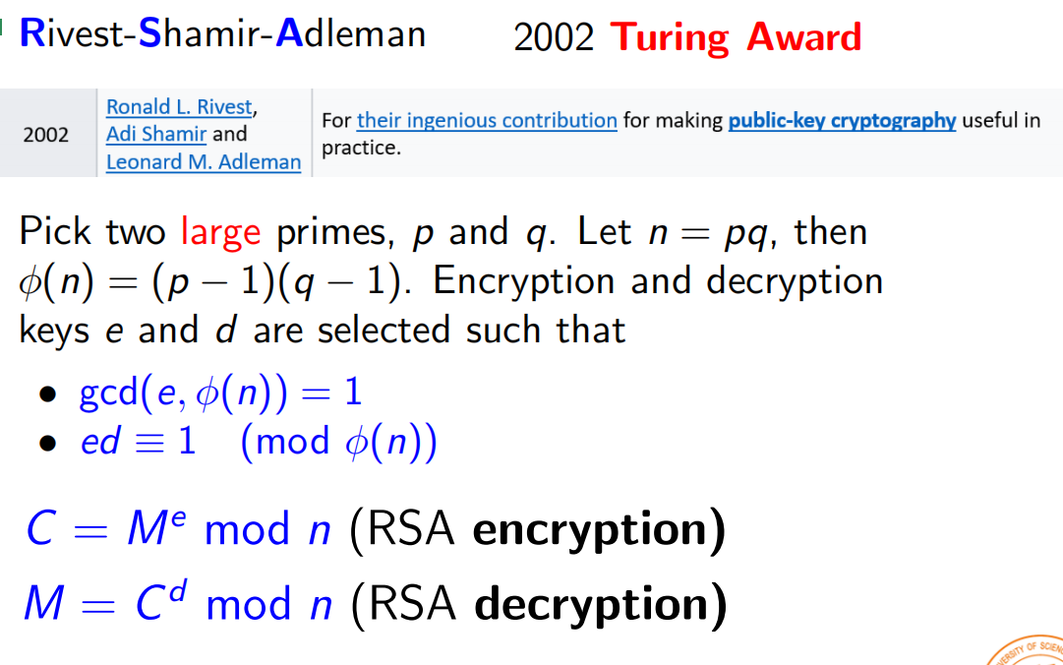
RSA

Slide 69
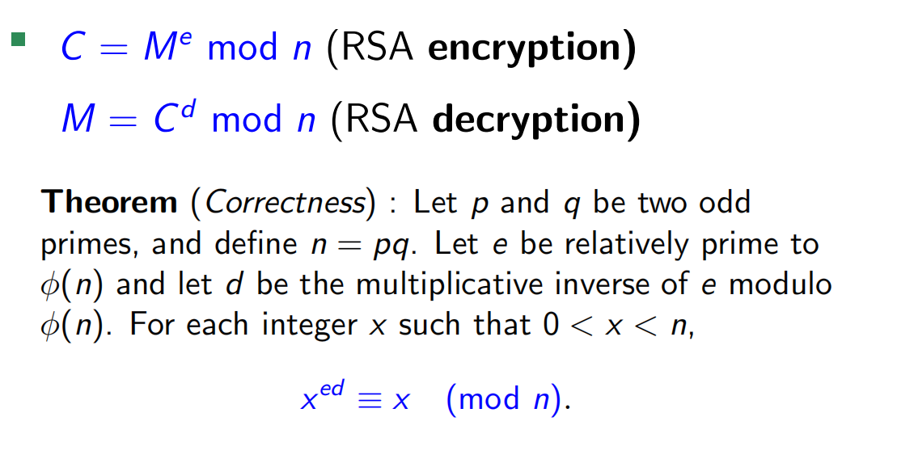

Slide 70
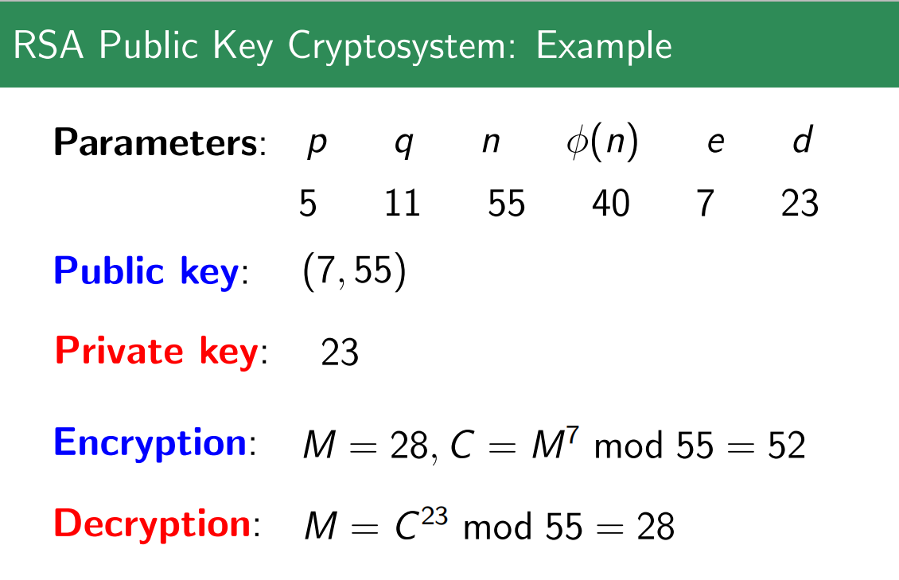

Slide 71
Parameters: p q n φ(n) e d
Public key: (e, n)
Private key: d
p, q, φ(n) must be kept secret!

Slide 72
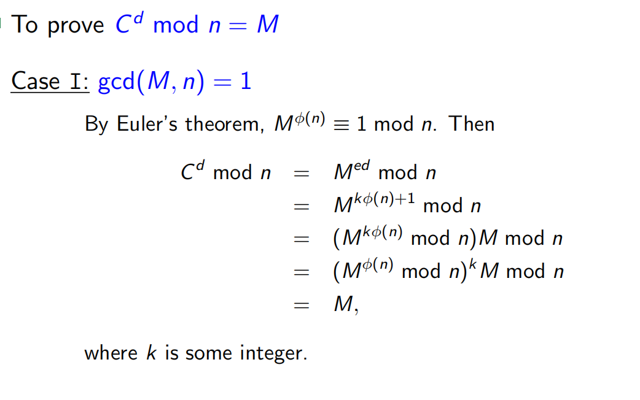
proof of RSA

Slide 73
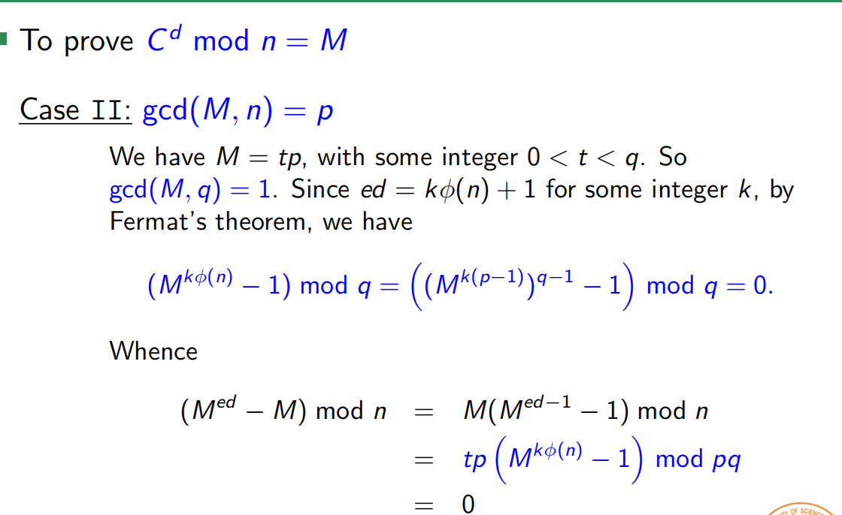

Slide 74
To prove C^{d} mod n = M
Case III: gcd(M, n) = q
Similar to Case II.
Case IV: gcd(M, n) = pq=n
Trivial since M = C = 0.

Slide 75
RSA cryptosystem
Each individual has an encryption key consisting of a modulus n=pq, where p and q are large primes, say with 200 digits each, and an exponent e that is relatively prime to (p-1)(q-1) (i.e., gcd(e, (p-1)(q-1))=1)
To transform M: Encryption: C=Me mod n, Decryption: C^{d}=M (mod pq)
The product of these primes n=pq, with approximately 400 digits, cannot be factored in a reasonable length of time (the most efficient factorization methods known as of 2005 require billions of years to factor 400-digit integers)

