Slide 1
Discrete Mathematics counting

Slide 2
6.1 Basics of counting
Combinatorics: they study of arrangements of objects
Enumeration: the counting of objects with certain properties (an important part of combinatorics)
Enumerate the different telephone numbers possible in US
The allowable password on a computer
The different orders in which runners in a race can reach

Slide 3
Example
Suppose a password on a system consists of 6, 7, or 8 characters
Each of these characters must be a digit or a letter of the alphabet
Each password must contain at least one digit
How many passwords are there?

Slide 4
Basic counting principles
Two basic counting principles
Product rule
Sum rule
Product rule: suppose that a procedure can be broken down into a sequence of two tasks
If there are n₁ ways to do the 1st task, and each of these there are n₂ ways to do the 2nd task, then there are n₁∙n₂ ways to do the procedure

Slide 5
Example
The chairs of a room to be labeled with a letter and a positive integer not exceeding 100. What is the largest number of chairs that can be labeled differently?
There are 26 letters to assign for the 1st part and 100 possible integers to assign for the 2nd part, so there are 26∙100=2600 different ways to label chairs

Slide 6
Product rule
Suppose that a procedure is carried out by performing the tasks T₁, T₂, …, T_{m} in sequence. If each task T_{i}, i=1, 2, …, n can be done in n_{i} ways, regardless of how the previous tasks were done, then there are n₁∙n₂∙ ..∙n_{m} ways to carry out the procedure

Slide 7
Example
How many different license plates are available if each plate contains a sequence of 3 letters followed by 3 digits (and non sequences of letters are prohibited, even if they are obscene)?
License plate _ _ _ _ _ _ : There are 26 choices for each letter and 10 choices for each digit. So, there are 26∙26∙26∙10∙10∙10 = 17,576,000 possible license plates

Slide 8
Counting functions
How many functions are there from a set with m elements to a set with n elements?
A function corresponds to one of the n elements in the codomain for each of the m elements in the domain
Hence, by product rule there are n∙n…∙n=n^{m} functions from a set with m elements to one with n elements

Slide 9
Counting one-to-one functions
How many one-to-one functions are there from a set with m elements to one with n elements?
First note that when m>n there are no one-to-one functions from a set with m elements to one with n elements
Let m≤n. Suppose the elements in the domain are a₁, a₂, …, a_{m}. There are n ways to choose the value for the value at a₁
As the function is one-to-one, the value of the function at a₂ can be picked in n-1 ways (the value used for a₁ cannot be used again)
Using the product rule, there are n(n-1)(n-2)…(n-m+1) one-to-one functions from a set with m elements to one with n elements

Slide 10
Example
From a set with 3 elements to one with 5 elements, there are 5∙4∙3=60 one-to-one functions

Slide 11
Example
The format of telephone numbers in north America is specified by a numbering plan
It consists of 10 digits, with 3-digit area code, 3-digit office code and 4-digit station code
Each digit can take one form of
X: 0, 1, …, 9
N: 2, 3, …, 9
Y: 0, 1

Slide 12
Example
In the old plan, the formats for area code, office code, and station code are NYX, NNX, and XXXX, respectively
So the phone numbers had NYX-NNX-XXXX
NYX: 8∙2∙10=160 area codes
NNX: 8∙8∙10=640 office codes
XXXX:10∙10∙10∙10=10,000 station codes
So, there are 160∙640∙10,000 = 1,024,000,000 phone numbers
X: 0, 1, …, 9
N: 2, 3, …, 9
Y: 0, 1

Slide 13
Example
In the new plan, the formats for area code, office code, and station code are NXX, NXX, and XXXX, respectively
So the phone numbers had NXX-NXX-XXXX
NXX: 8∙10∙10=800 area codes
NXX: 8∙10∙10=800 office codes
XXXX:10∙10∙10∙10=10,000 station codes
So, there are 800∙800∙10,000 = 6,400,000,000 phone numbers

Slide 14
Product rule
If A₁, A₂, …, A_{m} are finite sets, then the number of elements in the Cartesian product of these sets is the product of the number of elements in each set
|A₁ ⨯A₂ ⨯… ⨯A_{m}|=|A₁| ⨯|A₂| ⨯ … ⨯|A_{m}|

Slide 15
Sum rule
If a task can be done either in one of n₁ ways or in one of n₂ ways, where none of the set of n₁ ways is the same as any of the set of n₂ ways, then there are n₁+n₂ ways to do the task
Example: suppose either a member of faculty or a student in CSE is chosen as a representative to a university committee. How many different choices are there for this representative if there are 8 members in faculty and 200 students?
There are 8+200=208 ways to pick this representative

Slide 16
Sum rule
If A₁, A₂, …, A_{m} are disjoint finite sets, then the number of elements in the union of these sets is as follows
|A₁⋃A₂ ⋃… ⋃A_{m}|=|A₁|+|A₂|+…+|A_{m}|

Slide 17
More complex counting problems
In a version of the BASIC programming language, the name of a variable is a string of 1 or 2 alphanumeric characters, where uppercase and lowercase letters are not distinguished.
Moreover, a variable name must begin with a letter and must be different from the five strings of two characters that are reserved for programming use
How many different variables names are there?
Let V₁ be the number of these variables of 1 character, and likewise V₂ for variables of 2 characters
So, V₁=26, and V₂=26∙36-5=931
In total, there are 26+931=957 different variables

Slide 18
Example
Each user on a computer system has a password, which is 6 to 8 characters long, where each character is an uppercase letter or a digit. Each password must contain at least one digit. How many possible passwords are there?
Let P be the number of all possible passwords and P=P₆+P₇+P₈ where P_{i} is a password of i characters
P₆=36⁶-26⁶=1,867,866,560
P₇=36⁷-26⁷=70,332,353,920
P₈=36⁸-26⁸=208,827,064,576
P=P₆+P₇+P₈=2,684,483,063,360

Slide 19
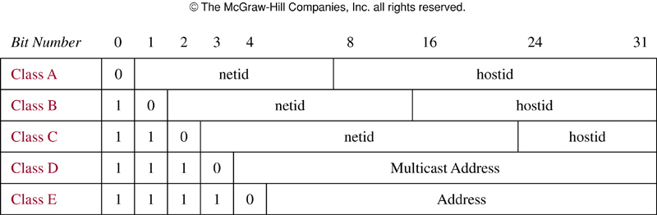
Example: Internet address
Internet protocol (IPv4)
Class A: largest network
Class B: medium-sized networks
Class C : smallest networks
Class D: multicast (not assigned for IP address)
Class E: future use
Some are reserved: netid 1111111, hostid all 1’s and 0’s
Neither class D or E addresses are assigned as the IPv4 addresses
How may different IPv4 addresses are available?

Slide 20
Example: Internet address
Let the total number of address be x, and x=x_{A}+x_{B}+x_{C}
Class A: there are 2⁷-1=127 netids (1111111 is reserved). For each netid, there are 2²⁴-2=16,777,214 hostids (as hostids of all 0s and 1s are reserved), so there are x_{A}=127∙16,777,214=2,130,706,178 addresses
Class B, C: 2¹⁴=16,384 Class B netids and 2²¹=2,097,152 Class C netids. 2¹⁶-2=65,534 Class B hostids, and 2⁸-2=254 Class C hostids. So, x_{B}=1,073,709,056, and x_{C}=532,676,608
So, x=x_{A}+x_{B}+x_{C}=3,737,091,842

Slide 21
Inclusion-exclusion principle
Suppose that a task can be done in n₁ or in n₂ ways, but some of the set of n₁ ways to do the task are the same as some of the n₂ ways to do the task
Cannot simply add n₁ and n₂, but need to subtract the number of ways to the task that is common in both sets
This technique is called principle of inclusion-exclusion or subtraction principle

Slide 22
Example
How many bit strings of length 8 either start with a 1 or end with two bits 00?
1 _ _ _ _ _ _ _: 2⁷=128 ways
_ _ _ _ _ _ 00: 2⁶=64 ways
1 _ _ _ _ _ 00: 2⁵=32 ways
Total number of possible bit strings is 128+64-32=160

Slide 23
Inclusion-exclusion principle
Using sets to explain
|A₁⋃A₂|=|A₁|+|A₂|-|A₁⋂A₂|

Slide 24
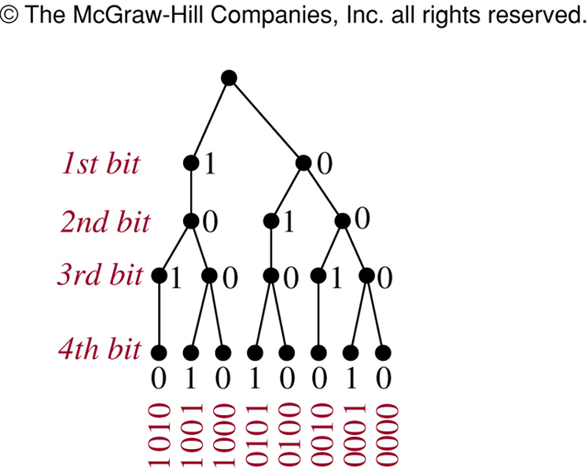
Tree diagrams
How many bit strings of length 4 do not have two consecutive 1s?
In some cases, we can use tree diagrams for counting
8 without two consecutive 1s

Slide 25
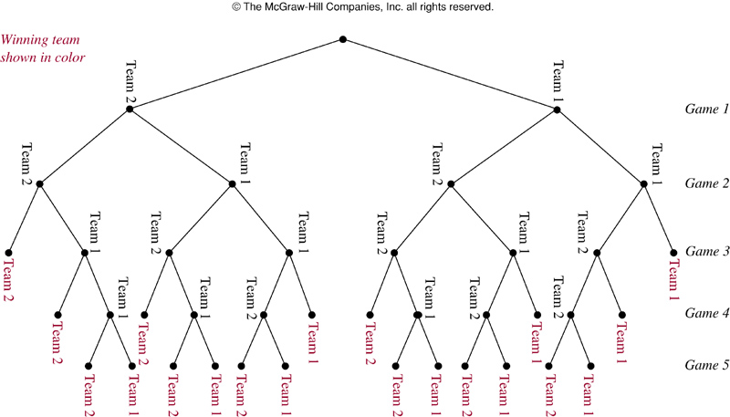
Example
A playoff between 2 teams consists of at most 5 games. The 1st team that wins 3 games wins the playoff. How many different ways are there?

Slide 26
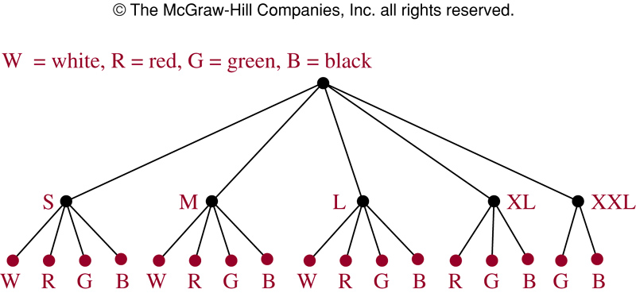
Example
Suppose a T-shirt comes in 5 different sizes: S, M, L, XL, and XXL. Further suppose that each size comes in 4 colors, white, green, red, and black except for XL which comes only in red, green and black, and XXL which comes only in green and black. How many possible size and color of the T-shirt?

Slide 27
6.2 Pigeonhole principle
Suppose that a flock of 20 pigeons flies into a set of 19 pigeonholes to roost
Thus, at least 1 of these 19 pigeonholes must have at least 2 pigeons
Why? If each pigeonhole had at most one pigeon in it, at most 19 pigeons, 1 per hole, could be accommodated
If there are more pigeons than pigeonholes, then there must be at least 1 pigeonhole with at least 2 pigeons in it

Slide 28
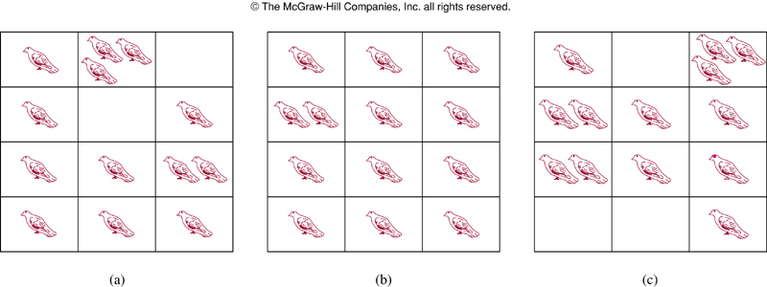
Example
13 pigeons and 12 pigeonholes

Slide 29
Pigeonhole principle
Theorem 1: If k is a positive integer and k+1 or more objects are placed into k boxes, then there is at least one box containing two or more of the objects
Proof: suppose that none of the k boxes contains more than one object. Then the total number of objects would be at most k. This is a contradiction as there are at least k+1 objects
Also known as Dirichlet drawer principle

Slide 30
Pigeonhole principle
Corollary 1: A function f from a set with k+1 or more elements to a set with k elements is not one-to-one
Proof: Suppose that for each element y in the codomain of f we have a box that contains all elements x of the domain f s.t. f(x)=y
As the domain contains k+1 or more elements and the codomain contain only k elements, the pigeonhole principle tells us that one of these boxes contains 2 or more elements x of the domain
This means that f cannot be one-to-one

Slide 31
Example
Among any group of 367 people, there must be at least 2 with the same birthday
How many students must be in a class to guarantee that at least 2 students receive the same score on the final exam, if the exam is graded on a scale from 0 to 100 points

Slide 32
Generalized pigeonhole principle
Theorem 2: If N objects are placed into k boxes, then there is at least one box containing at least⎾N/k⏋objects
Proof: Proof by contradiction. Suppose that none of the boxes contains more than ⎾N/k⏋-1 objects. Then the total number of objects is at most k(⎾N/k⏋-1)<k((N/k+1)-1)=N
where the inequality ⎾N/k⏋<N/k+1 is used
This is a contradiction as there are a total of N objects

Slide 33
Generalized pigeonhole principle
A common type of problem asks for the minimum number of objects s.t. at least r of these objects must be in one of k boxes when these objects are distributed among boxes
When we have N objects, the generalized pigeonhole principle tells us there must be at least r objects in one of the boxes as long as ⎾N/k⏋≥ r. Recall N/k+1>⎾N/k⏋. The smallest integer N with N/k>r-1, i.e., N=k(r-1)+1 is the smallest integer satisfying the inequality ⎾N/k⏋≥ r

Slide 34
Example
Among 100 people there are at least ⎾100/12⏋= 9 who were born in the same month
What is the minimum number of students required in a discrete mathematics class to be sure that at least 6 will receive the same grade, if there are 5 possible grades，A, B, C, D, and F ,?
The minimum number of students needed to ensure at least 6 students receive the same grade is the smallest integer N s.t. ⎾N/5⏋=6. Thus, the smallest N=5∙5+1=26

Slide 35
Example
How many cards must be selected from a standard deck of 52 cards to guarantee that a least 3 cards of the same suit are chosen?
Suppose there are 4 boxes, one for each suit. If N cards are selected, using the generalized pigeonhole principle, there is at lest one box containing at least ⎾N/4⏋cards
Thus to have ⎾N/4⏋≥ 3 , the smallest N is 2∙4+1=9. So at least 9 cards need to be selected

Slide 36
Example
How many cards must be selected to guarantee that at least 3 hearts are selected?
We do not use the generalized pigeonhole principle to answer this as we want to make sure that there are 3 hearts, not just 3 cards of one suit
Note in the worst case, we can select all the clubs, diamonds, and spades, 39 cards in all before selecting a single heart
The next 3 cards will be all hearts, so we may need to select 42 cars to guarantee 3 hearts are selected

Slide 37
Applications of Pigeonhole principle
During a month with 30 days, a baseball team plays at least one game a day, but no more than 45 games. Show that there must be a period of some number of consecutive days during which the team must play exactly 14 games
Let a_{j} be the number of games played on or before jth day of the month. Then a₁, a₂, …, a₃₀ is an increasing sequence of distinctive positive integers with 1≤a_{j} ≤45. Moreover a₁+14, a₂+14, …, a₃₀+14 is also an increasing sequence of distinct positive integers with 15 ≤a_{j}+14 ≤59
The 60 positive integers, a₁, a₂, …, a₃₀, a₁+14, a₂+14, 8…, a₃₀+14 are all less than or equal to 59. Hence, by the pigeonhole principle, two of these integers must be equal, i.e., there must be some I and j with a_{i}=a_{j}+14. This means exactly 14 games were played from day j+1 to day i

Slide 38
Ramsey theory
Example: Assume that in a group of 6 people, each pair of individuals consists of two friends or 2 enemies. Show that there are either 3 mutual friends or 3 mutual enemies in the group
Let A be one of the 6 people. Of the 5 other people in the group, there are either 3 or more who are friends of A, or 3 or more are enemies of A
This follows from the generalized pigeonholes principles, as 5 objects are divided into two sets, one of the sets has at least ⎾5/2⏋=3 elements

Slide 39
In the former case, suppose that B, C, and D are friends of A. If any two of these three individuals are friends, then these two and A form a group of three mutual friends. Otherwise, B, C, and D form a set of three mutual enemies.
The proof in the latter case, when there are three or more enemies of A, proceeds in a similar manner

Slide 40
Ramsey number
Ramsey number R(m, n) where m and n are positive integers greater than or equal to 2, denotes the minimum number of people at a party s.t. there are either m mutual friends or n mutual enemies, assuming that every pair of people at the party are friends or enemies
In the previous example, R(3,3)≤6
We conclude that R(3,3)=6 as in a group of 5 people where every two people are friends or enemies, there may not be 3 mutual friends or 3 mutual enemies

Slide 41
ramsey numbers
Note that by symmetry it can be shown that R(m, n) = R(n, m).
R(2, n) = n for every positive integer n ≥ 2
The exact values of only nine Ramsey numbers R(m, n) with 3 ≤ m ≤ n are known, including R(4, 4) = 18.
Only bounds are known for many other Ramsey numbers, including R(5, 5), which is known to satisfy 43 ≤ R(5, 5) ≤ 49.

Slide 42
6.3 Permutations & Combinations
Counting:
Find out the number of ways to select a particular number of elements from a set
Sometimes the order of these elements matter
Example:
How many ways we can select 3 students from a group of 5 students?
How many different ways they stand in line for picture?

Slide 43
Permutation
How many ways can we select 3 students from a group of 5 to stand in lines for a picture?
First note that the order in which we select students matters
There are 5 ways to select the 1st student
Once the 1st student is selected, there are 4 ways to select the 2nd student in line. By product rule, there are 5x4x3=60 ways to select 3 student from a group of 5 students to stand line for picture

Slide 44
Permutation
How many ways can we arrange all 5 in a line for a picture?
By product rule, we have 5x4x3x2x1=120 ways to arrange all 5 students in a line for a picture

Slide 45
Permutation
A permutation of a set of distinct objects is an ordered arrangement of these objects
An ordered arrangement of r elements of a set is called an r-permutation
The number of r-permutation of a set with n element is denoted by P(n,r). We can find P(n,r) using the product rule
Example: Let S={1, 2, 3}. The ordered arrangement 3, 1, 2 is a permutation of S. The ordered arrangement 3, 2, is a 2-permutation of S

Slide 46
Permutation
Let S={a, b, c}. The 2-permutation of S are the ordered arrangements, a, b; a, c; b, a; b, c; c, a; and c, b
Consequently, there are 6 2-permutation of this set with 3 elements
Note that there are 3 ways to choose the 1st element and then 2 ways to choose the 2nd element
By product rule, there are P(3,2)=3 x 2 = 6

Slide 47
r-permutation
Theorem 1: If n is a positive and r is an integer with 1≤r≤n, then there are
P(n,r)=n(n-1)(n-2)…(n-r+1)
r-permutations of a set with n elements
Proof: Use the product rule, the first element can be chosen in n ways. There are n-1 ways to chose the 2nd element. Likewise, there are n-2 ways to choose 3rd element, and so on until there are exactly n-(r-1)=n-r+1 ways to choose the r-th element. Thus, there are n∙(n-1)∙(n-2)… ∙(n-r+1) r-permutations of the set

Slide 48
r-permutation
Note that p(n,0)=1 whenever n is a nonnegative integer as there is exactly one way to order zero element
Corollary 1: If n and r are integers with 0≤r≤n, then P(n,r)=n!/(n-r)!
Proof: When n and r are integers with 1≤r≤n, by Theorem 1 we have
P(n,r)=n(n-1)…(n-r+1)=n!/(n-r)!
As n!/(n-0)!=1 when n is a nonnegative integer, we have P(n,r)=n!/(n-r)! also holds when r=0

Slide 49
r-permutation
By Theorem 1, we know that if n is a positive integer, then P(n,n)=n!
Example: How many ways are there to select a 1st prize winner, a 2nd prize winner, and a 3rd prize winner from 100 different contestants?
P(100,3)=100x99x98=970,200

Slide 50
Example
How many permutations of the letters ABCDEFGH contain string ABC?
As ABC must occur as a block, we can find the answer by finding the permutations of 6 letters, the block ABC and the individual letters, D,E,F,G, and H. As these 6 objects must occur in any order, there are 6!=720 permutations of the letters ABCDEFGH in which ABC occurs in a block

Slide 51
Combinations
How many different committees of 3 students can be formed from a group of 4 students?
We need to find the number of subsets with 3 elements from the set containing 4 students
We see that there are 4 such subsets, one for each of the 4 students as choosing 4 students is the same as choosing one of the 4 students to leave out of the group
This means there are 4 ways to choose 3 students for the committee, where th order in which these students are chosen does not matter

Slide 52
r-combination
An r-combination of elements of a set is an unordered selection of r elements from the set
An r-combination is simply a subset of the set with r elements
Denote by C(n,r). Note that C(n,r) is also denoted by and is called a binomial coefficient

Slide 53
Example
Let S be the set {1, 2, 3, 4}. Then {1, 3, 4} is a 3-combination from S
We see that C(4,2)=6, as the 2-combination of {a, b, c, d} are 6 subsets {a, b}, {a, c}, {a, d}, {b, c}, {b, d}, and {c, d}

Slide 54
r-combination
We can determine the number of r-combinations of a set with n elements using the formula for the number of r-permutations of a set
Note that the r-permutations of a set can be obtained by first forming r-combinations and then ordering the elements in these combinations

Slide 55
r-combination
The number of r-combinations of a set with n elements, where n is a nonnegative integer and r is an integer with 0≤r≤n equals
Proof: The r-permutations of the set can be obtained by forming the C(n,r) r-combinations and then ordering the elements in each r-permutation which can be done in P(r,r) ways

Slide 56
r-combination
When computing r-combination
thus canceling out all the terms in the larger factorial

Slide 57
Example
How many poker hands of 5 cards can be dealt from a standard deck of 52 cards? Also, how many ways are there to select 47 cards from a standard deck of 52 cards?
Choose 5 out of 52 cards: C(52,5)=52!/(5!47!)= (52x51x50x49x48)/(5x4x3x2x1)=26x17x10x49x12=2,598,960
C(52,47)=52!/(47!5!)=2,5,98,960

Slide 58
Corollary 2
Let n and r be nonnegative integers with r≤n. Then C(n,r)=C(n,n-r)
Proof:

Slide 59
Combinatorial proof
A combinatorial proof of an identity is a proof that uses counting arguments to prove that both sides of the identity count the same objects but in different ways
Proof of Corollary 2: Suppose that S is a set with n elements. Every subset A of S with r elements corresponds to a subset of S with n-r elements, i.e., . Thus, C(n,r)=C(n,n-r)

Slide 60
Example
How many ways are there to select 5 players from a 10-member tennis team?
Choose 5 out of 10 elements, i.e., C(10, 5)=10!/(5!5!)=252
How many bit strings of length n contain exactly r 1s?
This is equivalent to choose r elements from n elements, i.e., C(n,r)

Slide 61
6.4 Binomial coefficients
The number of r-combinations form a set with n elements is often denoted by
Also called as a binomial coefficient as these numbers occur as coefficients in the expansion of powers of binomial expressions such as (a+b)^{n}
A binomial expression is simply the sum of two terms, such as x+y

Slide 62
Example
The expansion of (x+y)³ can be found using combinational reasoning instead of multiplying the there terms out
When (x+y)³=(x+y)(x+y)(x+y) is expanded, all products of a term in the 1st sum, a term in the 2nd sum, and a term in the 3rd sum are added, e.g., x³, x²y, xy², and y³
To obtain a term of the form x³, an x must be chosen in each of the sums, and this can be done in only one way. Thus, the x³ term in the product has a coefficient of 1

Slide 63
Example
To obtain a term of the form x²y, an x must be chosen in 2 of the 3 sums (and consequently a y in the other sum). Hence, the number of such terms is the number of 2-combinations of 3 objects, namely,
Similarly, the number of terms of the form xy² is the number of ways to pick 1 of the 3 sums to obtain an x (and consequently take a y from each of the other two sums), which can be done in ways

Slide 64
Example
Consequently,
The binomial theorem: Let x and y be variables, and let n be a nonnegative integer

Slide 65
Binomial theorem
Proof: A combinatorial proof of the theorem is given. The terms in the product when it is expanded are of the form x^{n-j}y^{j} for j=0,1,2…, n
To count the number of terms of the form x^{n-j}y^{j} , note that to obtain such a term it is necessary to choose n-j x’s from the n sums (so that the other j terms in the product are y’s). Therefore, the coefficients of x^{n-j}y^{j} is which is equal to

Slide 66
Example
What is the coefficient of x¹²y¹³ in the expansion of (x+y)²⁵?

Slide 67
Example
What is the coefficient of x¹²y¹³ in the expansion of (2x-3y)²⁵?
Consequently, the coefficient of x¹²y¹³ is

Slide 68
Corollary
Corollary 1: Let n be a nonnegative integer. Then
Proof: Using Binomial theorem with x=1 and y=1

Slide 69
Corollary
There is also a combinatorial proof of Corollary 1
Proof: A set with n elements has a total of 2^{n} different subsets. Each subset has 0 elements, 1 element, 2 elements, or n elements in it. Thus, there are subsets with 0 elements, subsets with 1 element, … and subsets with n elements. Thus counts the total number of subsets of a set with n elements,
This shows that

Slide 70
Corollary 2

Slide 71
Corollary 3

Slide 72
Pascal identity and triangle
Pascal’s identity: Let n and k be positive integers with n ≥ k. Then
Combinatorial proof: Let T be a set containing n+1 elements. Let a be an element in T, and let S=T-{a} (S has n elements)
Note that there are subsets of T containing k elements. However, a subset of T with k elements either contains a (i.e., a subset of k-1 elements of S) or not.
There are subsets of k-1 elements of S, and so there are
subsets of k-1 elements containing a
There are subsets of k elements of T that do not contain a
Thus

Slide 73
Pascal identity and triangle
Can also prove the Pascal identity with algebraic manipulation of

Slide 74
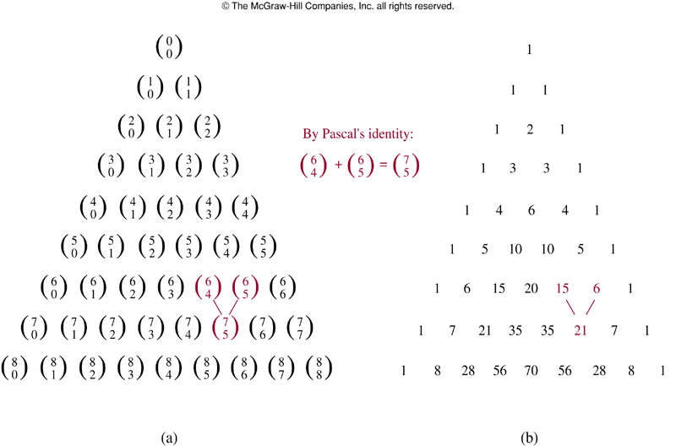
Pascal’s triangle
Pascal’s identity is the basis for a geometric arrangement of the binomial coefficients in a triangle

Slide 75
recursion and numbering question
hypercube

