Slide 1
Discrete Mathematics Relations

Slide 2
9.1 Relations and their properties
Relationships between elements of sets are represented using the structure called a relation
A subset of Cartesian product of the sets
Example: a student and his/her ID

Slide 3
Binary relation
The most direct way to express a relationship between elements of two sets is to use ordered pairs made up of two related elements
Binary relation: Let A and B be sets. A binary relation from A to B is a subset of A×B
A binary relation from A to B is a set R of ordered pairs where the 1st element comes from A and the 2nd element comes from B

Slide 4
Binary relation
aRb denotes that (a,b)∊R
When (a,b) belongs to R, a is said to be related to b by R
Likewise, n-ary relations express relationships among n elements
Let A₁, A₂, …, A_{n} be sets. An n-ary relation of these sets is a subset of A₁×A₂×…×A_{n}. The sets A₁, A₂, ..., A_{n} are called the domains of the relation, and n is called its degree

Slide 5
Example
Let A be the set of students and B be the set of courses
Let R be the relation that consists of those pairs (a, b) where a∊A and b∊B
If Jason is enrolled only in CSE20, and John is enrolled in CSE20 and CSE21
The pairs (Jason, CSE20), (John,CSE20), (John, CSE 21) belong to R
But (Jason, CSE21) does not belong to R

Slide 6
Example
Let A be the set of all cities, and let B be the set of the 50 states in US. Define a relation R by specifying (a,b) belongs to R if city a is in state b
For instance, (Boulder, Colorado), (Bangor, Maine), (Ann Arbor, Michigan), (Middletown, New Jersey), (Middletown, New York), (Cupertino, California), and (Red Bank, New Jersey) are in R

Slide 7
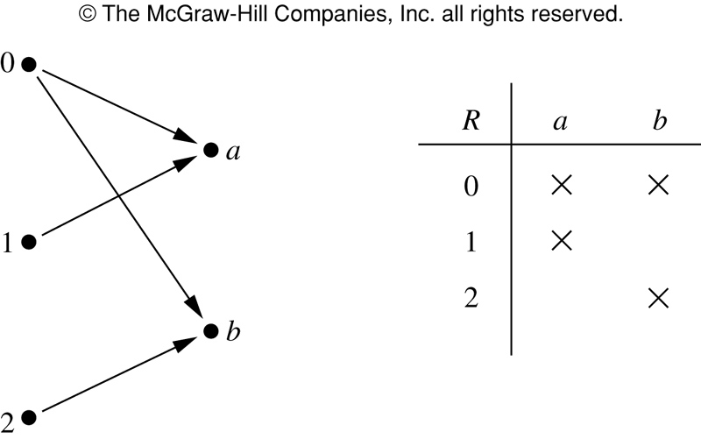
Example
Let A={0, 1, 2} and B={a, b}. Then {(0, a), (0, b), (1, a), (2, b)} is a relation from A to B
That is 0Ra but not 1Rb

Slide 8
Functions as relations
Recall that a function f from a set A to a set B assigns exactly one element of B to each element of A
The graph of f is the set of ordered pairs (a, b) such that b=f(a)
Because the graph of f is a subset of A x B, it is a relation from A to B
Furthermore, the graph of a function has the property that every element of A is the first element of exactly one ordered pair of the graph

Slide 9
Functions as relations
Conversely, if R is a relation from A to B such that every element in A is the first element of exactly one ordered pair of R, then a function can be defined with R as its graph
A relation can be used to express one-to-many relationship between the elements of the sets A and B where an element of A may be related to more than one element of B
A function represents a relation where exactly one element of B is related to each element of A
Relations are a generalization of functions

Slide 10
Relation on a set
A relation on the set A is a relation from A to A, i.e., a subset of A x A
Let A be the set {1, 2, 3, 4}. Which ordered pairs are in the relation R={(a,b)|a divides b}?
R={(1,1),(1,2),(1,3),(1,4),(2,2),(2,4),(3,3),(4,4)}
1
1
R | 1 | 2 | 3 | 4
1 | X | X | X | X
2 |  | X |  | X
3 |  |  | X
4 |  |  |  | X
2
2
3
3
4
4

Slide 11
Example
Consider these relations on set of integers
R₁={(a,b)|a≤b}
R₂={(a,b)|a>b}
R₃={(a,b)|a=b or a=-b}
R₄={(a,b)|a=b}
R₅={(a,b)|a=b+1}
R₆={(a,b)|a+b≤3}
Which of these relations contain each of the pairs (1,1), (1,2), (2,1), (1, -1) and (2, 2)?
(1,1) is in R₁, R₃, R₄ and R₆; (1,2) is in R₁ and R₆; (2,1) is in R₂, R₅, and R₆; (1,-1) is in R₂, R₃, and R₆; (2,2) is in R₁, R₃, and R₄

Slide 12
Example
How many relations are there on a set with n elements?
A relation on a set A is a subset of A x A
As A x A has n² elements, there are subsets
Thus there are relations on a set with n elements
That is, there are relations on the set {a, b, c}

Slide 13
Properties of relations: Reflexive
In some relations an element is always related to itself
Let R be the relation on the set of all people consisting of pairs (x,y) where x and y have the same mother and the same father. Then x R x for every person x
A relation R on a set A is called reflexive if (a,a) ∊ R for every element a∊A
The relation R on the set A is reflexive if ∀a((a,a) ∊ R)

Slide 14
Example
Consider these relations on {1, 2, 3, 4}
R₁={(1,1),(1,2),(2,1),(2,2),(3,4),(4,1),(4,4)}
R₂={(1,1),(1,2),(2,1)}
R₃={(1,1),(1,2),(1,4),(2,1),(2,2),(3,3),(4,1),(4,4)}
R₄={(2,1),(3,1),(3,2),(4,1),(4,2),(4,3)}
R₅={(1,1),(1,2),(1,3),(1,4),(2,2),(2,3),(2,4),(3,3),(3,4),(4,4)}
R₆={(3,4)}
Which of these relations are reflexive?
R₃ and R₅ are reflexive as both contain all pairs of the (a,a)
Is the “divides” relation on the set of positive integers reflexive?

Slide 15
Symmetric
In some relations an element is related to a second element if and only if the 2nd element is also related to the 1st element
A relation R on a set A is called symmetric if (b,a) ∊ R whenever (a,b) ∊ R for all a, b ∊ A
The relation R on the set A is symmetric if ∀a ∀b ((a,b)∊R→(b,a) ∊R)
A relation is symmetric if and only if a is related to b implies that b is related to a

Slide 16
Antisymmetric
A relation R on a set A such that for all a, b ∊ A, if (a, b)∊R and (b, a)∊ R, then a=b is called antisymmetric
Similarly, the relation R is antisymmetric if ∀a∀b(((a,b)∊R∧(b,a)∊R)→(a=b))
A relation is antisymmetric if and only if there are no pairs of distinct elements a and b with a related to b and b related to a
That is, the only way to have a related to b and b related to a is for a and b to be the same element

Slide 17
Symmetric and antisymmetric
The terms symmetric and antisymmetric are not opposites as a relation can have both of these properties or may lack both of them
A relation cannot be both symmetric and antisymmetric if it contains some pair of the form (a, b) where a ≠ b

Slide 18
Example
Consider these relations on {1, 2, 3, 4}
R₁={(1,1),(1,2),(2,1),(2,2),(3,4),(4,1),(4,4)}
R₂={(1,1),(1,2),(2,1)}
R₃={(1,1),(1,2),(1,4),(2,1),(2,2),(3,3),(4,1),(4,4)}
R₄={(2,1),(3,1),(3,2),(4,1),(4,2),(4,3)}
R₅={(1,1),(1,2),(1,3),(1,4),(2,2),(2,3),(2,4),(3,3),(3,4),(4,4)}
R₆={(3,4)}
Which of these relations are symmetric or antisymmetric?
R₂ and R₃ are symmetric: each (a,b) → (b,a) in the relation
R₄, R₅, and R₆ are all antisymmetric: no pair of elements a and b with a ≠ b s.t. (a, b) and (b, a) are both in the relation

Slide 19
Example
Which are symmetric and antisymmetric
R₁={(a,b)|a≤b}
R₂={(a,b)|a>b}
R₃={(a,b)|a=b or a=-b}
R₄={(a,b)|a=b}
R₅={(a,b)|a=b+1}
R₆={(a,b)|a+b≤3}
Symmetric: R₃, R₄, R₆. R₃ is symmetric, if a=b (or a=-b), then b=a (b=-a), R₄ is symmetric as a=b implies b=a, R₆ is symmetric as a+b≤3 implies b+a≤3
Antisymmetric: R₁, R₂, R₄, R₅ . R₁ is antisymmetric as a≤b and b≤a imply a=b. R₂ is antisymmetric as it is impossible to have a>b and b>a, R₄ is antisymmteric as two elements are related w.r.t. R₄ if and only if they are equal. R₅ is antisymmetric as it is impossible to have a=b+1 and b=a+1

Slide 20
Transitive
A relation R on a set A is called transitive if whenever (a,b)∊R and (b,c)∊R then (a,c)∊R for all a, b, c ∊ A
Using quantifiers, we see that a relation R is transitive if we have
∀a∀b∀c (((a,b)∊R ∧ (b,c)∊R)→ (a,c)∊R)

Slide 21
Example
Which one is transitive?
R₁={(1,1),(1,2),(2,1),(2,2),(3,4),(4,1),(4,4)}
R₂={(1,1),(1,2),(2,1)}
R₃={(1,1),(1,2),(1,4),(2,1),(2,2),(3,3),(4,1),(4,4)}
R₄={(2,1),(3,1),(3,2),(4,1),(4,2),(4,3)}
R₅={(1,1),(1,2),(1,3),(1,4),(2,2),(2,3),(2,4),(3,3),(3,4),(4,4)}
R₆={(3,4)}
R₄ R₅ R₆ are transitive
R₁ is not transitive as (3,1) is not in R₁
R₂ is not transitive as (2,2) is not in R₂
R₃ is not transitive as (4,2) is not in R₃

Slide 22
Example
Which are symmetric and antisymmetric
R₁={(a,b)|a≤b}
R₂={(a,b)|a>b}
R₃={(a,b)|a=b or a=-b}
R₄={(a,b)|a=b}
R₅={(a,b)|a=b+1}
R₆={(a,b)|a+b≤3}
R₁ is transitive as a≤b and b≤c implies a≤c. R₂ is transitive
R₃ , R₄ are transitive
R₅ is not transitive (e.g., (2,1), (1,0)). R₆ is not transitive (e.g. (2,1),(1,2))

Slide 23
Combining relations
Relations from A to B are subsets of A×B, two relations can be combined in any way that two sets can be combined
Let A={1,2,3} and B={1,2,3,4}. The relations R₁={(1,1),(2,2),(3,3)} and R₂={(1,1),(1,2),(1,3),(1,4)} can be combined
R₁⋃R₂={(1,1),(1,2),(1,3),(1,4),(2,2),(2,3),(3,3)}
R₁∩R₂={(1,1)}
R₁–R₂={(2,2),(3,3)}
R₂-R₁={(1,2),(1,3),(1,4)}

Slide 24
Example
Let R₁={(x,y)|x<y} and R₂={(x,y)|x>y}. What are R₁⋃R₂,R₁⋂R₂,R₁-R₂, R₂-R₁, and R₁⊕R₂?
Symmetric difference of A and B: denoted by A⊕B, is the set containing those elements in either A or B, but not in both A and B
We note that (x,y)∊ R₁⋃R₂, if and only if (x,y)∊ R₁ or (x,y)∊ R₂,it follows that R₁⋃R₂={(x,y)|x≠y}
Likewise, R₁⋂R₂= ∅,R₁-R₂=R₁, R₂-R₁=R₂,
R₁⊕R₂= R₁⋃R₂-R₁⋂R₂={(x,y)|x≠y}

Slide 25
Composite of relations
Let R be a relation from a set A to a set B, and S a relation from B to a set C.
The composite of R and S is the relation consisting of ordered pairs (a,c) where a∊A, c∊C and for which there exists an element b∊B s.t. (a,b)∊R and (b,c)∊S. We denote the composite of R and S by S∘R
Need to find the 2nd element of ordered pair in R the same as the 1st element of ordered pair in S

Slide 26
Example
What is the composite of the relations R and S, where R is the relation from {1,2,3} to {1,2,3,4} with R={(1,1),(1,4),(2,3),(3,1),(3,4)} and S is the relation from {1,2,3,4} to {0,1,2} with S={(1,0),(2,0),(3,1),(3,2),(4,1)}?
Need to find the 2nd element in the ordered pair in R is the same as the 1st element of order pair in S
S∘R={(1,0),(1,1),(2,1),(2,2),(3,0),(3,1)}

Slide 27
Power of relation
Let R be a relation on the set A. The powers R^{n},n=1,2,3,…, are defined recursively by R¹=R, R^{n+1}=R^{n}∘R
Example: Let R={(1,1),(2,1),(3,2),(4,3)}. Find the powers R^{n}, n=2,3,4,…
R²=R∘R, we find R²={(1,1),(2,1),(3,1),(4,2)}, R³=R²∘R, R³={(1,1),(2,1),(3,1),(4,1)}, R⁴={(1,1),(2,1),(3,1),(4,1)}.
It also follows R^{n}=R³ for n=5,6,7,…

Slide 28
Transitive
Theorem: The relation R on a set A is transitive if and only if R^{n}⊆R
Proof: We first prove the “if” part. Suppose R^{n}⊆R for n=1,2,3,… In particular R²⊆R. To see this implies R is transitive, note that if (a,b)∊R, and (b,c)∊R, then by definition of composition (a,c)∊ R². Because R²⊆R, this means that (a,c)∊ R. Hence R is transitive

Slide 29
Transitive
We will use mathematical induction to prove the “only if” part
Note n=1, the theorem is trivially true
Assume that R^{n}⊆R, where n is a positive integer. This is the induction hypothesis. To complete the inductive step, we must show that this implies that R^{n+1} is also a subset of R
To show this, assume that (a,b)∊R^{n+1}. Because R^{n+1}=R^{n}∘R, there is an element x with x A s.t. (a,x)∊R, and (x,b)∊R^{n}. The inductive hypothesis, i.e., R^{n}⊆R, implies that (x,b)∊R. As R is transitive, and (a,x)∊R, and (x,b)∊R, it follows that (a,b)∊R. This shows that R^{n+1}⊆R, completing the proof

Slide 30
exercise：
Suppose that R and S are reflexive relations on a set A.Prove or disprove each of these statements.
a) R ∪ S is reflexive.
b) R ∩ S is reflexive.
c) R ⊕ S is irreflexive.
d) R − S is irreflexive.
e) S ◦R is reflexive.
Notes:
50

Slide 31

9.2 n-ary Relations and Their Applications
example 1 Let R be the relation on N × N × N consisting of triples (a, b, c), where a, b, and c are integers with a<b<c. Then (1, 2, 3) ∈ R, but(2, 4, 3) is not in R. The degree of this relation is 3. Its domains are all equal to the set of natural numbers.

Slide 32
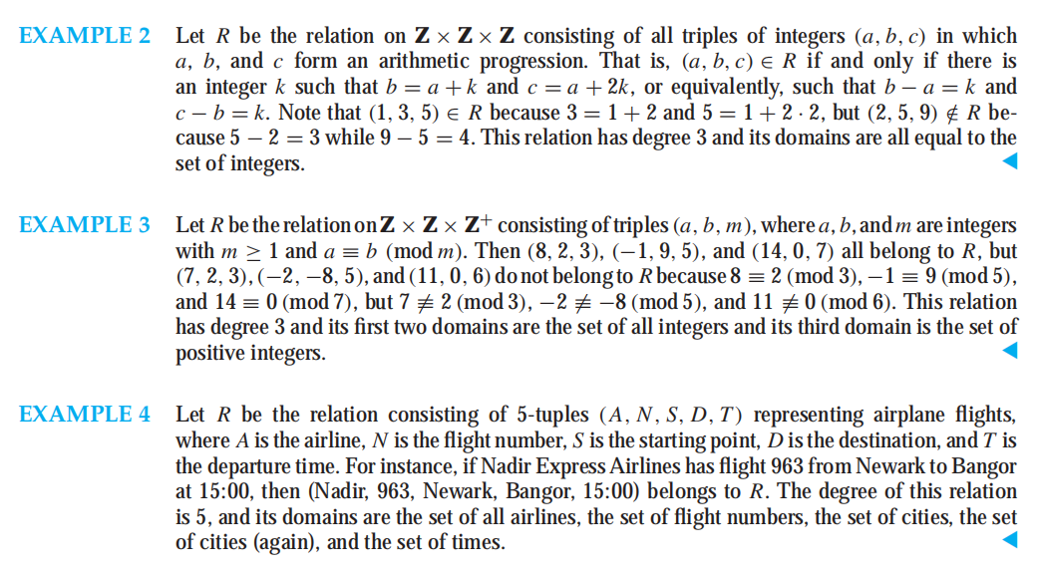

Slide 33
Databases and Relations
relational data model, based on the concept of a relation.
A database consists of records, which are n-tuples, made up of fields. The fields are the entries of the n-tuples.

Slide 34
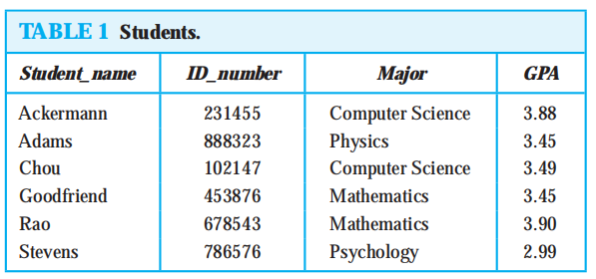
For instance, a database of student records may be made up of fields containing the name, student number, major, and grade point average of the student. The relational data model represents a database of records as an n-ary relation.

Slide 35
primary key
A domain of an n-ary relation is called a primary key when the value of the n-tuple from this domain determines the n-tuple. That is, a domain is a primary key when no two n-tuples in the relation have the same value from this domain.
Which domains are primary keys for the n-ary relation displayed in Table above, assuming that no n-tuples will be added in the future?

Slide 36
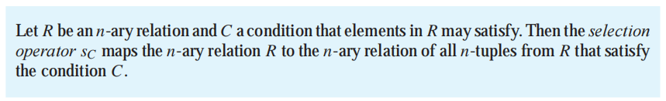

Operations on n-ary Relations
selection （抽取行）
projection （抽取列）

Slide 37
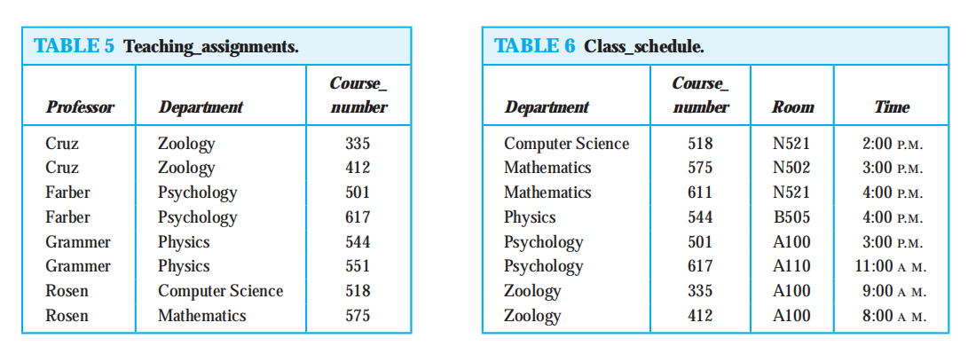
joining tables

Slide 38
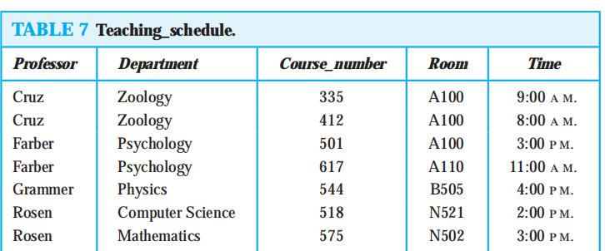

Slide 39
9.3 Representing relations
Can use ordered set, graph to represent sets
Generally, matrices are better choice
Suppose that R is a relation from A={a₁, a₂, …, a_{m}} to B={b₁, b₂, …, b_{n}}. The relation R can be represented by the matrix M_{R}=[m_{ij}] where
m_{ij}=1 if (a_{i},b_{j}) ∊R,
m_{ij}=0 if (a_{i},b_{j}) ∉R,
A zero-one (binary) matrix

Slide 40
Example
Suppose that A={1,2,3} and B={1,2}. Let R be the relation from A to B containing (a,b) if a∈A, b∈B, and a > b. What is the matrix representing R if a₁=1, a₂=2, and a₃=3, and b₁=1, and b₂=2
As R={(2,1), (3,1), (3,2)}, the matrix R is

Slide 41
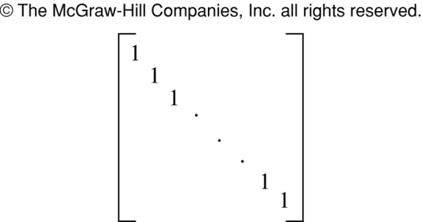
Matrix and relation properties
The matrix of a relation on a set, which is a square matrix, can be used to determine whether the relation has certain properties
Recall that a relation R on A is reflexive if (a,a)∈R. Thus R is reflexive if and only if (a_{i},a_{i})∈R for i=1,2,…,n
Hence R is reflexive iff m_{ii}=1, for i=1,2,…, n.
R is reflexive if all the elements on the main diagonal of M_{R} are 1

Slide 42
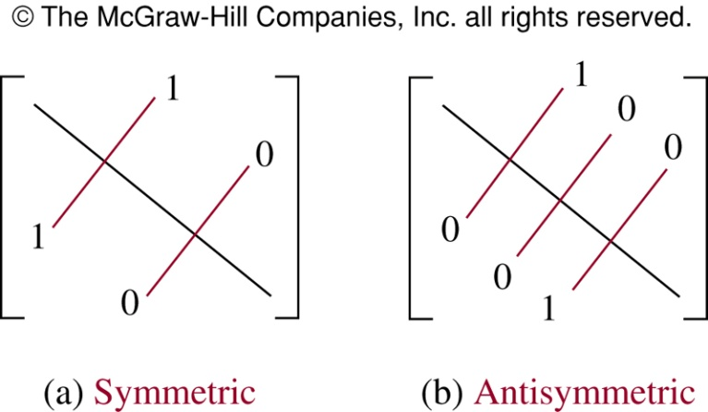
Symmetric
The relation R is symmetric if (a,b)∈R implies that (b,a)∈R
In terms of matrix, R is symmetric if and only m_{ji}=1 whenever m_{ij}=1, i.e., M_{R}=(M_{R})^{T}
R is symmetric iff M_{R} is a symmetric matrix

Slide 43
Antisymmetric
The relation R is symmetric if (a,b)∈R and (b,a)∈R imply a=b
The matrix of an antisymmetric relation has the property that if m_{ij}=1 with i≠j, then m_{ji}=0
Either m_{ij}=0 or m_{ji}=0 when i≠j

Slide 44
Example
Suppose that the relation R on a set is represented by the matrix
Is R reflexive, symmetric or antisymmetric?
As all the diagonal elements are 1, R is reflexive. As M_{R} is symmetric, R is symmetric. It is also easy to see R is not antisymmetric

Slide 45
Union, intersection of relations
Suppose R1 and R2 are relations on a set A represented by M_{R1} and M_{R2}
The matrices representing the union and intersection of these relations are
M_{R1⋃R2} = M_{R1} ⋁ M_{R2}
M_{R1⋂R2} = M_{R1} ⋀ M_{R2}

Slide 46
Example
Suppose that the relations R₁ and R₂ on a set A are represented by the matrices
What are the matrices for R₁⋃R₂ and R₁⋂R₂?

Slide 47
Boolean product (Section 3.8)
Boolean product A B is defined as
⊙
Replace x with ⋀ and + with ⋁

Slide 48
Boolean power (Section 3.8)
Let A be a square zero-one matrix and let r be positive integer. The r-th Boolean power of A is the Boolean product of r factors of A, denoted by A^{[r]}
A^{[r]}=A ⊙A ⊙A… ⊙A
r times

Slide 49
Example
Find the matrix representation of S∘R

Slide 50
Powers R^{n}
For powers of a relation
The matrix for R2 is

Slide 51
Composite of relations
Suppose R is a relation from A to B and S is a relation from B to C. Suppose that A, B, and C have m, n, and p elements with M_{S}, M_{R}
Use Boolean product of matrices
Let the zero-one matrices for S∘R, R, and S be M_{S∘R}=[t_{ij}], M_{R}=[r_{ij}], and M_{S}=[s_{ij}] (these matrices have sizes m×p, m×n, n×p)
The ordered pair (a_{i}, c_{j})∈S∘R iff there is an element b_{k} s.t.. (a_{i}, b_{k})∈R and (b_{k}, c_{j})∈S
It follows that t_{ij}=1 iff r_{ik}=s_{kj}=1 for some k
M_{S∘R} = M_{R} ⊙ M_{S}

Slide 52
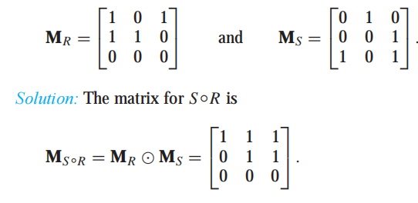
Find the matrix representing the relations S ◦R, where the matrices representing R and S are

Slide 53
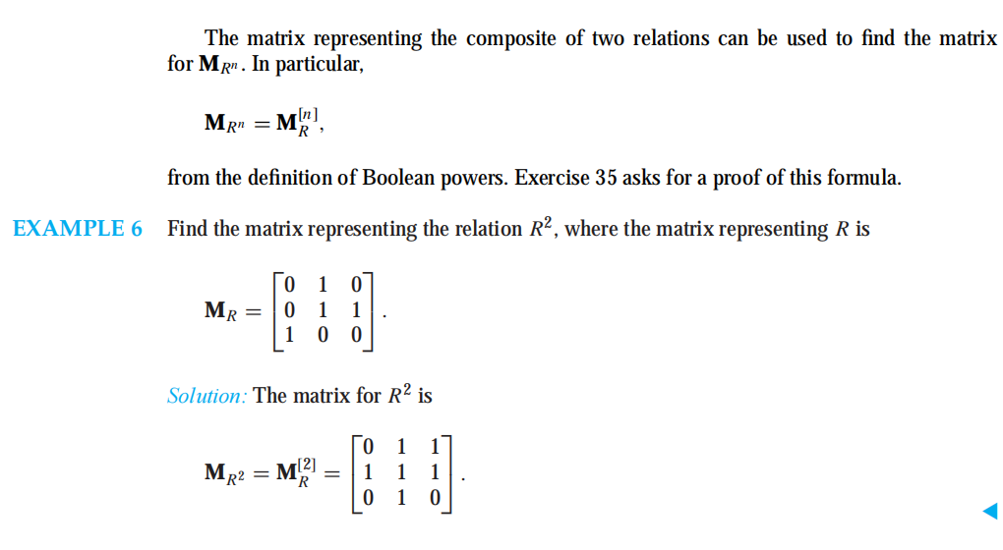

Slide 54
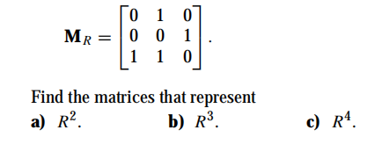
exercise

Slide 55
Representing relations using digraphs
A directed graph, or digraph, consists of a set V of vertices (or nodes) together with a set E of ordered pairs of elements of V called edges (or arcs)
The vertex a is called the initial vertex of the edge (a,b), and vertex b is called the terminal vertex of the edge
An edge of the form (a,a) is called a loop

Slide 56
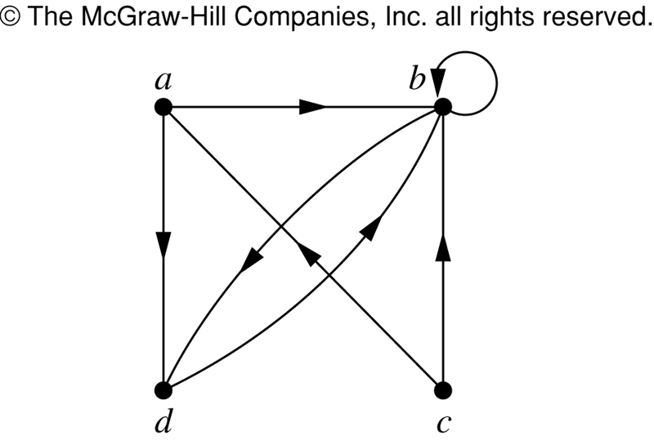
Example
The directed graph with vertices a, b, c, and d, and edges (a,b), (a,d), (b,b), (b,d), (c,a), (c,b), and (d,b) is shown

Slide 57
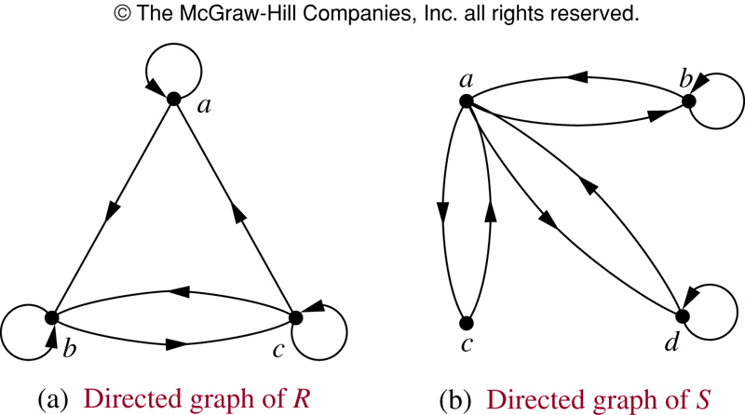
Example
R is reflexive. R is neither symmetric (e.g., (a,b)) nor antisymmetric (e.g., (b,c), (c,b)). R is not transitive (e.g., (a,b), (b,c))
S is not reflexive. S is symmetric but not antisymmetric (e.g., (a,c), (c,a)). S is not transitive (e.g., (c,a), (a,b))

Slide 58
9.4 Closures of Relations

Slide 59
Closures of Relations
Definition
The closure(闭包) of a relation R with respect to property P is the relation obtained by adding the minimum number of ordered pairs to R to obtain property P.
3 elements:
R₁ contains R
R₁ possesses the property P
If R₂ contains R and possesses the property P, then R₂ contains R₁

Slide 60
Closures of Relations
In terms of the digraph representation of R
To find the reflexive closure
add loops.
To find the symmetric closure
add arcs in the opposite direction.
To find the transitive closure
if there is a path from a to b, add an arc from a to b.

Slide 61
Reflexive Closure
Theorem:
Let R be a relation on A.
The reflexive closure of R, denoted r(R), is R∪Δ.
where Δ= {(a, a) | a ∈ A} is the diagonal relation on A.
Method:
Add loops to all vertices on the digraph representation of R.
Put 1’s on the diagonal of the connection matrix of R.

Slide 62
Symmetric closure
Theorem
Let R be a relation on A.
The symmetric closure of R, denoted s(R), is the relation R∪R⁻¹.
where R⁻¹ = {(b, a) | (a, b) ∈ R}.

Slide 63
Theorem
R is symmetric
If and only if
R = R⁻¹
Note: in digraph of a symmetric relation, use undirected edges instead of arcs

Slide 64
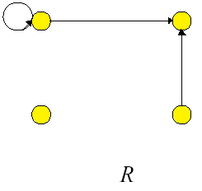
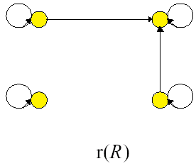
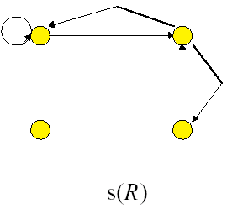
Example

Slide 65
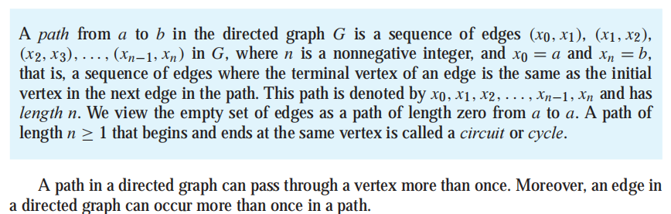
Paths in Directed Graphs

Slide 66
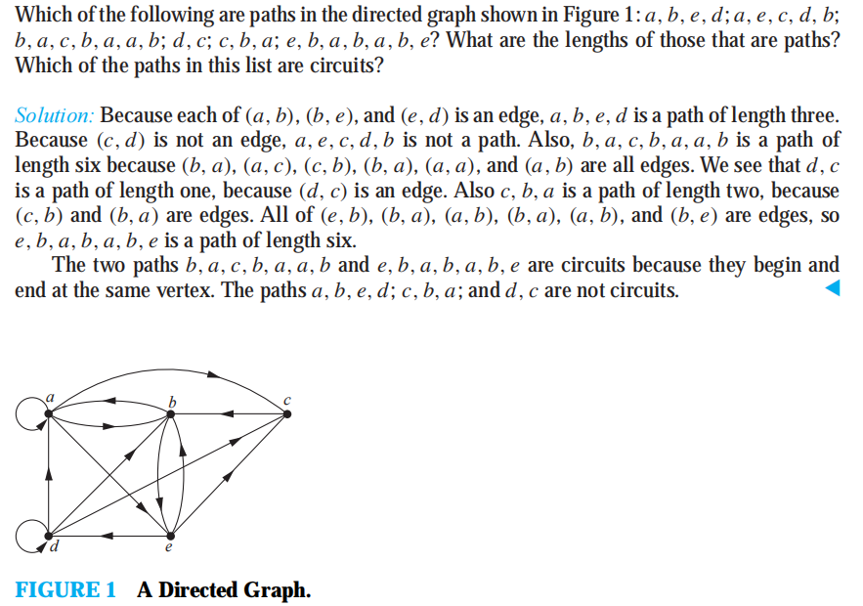

Slide 67
Path in Relation
Suppose that R is a relation on a set A. A path of length n in R from a to b is a finite sequence π : a, x₁ , x₂, ..., x_{n-1}, b, beginning with a and ending with b, such that
a R x₁, x₁ R x₂, ..., x_{n-1} R b
THEOREM 1： Let R be a relation on a set A. There is a path of length n, where n is a positive integer, from a to b if and only if (a, b) ∈ R^{n}.

Slide 68

Some definitions
A path that begins and ends at the same vertex is called a cycle.
R^{n} : x R^{n} y means that there is a path of length n from x to y in R.
R^{n} (x)
R* : x R* y ： The connectivity relation R∗ consists of the pairs (a, b) such that there is a path of length at least one from a to b in R.

Slide 69
Example
Let A = {1, 2, 3, 4, 5, 6}
R is shown as in figure
R² = ?
1
2
5
3
4
6

Slide 70
Example
Let A = {a, b, c, d, e}
R = {(a, a), (a, b), (b, c), (c, e), (c, d), (d, e)}.
Compute (a) R² ; (b) R*

Slide 71
Solution
R = {(a, a), (a, b), (b, c), (c, e), (c, d), (d, e)}.
a
b
a
b
a
b
d
c
d
c
d
c
e
e
e
R R² R∞

Slide 72
example
Let R be the relation on the set of all people in the world that contains (a, b) if a has met b. What is R^{n}, where n is a positive integer greater than one? What is R*?

Slide 73
THEOREM 2： The transitive closure of a relation R equals the connectivity relation R∗.
transistive， minimum
we must also show that R∗ is transitive and that R∗ ⊆ S whenever S is a transitive relation that contains R.

Slide 74
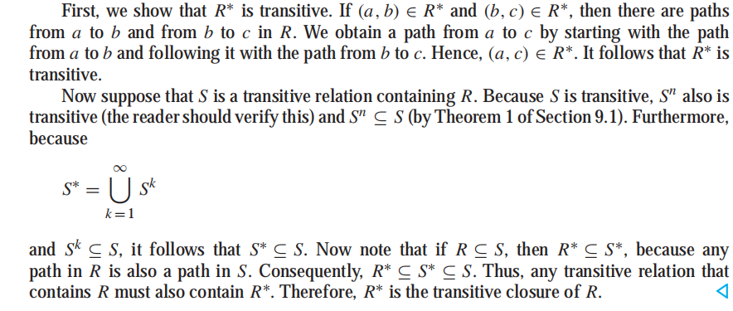

Slide 75
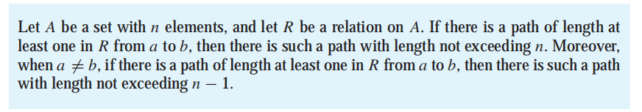

LEMMA 1
From Lemma 1

Slide 76
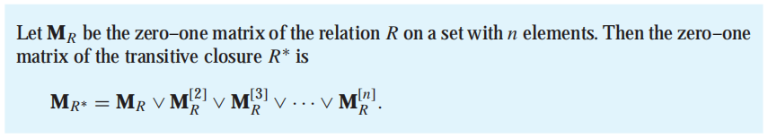
Theorem 3

Slide 77
Theorem
If R is a relation on A = {a₁, a₂, …, a_{n}}, then

Slide 78
Proof
Let M_{R} = [m_{ij}] and M_{R2} = [n_{ij}].
the i, jth element of M_{R}⊗ M_{R} is equal to l
m_{ik}= 1 and m_{kj} = l for some k, l ≤ k ≤ n.
By definition of the matrix M_{R}
a_{i} R a_{k} and a_{k} R a_{j}
a_{i} R² a_{j} , and so n_{ij} = 1.
Therefore
position i, j of M_{R} ⊗ M_{R} is equal to 1
n_{ij} = l.
So M_{R} ⊗ M_{R} = M_{R2}
QED

Slide 79
Example
Let A = {a, b, c, d, e}
R = {(a, a), (a, b), (b, c), (c, e), (c, d), (d, e)}.
Compute R²

Slide 80
Example cont.

Slide 81
Theorem
For n ≥ 2 and R a relation on a finite set A, we have

Slide 82
Proof by induction
Let P(n) be the assertion that the statement holds for an integer n ≥ 2.
Basis Step: P(2) is true by Theorem 1.

Slide 83
Induction Step
Consider the matrix M_{Rk+1}. Let M_{Rk+1} = [x_{ij}], M_{Rk} = [y_{ij}], and M_{R} = [m_{ij}]
If x_{ij} = 1, we must have a path of length k + 1 from a_{i} to a_{j}.
If we let a_{s}be the vertex that this path reaches just before the last vertex a_{j}, then there is a path of length k from a_{i} to a_{s} and a path of length l from a_{s} to a_{j}.
Thus y_{is} = 1 and m_{sj} = 1, so has a 1 in position i, j.
similarly, if has a 1 in position i, j, then x_{ij} = 1.
So

Slide 84
Induction Step
is true.
Thus by the principle of mathematical induction, P(n) is true for all n
QED

Slide 85
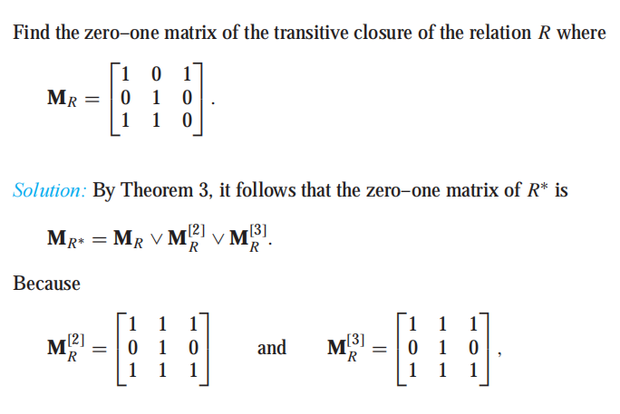
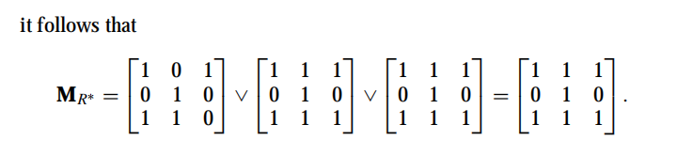

Slide 86
Example
Let
A={1, 2, 3, 4}
R={(1, 2), (2, 3), (3, 4), (2, 1)}
Find the transitive closure of R.
2
1
3
4

Slide 87
Example

Slide 88
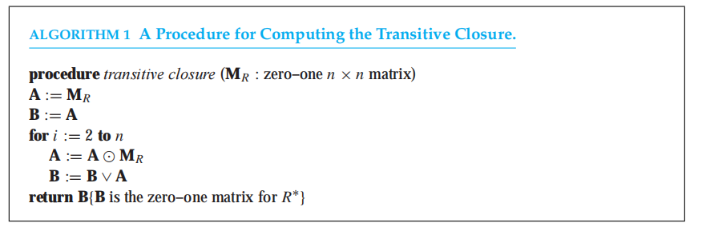
Transistive closure Algorithm
2n³(n − 1) bit operations.

Slide 89
Warshall’s Algorithm
the transitive closure can be found by Warshall‘s algorithm using only 2n³ bit operations.

Slide 90
Some definitions
Let
A = {a₁, a₂,…, a_{n}}
R be a relation on A
Interior vertices
a, x₁, x₂,…, x_{i}, b
For instance, the interior vertices of a path
a, c, d, f, g, h, b, j in a directed graph Relations are c, d, f, g, h, and b.

Slide 91
Warshall’s algorithm is based on the construction of a sequence of zero–one matrices

Slide 92
Some definitions
W_{k}: a Boolean matrix, for 1≤k≤n
W_{k} has a 1 in position i, j
If and only if
there is a path from v_{i} to v_{j} in R whose interior vertices, if any, come from the set {v₁, v₂,…, v_{k}}
(vi和vj存在所有内部节点为前k个节点的路)
What about W₀ and W_{n} ?
Let W₀ = M_{R}（有一条路vi和vj连着，但内部节点为空）
W_{n} = W_{R}*
W₀, W₁ , W₂ , … , W_{n}

Slide 93
Warshall’s Algorithm
Procedure
begin with the matrix of R, and
compute each matrix W_{k} from the previous matrix W_{k-1}, and,
reach W_{R}* in n steps,

Slide 94
Warshall’s Algorithm
Suppose
W_{k} = [t_{ij}]
W_{k-1} = [s_{ij}]
If t_{ij} = 1, then there must be a path from a_{i} to a_{j} whose interior vertices come from the set {a₁, a₂,…, a_{k}}.
Whether a_{k} is an interior vertex ?
Two cases

Slide 95
Warshall’s Algorithm
If t_{ij} = 1（有a1到ak为内部节点的路）
a_{k} is not an interior vertex
then all interior vertices must actually come from the set {a₁, a₂,…, a_{k-1}} （ak不是内部节点，又要连着，只能全来自上一轮）
so s_{ij} = 1.
a_{k} is an interior vertex
Assume a_{k} appears only once (出现两次形成圈，不计入)
Two subpaths
a_{i} to a_{k} and a_{k} to a_{j}
s_{ik} = 1 and s_{kj} = 1
a_{k}
a_{i}
a_{j}

Slide 96
Warshall’s Algorithm
The basis for Warshall’s Algorithm
t_{ij} = 1
If and only if
either
s_{ij} = 1
s_{ik} = 1 and s_{kj} = 1

Slide 97
Warshall’s Algorithm
Step1:
First transfer to W_{k} all 1’s in W_{k-1}.
Step2:
List the locations p₁, p₂, …, in column k of W_{k-1}, where the entry is 1
List the locations q₁, q₂, …, in row k of W_{k-1}, where the entry is 1
Step3:
Put 1’s in all the positions p_{i}, q_{j} of W_{k} (if they are not already there)

Slide 98
Example (1)
Let
A={1, 2, 3, 4}
R={(1, 2), (2, 3), (3, 4), (2, 1)}
Find the transitive closure of R.
2
1
3
4

Slide 99
Example

Slide 100
Warshall’s Algorithm
Algorithm Warshall
CLOSURE←MAT
For k = 1 thru N
For i = 1 thru N
For j = 1 thru N
CLOSURE[i,j]←CLOSURE[i,j]
∨(CLOSURE[i,k]∧CLOSURE[k,j])
End of Algorithm Warshall

Slide 101
Analysis
Complexity of Algorithm
Warshall
n³
M_{R*}
n⁴

Slide 102
exercise：
Use Warshall’s algorithm to find the transitive closures of the relation：
{(a, b), (a, c), (a, e), (b, a), (b, c), (c, a), (c, b), (d, a),(e, d)}
Notes:
9-4：28c

Slide 103
9.5 Equivalence Relations

Slide 104
Definition
A relation R on a set A is an equivalence relation (等价关系) iff R is
reflexive
symmetric
transitive
It is easy to recognize equivalence relations using digraphs.

Slide 105
example
Let R be the relation on the set of real numbers such that aRb if and only if a − b is an integer.
Is R an equivalence relation?
reflexive
symmetric
transitive

Slide 106
Congruence Modulo m Let m be an integer with m > 1. Show that the relation
R = {(a, b) | a ≡ b (mod m)}
is an equivalence relation on the set of integers.

Slide 107
Let R be the relation on the set of real numbers such that xRy if and only if x and y are real numbers that differ by less than 1, that is|x − y| < 1. Show that R is not an equivalence relation.

Slide 108
Equivalence Class
Consider the relation R on A that consists of all pairs (x, y), where x and y graduated from the same high school. Given a student x, we can form the set of all students equivalent to x with respect to R.
This set consists of all students who graduated from the same high school as x did. This subset of A is called an equivalence class of the relation.

Slide 109

Definition
Let R be an equivalence relation on a set A. The set of all elements that are related to an element a of A is called the equivalence class of a.
The equivalence class of a with respect to R is denoted by [a]_{R}.
When only one relation is under consideration, we can delete the subscript R and write [a] for this equivalence class.
If b ∈ [a]_{R}, then b is called a representative of this equivalence class. Any element of a class can be used as a representative of this class.

Slide 110

example
What are the equivalence classes of 0 and 1 for congruence modulo 4?
[1]={..., −7, −3, 1, 5, 9,...}.

Slide 111
Equivalence Relations and Partitions
A : students at your school who are majoring in exactly one subject,
R:the relation on A consisting of pairs (x, y), where x and y are students with the same major.
Then R is an equivalence relation
R splits all students in A into a collection of disjoint subsets, where each subset contains students with a specified major. these subsets are equivalence classes of R.

Slide 112
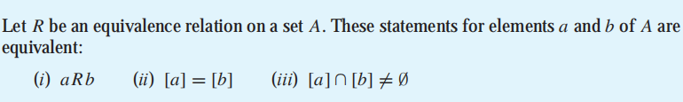
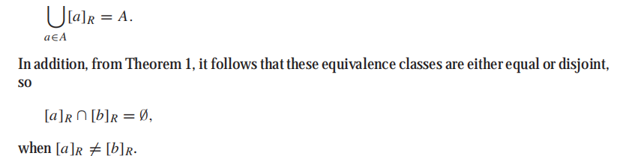
Theorem

Slide 113
a partition of a set S is a collection of disjoint nonempty subsets of S that have S as their union. In other words, the collection of subsets A_{i}, i ∈ I (where I is an index set) forms a partition of S if and only if
A_{i} ≠ ∅ for i ∈ I,
A_{i} ∩ A_{j} = ∅ when i ≠j,

Slide 114
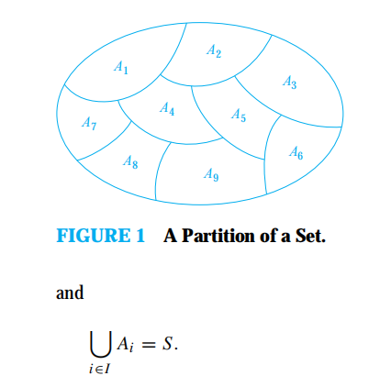

Slide 115
EXAMPLE
Suppose that S = {1, 2, 3, 4, 5, 6}. The collection of sets A1 = {1, 2, 3}, A2 = {4, 5}, and
A3 = {6} forms a partition of S, because these sets are disjoint and their union is S.

Slide 116
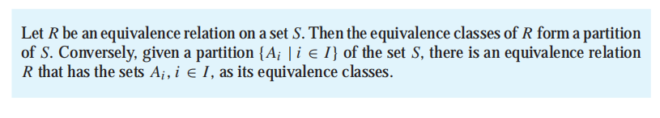
Theorem

Slide 117
example
List the ordered pairs in the equivalence relation R produced by the partition A1 = {1, 2, 3}, A2 = {4, 5}, and A3 = {6} of S = {1, 2, 3, 4, 5, 6}
The subsets in the partition are the equivalence classes of R. The pair (a, b) ∈ R if and only if a and b are in the same subset of the partition
...

Slide 118
What are the sets in the partition of the integers arising from congruence modulo 4?
There are four congruence classes, corresponding to [0]₄, [1]₄, [2]₄, and [3]₄. They are the sets
These congruence classes are disjoint, and every integer is in exactly one of them. In other words, as Theorem 2 says, these congruence classes form a partition.

Slide 119
Section 9.6
Partial Orderings
偏序关系

Slide 120
Definition: A relation R on a set S is called a partial ordering or partial order if it is reflexive, antisymmetric, and transitive.
A set S together with a partial ordering R is called a partially ordered set, or poset, and is denoted by (S, R). Members of S are called elements of the poset.

Slide 121
Example 1 Show that the “greater than or equal” relation (≥)is a partial ordering on the set of integers.
Solution: Since a ≥ a for every integer a, ≥ is reflexive. If a ≥b and b ≥a, then a=b. Hence, ≥ is antisymmetric. Finally, ≥ is transitive since a ≥b and b ≥c imply that a ≥c. It follows that ≥ is a partial ordering on the set of integers and (Z, ≥) is a poset.

Slide 122
The divisibility relation可整除 | is a partial ordering on the set of positive integers. (Z⁺,|) is a poset.
The inclusion relation ⊆ is a partial ordering on the power set of a set S. (P(S), ⊆) is a poset.

Slide 123
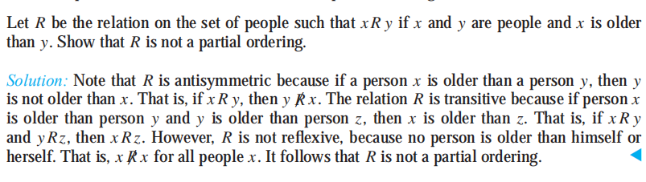

Slide 124
In a poset the notation a ≼ b denotes that (a,b)∈R.
The notation ab denotes that a ≼b, but a≠b.
(S, ≼ ) is a poset.

Slide 125
Note: It is not required that two things be related under a partial order. That‘s the partial part of it部分偏序.
*
Definition The elements a and b of a poset(S, ≼ ) are called comparable相容的， if either a ≼b or b ≼ a. When a and b are elements of S such that neither a≼b nor b≼a, a and b are imcomparable不相容的.

Slide 126
Example In the poset (Z⁺,|), are the integers 3 and 9 comparable? Are 5 and 7 comparable?
Solution The integers 3 and 9 are comparable since 3|9.
The integers 5 and 7 are not comparable.

Slide 127
Definition If (S,R) is a poset and every two elements are comparable, S is called a total ordered 全序or linear ordered线序 or simple ordered set简单有序集. In this case (S, R) is called a chain链.
Example The poset (Z,≤) is totally ordered, since a ≤b or b ≤a whenever a and b are integers. (Z, ≤) is a chain.
Example The poset (Z⁺,|) is not totally ordered since it contains elements that are incomparable, such as 5 and 7.

Slide 128
Definition: Let R be a total order on A and suppose S ⊆ A. An element s in S is a least element最小元素 of S iff sRb for every b in S.
Note: this implies that <a, s> is not in R for any a unless a= s. (There is nothing smaller than s under the order R).
Similarly for greatest element最大元素.
Definition: Let R be a total order on A and suppose S ⊆ A. An element c in S is a greatest element of S iff bRc for every b in S.

Slide 129
Definition: A chain (A, R) is well-ordered 良序iff every nonempty subset of A has a least element.
___________________
Examples:
• (Z, ≤) is a chain but not well-ordered. Z does not have least element.
• (N, ≤ ) is well-ordered.
• (N, ≥) is not well-ordered.
__________________

Slide 130
Lexicographic Order
Given two posets (A₁, R₁) and (A₂, R₂) we construct an Lexicographic ordering词典序 (induced partial order) R on A₁ × A₂: < x₁, y₁> R <x₂, y₂> iff
• x₁ R₁ x₂
or
• x₁ = x₂ and y₁ R₂ y₂.
_________________

Slide 131
Example:
Let A₁ = A₂ = Z⁺ and R₁ = R₂ = 'divides'.
Then
• <2, 4> R <2, 8> since x₁ = x₂ and y₁ R₂ y₂.
• <2, 4> is not related under R to <2, 6> since x₁ = x₂ but 4 does not divide 6.
• <2, 4> R <4, 5> since x₁ R₁ x₂. (Note that 4 is not related to 5).
__________________

Slide 132
This definition extends naturally to multiple Cartesian products of partially ordered sets: A₁ × A₂ × A₃ × . . . × A_{n}.
(a₁,a₂,…a_{n}) (b₁,b₂,…b_{n})
If a₁ ₁b₁,or if there is an integer i>0 such that
a₁=b₁,…, a_{i}=b_{i} and a_{i+1}_{i+1}b_{i+1}

Slide 133
Example: Let A₁ = A₂ =…=A_{n}= Z⁺ and R₁ = R₂ =…=R_{i}= 'divides'.
Then
• < 2, 3, 4, 5> R < 2, 3, 8, 2> since x1 = x2, y1 = y2 and 4 divides 8.
• <2, 3, 4, 5> is not related to <3, 6, 8, 10> since 2
does not divide 3.
_______________
Notes:
前面只要有一个不同就不看后面是否满足关系。

Slide 134
Lexicographic Ordering of Strings串的词典序
We apply this ordering to strings of symbols where there is an underlying 'alphabetical' or partial order (which is a total order in this case).
________________
Consider the strings a₁a₂…a_{m} and b₁b₂…b_{n} on a partial ordered set S. Suppose that these strings are not equal. Let t be the minimun of m and n.The definition of lexicographic ordering is that the string a₁a₂…a_{m} is less than b₁b₂…b_{n} if and only if (a₁,a₂,…,a_{t}) (b₁,b₂,…b_{t}) or (a₁,a₂,…,a_{t})= (b₁,b₂,…b_{t}) and m<n.

Slide 135
Example:
Consider the set of strings of lowercase小写 English letters.
discreetdiscrete
discreetdiscreetness
discretediscretion

Slide 136
Example Find the lexicographic ordering of the bit strings 0,01,11,001,010,011,0001,and 0101 based on the ordering 0<1.
01<11, 001<01,01<010,01<011, 0001<01
0001<001
010<011<11
0<0001<001<01<010<011<11

Slide 137
Hasseor Poset Diagrams哈斯图
To construct a Hasse diagram:
1) Construct a digraph representation of the poset (A, R) so that all arcs point up (except the loops).
2) Eliminate all loops消减
3) Eliminate all arcs that are redundant多余 because of transitivity
4) eliminate the arrows at the ends of arcs since everything points up.

Slide 138
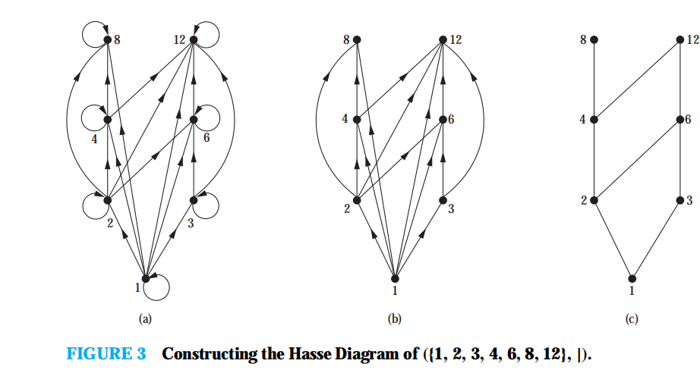

Slide 139
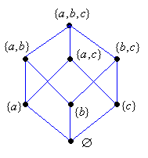
Example:
Construct the Hasse diagram of (P({a, b, c}), ⊆ ).
The elements of P({a, b, c}) are ∅, {a}, {b}, {c},{a, b}, {a, c}, {b, c}, {a, b, c}
The digraph is

Slide 140
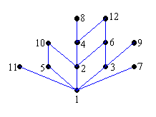
Example Draw the Hasse diagram representing the partial ordering {(a,b)| a divides b} on A={1,2,3,…12}
Solution R=I_{A}∪{(1,2), (1,3), (1,4), (1,5), (1,6), (1,7), (1,8), (1,9), (1,10), (1,11), (1,12), (2,4), (2,6), (2,8), (2,10),(2,12),(3,6), (3,9), (3,12), (4,8), (4,12),,(5,10),(6,12)}

Slide 141
Covering relation覆盖关系
Let (S, ≼)be a poset. We say that an element y∈S covers an element x ∈S if x  y and there is no element z ∈S such that xz  y. The set of pairs(x,y) such that y cover x is called the covering relation of (S, ≼).

Slide 142
Maximal and Minimal Elements极大和极小元素
Definition: Let (A, R) be a poset. Then a in A is a maximal element if there does not exist an element b in A such that aRb.
Definition: Let (A, R) be a poset. Then a in A is a minimal element if there does not exist an element b in A such that bRa.

Slide 143
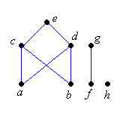
Note: there can be more than one minimal and maximal element in a poset.
Example: Which elements of the poset with given Hasse diagram are maximal, and which are minimal?
Solution: The maximal elements are e,g,h
The minimal elements are a,b,f,h

Slide 144
Least and Greatest Elements最大和最小元素(every)
Definition: Let (A, R) be a poset. Then a in A is the least element if for every element b in A, aRb and b is the greatest element if for every element a in A, aRb.
{a, b, c} is the greatest element. ∅ is the least element.

Slide 145
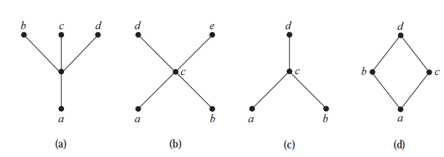
Theorem: Least and greatest elements are unique.
Determine whether the posets represented by each of the Hasse diagrams in following figure have agreatest element and a least element.

Slide 146
Upper and Lower Bounds上界和下界
Definition: Let S be a subset of A in the poset (A, R). If there exists an element a in A such that sRa for all s in S, then a is called an upper bound of S上界. (find s in S then test every s)
Note: the upper bound must be related to every element in the set.
_________________

Slide 147
Definition: Let S be a subset of A in the poset (A, R). If there exists an element a in A such that aRs for all s in S, then a is called an lower bound 下界 of S.
Note: the lower bound must be related to every element in the set.
_________________

Slide 148
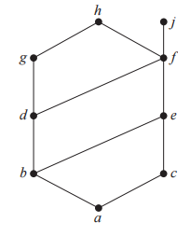
Example:
• Find the lower and upper bounds of the subsets {a, b, c}, {j, h}, and {a, c, d, f } in the poset with the Hasse diagram shown in Figure below

Slide 149
Example:
• Find the lower and upper bounds of the subsets {a, b, c}, {j, h}, and {a, c, d, f } in the poset with the Hasse diagram shown in Figure below
Solution:The upper bounds of {a, b, c} are e, f, j , and h, and its only lower bound is a. There are no upper bounds of {j, h}, and its lower bounds are a, b, c, d, e, and f . The upper bounds
of {a, c, d, f } are f , h, and j , and its lower bound is a.
how about {b, d, g}?
Notes:
upper bound别忘记自己

Slide 150
Least Upper and Greatest Lower Bounds
Definition: Let S be a subset of A in the poset (A, R). If a is an upper bound for S and aRx for all other upper bounds x of S then a is the least upper bound, denoted lub(S)最小上界.
Let S be a subset of A in the poset (A, R). If a is an lower bound for S and xRa for all other lower bounds x of S then a is the greast lower bound, denoted glb(S)最大下界.
____________

Slide 151
Example:
• Find the greatest lower bound and the least upper bound of {b, d, g}, if they exist, in the posetshown in Figure below

Slide 152
Example:
• Find the greatest lower bound and the least upper bound of {b, d, g}, if they exist, in the posetshown in Figure below
Solution:The upper bounds of {a, b, c} are e, f, j , and h, and its only lower bound is a. There are no upper bounds of {j, h}, and its lower bounds are a, b, c, d, e, and f . The upper bounds
of {a, c, d, f } are f , h, and j , and its lower bound is a.

Slide 153
24
60
8
12
4
6
2
3
1
upper bounds lower bounds glb lub
{1,2,3}
6,12,24,60
1
1
6
{1,3,4,12}
12,24,60
1
1
12
{24,60}
no
1,2,3,4,6,12
12
no

Slide 154
Example:
Find the greatest lower bound and the least upper bound of the sets{3, 9, 12} and {1, 2, 4, 5, 10}, if they exist, in the poset (Z⁺, |).

Slide 155
Lattices
A partially ordered set in which every pair of elements has both a least upper bound and a
greatest lower bound is called a lattice. Lattices have many special properties. Furthermore,
lattices are used in many different applications such as models of information flow and play an
important role in Boolean algebra.

Slide 156
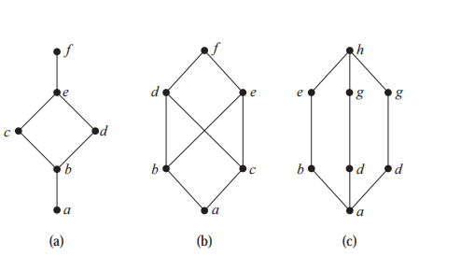
Determine whether the posets represented by each of the Hasse diagrams in following figure are lattices.
Notes:
bisnot

Slide 157
(b)
is not a lattice, because the elements b and c have no least upper bound. To see this, note that
each of the elements d, e, and f is an upper bound, but none of these three elements precedes
the other two with respect to the ordering of this poset.

Slide 158
Determine whether the posets ({1, 2, 3, 4, 5}, |) and ({1, 2, 4, 8, 16}, |) are lattices
Because 2 and 3 have no upper bounds in ({1, 2, 3, 4, 5}, |), they certainly do not have
a least upper bound. Hence, the first poset is not a lattice.
Is the poset (Z⁺, |) a lattice?
Notes:
yes

