Slide 1
Discrete Mathematics
peng xiaogang

Slide 2
Logical equivalences
S≡T: Two statements S and T involving predicates and quantifiers are logically equivalent
If and only if they have the same truth value no matter which predicates are substituted into these statements and which domain is used for the variables.
Example:
i.e., we can distribute a universal quantifier over a conjunction

Slide 3
Both statements must take the same truth value no matter the predicates p and q, and non matter which domain is used
Show
If p is true, then q is true (p → q)
If q is true, then p is true (q → p)

Slide 4
(→) If a is in the domain, then p(a)˄q(a) is true. Hence, p(a) is true and q(a) is true. Because p(a) is true and q(a) is true for every element in the domain, so is true
(←) It follows that are true. Hence, for a in the domain, p(a) is true and q(a) is true, hence p(a)˄q(a) is true. If follows is true

Slide 5
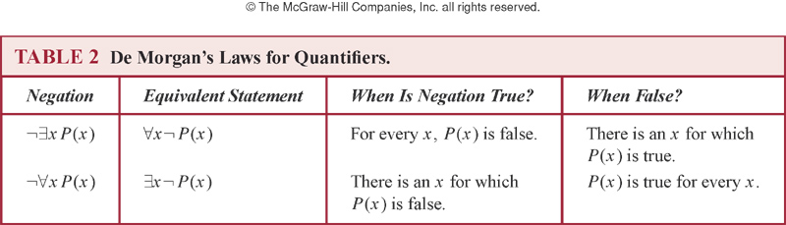
Negating quantified expressions
Negations of the following 2 statements
1.“There is an honest politician”
“Every politician is dishonest”
(Note “All politicians are not honest” is ambiguous)
2.“All Americans eat cheeseburgers”
“Some American does not eat cheeseburgers”

Slide 6
Example

Slide 7
Translating English into logical expressions
“Every student in this class has studied calculus”
Let C(x) be the statement that “x has studied calculus”. Let S(x) be the statement “x is in this class”

Slide 8
“Some student in this class has visited Mexico”
M(x), which is the statement “x has visited Mexico.”
the domain for the variable x consists of all people. We introduce S(x) to represent“x is a student in this class.”
Solution:∃x(S(x) ∧ M(x))
∃x(S(x) → M(x)) is wrong! which is true when there is someone not in the class. two meanings

Slide 9
Every student in this class has visited either Canada or Mexico
C(x) be “x has visited Canada.”
∀x(S(x) → (C(x) ∨ M(x)))
use a two-place predicate V (x, y) to represent “x has visited country y.” In this case, V (x, Mexico) and V (x, Canada)
∀x(S(x) → (V (x, Mexico) ∨V (x, Canada)))

Slide 10
Using quantifiers in system specifications
“Every mail message larger than one megabyte will be compressed”
Let s(m,y) be “mail message m is larger than y megabytes” where m has the domain of all mail messages and y is a positive real number. Let c(m) denote “message m will be compressed”

Slide 11
Example
“If a user is active, at least one network link will be available”
Let a(u) represent “user u is active” where u has the domain of all users, and let s(n, x) denote “network link n is in state x” where n has the domain of all network links, and x has the domain of all possible states, {available, unavailable}.

Slide 12
1.5 Nested quantifiers
Let the variable domain be real numbers
where the domain for these variables
consists of real numbers

Slide 13
Quantification as loop
For every x, for every y
Loop through x and for each x loop through y
If we find p(x,y) is true for all x and y, then the statement is true
If we ever hit a value x for which we hit a value for which p(x,y) is false, the whole statement is false
For every x, there exists y
Loop through x until we find a y that p(x,y) is true
If for every x, we find such a y, then the statement is true

Slide 14
Quantification as loop
: loop through the values for x until we find an x for which p(x,y) is always true when we loop through all values for y
Once found such one x, then it is true
: loop though the values for x where for each x loop through the values of y until we find an x for which we find a y such that p(x,y) is true
False only if we never hit an x for which we never find y such that p(x,y) is true

Slide 15
Order of quantification

Slide 16
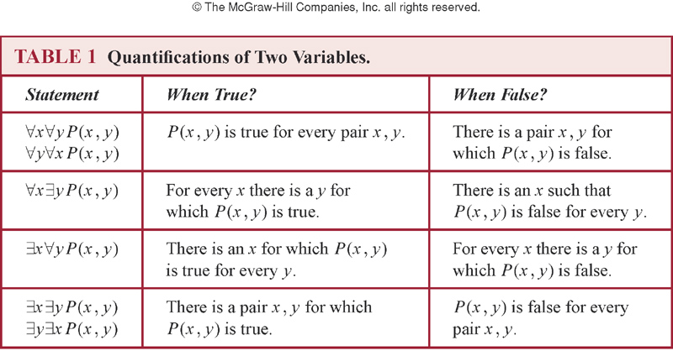
Quantification of two variables

Slide 17
Quantification with more variables

Slide 18
Translating mathematical statements
“The sum of two positive integers is always positive”

Slide 19
Example
“Every real number except zero has a multiplicative inverse”

Slide 20
Express limit using quantifiers
For every real number ε>0, there exists a real number δ>0, such that |f(x)-L|<ε whenever 0<|x-a|<δ

Slide 21
Translating English into Logical Statement
If a person is female and is a parent, then this person is someone’s mother
∀x((F (x) ∧ P (x)) → ∃yM(x, y)).
is ∀x∃y((F (x) ∧ P (x)) → M(x, y)) ok?

Slide 22
Everyone has exactly one best friend
“For every person x, person x has exactly one best friend.”
∀x(person x has exactly one best friend),
B(x, y) to be the statement “y is the best friend of x,”
∃y(B(x, y) ∧ ∀z((z ≠ y) → ¬B(x, z))).
conclusion
∀x∃y(B(x, y) ∧ ∀z((z ≠ y) → ¬B(x, z))).
∀x∃₁y(B(x, y))

Slide 23
There is a woman who has taken a flight on every airline in the world.
woman, airline, flight
take , on
Let P (w,f) be “w has taken f ” and Q(f, a) be “f is a flight on a.” We can express the statement as∃w∀a∃f (P (w,f) ∧ Q(f, a)),
another expression ∃w∀a∃f R(w, f, a),

Slide 24
EXERCISE: Translating statements into English
where c(x) is “x has a computer”, f(x,y) is “x and y are friends”, and the domain for both x and y consists of all students in our school
where f(x,y) means x and y are friends, and the domain consists of all students in our school

Slide 25
Use quantifiers to express the statement “There is a woman who has taken a flight on every airline in the world.”
flight ：sz-bj ；Airline：eastern,southen...
Let P (w,f) be “w has taken f ” and Q(f, a) be “f is a flight on a.” We can express the statement as
∃w∀a∃f (P (w,f) ∧ Q(f, a)),
how about ∃w∃f∀a (P (w,f) ∧ Q(f, a))?
Notes:
共享代码

Slide 26
Negating nested quantifiers
There does not exist a woman who has taken a flight on every airline in the world
where p(w,f) is “w has taken f”, and q(f,a) is “f is a flight on a. Translate it ??

Slide 27
Homework1
use propersition logic to translate three sentences （3 Proposition + ）then, try to do the negation of the sentences
use quantifier and predicate logic to translate three sentences （3 variables +）then, try to do the negation of the sentences
Chinese is allowed

