Slide 1
Discrete Mathematics sets
Peng Xiaogang

Slide 2
2. 1 Basic structures
Sets
Functions
Sequences
Sums

Slide 3
Sets
Used to group objects together
Objects of a set often have similar properties
all students enrolled at UC Merced
all students currently taking discrete mathematics
A set is an unordered collection of objects
The objects in a set are called the elements or members of the set
A set is said to contain its elements

Slide 4
Notation
The set of all vowels in the English alphabet can be written as V={a, e, i, o, u}
The set of odd positive integers less than 10 can be expressed by O={1, 3, 5, 7, 9}
Nothing prevents a set from having seemingly unrelated elements, {a, 2, Fred, New Jersey}
The set of positive integers<100: {1,2,3,…, 99}

Slide 5
Notation
Set builder: characterize the elements by stating the property or properties
The set O of all odd positive integers < 10:
O={x|x is an odd positive integer < 10}
or specify as
The set of positive rational numbers

Slide 6
Notation
The set {N, Z, Q, R} is a set containing four elements, each of which is a set

Slide 7
Sets and operations
A datatype or type is the name of a set,
Together with a set of operations that can be performed on objects from that set
Boolean: the name of the set {0,1} together with operations on one or more elements of this set such as AND, OR, and NOT

Slide 8
Sets
Two sets are equal if and only if they have the same elements
That is if A and B are sets, then A and B are equal if and only if . We write A=B if A and B are equal sets
The sets {1, 3, 5} and {3, 5, 1} are equal
The sets {1, 3, 3, 3, 5, 5, 5, 5} is the same as {1, 3, 5} because the have the same elements

Slide 9
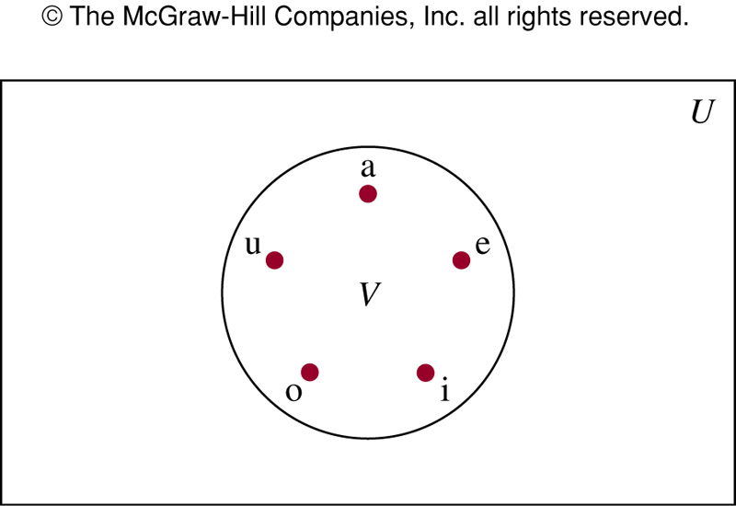
Venn diagram
Rectangle: Universal set that contains all the objects
Circle: sets
U: 26 letters of English alphabet
V: a set of vowels in the English alphabet

Slide 10
Empty set and singleton
Empty (null) set: denoted by {} or Ø
The set of positive integers that are greater than their squares is the null set
Singleton: A set with one element
A common mistake is to confuse Ø with {Ø}

Slide 11
Subset
The set A is a subset of B if and only if every element of A is also an element of B
Denote by A⊆B
We see A⊆B if and only if

Slide 12
Empty set and the set S itself
Theorem: or every set S
(i) Ø⊆S, and
(ii)S⊆S
Let S be a set, to show Ø⊆S, we need to show ∀x(x∈∅→x∈S) is true.
But x∈∅ is always false, and thus the conditional statement is always true
An example of vacuous proof
(ii) is left as an exercise

Slide 13
Proper subset
A is a proper subset of B: Emphasize that A is a subset of B but that A≠B, and write it as A⊂B
One way to show that two sets have the same elements is to show that each set is a subset of the other, i.e., if A⊆B and B⊆A, then A=B

Slide 14
Sets have other sets as members
A={∅, {a}, {b}, {a,b}}
B={x|x is a subset of the set {a, b}}
Note that A=B and {a}∊A but a∉A
Sets are used extensively in computing problem

Slide 15
Cardinality
Let S be a set. If there are exactly n distinct elements in S where n is a non-negative integer
S is a finite set
|S|=n, n is the cardinality of S
Let A be the set of odd positive integers < 10, |A|=5
Let S be the set of letters in English alphabet, |S|=26
The null set has no elements, thus |∅|=0

Slide 16
Infinite set and power set
A set is said to be infinite if it is not finite
The set of positive integers is infinite
Given a set S, the power set of S is the set of all subsets of the set S. The power set of S is denoted by P(S)
The power set of {0,1,2}
P({0,1,2})={∅,{0},{1},{2},{0,1},{1,2},{0,2},{0,1,2}}
Note the empty set and set itself are members of this set of subsets

Slide 17
Example
What is the power set of the empty set?
P(∅)={∅}
The set {∅} has exactly two subsets, i.e., ∅, and the set {∅}. Thus P({∅})={∅,{∅}}
If a set has n elements, then its power set has 2^{n} elements

Slide 18
Cartesian product
Sets are unordered
The ordered n-tuple (a₁, a₂, …, a_{n}) is the ordered collection that has a₁ as its first element, a₂ as its second element, and an as its nth element
(a₁, a₂, …, a_{n})= (b₁, b₂, …, b_{n}) if and only if a_{i}=b_{i} for i=1, 2, .., n

Slide 19
Ordered pairs
2-tuples are called ordered pairs
(a, b) and (c, d) are equal if and only if a=c and b=d
Note that (a, b) and (b, a) are not equal unless a=b

Slide 20
Cartesian product
The Cartesian product of sets A and B, denoted by A x B, is the set of all ordered pairs (a,b), where a ∊ A and b ∊ B
A: students of szu, B: all courses offered at szu
A x B consists of all ordered pairs of (a, b), i.e., all possible enrollments of students at szu

Slide 21
Example
A={1, 2}, B={a, b, c}, What is A x B?
A x B = {(1, a), (1, b), (1, c), (2, a), (2, b), (2, c)}
A subset R of the Cartesian product A x B is called a relation
A={a, b, c} and B={0, 1, 2, 3}, R={(a, 0), (a, 1), (a,3), (b, 1), (b, 2), (c, 0), (c,3)} is a relation from A to B
A x B ≠ B x A
B x A = {(a, 1), (a, 2), (b, 1), (b, 2), (c, 1), (c, 2)}

Slide 22
Cartesian product: general case
Cartesian product of A₁, A₂, …, A_{n}, is denoted by A₁ x A₂ x … x A_{n} is the set of ordered n-tuples (a₁, a₂, …, a_{n}) where a_{i} belongs to A_{i} for i=1, 2, …, n
A={0,1}, B={1,2}, C={0,1,2}
A x B x C={{0, 1, 0},{0, 1, 1}, {0, 1, 2}, {0, 2, 0}, {0, 2, 1}, {0, 2, 2}, {1, 1, 0}, {1, 1, 1}, {1, 1, 2}, {1, 2, 0}, {1, 2, 1}, {1, 2, 2}}

Slide 23
Using set notation with quantifiers
denotes the universal quantification P(x) over all elements in the set S
Shorthand for
is shorthand for
What do they man?
The square of every real number is non-negative
There is an integer whose square is 1

Slide 24
Truth sets of quantifiers
Predicate P, and a domain D, the truth set of P is the set of elements x in D for which P(x) is true, denote by {x ∊ D|P(x)}
P(x) is |x|=1, Q(x) is x²=2, and R(x) is |x|=x and the domain is the set of integers
Truth set of P, {x∊Z||x|=1}, i.e., the truth set of P is {-1,1}
Truth set of Q, {x∊Z|x²=2}, i.e., the truth set is ∅
Truth set of R, {x∊Z||x|=x}, i.e., the truth set is N

Slide 25
NOTE:
is true over the domain U if and only if P is the set U
is true over the domain U if and only if P is non-empty

Slide 26
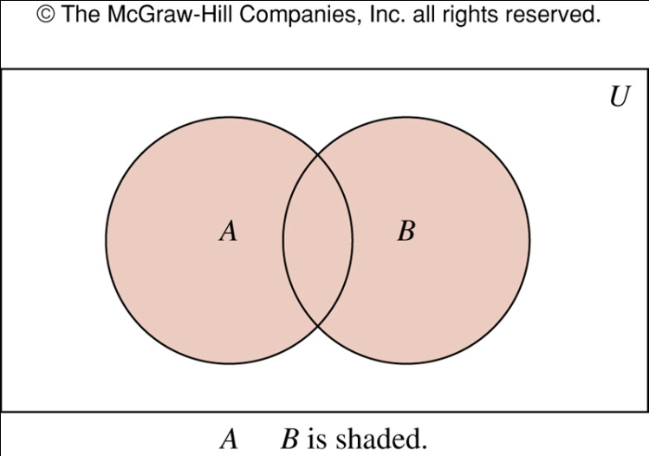
2.2 Set operations
Union: the set that contains those elements that are either in A or in B, or in both
A={1,3,5}, B={1,2,3}, A⋃B={1,2,3,5}

Slide 27
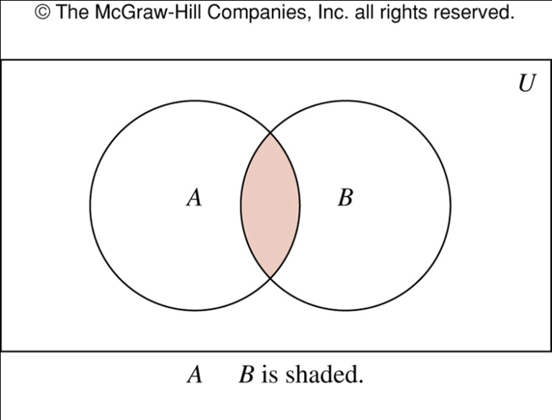
Intersection
Intersection: the set containing the elements in both A and B
A={1,3,5}, B={1,2,3}, A⋂B={1,3}

Slide 28
Disjoint set
Two sets are disjoint if their intersection is ∅
A={1,3}, B={2,4}, A and B are disjoint
Cardinality:

Slide 29
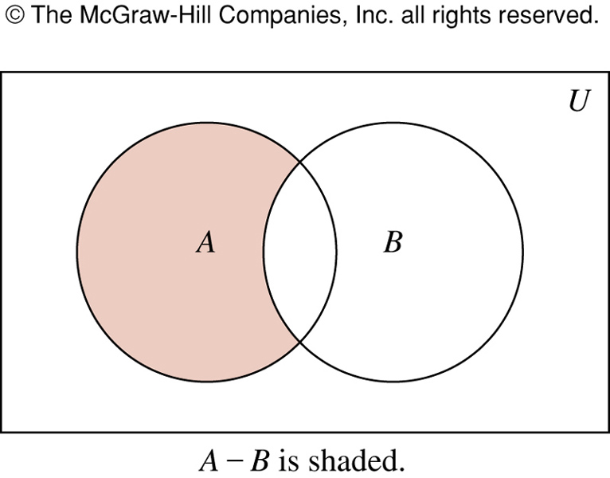
Difference and complement
A-B: the set containing those elements in A but not in B
A={1,3,5},B={1,2,3}, A-B={5}

Slide 30
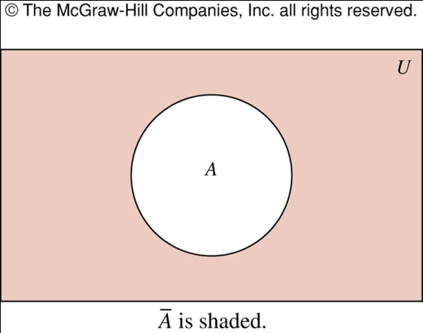
Complement
Once the universal set U is specified, the complement of a set can be defined
Complement of A:
A-B is also called the complement of B with respect to A

Slide 31
Example
A is the set of positive integers > 10 and the universal set is the set of all positive integers, then
A-B is also called the complement of B with respect to A

Slide 32
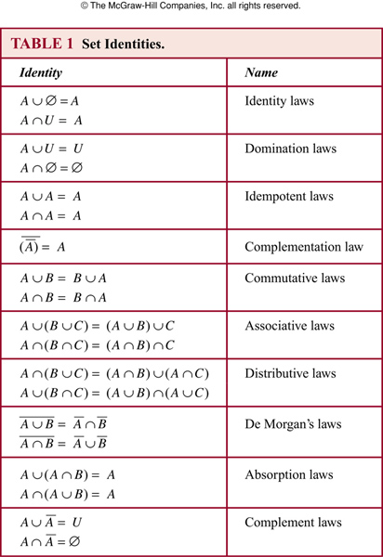
Set identities

Slide 33
Example
Prove
Will show that
(→): Suppose that , by definition of complement and use De Morgan’s law
By definition of complement
By definition of union

Slide 34
Example
(←): Suppose that
By definition of union
By definition of complement
Thus
By De Morgan’s law:
By definition of complement,

Slide 35
Builder notation
Prove it with builder notation

Slide 36
Example
Prove
(→): Suppose that then
and . By definition of union, it follows that , and or . Consequently, and or and
By definition of intersection, it follows
or
By definition of union,

Slide 37
Example
(←): Suppose that
By definition of union, or
By definition of intersection, and , or and
From this, we see , and or
By definition of union, and
By definition of intersection,

Slide 38
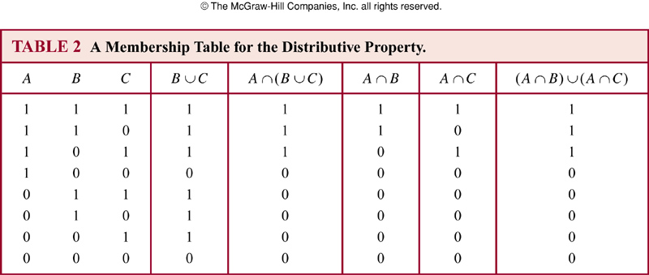
Membership table

Slide 39
Example
Show that

Slide 40
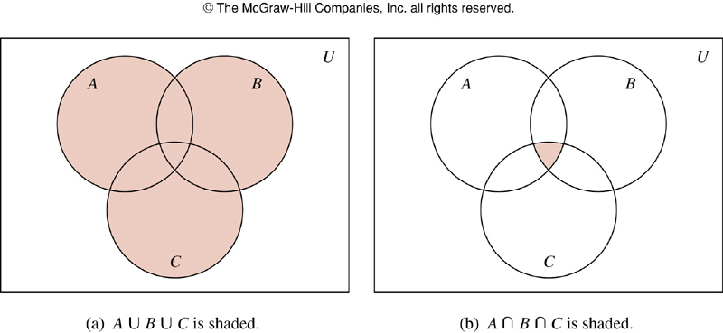
Generalized union and intersection
A={0,2,4,6,8}, B={0,1,2,3,4}, C={0,3,6,9}
A⋃B⋃C={0,1,2,3,4,6,8,9}
A⋂B⋂C={0}

Slide 41
General case
Union:
Intersection
Union:
Intersection:
Suppose A_{i}={1, 2, 3,…, i} for i=1,2,3,…

Slide 42
Computer representation of sets
U={1,2,3,4,5,6,7,8,9,10}
A={1,3,5,7,9} (odd integer ≤10),B={1,2,3,4,5} (integer ≤5)
Represent A and B as 1010101010, and 1111100000
Complement of A: 0101010101
A⋂B: 1010101010˄1111100000=1010100000
which corresponds to {1,3,5}

Slide 43

exercise:
What can you say about the sets A and B if we know that
a) A ∪ B = A? b) A ∩ B = A?
c) A − B = A? d) A ∩ B = B ∩ A?
e) A − B = B − A?
Notes:
2.2-29

