Slide 1
Discrete Mathematics Functions
Peng Xiaogang

Slide 2
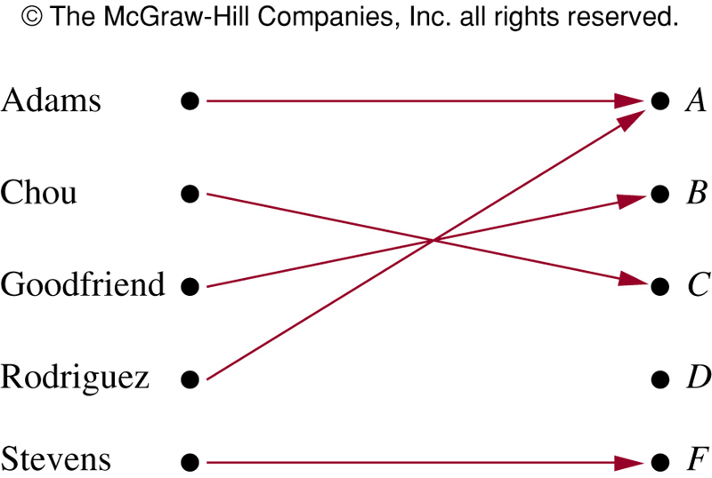
2.3 Functions
Assign each element of a set to a particular element of a second set

Slide 3
Function
A function f from A to B, f:A→B, is an assignment of exactly one element of B to each element of A
f(a)=b if b is the unique element of B assigned by the function f to the element a
Sometimes also called mapping or transformation

Slide 4
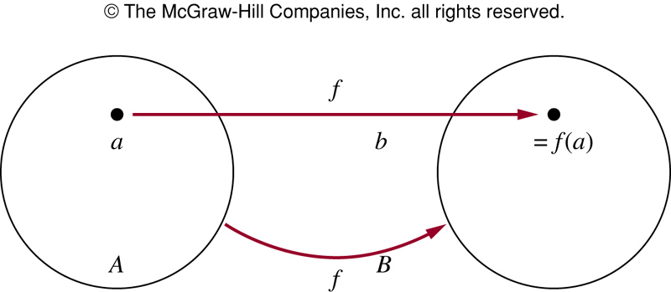
Function and relation
f:A→B can be defined in terms of a relation from A to B
Recall a relation from A to B is just a subset of A x B
A relation from A to B that contains one, and only one, ordered pair (a,b) for every element a ∈ A, defines a function f from A to B
f(a)=b where (a,b) is the unique ordered pair in the relation

Slide 5
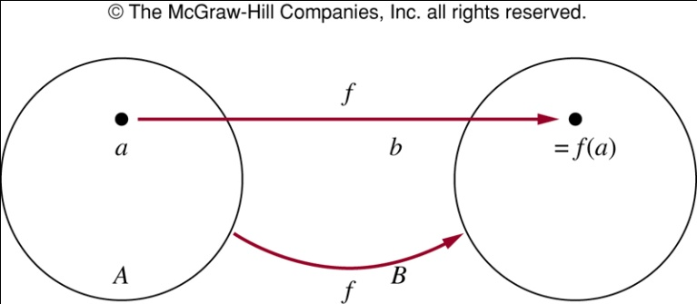
Domain and range
If f is a function from A to B
A is the domain of f
B is the codomain of f
f(a)=b, b is the image of a and a is preimage of b
Range of f: set of all images of element of A
f maps A to B

Slide 6
Function
Specify a function by
Domain
Codomain
Mapping of elements
Two functions are equal if they have
Same domain, codomain, mapping of elements

Slide 7
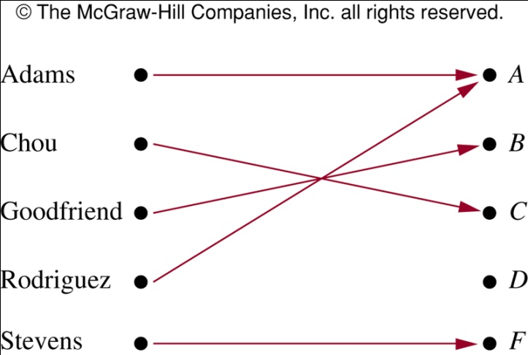
Example
G: function that assigns a grade to a student, e.g., G(Adams)=A
Domain of G: {Adams, Chou, Goodfriend, Rodriguez, Stevens}
Codomain of G: {A, B, C, D, F}
Range of G is: {A, B, C, F}

Slide 8
Example
Let R be the relation consisting of (Abdul, 22), (Brenda, 24), (Carla, 21), (Desire, 22), (Eddie, 24) and (Felicia, 22)
f: f(Abdul)=22, f(Brenda)=24, f(Carla)=21, f(Desire)=22, f(Eddie)=24, and f(Felicia)=22
Domain: {Abdul, Brenda, Carla, Desire, Eddie, Felicia}
Codomain: set of positive integers
Range: {21, 22, 24}

Slide 9
Example
f: assigns the last two bits of a bit string of length 2 or greater to that string, e.g., f(11010)=10
Domain: all bit strings of length 2 or greater
Codomain: {00, 01, 10, 11}
Range: {00, 01, 10, 11}

Slide 10
Example
f: Z → Z, assigns the square of an integer to its integer, f(x)=x²
Domain: the set of all integers
Codomain: set of all integers
Range: all integers that are perfect squares, i.e., {0, 1, 4, 9, …}

Slide 11
Example
In programming languages
int floor(float x){…}
Domain: the set of real numbers
Codomain: the set of integers

Slide 12
Functions
Two real-valued functions with the same domain can be added and multiplied
Let f₁ and f₂ be functions from A to R, then f₁+f₂, and f₁f₂ are also functions from A to R defined by
(f₁+f₂)(x)= f₁(x)+f₂(x)
(f₁f₂)(x)= f₁(x) f₂(x)
Note that the functions f₁+f₂ and f₁f₂ at x are defined in terms f₁ and f₂ at x

Slide 13
Example
f₁(x) =x² and f₂(x)= x-x²
(f₁+f₂)(x)=f₁(x)+f₂(x)=x²+x-x²=x
(f₁f₂)(x)=f₁(x)f₂(x)=x²(x-x²)=x³-x⁴

Slide 14
Function and subset
When f is a function from A to B (f:A→B), the image of a subset of A can also be defined
Let S be a subset of A, the image of S under function f is the subset of B that consists of the images of the elements of S
Denote the image of S by f(S)
f(S) denotes a set, not the value of function f

Slide 15
One-to-one function
A function f is said to be one-to-one or injective, if and only if f(a)=f(b) implies a=b for all a and b in the domain of f
A function f is one-to-one if and only if f(a)≠f(b) whenever a≠b
Using contrapositive of the implication in the definition (p→q ≡ q whenever p)
Every element of B is the image of a unique element of A

Slide 16
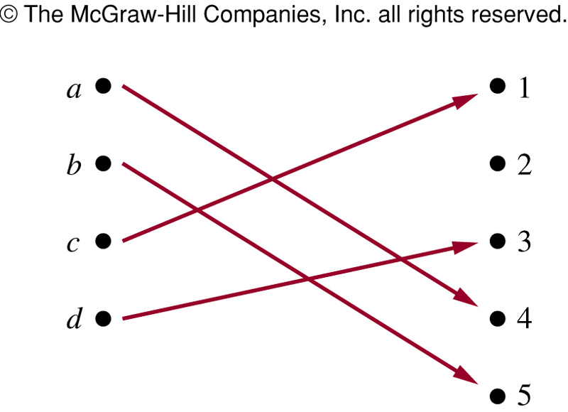
Example
f maps {a,b,c,d} to {1,2,3,4,5} with f(a)=4, f(b)=5, f(c)=1, f(d)=3
Is f an one-to-one function?

Slide 17
Example
Let f(x)=x², from the set of integers to the set of integers. Is it one-to-one?
f(1)=1, f(-1)=1, f(1)=f(-1) but 1≠-1
However, f(x)=x² is one-to-one for Z⁺
Determine f(x)=x+1 from real numbers to itself is one-to-one or not
It is one-to-one. To show this, note that x+1 ≠ y+1 when x≠y

Slide 18
Increasing/decreasing functions
Increasing (decreasing): if f(x)≤f(y) (f(x)≥f(y)), whenever x<y and x, y are in the domain of f
Strictly increasing (decreasing): if f(x)<f(y) (f(x) > f(y)) whenever x<y, and x, y are in the domain of f
A function that is either strictly increasing or decreasing must be one-to-one

Slide 19
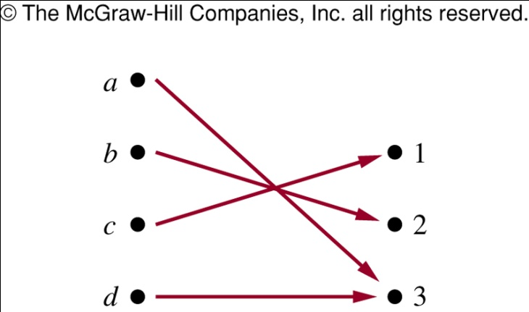
Onto functions
Onto: A function from A to B is onto or surjective, if and only if for every element b ∈ B there is an element a ∈ A with f(a)=b
Every element of B is the image of some element in A
f maps from {a, b, c, d}
to {1, 2, 3}, is f onto?

Slide 20
Example
Is f(x)=x² from the set of integers to the set of integers onto?
f(x)=-1?
Is f(x)=x+1 from the set of integers to the set of integers onto?
It is onto, as for each integer y there is an integer x such that f(x)=y
To see this, f(x)=y iff x+1=y, which holds if and only if x=y-1

Slide 21
One-to-one correspondence
The function f is a one-and-one correspondence, or bijective, if it is both one-to-one and onto
Let f be the function from {a, b, c, d} to {1, 2, 3, 4} with f(a)=4, f(b)=2, f(c)=1, and f(d)=3, is f bijective?
It is one-to-one as no two values in the domain are assigned the same function value
It is onto as all four elements of the codomain are images of elements in the domain

Slide 22
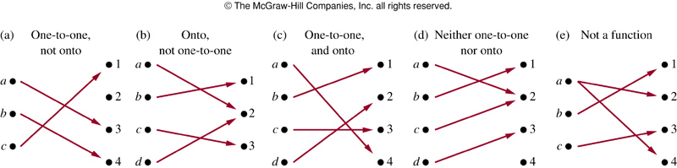
Example
Identity function:
It is one-to-one and onto

Slide 23
2.3 Inverse function
Consider a one-to-one correspondence f from A to B
Since f is onto, every element of B is the image of some element in A
Since f is also one-to-one, every element of B is the image of a unique element of A
Thus, we can define a new function from B to A that reverses the correspondence given by f

Slide 24
Inverse function
Let f be a one-to-one correspondence from the set A to the set B
The inverse function of f is the function that assigns an element b belonging to B the unique element a in A such that f(a)=b
Denoted by f⁻¹, hence f⁻¹(b)=a when f(a)=b
Note f⁻¹ is not the same as 1/f

Slide 25
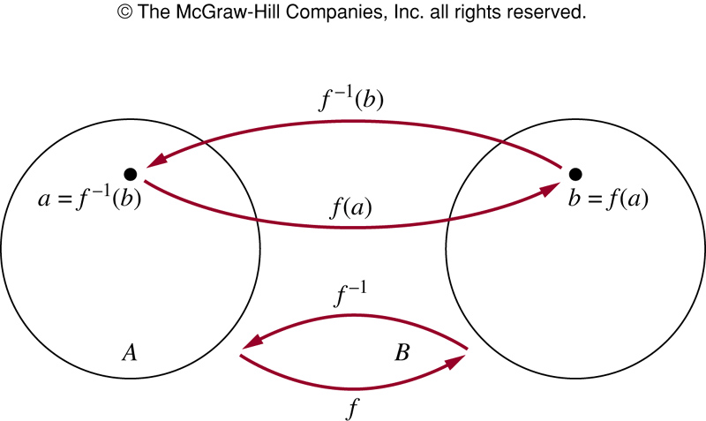
One-to-one correspondence and inverse function
If a function f is not one-to-one correspondence, cannot define an inverse function of f
A one-to-one correspondence is called invertible

Slide 26
Example
f is a function from {a, b, c} to {1, 2, 3} with f(a)=2, f(b)=3, f(c)=1. Is it invertible? What is it its inverse?
Let f: Z→Z such that f(x)=x+1, Is f invertible? If so, what is its inverse?
y=x+1, x=y-1, f⁻¹(y)=y-1
Let f: R→R with f(x)=x², Is it invertible?
Since f(2)=f(-2)=4, f is not one-to-one, and so not invertible

Slide 27
Example
Sometimes we restrict the domain or the codomain of a function or both, to have an invertible function
The function f(x)=x², from R⁺ to R⁺ is
one-to-one : If f(x)=f(y), then x²=y², then x+y=0 or x-y=0, so x=-y or x=y
onto: y= x², every non-negative real number has a square root
inverse function:

Slide 28
Composition of functions
Let g be a function from A to B and f be a function from B to C, the composition of the functions f and g, denoted by f ◦ g, is defined by (f ◦ g)(a)=f(g(a))
First apply g to a to obtain g(a)
Then apply f to g(a) to obtain (f ◦ g)(a)=f(g(a))

Slide 29
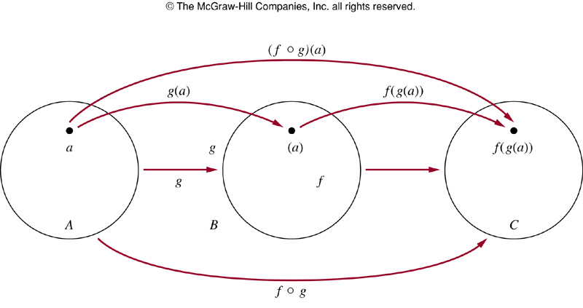
Composition of functions
Note f ◦ g cannot be defined unless the range of g is a subset of the domain of f

Slide 30
Example
g: {a, b, c} → {a, b, c}, g(a)=b, g(b)=c, g(c)=a, and f:{a,b,c} →{1,2,3}, f(a)=3, f(b)=2, f(c)=1. What are f ◦ g and g ◦ f?
(f◦g)(a)=f(g(a))=f(b)=2,(f◦g)(b)=f(g(b))=f(c)=1,
(f◦g)(c)=f(a)=3
(g◦f)(a)=g(f(a))=g(3) not defined. g◦f is not defined

Slide 31
Example
f(x)=2x+3, g(x)=3x+2. What are f ◦ g and g ◦ f?
(f ◦ g)(x)=f(g(x))=f(3x+2)=2(3x+2)+3=6x+7
(g ◦ f)(x)=g(f(x))=g(2x+3)=3(2x+3)+2=6x+11
Note that f ◦ g and g ◦ f are defined in this example, but they are not equal
The commutative law does not hold for composition of functions

Slide 32
f and f⁻¹
f and f⁻¹ form an identity function in any order
Let f: A →B with f(a)=b
Suppose f is one-to-one correspondence from A to B
Then f⁻¹ is one-to-one correspondence from B to A
The inverse function reverses the correspondence of f, so f⁻¹(b)=a when f(a)=b, and f(a)=b when f⁻¹(b)=a
(f⁻¹ ◦f)(a)=f⁻¹(f(a))=f⁻¹(b)=a, and
(f ◦ f⁻¹ )(b)=f(f⁻¹ )(b))=f(a)=b

Slide 33
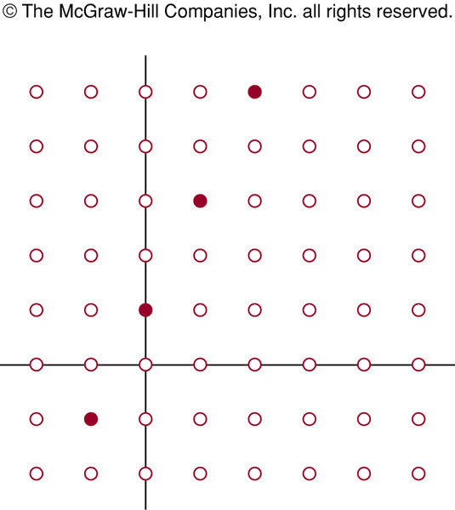
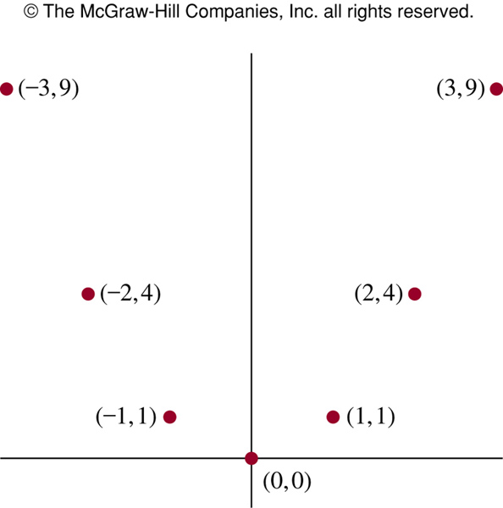
Graphs of functions
Associate a set of pairs in A x B to each function from A to B
The set of pairs is called the graph of the function: {(a,b)|a∈A, b ∈ B, and f(a)=b}
f(x)=2x+1
f(x)=x²

Slide 34
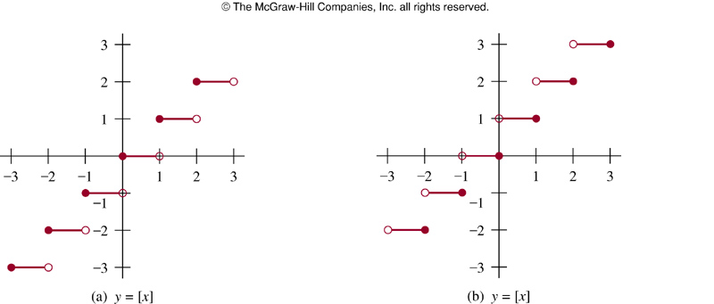
Example

Slide 35
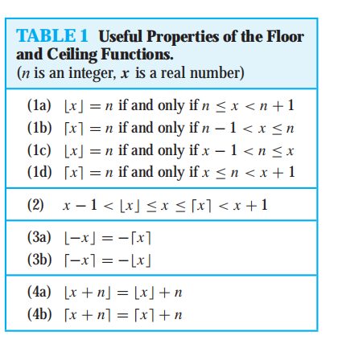

Slide 36

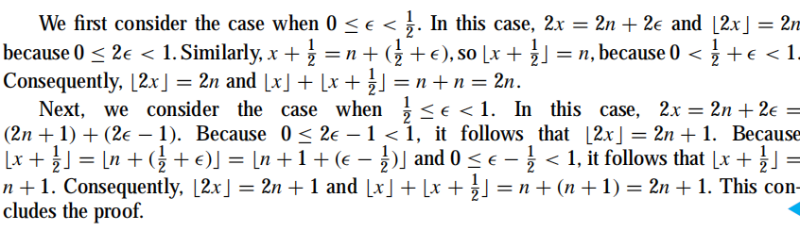

Slide 37
2.4 Sequences
Ordered list of elements
e.g., 1, 2, 3, 5, 8 is a sequence with 5 elements
1, 3, 9, 27, 81, …, 30, …, is an infinite sequence
Sequence {a_{n}}: a function from a subset of the set of integers (usually either the set of {0, 1, 2, …} or the set {1, 2, 3, …}) to a set S
Use a_{n} to denote the image of the integer n
Call a_{n} a term of the sequence

Slide 38
Sequences
Example: {a_{n}} where a_{n}=1/n
a₁, a₂, a₃, a₄, …
1, ½, 1/3, ¼,…
When the elements of an infinite set can be listed, the set is called countable
Will show that the set of positive rational numbers is countable, but the set of real numbers is not

Slide 39
Geometric progression
Geometric progression: a sequence of the form
a, ar, ar², ar³,…, ar^{n}
where the initial term a and common ratio r are real numbers
Can be written as f(x)=a ∙ r^{x}
The sequences {b_{n}} with b_{n}=(-1)^{n}, {c_{n}} with c_{n}=2∙5^{n}, {d_{n}} with d_{n}=6 ∙(1/3)^{n} are geometric progression
b_{n} : 1, -1, 1, -1, 1, …
c_{n}: 2, 10, 50, 250, 1250, …
d_{n:} 6, 2, 2/3, 2/9, 2/27, …

Slide 40
Arithmetic progression
Arithmetic progression: a sequence of the form
a, a+d, a+2d, …, a+nd
where the initial term a and the common difference d are real numbers
Can be written as f(x)=a+dx
{s_{n}} with s_{n}=-1+4n, {t_{n}} with t_{n}=7-3n
{s_{n}}: -1, 3, 7, 11, …
{t_{n}}: 7, 4, 1, -2, …

Slide 41
String
Sequences of the form a₁, a₂, …, a_{n} are often used in computer science
These finite sequences are also called strings
The length of the string S is the number of terms
The empty string, denoted by 𝝺, is the string has no terms

Slide 42
Recurrence relation
Express a_{n} in terms of one or more of the previous terms of the sequence
Example: a_{n}=a_{n-1}+3 for n=1,2,3,… and a₁=2
a₂=a₁+3=2+3=5, a₃=a₂+3=(2+3)+3=2+3x2=8 , a₄=a₃+3=(2+3+3)+3=2+3+3+3=2+3x3=11
a_{n}=2+3(n-1)
a_{n}=a_{n-1}+3=(a_{n-2}+3)+3=a_{n-2}+3x2
=(a_{n-3}+3)+3x2=a_{n-3}+3x3
=a₂+3(n-2)=(a₁+3)+3(n-2)=2+3(n-1)

Slide 43
Fibonacci sequence
f₀=0, f₁=1, f_{n}=f_{n-1}+f_{n-2}, for n=2, 3, 4
f₂=f₁+f₀=1+0=1
f₃=f₂+f₁=1+1=2
f₄=f₃+f₂=2+1=3
f₅=f₄+f₃=3+2=5
f₆=f₅+f₄=5+3=8

Slide 44
Closed formula
Determine whether the sequence {a_{n}}, a_{n}=3n for every nonnegative integer n, is a solution of the recurrence relation a_{n}=2a_{n-1}-a_{n-2} for n=2,3,4,
For n>=2, a_{n}=2a_{n-1}-a_{n-2}=2(3(n-1))-3(n-2)=3n=a_{n}
Suppose a_{n}=2^{n}, Note that a₀=1, a₁=2, a₂=4, but 2a₁-a₀=2x2-1=3 ≠a₂, thus a_{n}=2^{n} is not a solution of the recurrence relation

Slide 45
Special integer sequences
Finding some patterns among the terms
Are terms obtained from previous terms
by adding the same amount or an amount depends on the position in the sequence?
by multiplying a particular amount?
By combining previous terms in a certain way?
In some cycle?

Slide 46
Example
Find formulate for the sequences with the following 5 terms
1, ½, ¼, 1/8, 1/16
1, 3, 5, 7, 9
1, -1, 1, -1, 1
The first 10 terms: 1, 2, 2, 3, 3, 3, 4, 4, 4, 4
The first 10 terms: 5, 11, 17, 23, 29, 35, 41, 47, 53, 59

Slide 47
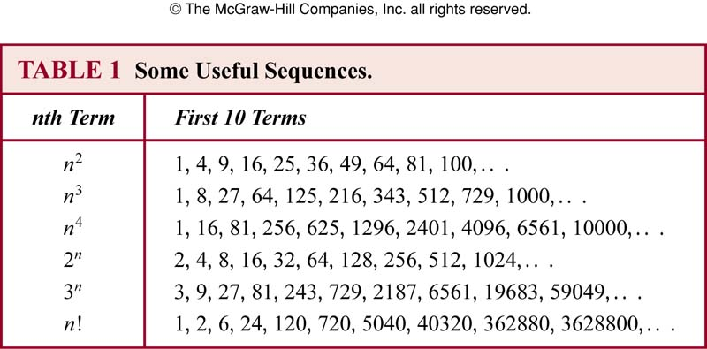
Example
Conjecture a simple formula for {a_{n}} where the first 10 terms are 1, 7, 25, 79, 241, 727, 2185, 6559, 19681, 59047
Notes:
3&n-2

Slide 48
Summations
The sum of terms: a_{m}, a_{m+1}, …, a_{n} from {a_{n}}
that represents
Here j is the index of summation (can be replaced arbitrarily by i or k)
The index runs from the lower limit m to upper limit n
The usual laws for arithmetic applies

Slide 49
Example
Express the sum of the first 100 terms of the sequence {a_{n}} where a_{n}=1/n, n=1, 2, 3, …
What is the value of
What is the value of
Shift index:

Slide 50
Geometric series
Geometric series: sums of geometric progressions

Slide 51
Double summations
Often used in programs
Can also write summation to add values of a function of a set

Slide 52
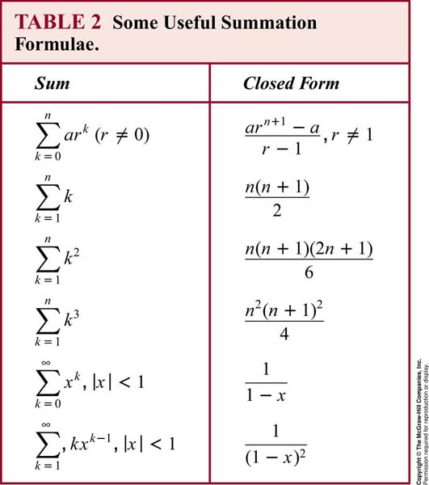

Slide 53
Example
Find
Let x be a real number with |x|<1, Find
Differentiating both sides of

Slide 54
2.5 Cardinality
The sets A and B have the same cardinality, |A|=|B|, if and only if there is a one-to-one correspondence from A to B
Countable: A set that is either finite or has the same cardinality as the set of positive integers
A set that is not countable is called uncountable
When an infinite set S is countable, we denote the cardinality of S by ℕ₀, i.e., |S|= ℕ₀

Slide 55
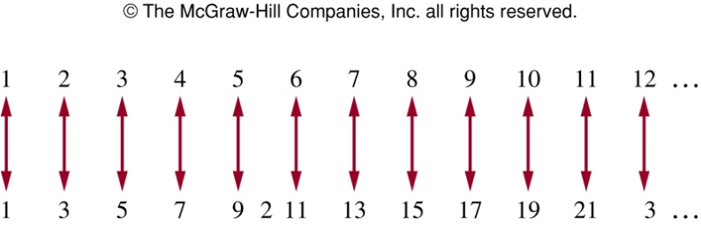
Example
Is the set of odd positive integers countable?
f(n)=2n-1 from Z⁺ to the set of odd positive integers
One-to-one: suppose that f(n)=f(m) then 2n-1=2m-1, so n=m
Onto: suppose t is an odd positive integer, then t is 1 less than an even integer 2k where k is a natural number. Hence t=2k-1=f(k)

Slide 56
Infinite set
An infinite set is countable if and only if it is possible to list the elements of the set in a sequence
The reason being that a one-to-one correspondence f from the set of positive integers to a set S can be expressed by
a₁, a₂, …, a_{n}, …where a₁=f(1),a₂=f(2),…a_{n}=f(n)
For instance, the set of odd integers, a_{n}=2n-1

Slide 57
Example
Show the set of all integers is countable
We can list all integers in a sequence by 0, 1, -1, 2, -2, …
Or f(n)=n/2 when n is even and f(n)=-(n-1)/2 when n is odd (n=1, 2, 3, …)

Slide 58
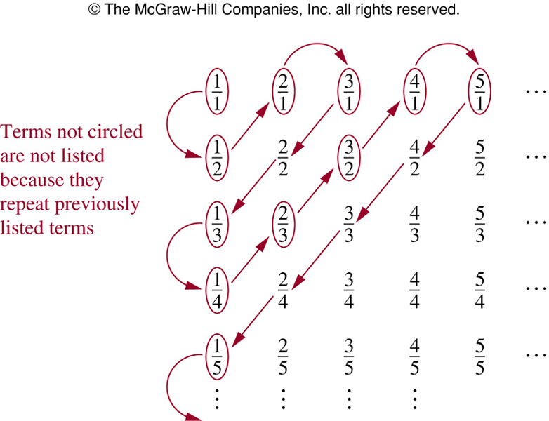
Example
Is the set of positive rational numbers countable?
Every positive rational number is p/q
First consider p+q=2, then p+q=3, p+q=4, …
1, ½, 2,3,1/3,
¼, 2/3, 3/2, 4, 5,…
Because all positive
rational numbers are
listed once, the set is
countable

Slide 59
Example
Is the set of real numbers uncountable?
Proof by contradiction
Suppose the set is countable, then the subset of all real numbers that fall between 0 and 1 would be countable (as any subset of a countable set is also countable)
The real numbers can then be listed in some order, say, r₁, r₂, r₃, …

Slide 60
Example
So
Form a new real number with
Every real number has a unique decimal expansion
The real number r is not equal to r₁, r₂, … as its decimal expansion of r_{i} in the i-th place differs from others
So there is a real number between 0 and 1 that is not in the list
So the assumption that all real numbers can between
0 and 1 can be listed must be false
So all the real numbers between 0 and 1 cannot be listed
The set of real numbers between 0 and 1 is uncountable

Slide 61
exercise
Show that the union of a countable number of countable sets is countable.
Show that the set Z⁺ × Z⁺ is countable.
Notes:
2.5-27，28matrix crossline

